Slide 1
Formula SAE
Powertrain
Damian Boniella, Matt Gingold, Tobin Lanford, Joey LeBlanc, Lucille Longhurst

Slide 2
AGENDA
01
02
03
04
05
06
PROJECT DESCRIPTION
CONCEPT
GENERATION
ENGINEERING
CALCULATIONS
Concept Evaluation
SCHEDULE, BUDGET, BoM
CONCLUSION

Slide 3








PROJECT DESCRIPTION: OVERVIEW
Formula SAE: An engineering competition where student teams design, build, and race small, single-seater, open-wheel race cars [1].
  Powertrain is the system in the vehicle that is responsible for generating and delivering power to the wheels and enabling vehicle motion.
FSAE is important for promoting careers and excellence in engineering as it encompasses research, design, manufacturing, testing, developing, marketing, managing, and financing within the automotive industry [1].
The project is sponsored by business willing to donate money/materials in exchange for exposure.
CURRENT SPONSORS:

Slide 4
PROJECT DESCRIPTION: BLACK BOX MODEL
Material:
Engine, Chain, Axles, Engine/Diff. Mounts, Intake, Shifter, Sprocket, ECU, Wiring, Exhaust, Wheels
Energy:
Fuel, Air, Electrical
Signal:
Sensors, Human
Material:
Engine, Chain, Axles, Engine/diff. Mounts, Intake, Shifter, Sprocket, ECU, Wiring, Exhaust, Wheels
Energy:
Noise, Heat, Movement
Signal:
Sensors, Human
Car
Moves
Material
Energy
Signal

Slide 5
Physical Decomposition
A Moving Car
Engine
Axles
Fuel
Air
Spark
Differential
Transmission
Wheels
Fuel System
Intake
Electrical System
Mounting Points
Gearbox
Fuel Tank
ECU
Paddle Shifters
Sensors
Sprocket/Chain

Slide 6
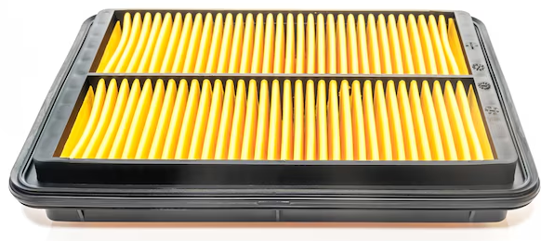
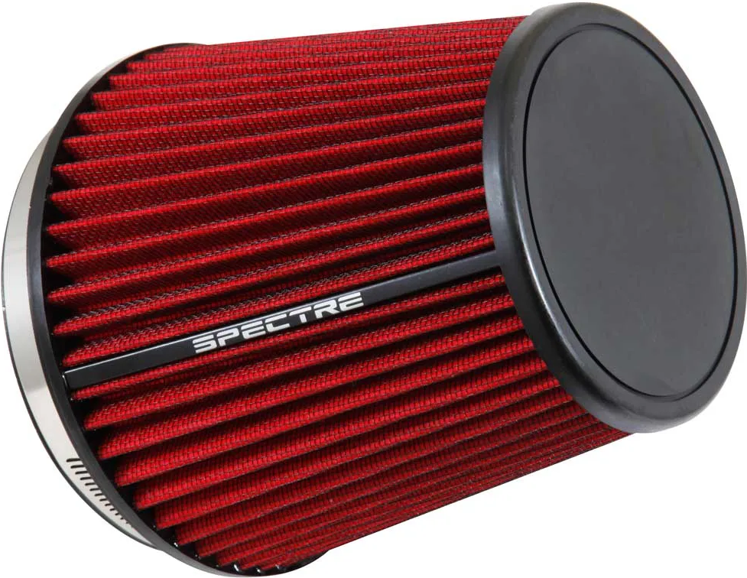
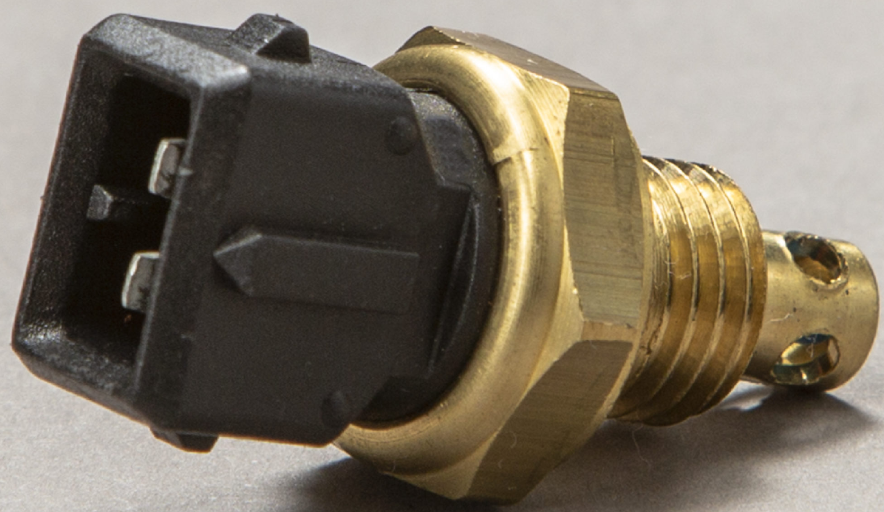
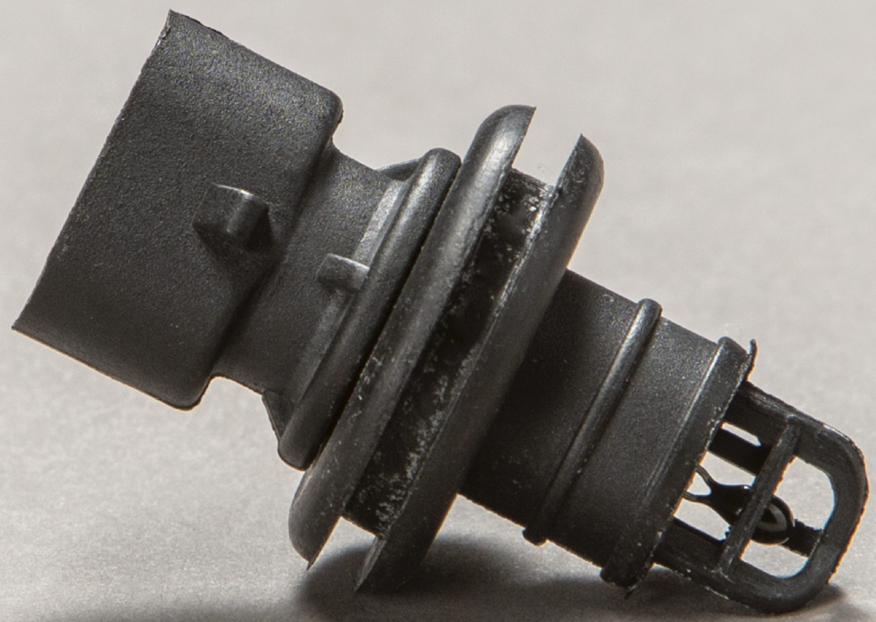
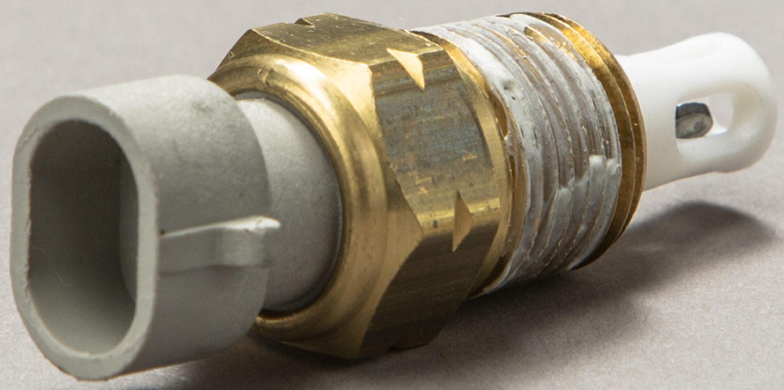
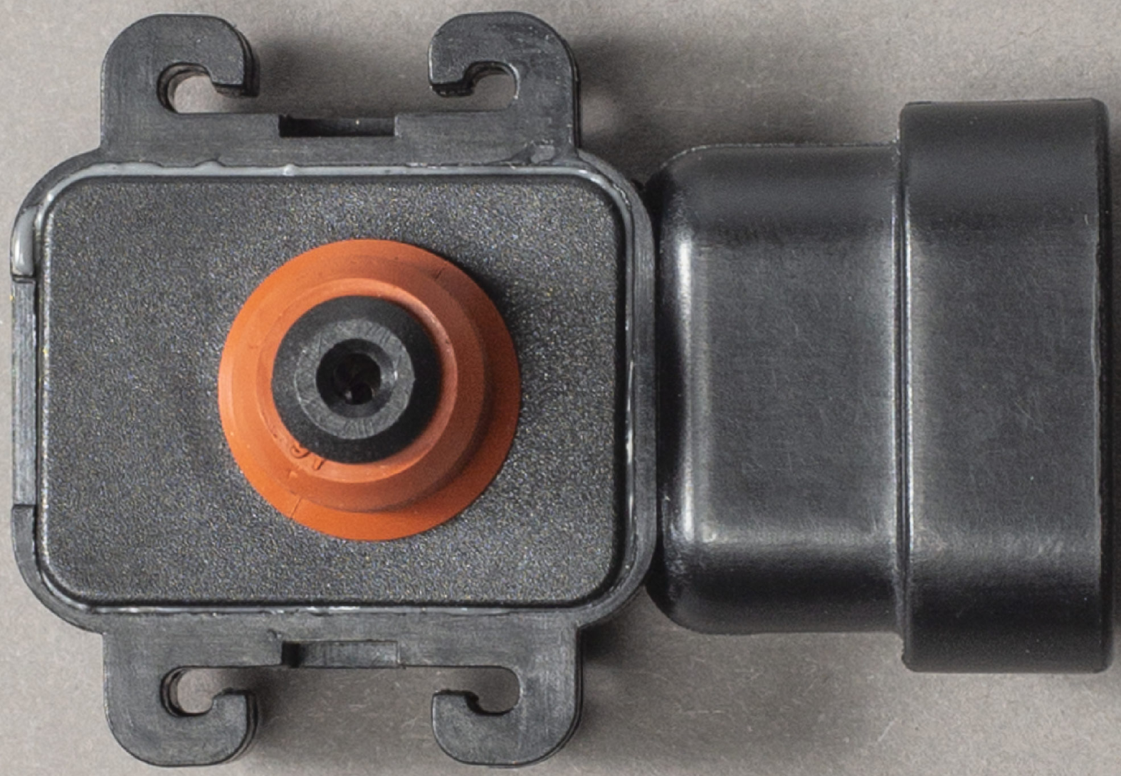
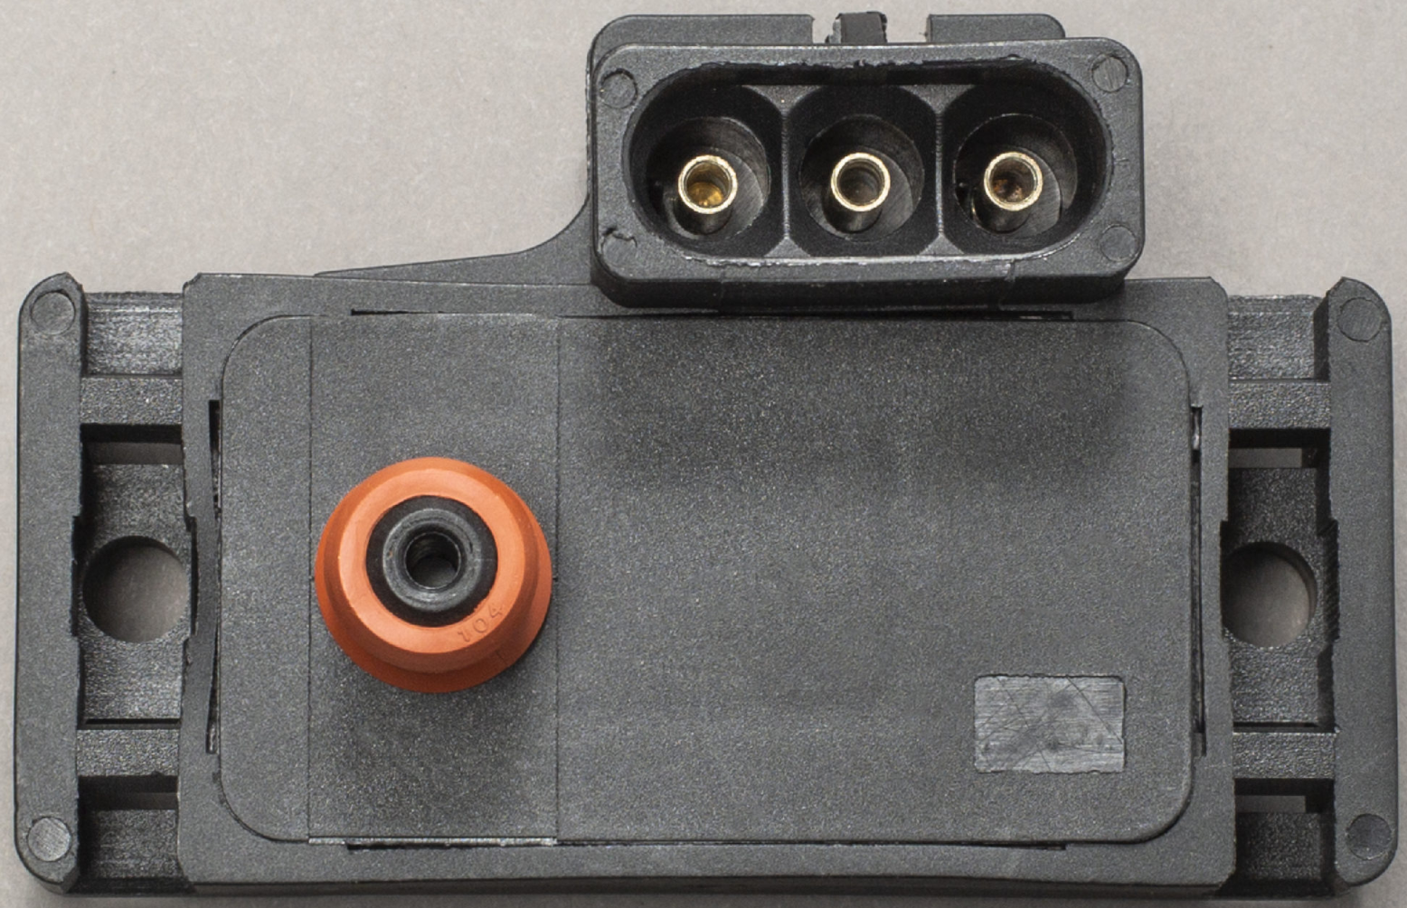
CONCEPT GENERATION Intake (Damian):
Items: | 1 | 2 | 3 | 4 | 5
3D Filament | PA6-CF | PET-CF | PC | PETG-CF | ASA-CF
Throttle Body | 28mm | 30mm | 32mm | 34mm
Air Filter
Temperature Sensor
MAP Sensor

Slide 7
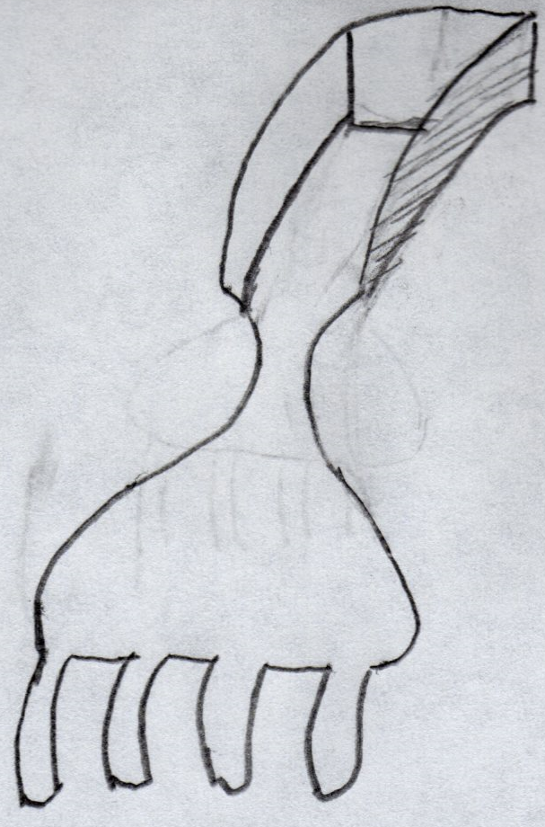
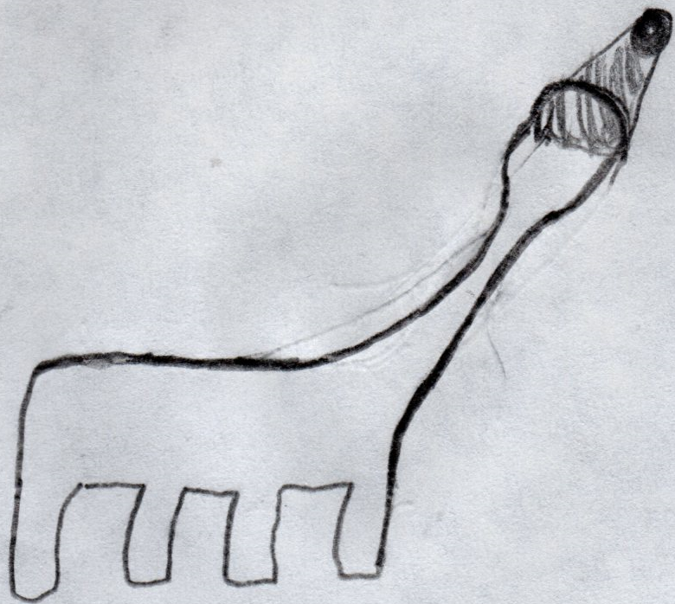
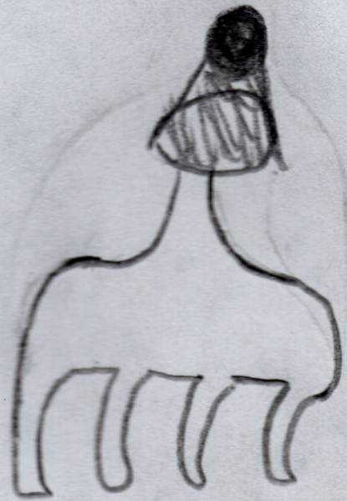
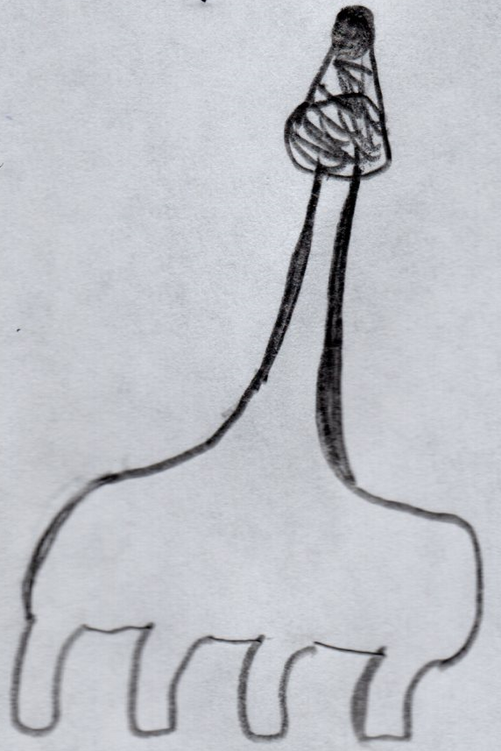
CONCEPT GENERATION Intake (Damian):
Concept: | Formula Intake | Side Intake | Short Intake | Long Intake
Materials Used: | PET-CF, Throttle Body: 34mm, Square Air Filter, Temp. Sensor 1, MAP Sensor 1 | PA6-CF, Throttle Body: 32mm, Conical Air Filter, Temp. Sensor 1, MAP Sensor 1 | PC, Throttle Body: 32mm, Conical Air Filter, Temp. Sensor 1, MAP Sensor 1 | PA6-CF, Throttle Body: 32mm, Conical Air Filter, Temp. Sensor 1, MAP Sensor 1
Advantages: | Ram Air Effect, Style Points | Clean Air, Style Points | Small Material Usage, Needs Little Structural Support, Low Cost | Clean Air, Widely Used by Other Teams
Disadvantages: | Large Material Usage, Needs Structural Support, High Cost | Large Material Usage, Needs Structural Support, High Cost | Hot and Disturbed Air | Large Material Usage, Needs Structural Support, High Cost

Slide 8
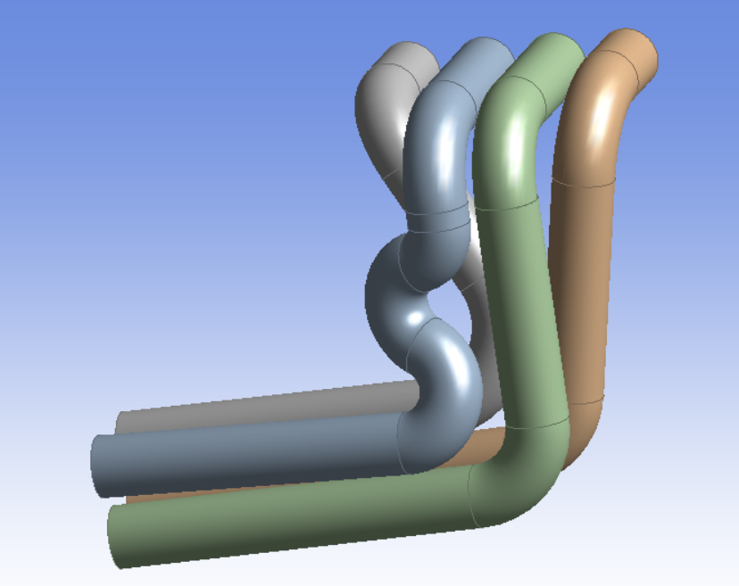
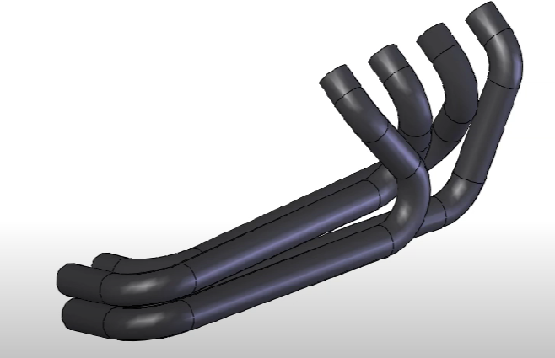
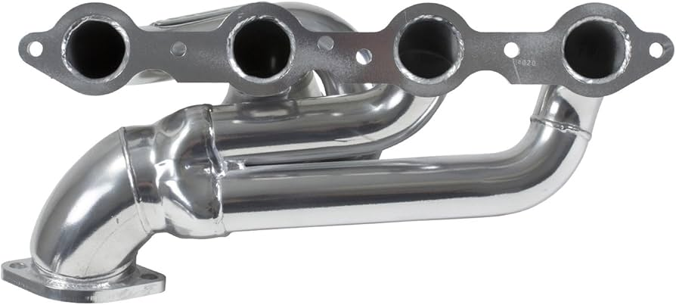
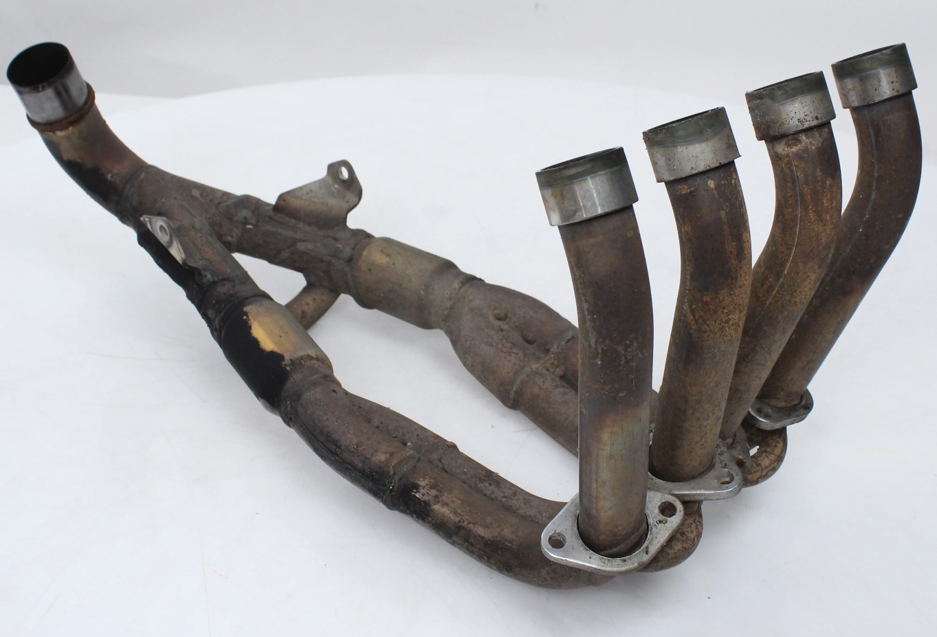
Concept Generation (Matt)
Concept: | Long Tube Headers (Steel) | Long Tube Headers (Titanium) | Short Tube Headers (Steel) | Stock Headers (Steel)
Image:
Pros: | More top end power Lowers engine Cheap to create | More top end power Lowers engine High Exhaust volume Better Heat dissipation | More low end power Lowers engine Smaller in size Cheap to make | Stock configuration Have one currently
Cons: | Large/bulky Less low end power | Large/Bulky Less low end power Low exhaust velocity Much more expensive | Less high end power More difficult to make (might upset our welders) | Engine must be higher (~6 inches) Not as optimized for our use
https://www.youtube.com/watch?v=mWcKGWQfAos
https://www.amazon.com/BBK-40200-Performance-Exhaust-Headers/dp/B003HII37E
https://cheapthrillsmoto.com/products/exhaust-header-honda-cbr600rr-03-04-oem-cbr-600-rr

Slide 9
DIFFERENTIAL MOUNT
CONCEPT GENERATION:
Mounting Locations | Tensioning System | Material | Differential
Existing engine mounts | Horizontally adjustable brackets | Aluminum 6061 | Drexler FSAE Adjustable LSD
Vehicle frame | Radially adjustable brackets | Steel | Drexler FSAE Non-adjustable LSD
Frame and engine | Tensioning sprocket

Slide 10
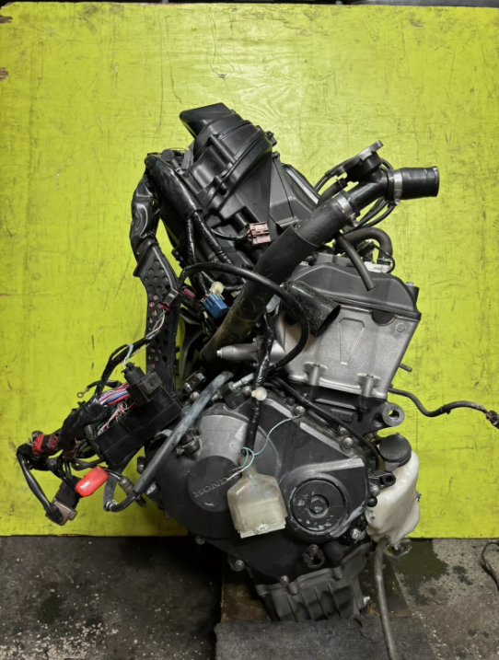
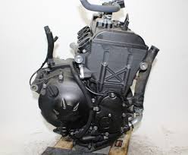
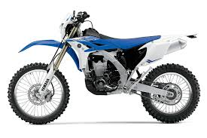
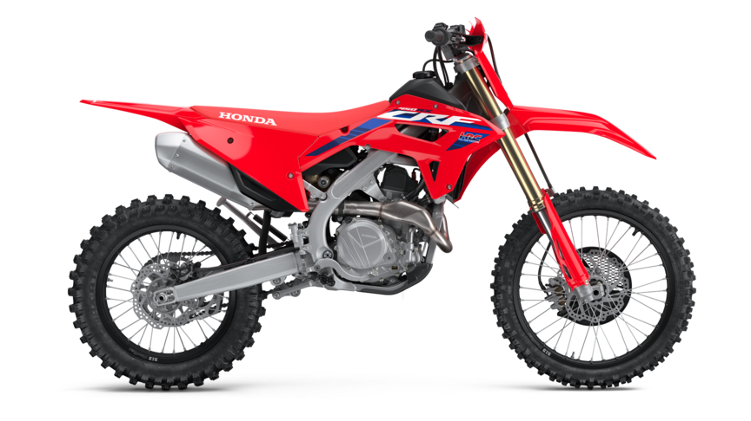
CONCEPT GENERATION (Joey):
Concept: | Honda CBR600RR | Yamaha YZF-R6 | Yamaha WR450F | Honda CRF450RX
Materials Used: | OEM Intake, OEM Exhaust Manifold, OEM Wiring Harness, OEM ECU | OEM Intake, OEM Exhaust Manifold, OEM Wiring Harness, OEM ECU | Full 2013 motorcycle | Full 2019 motorcycle
Advantages: | Cheap, easy to find, configuration variety, reliable, tunability | Easy to find, configuration variety, reliable, tunability | Lightweight, easy to find, simple wiring | Reliable, lightweight, simple wiring
Disadvantages: | Missing parts to run outside of bike | Expensive, missing parts to run outside of bike | Expensive, limited configurations, shorter lifespan | Expensive, one configuration, shorter lifespan

Slide 11
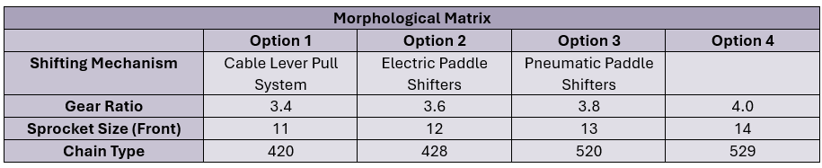
CONCEPT GENERATION (Lucille):
Shifting Systems Considered:
Pneumatic Paddle Shifting System:
Uses compressed air to engage and disengage gears
Typically smaller in size compared to hydraulic systems
Electronic Paddle Shifting System:
Utilizes sensors and an electronic control unit for gear changes.
Offers quicker shifts and could add features like automatic rev-matching.
Cable Lever Pull System:
Uses cables to pull the lever for shifting, providing a tactile response.
Simpler design with fewer components.
Sub-Assembly Concepts
Gear Ratio:
Top Speed v. Acceleration
Sprocket Design:
Variations in sprocket size and material.
Chain Type:
Different standards (420, 428, 520, etc.) based on weight and strength..

Slide 12
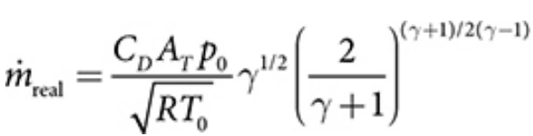


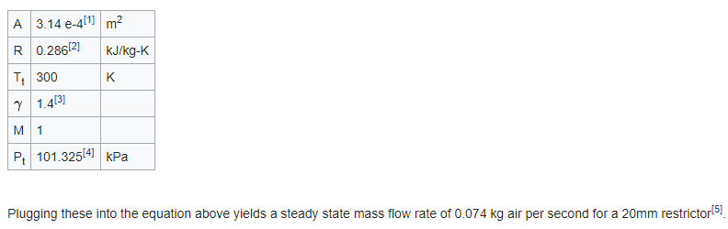
ENGINEERING CALCULATIONS (Damian):
Choked Mass Flow Rate Actual:
Choked Mass Flow Rate Theoretical:
Mass Flow Rate:
Example:

Slide 13
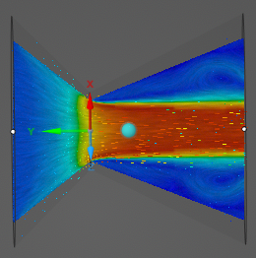
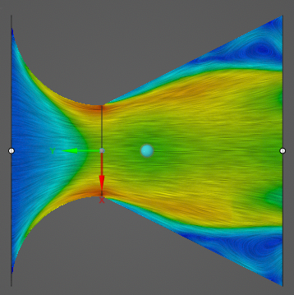
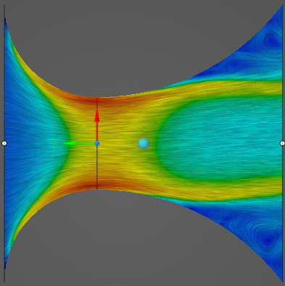
ENGINEERING CALCULATIONS (Damian):
Parameters:
Density: 1.225 kg/m^3
CD: 90%
A: 20mm Restrictor
R: 286.9 J/kg*K
T: 288.15 K
P: 101325 Pa
Straight Lined
Mass Flow Rate Theoretical = 0.3032 kg/s = 535 cfm
Curved Top
Mass Flow Rate Actual = 0.2729 kg/s = 481 cfm
Max Theoretical Velocity = 197 m/s = 646 ft/s
Curved

Slide 14

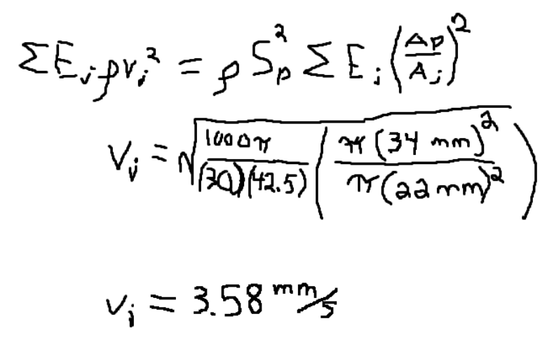
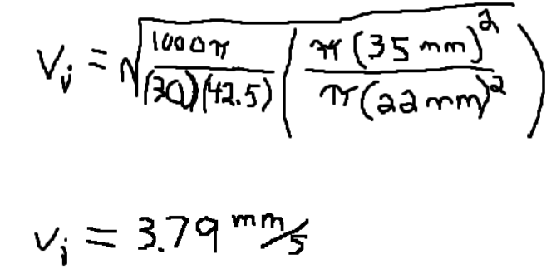
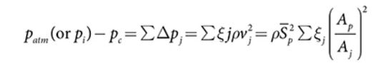
ENGINEERING CALCULATIONS (Matt):
Flow Rate of Stock Exhaust (just 1 cylinder)
Bernoulli’s equation (assuming quasi steady flow)
ξj is the flow resistance coefficient
vj is the local velocity
This relates to piston speed (Sp):
Flow Rate of Long Tube header (also just 1 cylinder)
Equation giving loss due to friction in the intake and exhaust

Slide 15
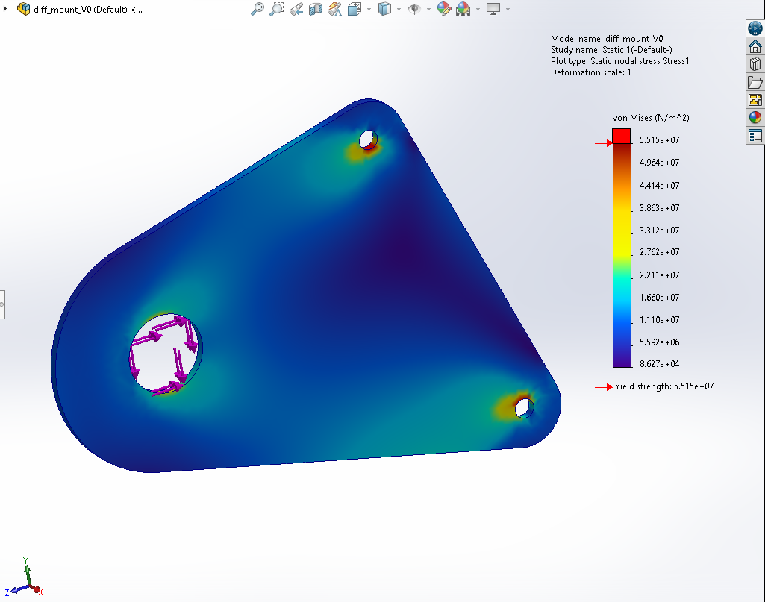
DIFFERENTIAL MOUNT FEA:
SolidWorks Static Study on a preliminary differential mounting bracket design
Current loading based on maximum rated engine torque transferred to the rear sprocket and weight of the Drexler LSD
Weights of axles, brake components, sprocket and sprocket mount, as well as braking forces will need to be considered for more in depth analysis
Horizontally adjustable components will be incorporated in the future

Slide 16
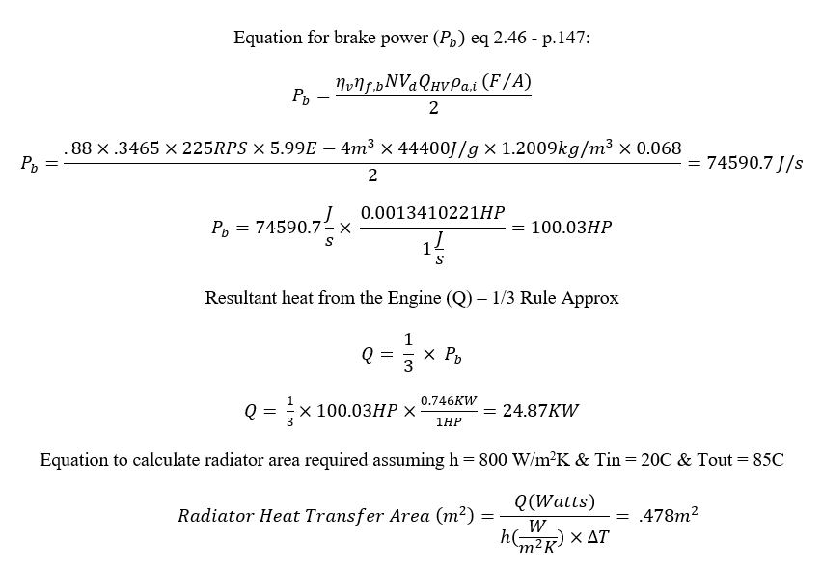
ENGINEERING CALCULATIONS (Joey):

Slide 17
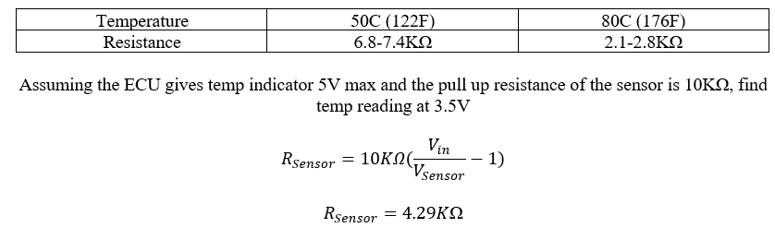
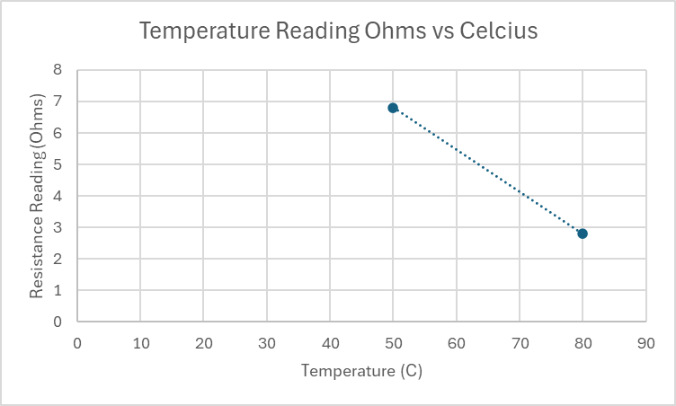
ENGINEERING CALCULATIONS (Joey):

Slide 18
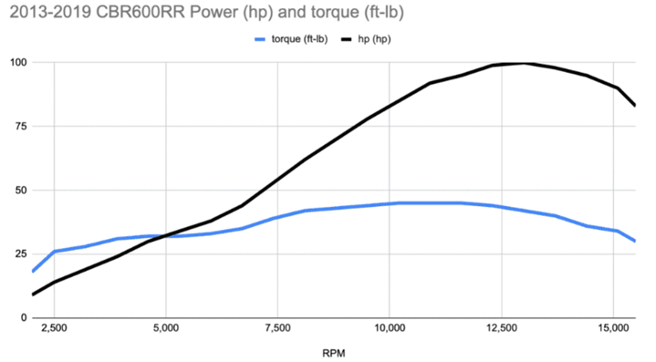
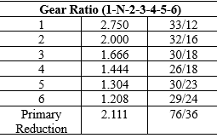
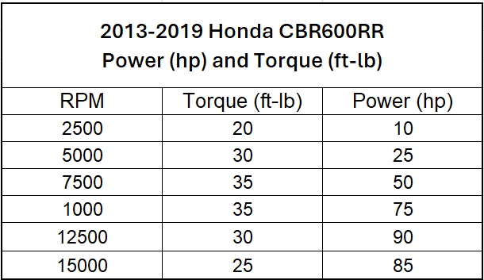
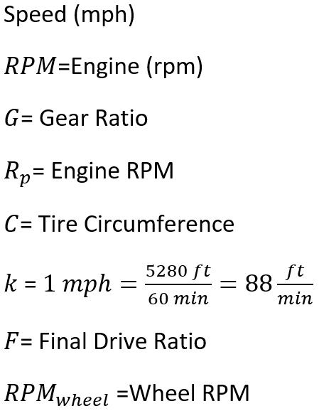
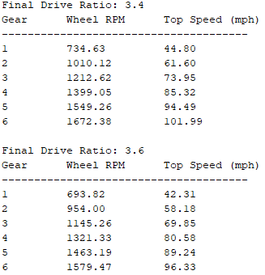
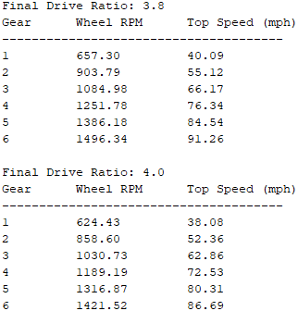
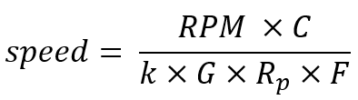
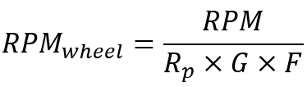
ENGINEERING CALCULATIONS:FINAL GEAR RATIO (Lucille)
PARAMETERS: 20.5’’ Tires, Max RPM 14500

Slide 19
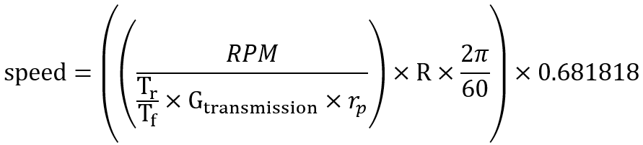
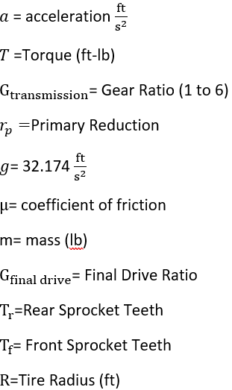
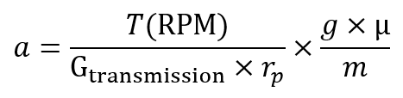
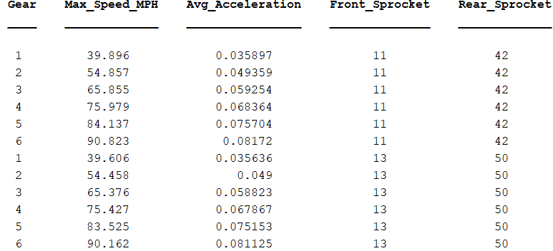
ENGINEERING CALCULATIONS: SPROCKET SIZES AND PATTERN (Lucille)

Slide 20
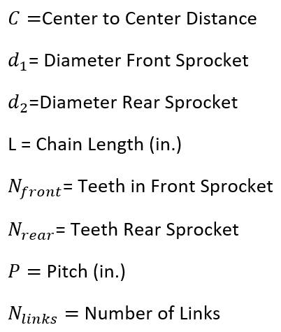

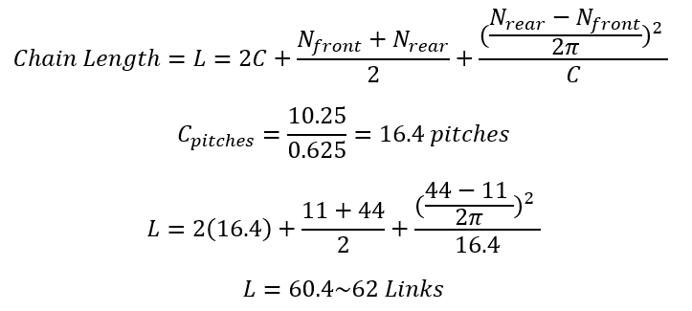

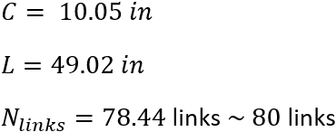
ENGINEERING CALCULATIONS (Lucille):

Slide 21
CONCEPT EVALUATION (Damian):
 | Formula Intake | Side Intake | Short Intake | Long Intake | Last Years
Material Usage and Print Time | 1 | 2 | 4 | 3 | 5
Ease of Tuning | 2 | 3 | 5 | 4 | 1
Overall Cost | 1 | 2 | 4 | 3 | 5
Air Quality | 5 | 4 | 2 | 3 | 1
Ease of Implementation | 1 | 2 | 4 | 3 | 5
Total: | 10 | 13 | 19 | 16 | 17

Slide 22
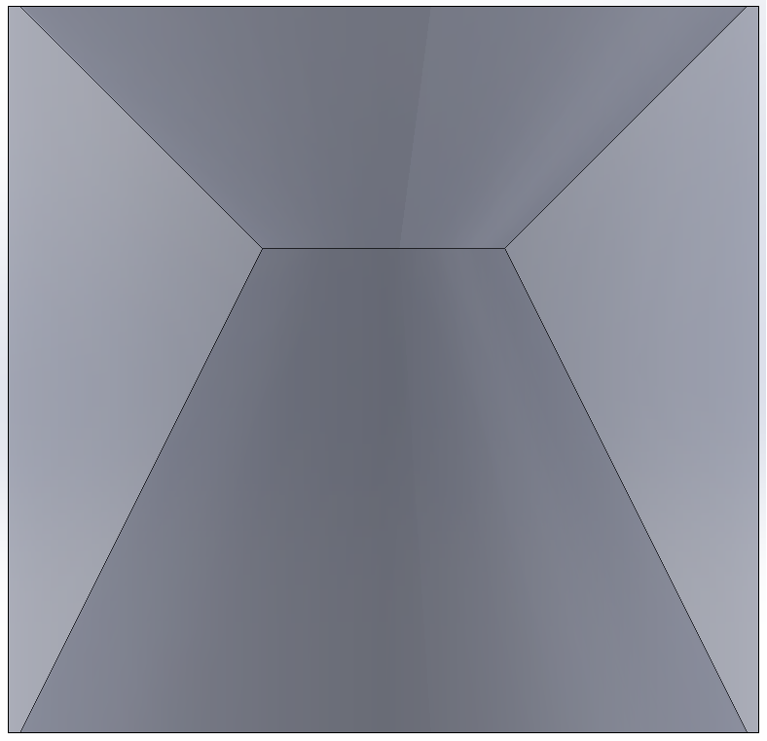
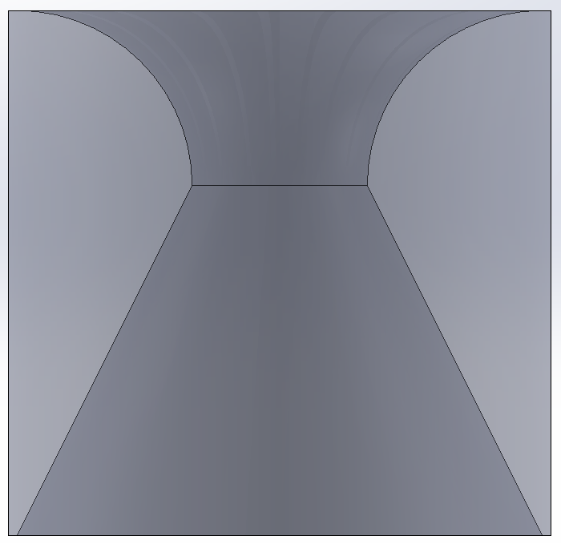
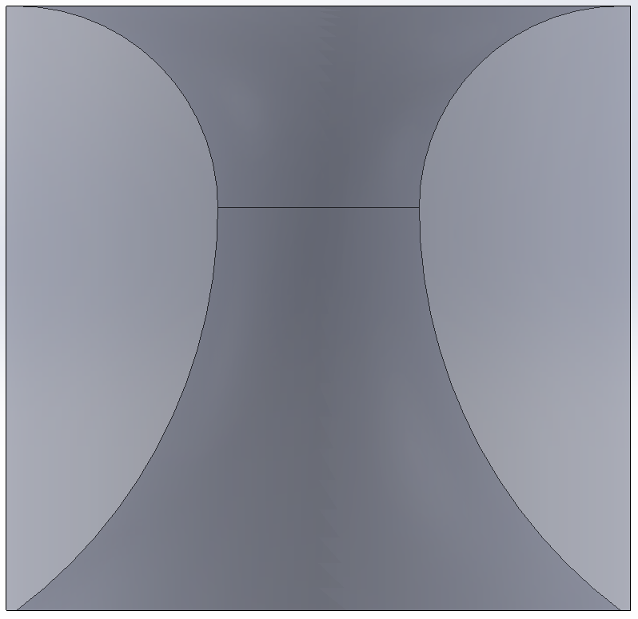

CONCEPT EVALUATION (Damian):
Short Intake: Is the smallest of all the intakes resulting in reduced overall costs and ease of implementation. This intake will be gathering air for within the engine compartment.
Customer: Most cost effective design, easiest to implement, easy to tune, short print time
Engineering: Stays within the tire envelope, 20mm restrictor, delivers air to engine
Long Intake: Is a larger intake that takes advantage of clean air. The intake will need to be supported due to cantilever weight. This design will be more expensive than Short Intake.
Customer: Garthers clean air, next easiest intake to implement, easy to tune
Engineering: Stays within the tire envelope, 20mm restrictor, delivers air to engine
Straight Lined
Curved Top
Curved

Slide 23
CONCEPT EVALUATION (Matt):
Engineering Requirements:
  Needs to pass technical requirements
    103dB at idle
    110dB at other speeds
    No down pipe/muffler currently
  Cannot run directly next to things that could explode
    Fuel tank/any fuel lines
Customer Requirements:
  Cannot be too complicated to create
    Do not want to make the welder’s lives harder
  Must have relatively easy installation
  Maximize power output
    According to our motor

Slide 24

CONCEPT EVALUATION (Tobin):
Existing Engine Mounts
  Engine mounts are already load bearing
  Minimize potential deflection between the engine and rear axle
Horizontally adjustable brackets
  Built-in adjustability for tensioning the drive chain
  Limits adjustments to one direction
Aluminum 6061
  Relatively inexpensive
  Easier machinability
Adjustable Drexler FSAE LSD
  Tunable to improve handling

Slide 25

CONCEPT EVALUATION (Joey):

Slide 26

CONCEPT EVALUATION (Joey):

Slide 27
CONCEPT EVALUATION (Lucille):
Engineering Requirements:
Shifting Mechanism
Response Time: Should be within 10-15 milliseconds.
Reliability: High durability under repeated use.
Integration: Compatibility with the car’s electronics and control systems.
Gear Ratio
Optimal Ratio: Ensure the ratio balances acceleration and top speed.
Sprocket Size (Front)
Material Strength: Must withstand high torque loads.
Chain Type
Strength: Adequate tensile strength for load-bearing.
Durability: High resistance to stretching and fatigue.
Customer Requirements:
Shifting Mechanism
Ease of Use: User-friendly for quick gear changes.
Responsiveness: Immediate gear shifts for optimal performance.
Comfort: Ergonomic and comfortable for prolonged use.
Accuracy: Provides precise and immediate feedback to the driver.
User Interface: Intuitive and responsive to driver input.

Slide 28

CONCEPT EVALUATION (Lucille):
Designs Selected:
Electric Paddle Shifters
Gear Ratio: 3.8
Sprockets 11-42
520 Chain ~80 Links
Moving Forward:
Design of Spare Drexler Sprocket Adapter:
Focus on ensuring the design can accommodate the selected 11-42 sprocket size with a 520 chain.
Bearings
Research suitable bearings that can support the shifting mechanism and sprocket assembly, prioritizing weight and durability.
Prototype Development
Create prototypes of the electric paddle shifters to test real-world performance and gather data for further refinement before finalizing the design

Slide 29

BILL OF MATERIALS

Slide 30

Powertrain Purchase Total

Slide 31

Fundraising & Current Balance

Slide 32

FSAE 2025 Budget

Slide 33

SCHEDULE

Slide 34

SCHEDULE

Slide 35
CONCLUSION
Future Plans:
Do maintenance on the Engine
Get Engine Running on a Stand
Machine Sprocket Mount
Finalize Exhaust Headers
More Fundraising

Slide 36
REFERENCES
[1] “About Formula SAE® Series,” SAE International, https://www.sae.org/attend/student-events/formula-sae-knowledge/about#:~:text=Formula%20SAE%20promotes%20careers%20and,%2C%20marketing%2C%20management%20and%20finances. (accessed Oct. 5, 2024).
[2] “Power Limit Derivation,” FSwiki, https://fswiki.us/Restrictor (accessed Oct. 7, 2024).
[3] Study of the performance of an FSAE cooling radiator, https://www.researchgate.net/profile/Ahmed-Abdel-Gawad-3/publication/351326793_Study_of_the_Performance_of_an_FSAE_Cooling_Radiator/links/6091522da6fdccaebd08f27a/Study-of-the-Performance-of-an-FSAE-Cooling-Radiator.pdf (accessed Oct. 7, 2024).

Slide 37
QUESTIONS?
THANK YOU

