Slide 1
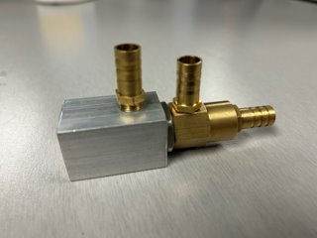
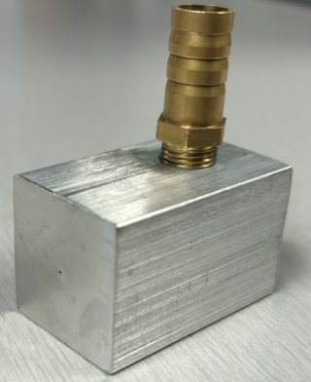
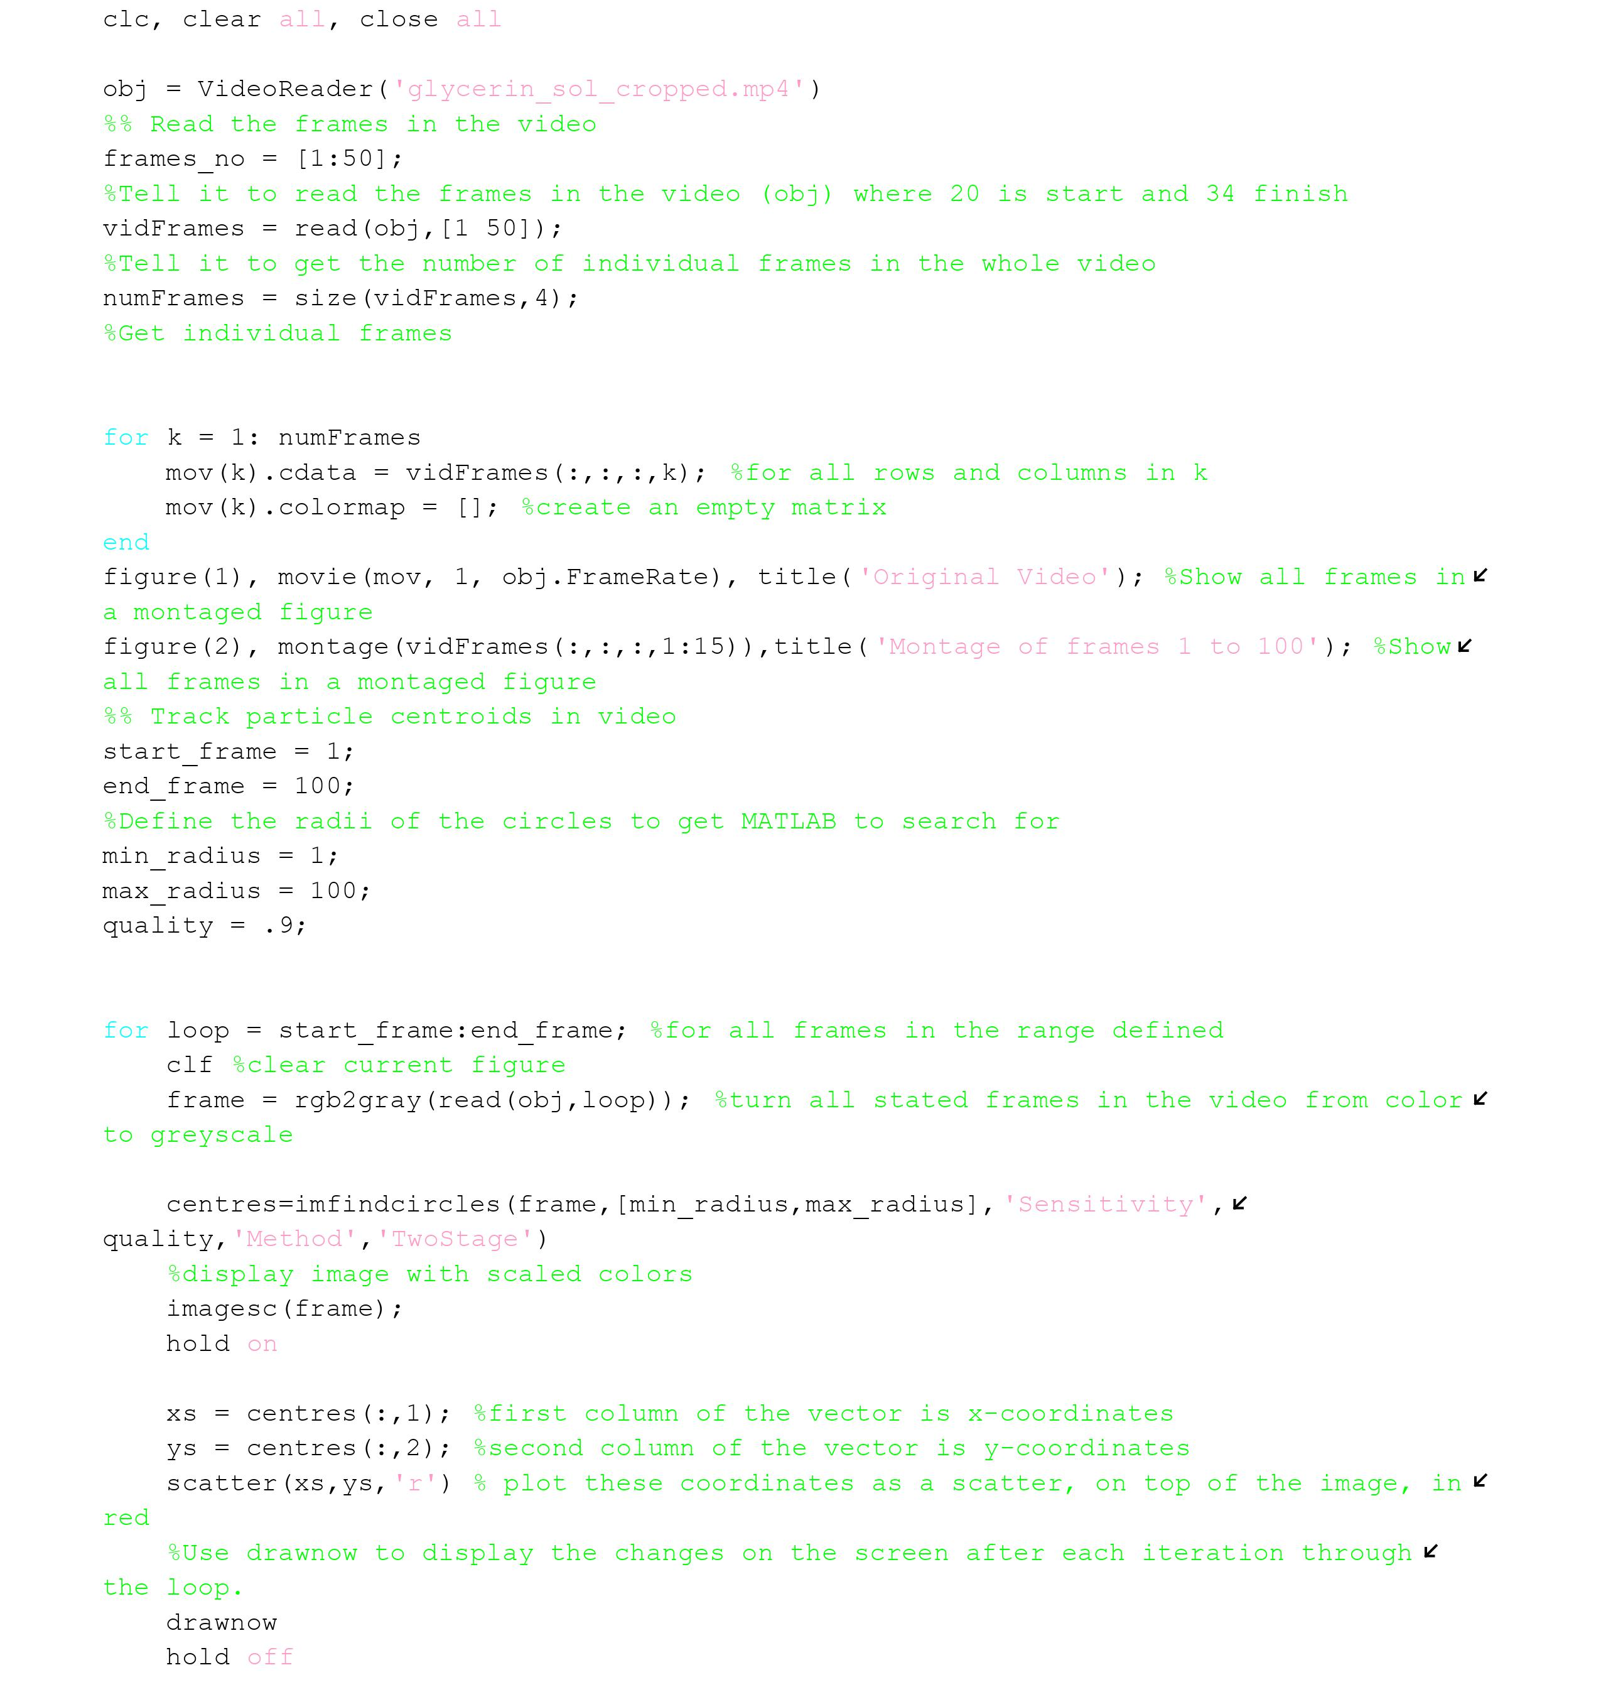
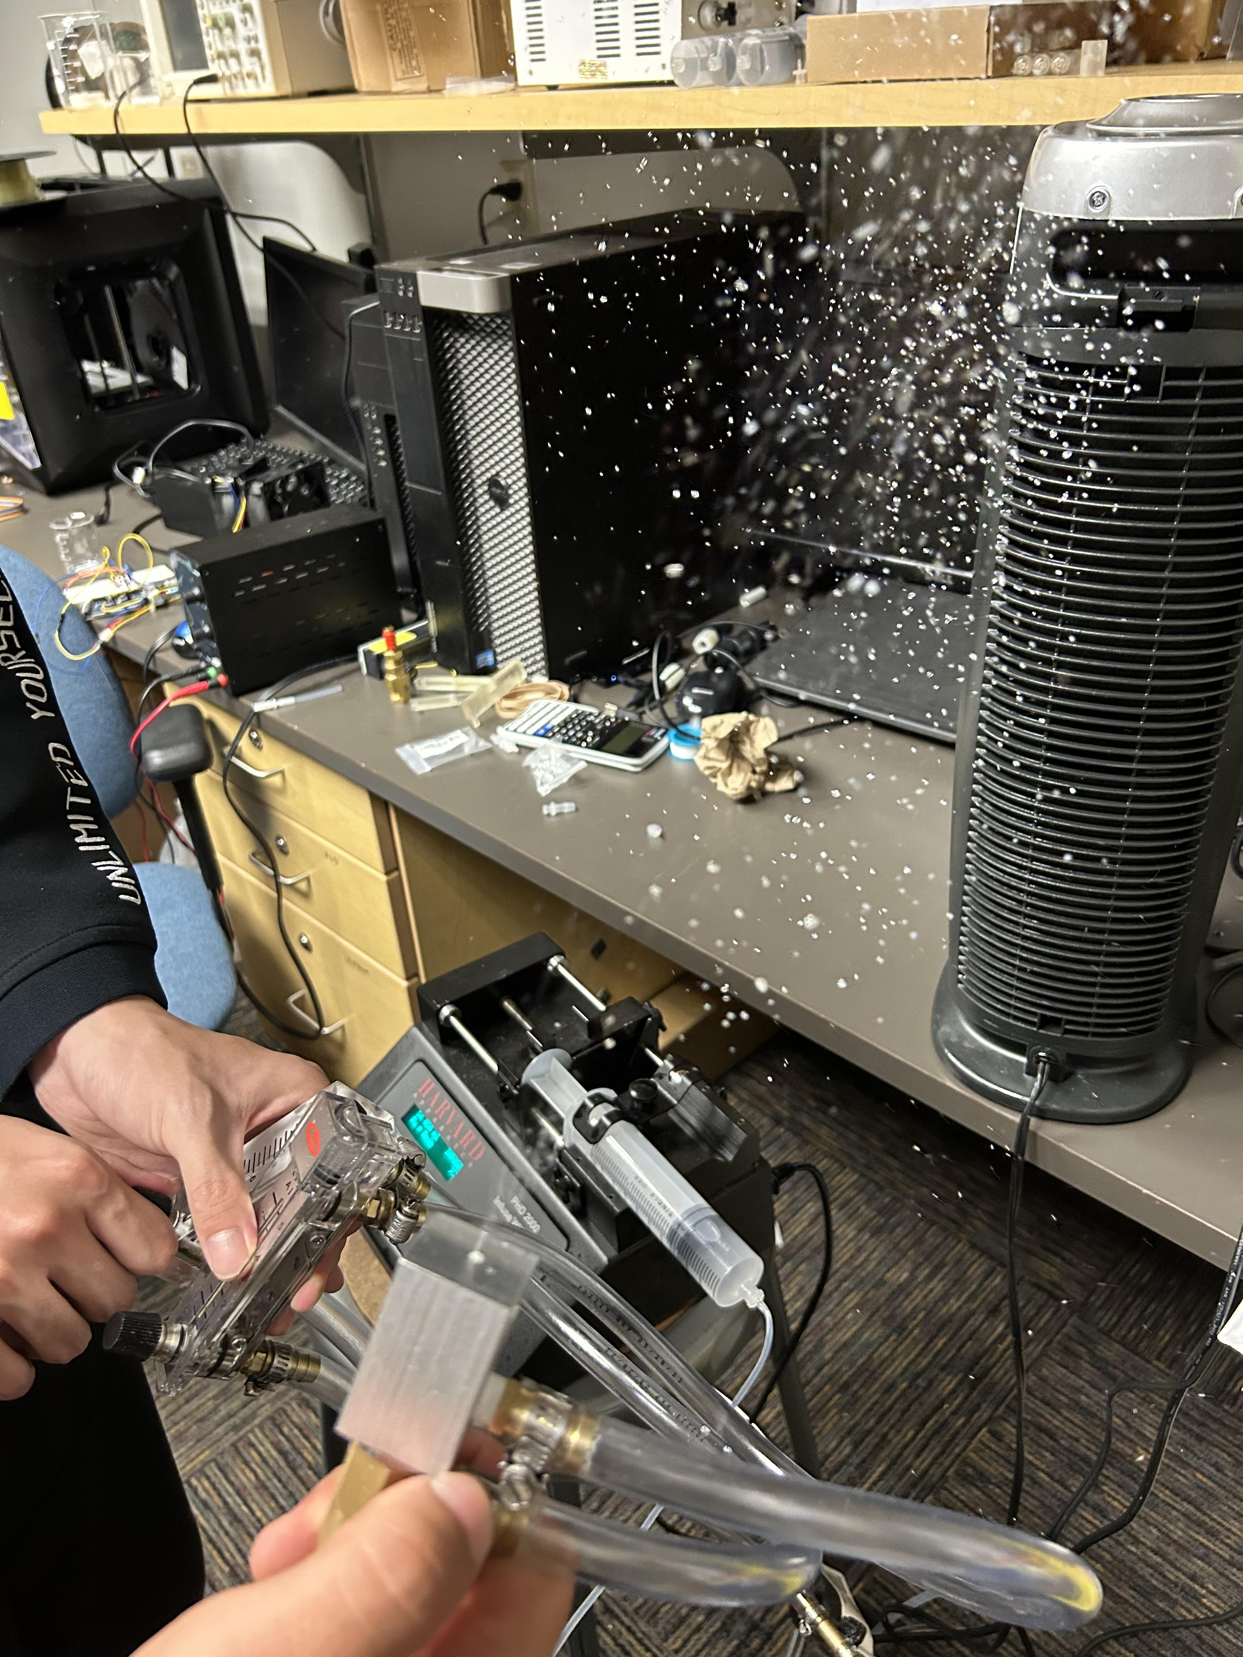
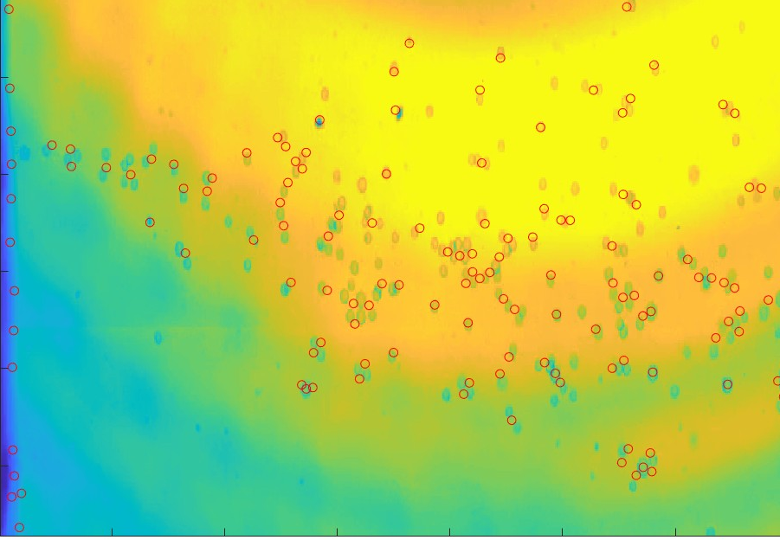
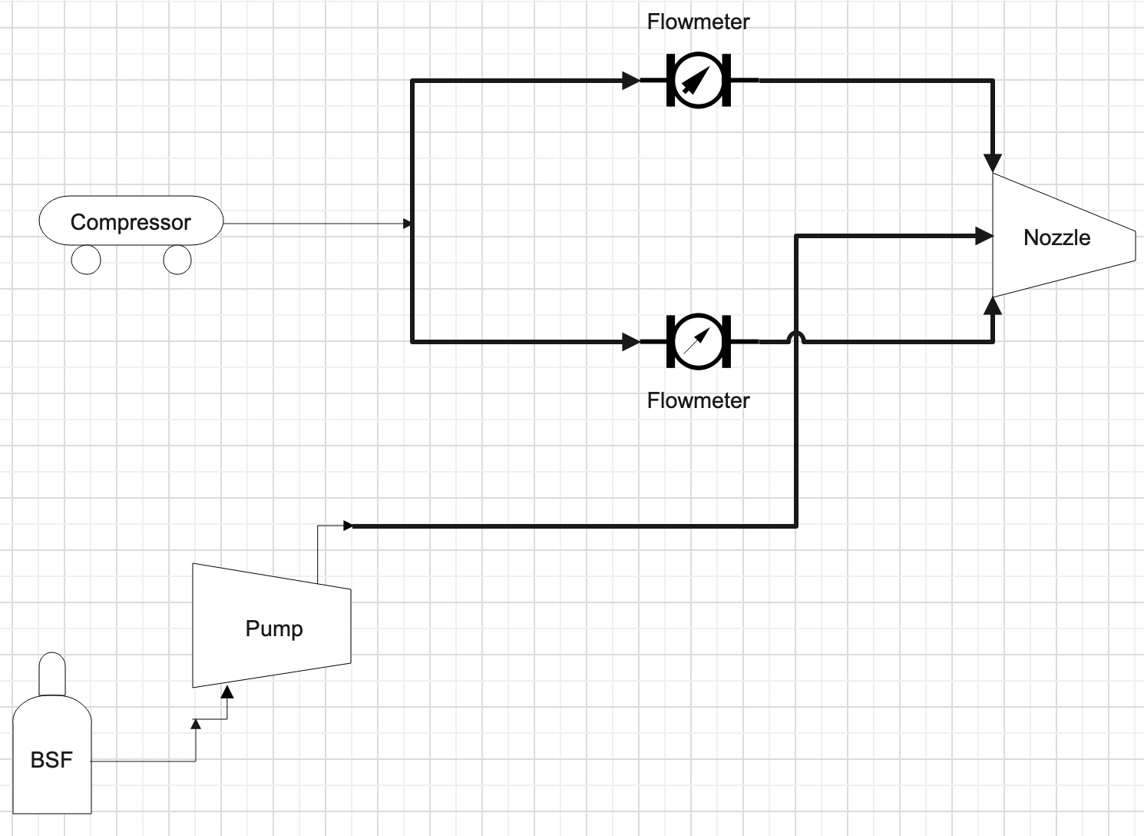
Use of Helium Filled Microscale Bubbles as a Seeding Particle for Flow Visualization
Semester: Spring 2023
Aaron Walcott, Simei Portillo, Musaab Nasralla
College of Engineering, Informatics and Applied Sciences, Northern Arizona University, Flagstaff, AZ 86011
Abstract
Methods
Initial vs. Final Design
The motivation for this project was to provide the client, Dr. Zhongwang Dou with a device for his flow visualization lab in the mechanical engineering department so that he can use it for flow analysis. The problem that the team was tasked with solving was to figure out how to make microscale bubbles as a tracer particle for flow visualization. As well as how can the team produce 107 bubbles per second at a density of 20,000 per cm3 with a diameter of 15-150 microns. The approach that the team decided upon was to use a 3-layer coaxial nozzle that would be using air, helium, and a bubble solution to make the bubbles. Use of helium would be to decrease density and help bubbles follow the flow towards the object being analyzed. The anticipated results are to use a high-speed camera to capture the bubbles as they flow and to figure out the bubble diameter and what type of bubble stream the nozzle is producing. The conclusion that can be drawn from the team’s solution is that they were able to go through testing and with the results obtained, they were able to meet the client’s requirements by producing a valid solution to the seeding particle problem.
For this project, the client provided the team with a 2-Layer Coaxial Nozzle and wanted to figure out a way in which to make it into a 3-Layer Coaxial Nozzle. To do so, the team designed the third layer utilizing an aluminum bar that could attach to the nozzle.
Testing Procedure:
Utilization of Phantom Camera
Recordings done at 68,000 fps
Data Collection using MATLAB code
Analyze frame by frame to measure:
Diameter, flow rate, and bubble concentration
Bubble Soap Formula Trials
Main: Glycerol, Water, Dish Soap
SIA 1035 BFS
Figure 1: Initial Resin Nozzle Design
Figure 2: Initial Resin Nozzle
Results
Figure 3: Final Full Nozzle Assembly
Figure 4: Final Adapter
MATLAB Code
The device was able to run for more than 30 minutes, the only problem the team encountered in the first couple of tests was that they still haven’t been able to find the “sweet spot” for the fluid flows in order to produce bubbles non-stop. In the figure below, most bubbles in the picture are shown to be smaller than 1mm, which is what the client wants, but we are still missing consistency due to not having the flows set on the “set spot”. During testing, the team only used the air compressor and the Bubble formula solution (BFS). The BFS used for these results was SIA 1035 BFS which is great to produce high concentrations of bubbles at a high cost.
Nozzle Adapter Specifications
2-3mm of space between brass nozzle end and adapter outlet
3-Layer Coaxial Nozzle​
Made from aluminum​
0.5mm diameter outlet​
Total adapter length is 1.6 inches
Conclusions
ER​ | Target​ | Tolerance​ | Measure/Calc Value​ | ER Met? (Y/N)​ | Client Acceptable? (Y/N)​
ER1-Bubble Output​ | 3^6​ | + 3^3​ | ​3x10^6 | Y​ | Y​
ER2-Bubble Density​ | 20000 /cm^3​ | + 100 / cm^3​ | ​5000 | ​N | ​Y
ER3-Residence Time​ | 30 minutes​ | + 2-3 minutes​ | 28 minutes​ | Y​ | Y​
ER4-Material​ | -​ | -​ | -​ | -​ | -​
ER5-Bubble Size​ | 15-150 Microns​ | +20 microns​ ​ | 50-300 Microns | N​ | Y
The team has spent nine months working to deliver a nozzle that will create microscale bubbles for flow visualization. After numerous hours of research and reading thesis papers and collaborating with the client, they have made a nozzle that is capable of meeting the customer’s requirements, The bubble sizes are being worked on to create a smaller range however they are currently client acceptable. Through the testing procedures the team has not run into many issues, and it has been smooth. Some future work that can be done is listed below
Team is working on creating a different type of bubble solution that will be more cost effective
Additional nozzles would need to be made to hit some of the project requirements
Modify MATLAB code to analyze bubbles with a greater accuracy
Requirements
Bubble output rate 10,000,000 bubbles/second
Bubble concentration of 20,000 bubbles/cm³
Device residence of 30 minutes
Device material of aluminum and brass
Bubble size of 15-150 microns in diameter
References
Figure 5: Engineering Requirements
Figure 7: Demonstration of bubbles
[1] Caridi, G. C. A. (2018). Development and Application of Helium-Filled Soap Bubbles: For Large-Scale PIV Experiments in Aerodynamics. https://doi.org/10.4233/uuid:effc65f6-34df-4eac-8ad9-3fdb22a294dc
[2] Barros, D.C., Duan, Y., Troolin, D.R. et al. Air-Filled Soap Bubbles for Volumetric Velocity Measurements. Exp Fluids 62, 36 (2021). https://doi.org/10.1007/s00348-021-03134-6
[3] S. Shibata, T. Yamazaki, and H. Matsuda, “Development of Micro Soap Bubble Generator for piv tracer using home stereolithography 3D printer,” 14th International Symposium on Particle Image Velocimetry, vol. 1, no. 1, 2021.
[4] F. Scarano, S. Ghaemi, G. C. Caridi, J. Bosbach, U. Dierksheide, and A. Sciacchitano, “On the use of helium-filled soap bubbles for large-scale tomographic PIV in wind tunnel experiments,” Experiments in Fluids, vol. 56, no. 2, 2015.
[5] J. I. Arrizubieta, I. Tabernero, J. E. Ruiz, A. Lamikiz, S. Martinez, and E. Ukar, “Continuous coaxial nozzle design for LMD based on numerical simulation,” Physics Procedia, vol. 56, pp. 429–438, 2014.
Fluid Flow Testing Schematic
Acknowledgements
Figure 6: Bubbles through Phantom Camera
Figure 6: Bubble Tracking
Dr. Zhongwang Dou – Client/Assistant engineering professor at NAU
Dr. David Willy – Engineering professor at NAU
Claude – Owner of Quality Tool in Flagstaff
Perry Wood – Head of NAU Machine Shop/Engineering professor at NAU
Travis Harrison – Machinist at NAU Machine Shop/ Lab aide/Teacher aide
Check our website!

