Slide 1

Microscale Soap Bubble Generator
P16: Aaron Walcott, Simei Portillo, Musaab Nasralla​

Slide 2
Customer Requirements
The team has been given a set of multiple requirements by the client Dr. Zhongwang Dou that the bubble generator should have. The most important requirements are the bubble output rate, the concentration of the bubble, and the size of the bubble. These are the major requirements which will make our machine different and better than the currently available machines. The requirements with ratings are given below.
CR1: Bubble output rate, this was rated at 12/12
  This was rated a 12 since it was one of the main goals of the project
CR2: Bubble Concentration, this was rated at 12/12
  This was rated a 12 since it was one of the main goals of the project
CR3: Device residence, this was rated at 10/12
  This was rated a 10 since it was slightly less important than the others since the client felt as though the 30-minute run time was not as important
CR4: Device material, this was rated at 10/12
  This was also rated a 10 since the device needs to be able to withstand higher pressures being pushed through the nozzle.
CR5: Bubble size, this was rated at 12/12
  This was rated a 12 since it was one of the main goals of the project
CR6: User friendly, this was rated at 4/12
  The client mentioned this as a goal however felt as though it was not the most important since his lab would mostly be the people using the device
CR7: Durability, this was rated at 12/12
  The device needs to be able to withstand a constant stream of fluids and pressure going through the nozzle so the team felt as though durability was very important since the product needs to be a quality one that would last a long period of time.
CR8: Reliability, this was rated at 12/12

Slide 3
Engineering Requirements
The engineering requirements were based on the customer requirements that the team received. So, the team took the customer requirements and had to produce a feasible way to conceptualize them. They were then able to make the list below.
ER1: Bubble output rate 3,000,000 bubbles/second
ER2: Bubble concentration of 20,000 bubbles/cm³
ER3: Device residence of 30 minutes
ER4: Device material of aluminum and brass
ER5: Bubble size of 15-150 microns

Slide 4
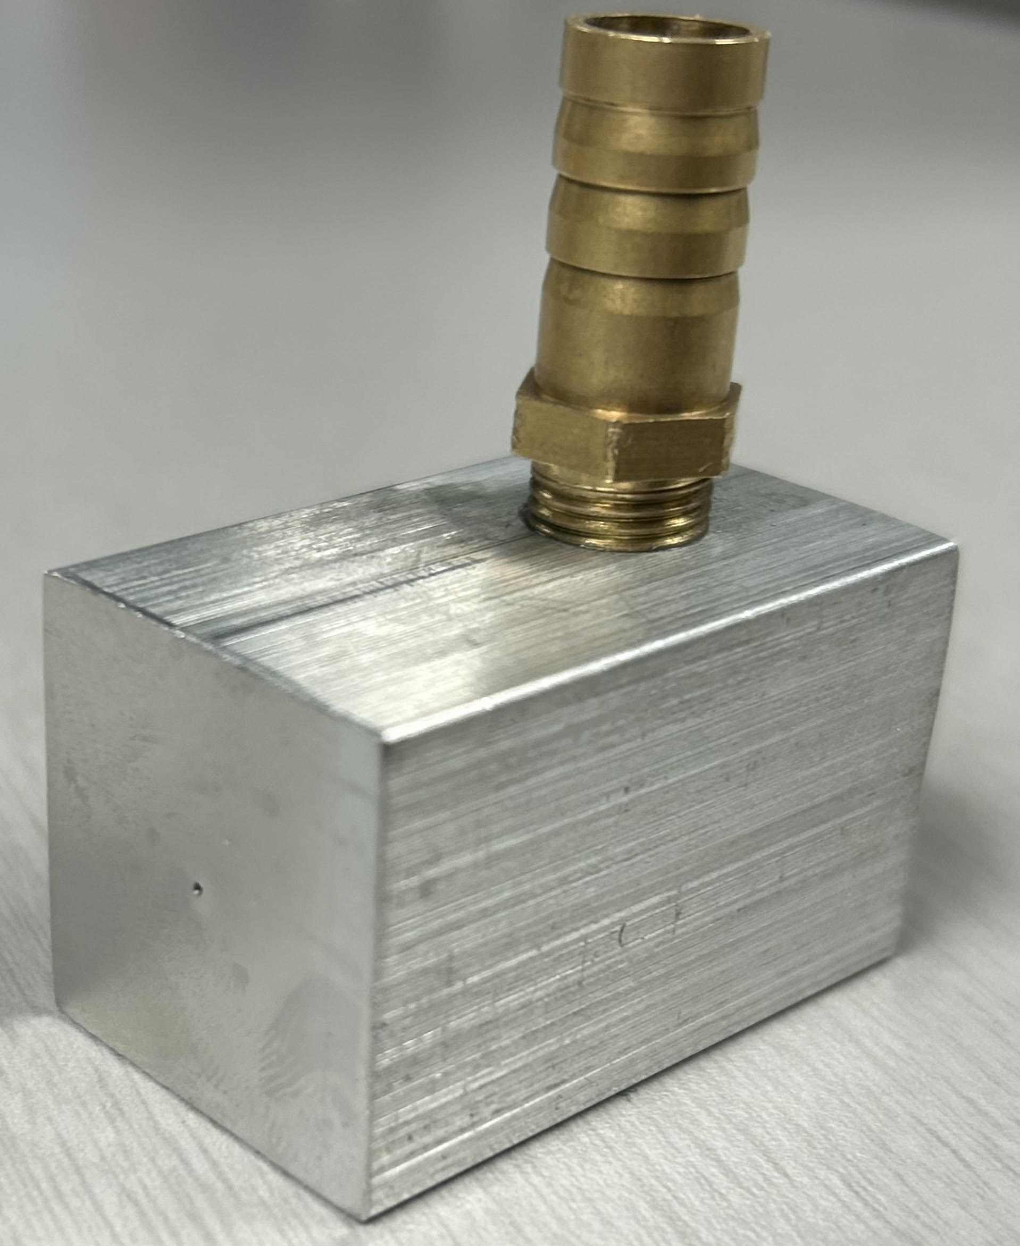
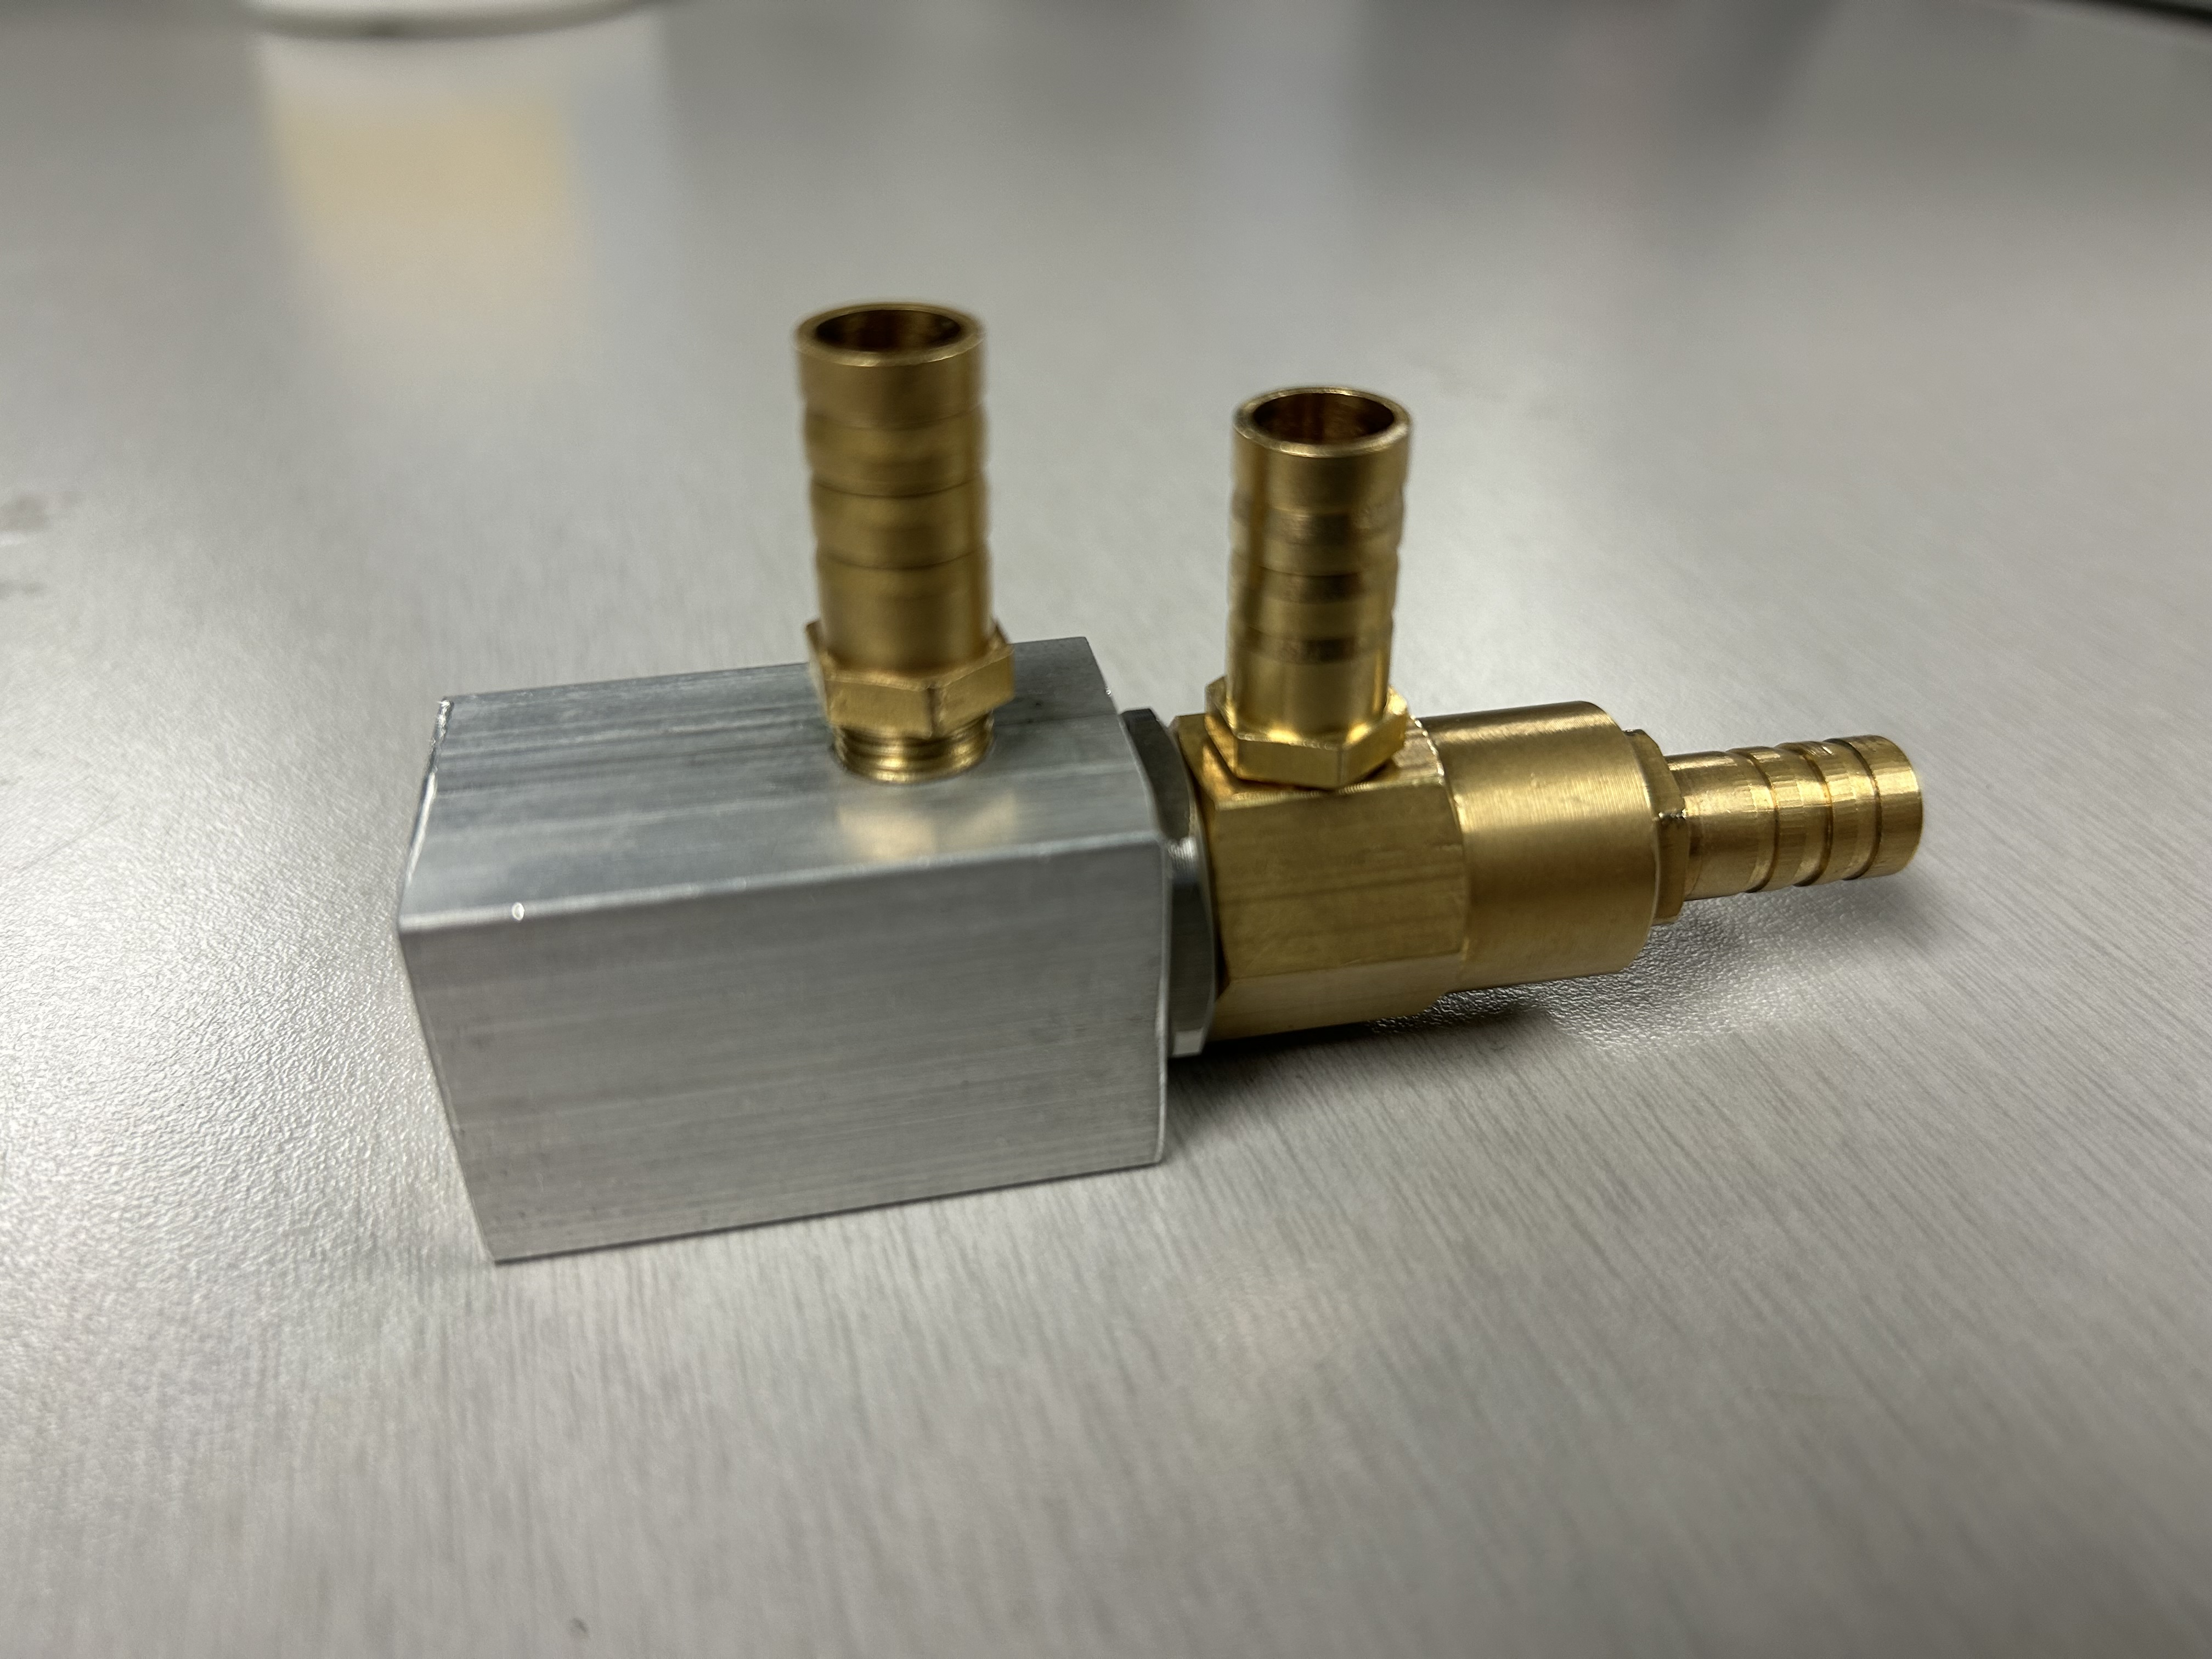
Nozzle Specifications
Third layer adapter now machined.
Threads all the way to the end of the nozzle
2-3mm of space between brass nozzle end and adapter outlet
Made from aluminum
Still 0.5mm diameter outlet
Total length is 1.6 inches
Figure 1: Full Coaxial Design
Figure 2: Third Layer Adapter

Slide 5
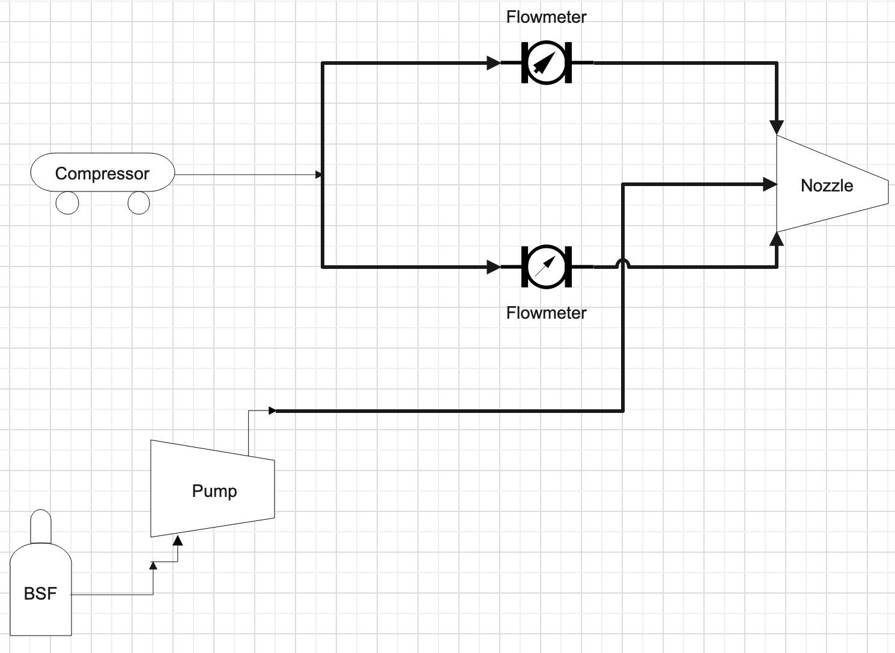
Schematic Diagram
Figure 3: Schematic Diagram

Slide 6
Current Testing Specifications
Main Air input: 1 liters/min
Secondary Air input: 0.1 liters/min
Solution input: 7 mL/hr
Other Important Specifications
The total height of the camera frame: 6.28mm
Roughly: 1 cm = 132 px
Whole picture: 829 pixels
Frame rate: 68,000 fps
Bubble Soap Formula: Glycerol, Water, Dish Soap

Slide 7
Experiment 1: Bubble Output Rate
During this test, the goal is to be able to measure the number of bubbles that had been generated by the 3-layer coaxial nozzle, we need to be able to generate 10,000,000 bubbles/s. To be able to perform this test and any other test, the team will need to first have finished the 3rd layer of the nozzle, which is currently at the Machine Shop. Another equipment needed to perform this test is the Phantom v7.3 camera which has been provided by the client and the wind tunnel. Below is a list of steps needed to perform the test:
Connect compressor, Pump, and Helium tank to nozzle.
Open Valves to start generating bubbles.
Set Phantom camera to record the generated bubbles.
Use MATLAB code to analyze how many bubbles per frame
The main variables that need to be calculated from these results are the bubble diameters and bubble concentrations.

Slide 8
Experiment 2: Bubble Concentration
During this test, the goal is to be able to measure the number of bubbles that had been generated by the 3-layer coaxial nozzle, we need to be able to generate 20,000 bubbles/cm³. To perform this test, we will need the 3-layer coaxial nozzle, Phantom camera, and wind tunnel. Below is a list of steps needed to perform the test:
Connect compressor, Pump, and Helium tank to nozzle.
Open Valves to start generating bubbles.
Set Phantom camera to record the generated bubbles.
Use MATLAB code depth perception included.
The main variables that need to be calculated from these results are the bubble diameters and bubble concentrations as well as the type of bubble stream the team is achieving.

Slide 9
Experiment 3: Bubble Diameter
During this test, the goal is to be able to measure the diameter of the bubbles that had been generated by the 3-layer coaxial nozzle, we need to be able to generate bubbles with diameters that range between 15-150 microns. To perform this test, we will need the 3-layer coaxial nozzle, Phantom camera, and wind tunnel. Below is a list of steps needed to perform the test:
Connect compressor, Pump, and Helium tank to nozzle.
Open Valves to start generating bubbles.
Set Phantom camera to record the generated bubbles.
Use MATLAB code depth perception included.
The main variables that need to be calculated from these results are the bubble diameters and bubble concentrations and the type of bubble stream.

Slide 10
Results from bubble diameter test
Team achieved around 500 microns in initial testing which could have been due to the flow rate, however the client said that it might work
Recorded a close-up slow-motion video at 68,000 fps, then in the same frame took a ruler and had to count the number of pixels the bubbles were and how many pixels were in a millimeter.
The team is currently retesting this now to try and get smaller bubbles.
  There were way smaller bubbles present however it was a bit harder to measure as they just appeared as blobs
    Client reassured the team that they were bubbles

Slide 11
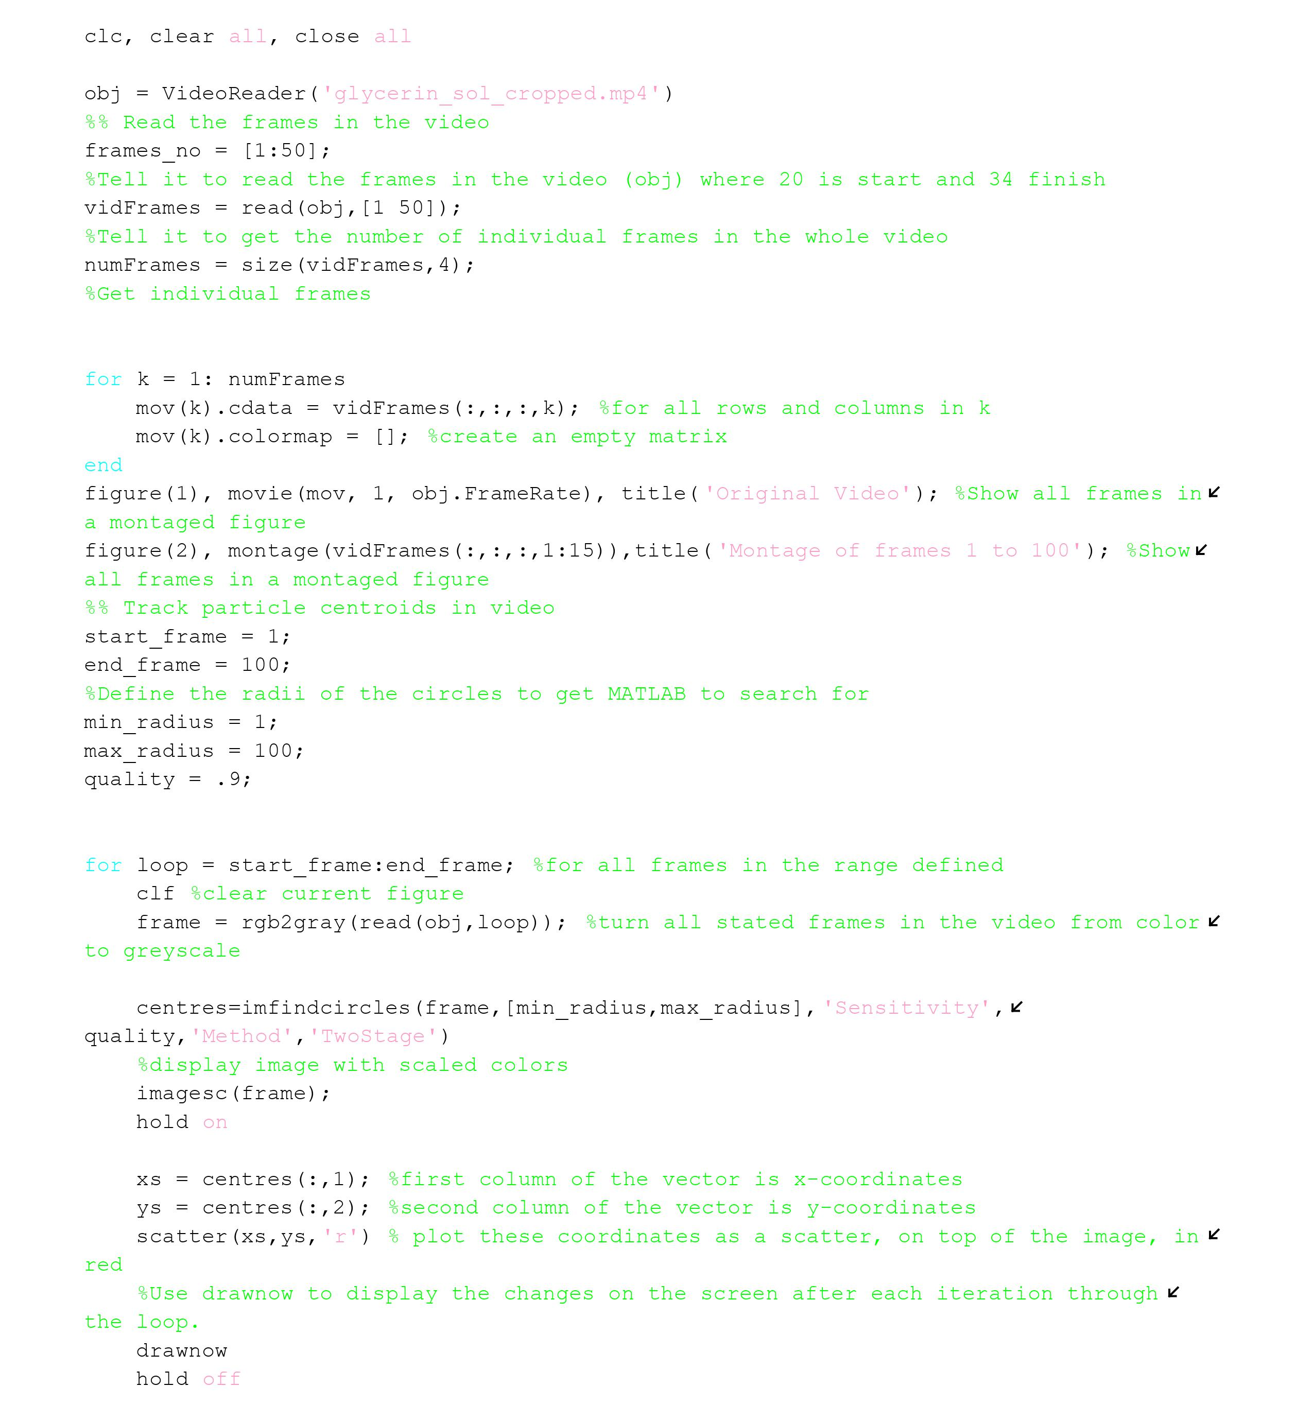
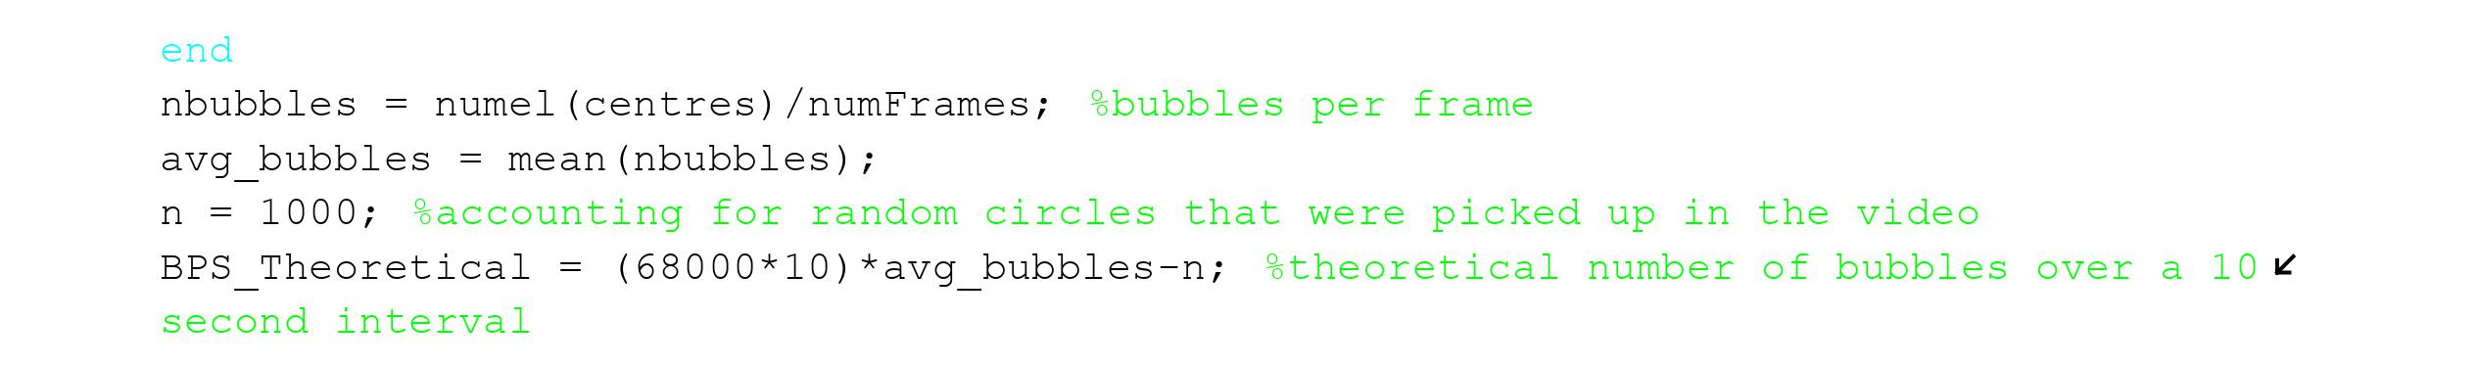
MATLAB

Slide 12
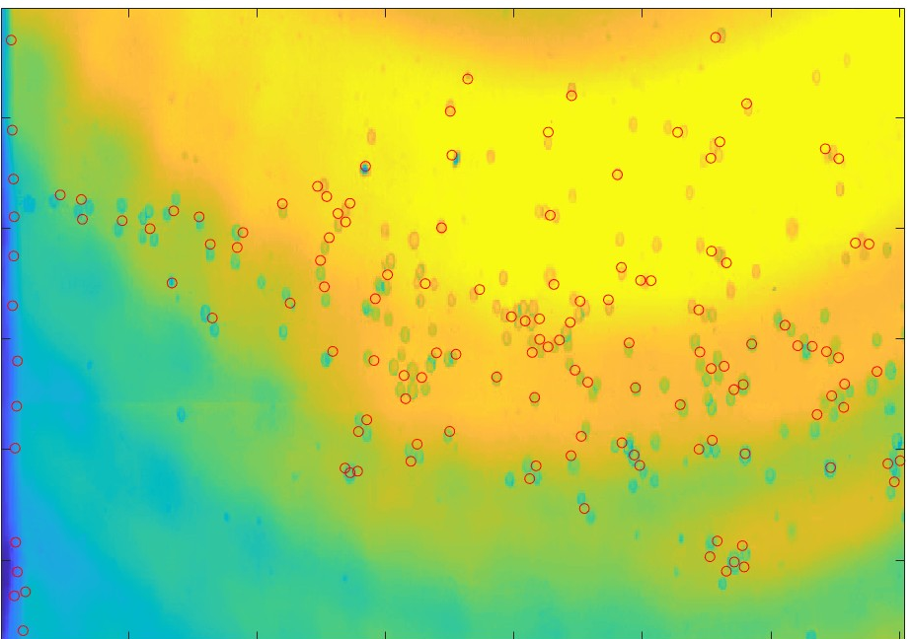
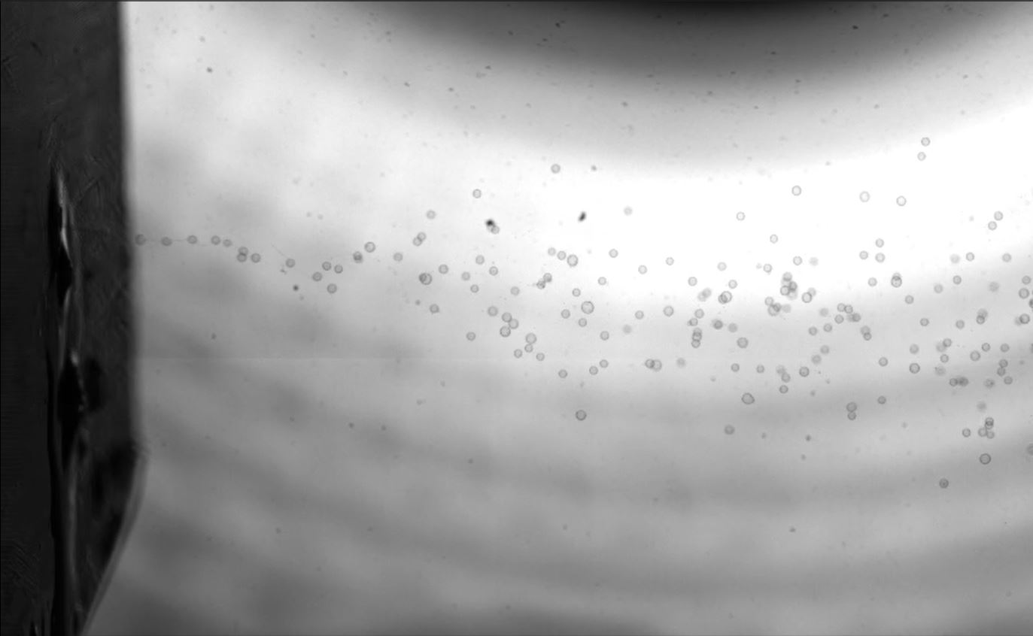
Pictures!
Figure 4: Bubble Tracking
Figure 5: Shadowgraph

Slide 13
Specification sheet
Table 2: Customer Requirements Spec Sheet
Customer Requirement | Cr Met? (Y/N) | Client Acceptable? (Y/N)
CR1 | Y | Y
CR2 | N | Y
CR3 | Y | Y
CR4 | Y | Y
CR5 | Y | Y
CR6 | Y | Y
CR7 | Y | Y
CR8 | Y | Y

Slide 14
Specification sheet cont.
Table 3: Engineering Requirement Specification Sheet
ER | Target | Tolerance | Measure/Calc Value | ER Met? (Y/N) | Client Acceptable? (Y/N)
ER1-Bubble Output | 3^6 | + 3^3 | 3x10^6 | Y | Y
ER2-Bubble Density | 20000 /cm^3 | + 100 / cm^3 | 5000 | N | Y
ER3-Residence Time | 30 minutes | + 2-3 minutes | 28 minutes | Y | Y
ER4-Material | - | - | - | - | -
ER5-Bubble Size | 15-150 Microns | + 20 microns | 50-300 microns | Y | Y

Slide 15
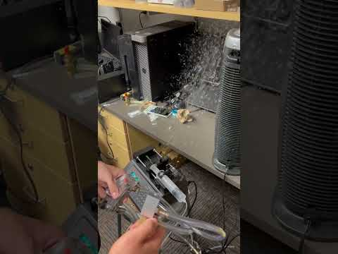
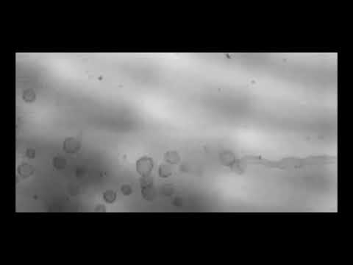
Short video Demo
Video 1: Closeup Bubble
Video 2: Bubble Demonstration

Slide 16
Future Work
The team is still currently working on test to provide an array of options for the client
This is being done through manipulation of flow rates and Bubble Soap Formulas to get different bubbles
The team is also working on improving their MATLAB code to make it more efficient when analyzing the bubbles in the frame
  This is to eliminate any need to visually inspect the frames of bubbles
Another thing that can be done in the future would be to add additional nozzles so that the bubble concentrations and output rates are higher and better

Slide 17
Questions?

