Slide 1

HELIUM-FILLED BUBBLE SOAP GENERATOR​
P16: Aaron Walcott, Simei Portillo, Musaab Nasralla​

Slide 2
Where are we at now?
Adapter has been manufactured
  Client approved
Client gave the team a more portable compressor to work with outside of lab
The team has started testing – video on a later slide

Slide 3
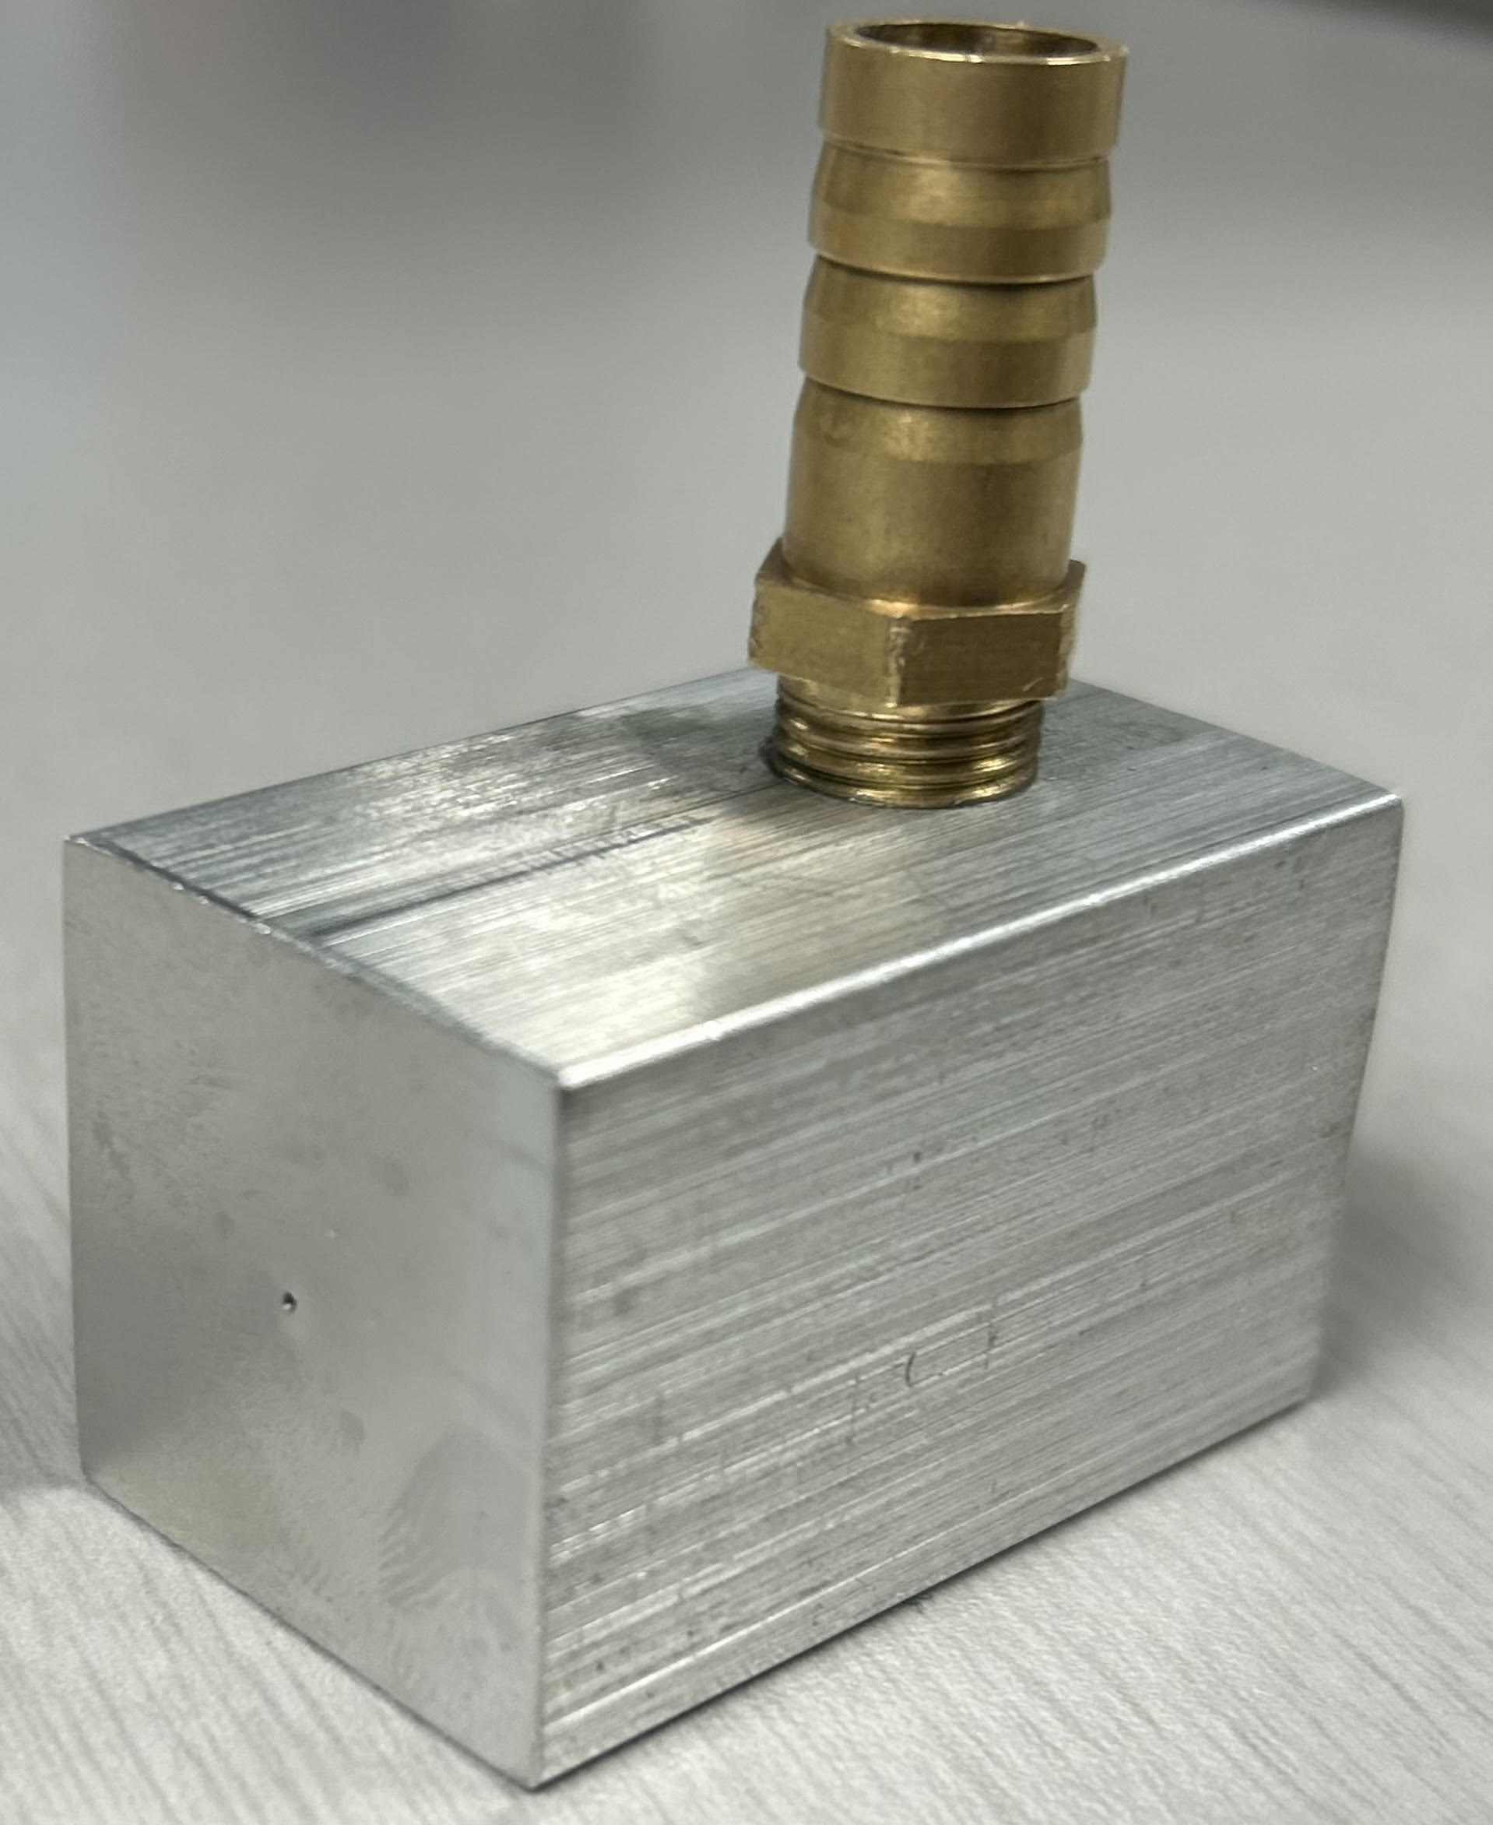
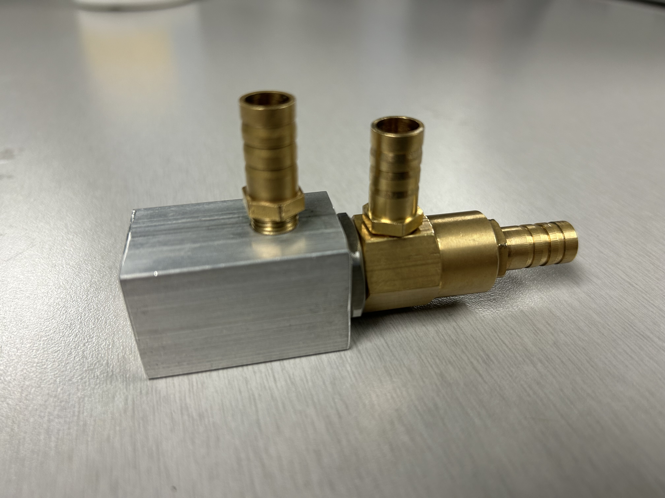
Nozzle Specifications
Third layer adapter now machined.
Threads all the way to the end of the nozzle
2-3mm of space between brass nozzle end and adapter outlet
Made from aluminum
Still 0.5mm diameter outlet
Total length is 1.6 inches
Figure 1: Full Coaxial Design
Figure 2: Third Layer Adapter

Slide 4
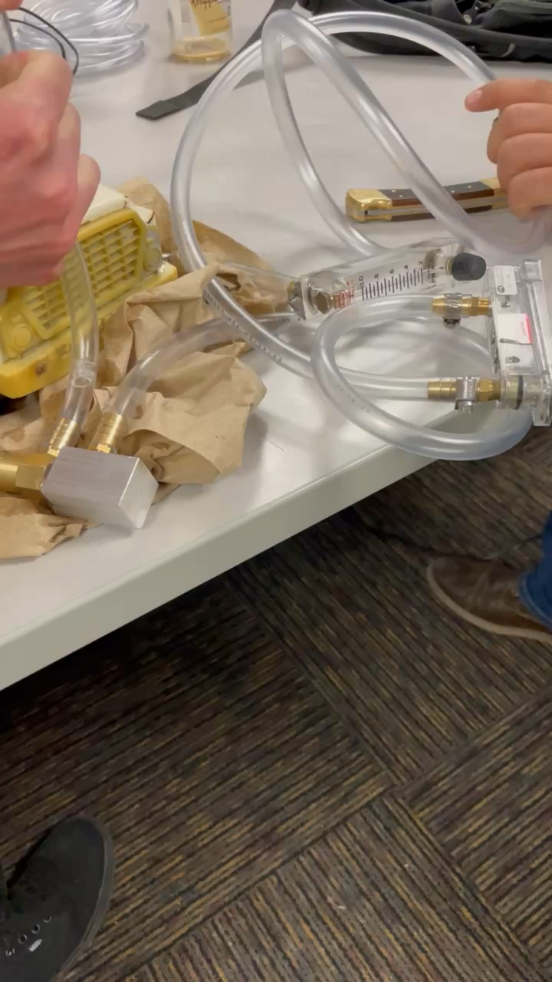
Demonstration
Video demo of nozzle flowing
  Using a soap and water solution
  Not using helium for now until client needs
    Dr. Dou said for testing to just use air
  Using a smaller air compressor to push air through
    Will be using a much higher pressure for in lab testing
  Will be using a syringe to put the liquid solution through to create more pressure

Slide 5
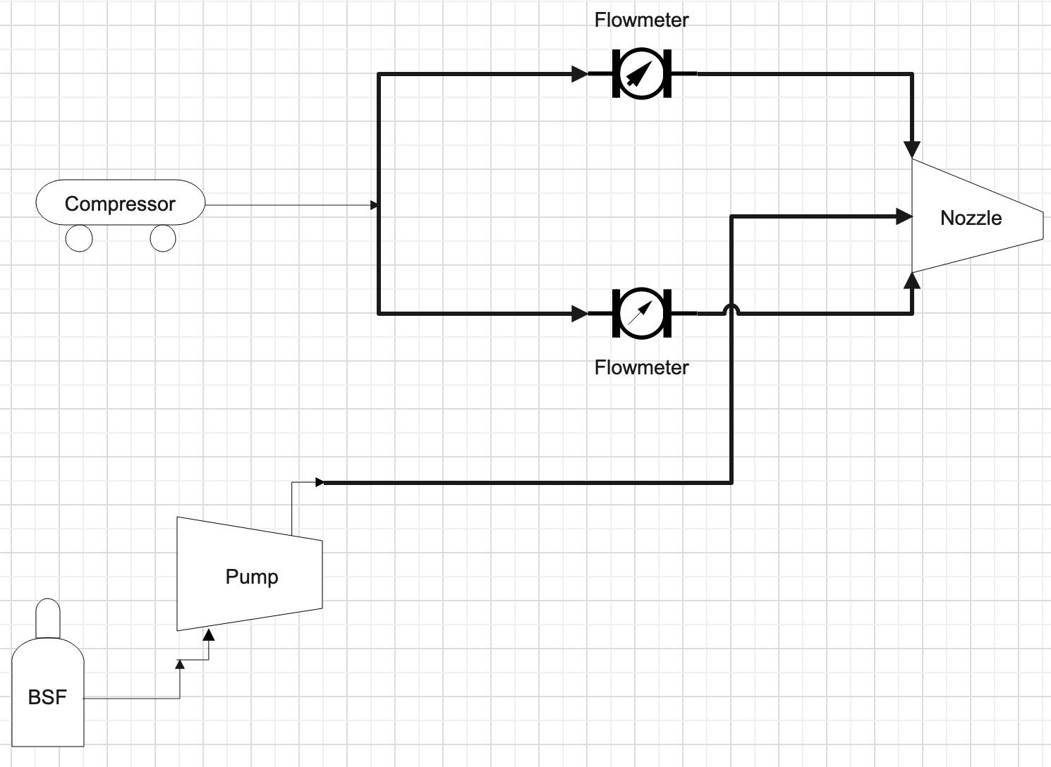
Schematic Diagram
Figure 3: Schematic Diagram

Slide 6
Testing Plan
For the team's testing they will be using a phantom high-speed camera to capture their bubble output
  They will then be importing pictures and data into MATLAB to solve for:
    Bubble output rate
    Bubble concentration
    Bubble diameter
  While they run these tests, they will gage the amount of time the machine was running so they can see if it will be able to run for 30 minutes

Slide 7
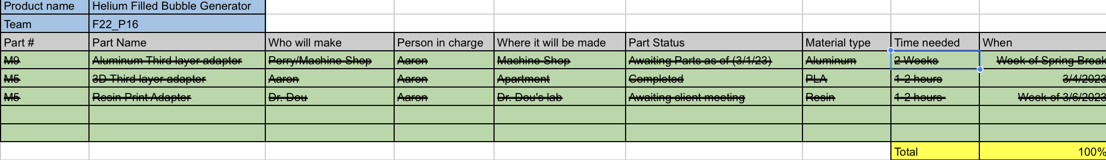
Manufacturing Plan
Figure 4: Manufacturing Plan

Slide 8
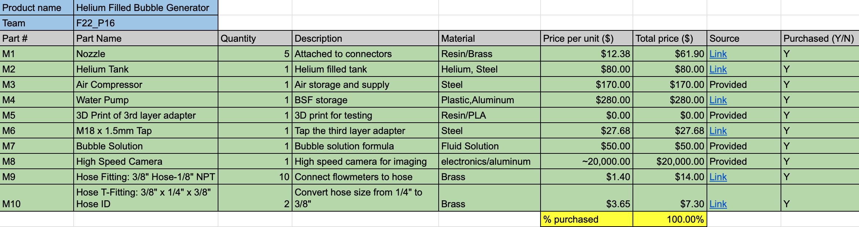
Purchasing Plan
Figure 5: Purchasing Plan

Slide 9
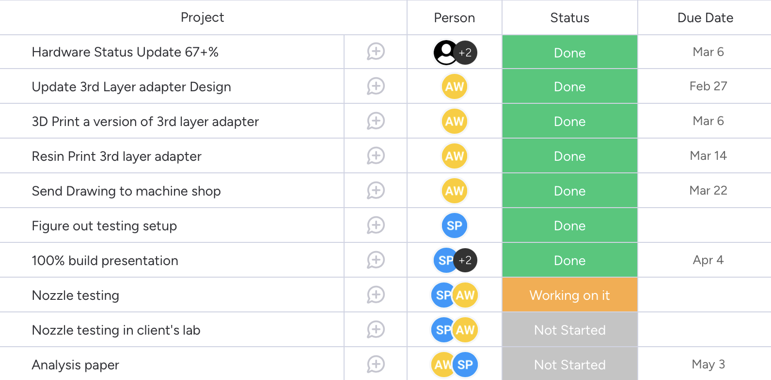
Gantt Chart
Figure 6: Gantt Chart

