Slide 1
Design of Front suspension, brake, dashboard systems for BAJA SAE
Team members
Salem Al marri
Omer Alamoudi
Rashid Algelmod
Musaed Fraidoun
Chujian Wang
Dr: David Willy

Slide 2
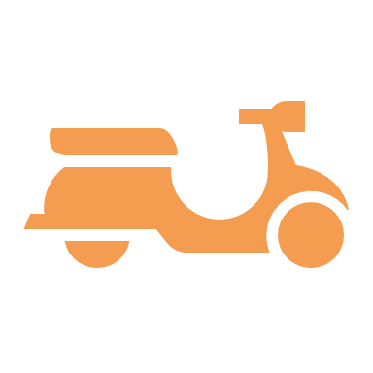


Project Description
This project aims to review and redesign of front suspension, brake, and dashboard systems.
PROJECT IMPORTANCE: This project include an SAE-BAJA off-roading vehicle design which can be abide by SAE BAJA completion.
The significance of our project is to achieve objectives.

Slide 3
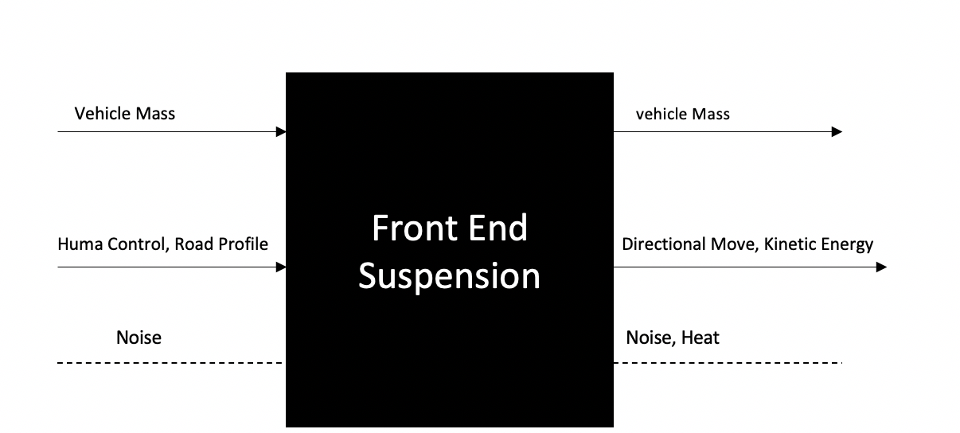
Black Box Model-front suspension system
Figure 1. black box model-Front suspension

Slide 4
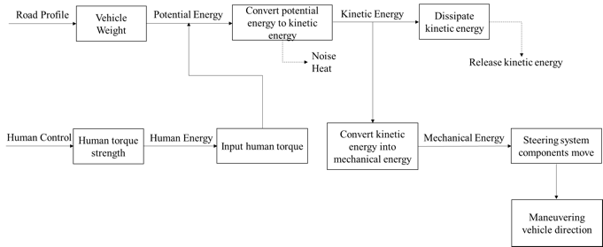
Functional Decomposition- Front-end suspension
Figure 2:Hypothesized Functional model for Front suspension

Slide 5
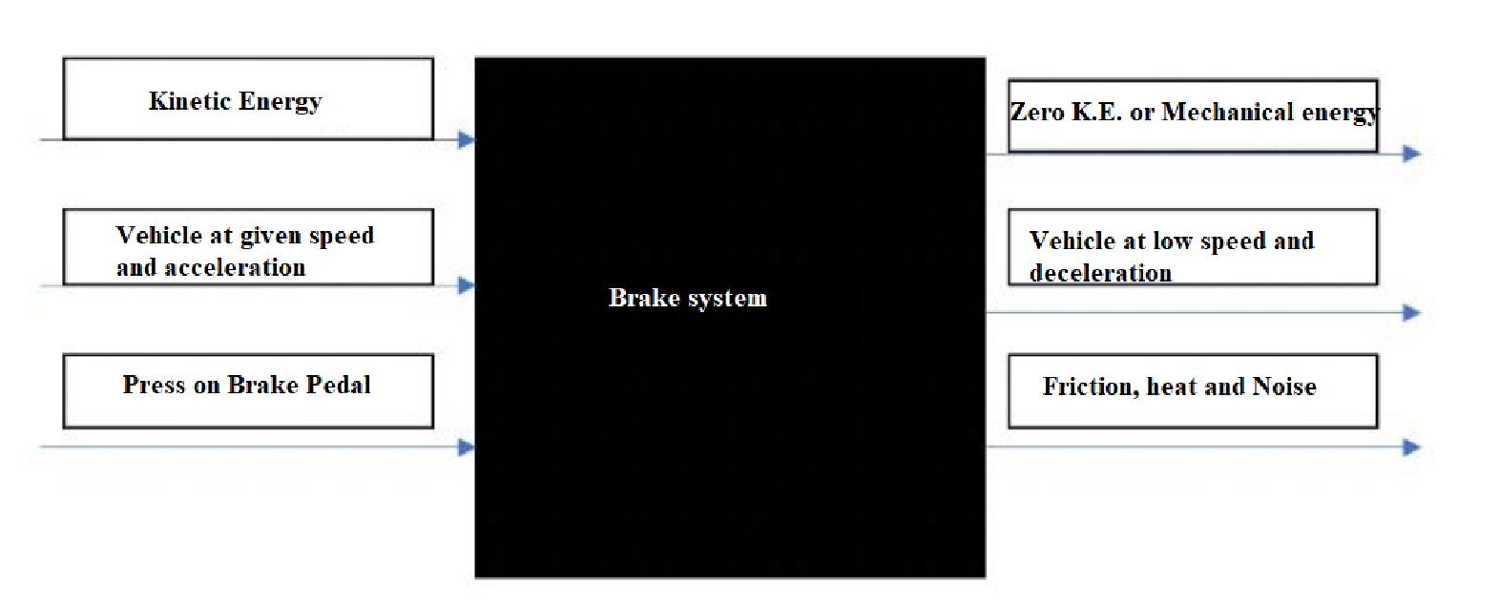
Black Box Model-brake system
Figure 3. black box model –brake system

Slide 6
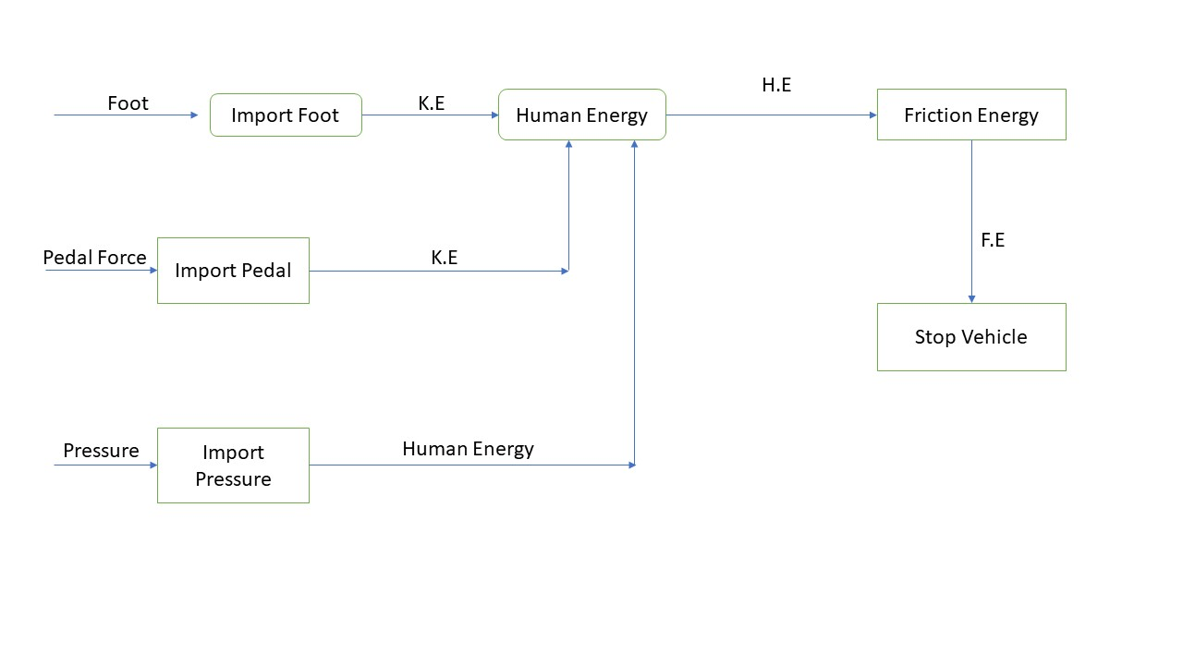
Hypothesized Functional
Figure 4 Hypothesized functional

Slide 7
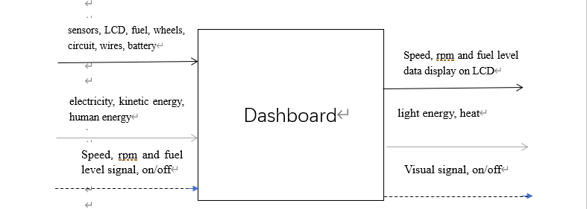
Black Box dashboard system
Figure 5. black box of dashboard system

Slide 8
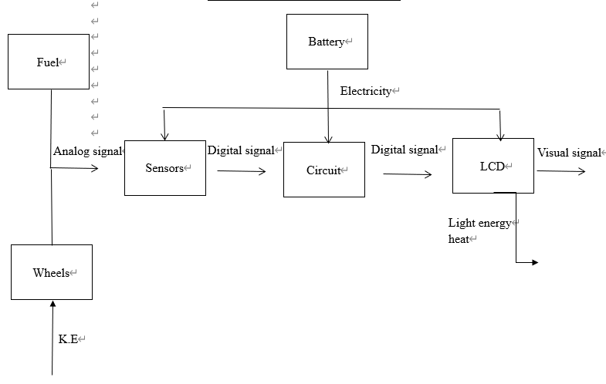
Hypothesized Functional
Figure 6. Hypothesized Functional model for dashboard

Slide 9
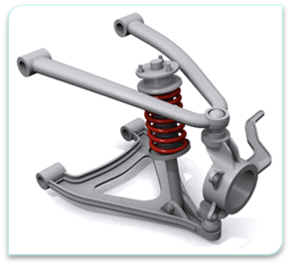
Concept Generation - Front suspension system
Advantage
Independent suspension system
Keeps high degree wheel-tires alignment
Disadvantage
expensive
Difficult repair
complex manufacturing and measurements.
Figure 7: Double Wishbone suspension [1]

Slide 10
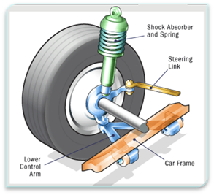
Concept Generation - Front suspension system
Advantage
lighter weight due to reduced unsprung weight
Inexpensive
Essay to assemble and maintain
Disadvantage
More space required to install, tall design
Less- efficient off-road
Figure 8: MacPherson strut system [2]

Slide 11
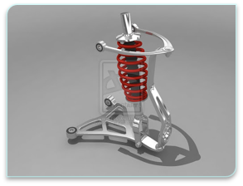
Concept Generation - Front suspension system
Advantage
Negative camber gain during hard cornering
Desirable compactness
Disadvantage
To adjust the suspension, the spring should be changed
Complex dimension determinations
Figure 9: Unequal length double A-arms [3]

Slide 12
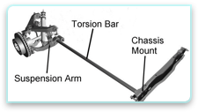
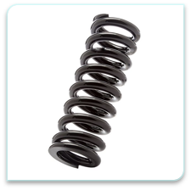
Concept Generation - Front suspension system
Advantages
Greater flexibility
Customizable
Off-road capability
Disadvantages
Not for heavy vehicles
Can be espersive
Figure 11 torsion bar spring [5]
Advantages
inexpressive
Easy to replace parts
Disadvantages
Cannot handle bumps well
Less-efficient for off-road driving
Figure 10: Coil Spring [4]

Slide 13
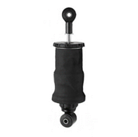
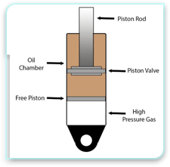
Concept generation- front end suspension
Advantages
High stability and control
Can bear with large payload
Disadvantages
High initial cost
Complex maintenance
Not preferable on rough terrain
Advantages
Damping stability
Aeration doesn't occur since air and oil are separated
customizable
Disadvantages
High initial cost
Any outer damage can affect the internal function
Figure 13 mono-tube shocks [7]
Figure 12 air spring [6]

Slide 14
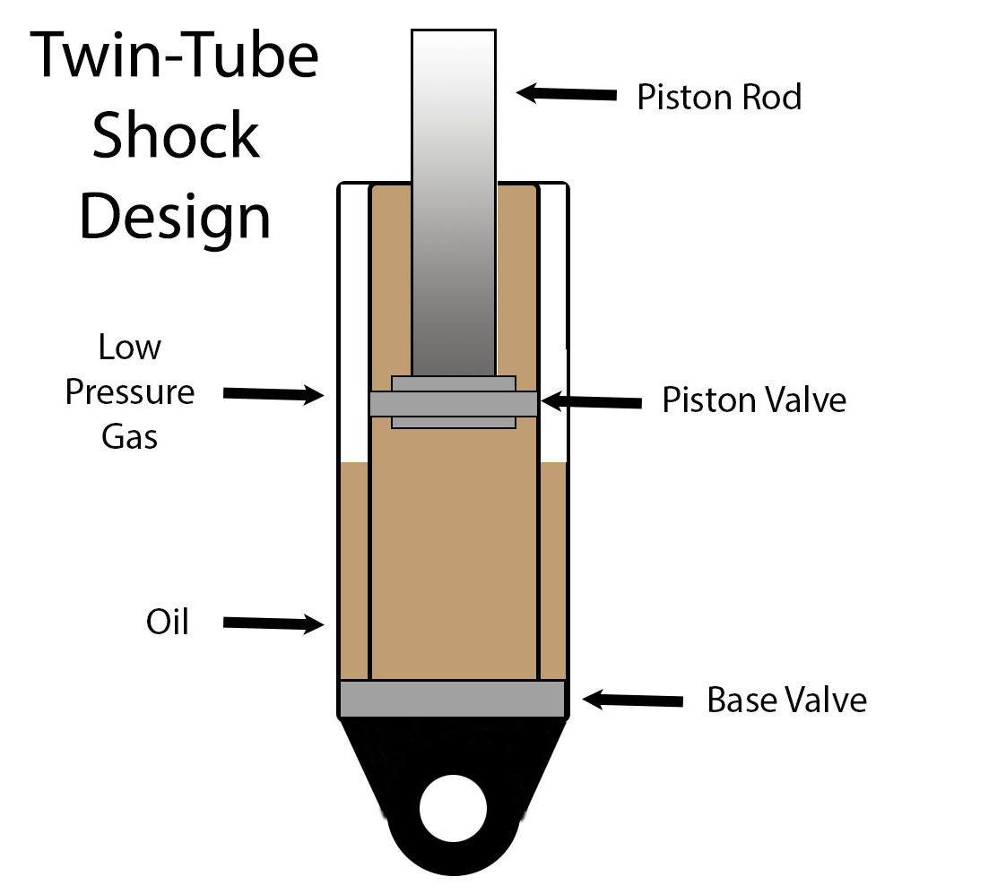
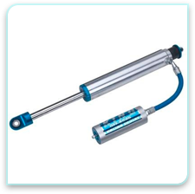
Concept generation- front end suspension
Advantages
Low production cost
Long further than monotube
Provides stability
Disadvantages
Aeration possible
Cannot be customizable
Limited oil capacity
Advantages
Flexible mounting capacity
Provides more oil capacity
Disadvantages
More component raise risk of damage
Less compactness
Figure 14 Twin Tube Shock [9]
Figure 15 Remote reservoir Shocks [8]

Slide 15
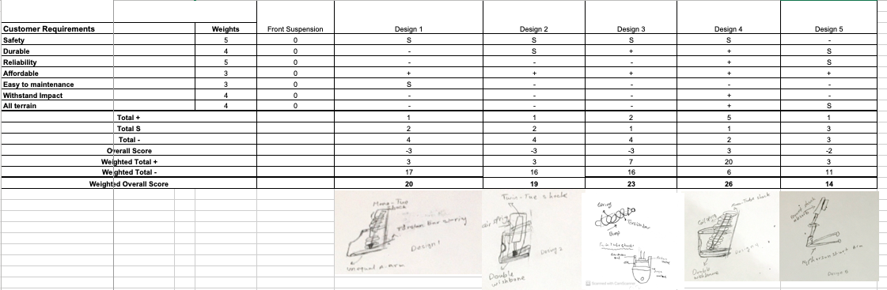
Pugh Chart
Table 1 Pugh Chart for Front Suspension

Slide 16
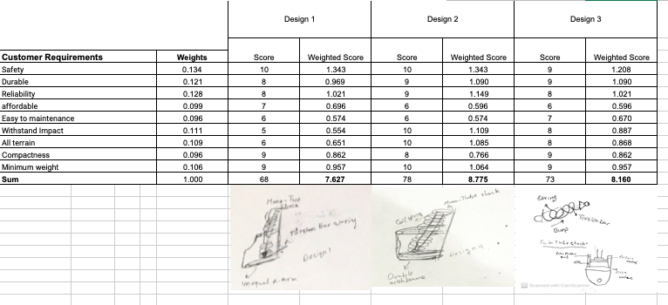
Decision Matrix
Table 2 Decision Matrix

Slide 17
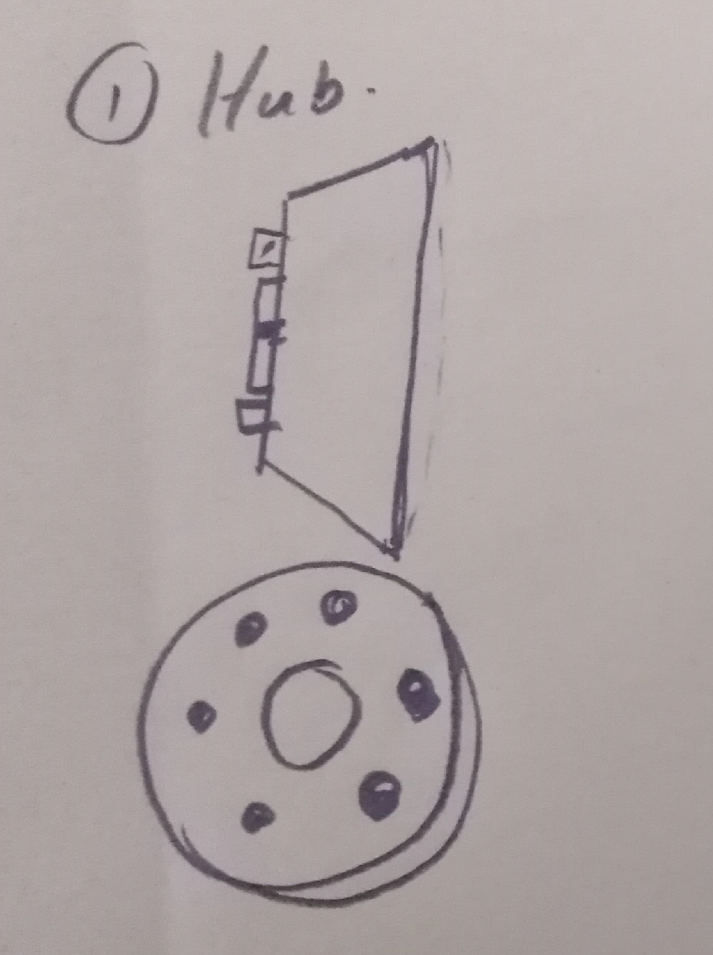
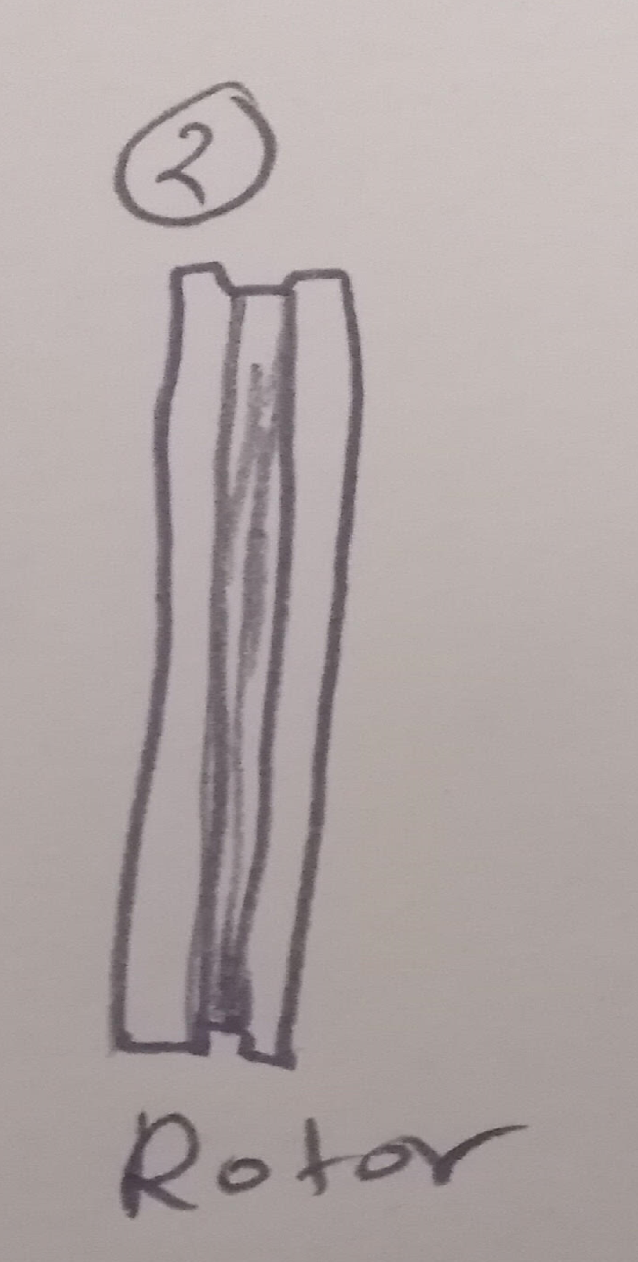
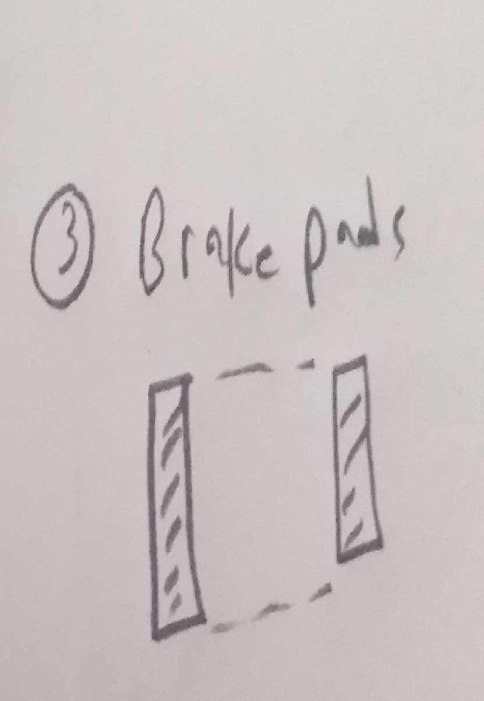
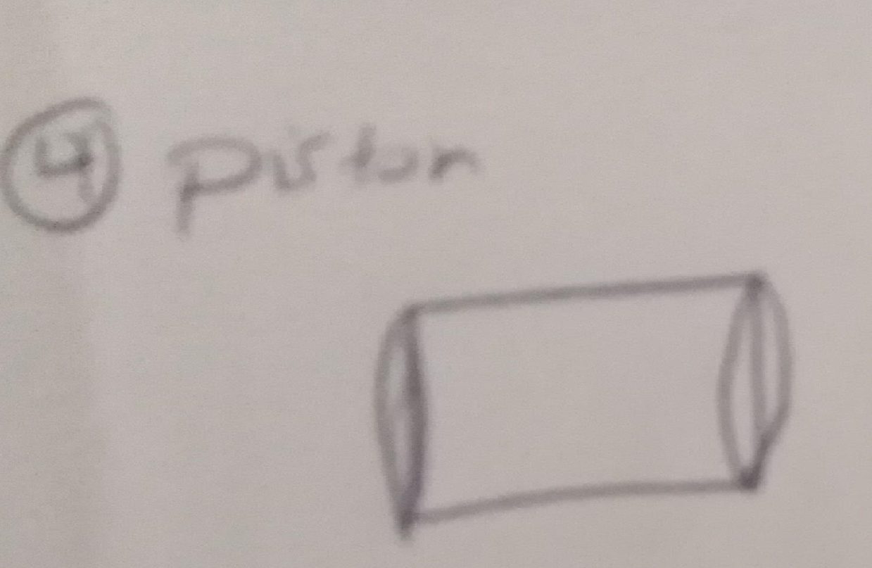
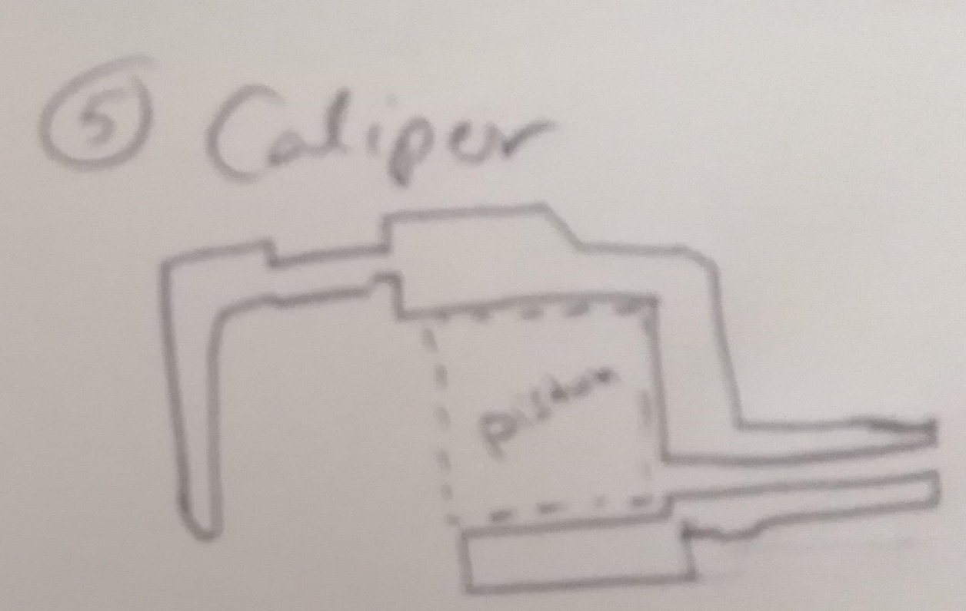
Component Designs 2 brake system
Figure 16 Components of brake system

Slide 18
Component Designs 2 brake system /calculations
1- Fbd= Fd*(A/B)= 385*(6/1)= 2310 N
2- Fca= Pcal*Acal= 8.105*962.11=8570.46 N
3- F friction=Fcl*Upb= 1559.80*0.4= 6856.37 N
4 - F tire= (Tt/Rt)=(1607.7/0.2921)= 5503.94
5- Total force= 5503.94+5503.94= 11007.88 N
6- deceleration= (F total/Mv*g)= 11007.88/9.81*210)= 5.34 m/s^2
7 - Stopping Distance= (Vv^2/2*Av)=(11.12^2/2*5.34)=11.8 m
9 - Time to stop= (Vv/Av)= (11.12/11.8)= 0.943 Sec

Slide 19
Concept Generation dashboard system
The design of the dashboard is mainly based on the type of sensor and the display screen
I choose to use Arduino as the motherboard to design circuit and connect sensor and display
I choose arduino LCD screen as the display screen.

Slide 20
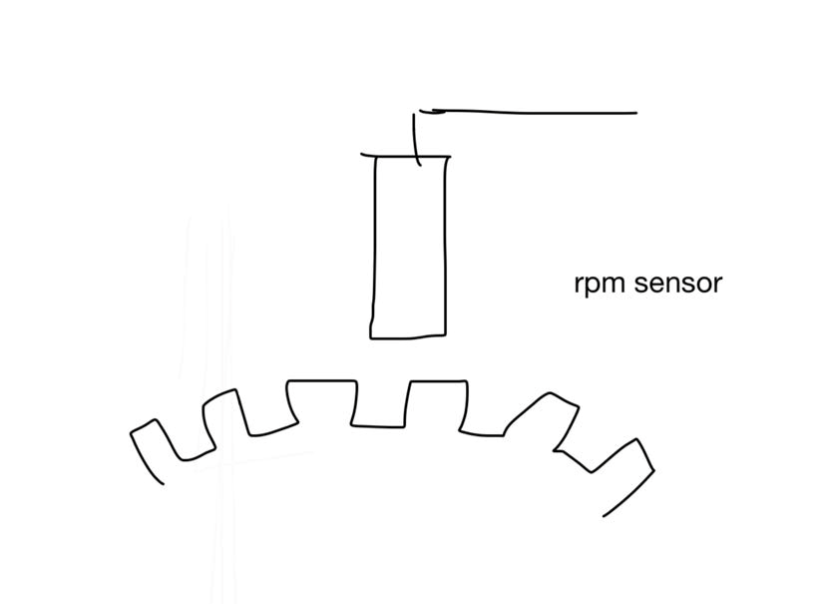
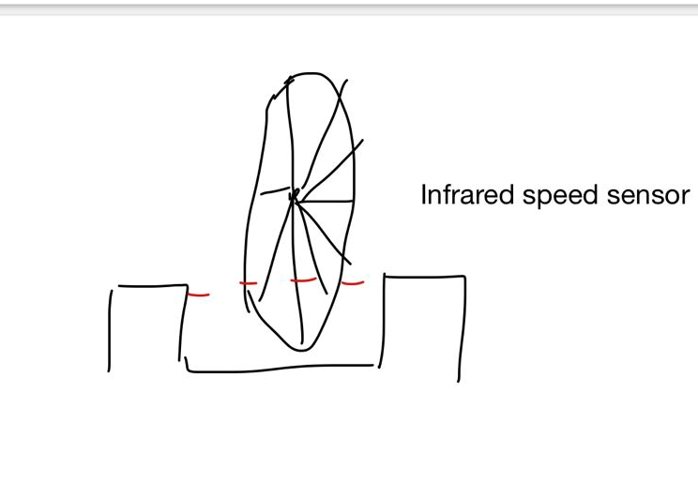
Concept Generation-Sketch of sensor measurement dashboard system
Figure 17: Hall speed sensor
Figure 18:Infrared speed sensor

Slide 21


Concept Generation-Comparison dashboard system
Table 3: Hall speed sensor
Table 4 : Infrared speed sensor

Slide 22
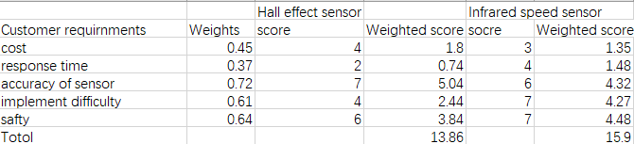
Concept Generation-Decision Matrix dashboard system
Table 5 : Decision matrix-dashboard system

Slide 23
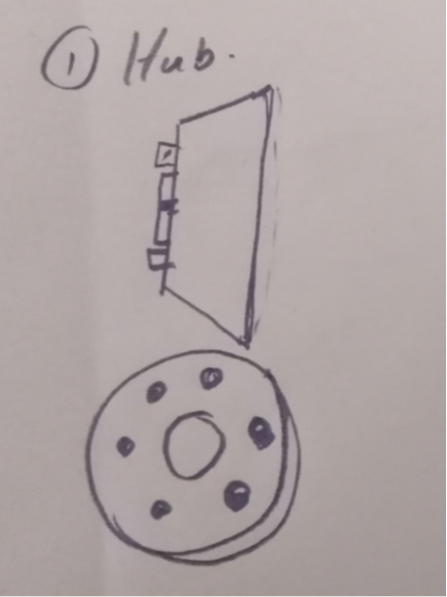
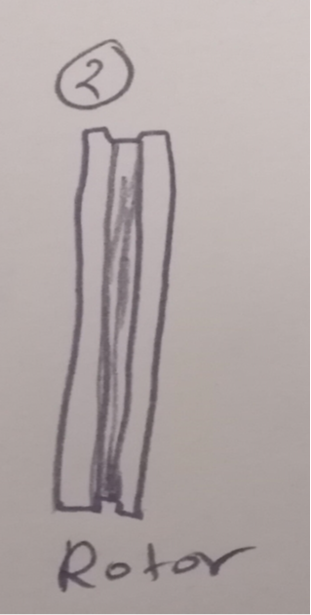

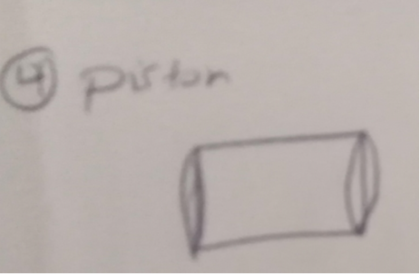
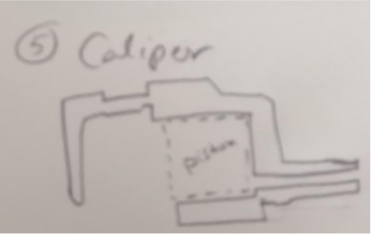
Morph Matrix-brake system
Aspects | 1 | No.
Hub |  | 4
Rotor |  | 4
Brake pads |  | 8
Piston |  | 1
Caliper |  | 4
Figure 19 Morph matrix-brake system

Slide 24
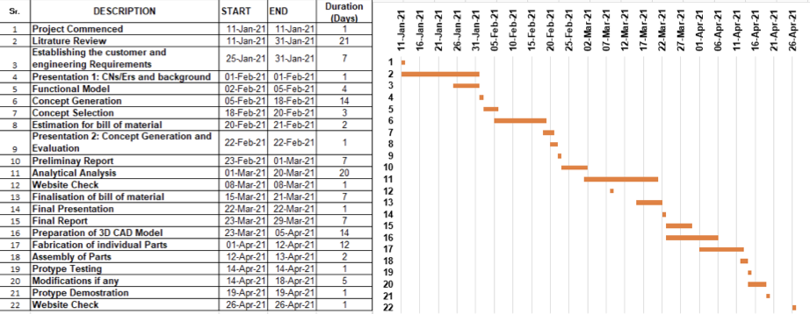
Gantt Chart
Table 6 Gantt Chart

Slide 25
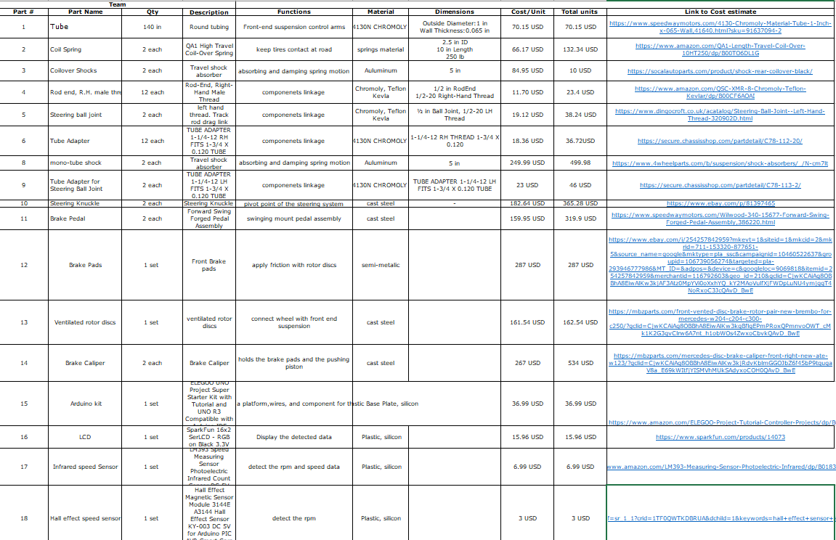
Project Planning
le 7 Material list

Slide 26

Questions?

Slide 27
Reference
[1] Stevens, M., 2021. MacPherson Strut vs Double Wishbone Suspension (Pros and Cons). [online] CarTreatments.com. Available at: : <https://cartreatments.com/pros-and-cons-of-macpherson-vs-double-wishbone-suspension/> [Accessed 18 February 2021].
[2] Pinterest, 2021. MacPherson Strut. [Online]. Available at: < https://www.pinterest.com/pin/468092954999018913/> [Accessed 18 February 2021].
[3] armec, 2021. comprasion | Double Wishbone, MachPherson Strut, Solid Axle and Twist beam. [Online].aermech.com Available at:< https://aermech.com/double-wishbonemacpherson-strutsolid-axle-and-twist-beam/ > [Accessed 19, 2021]
[4] "Fox Racing Shox Coil Spring Steel 2.5 - 2.8" Stroke", Cyclinic, 2021. [Online]. Available: https://cyclinic.com.au/products/fox-racing-shox-coil-spring-steel-2-5-2-8-stroke. [Accessed: 21- Feb- 2021].

Slide 28
Reference
[5] "A torsion bar suspension, also known as a torsion spring suspension (but not to be confused with torsion beam rear su… | Torsion bar suspension, Bar, Torsion spring", Pinterest, 2021. [Online]. Available: https://www.pinterest.co.uk/pin/754986325011635787/. [Accessed: 21- Feb- 2021].
[6] "Man Truck Air Spring Suspension - Airstar Cabin Air Springs", Airstar Cabin Air Springs, 2021. [Online]. Available: http://www.cabinairsprings.com/urun/81417226054/. [Accessed: 21- Feb- 2021].
[7] "What is a monotube shock?", Help.summitracing.com, 2021. [Online]. Available: https://help.summitracing.com/app/answers/detail/a_id/5251/~/what-is-a-monotube-shock%3F. [Accessed: 22- Feb- 2021].
[8] [Online]. Available: https://www.4wheelparts.com/p/king-shocks-2-5-oem-performance-series-rear-remote-reservoir-shock-absorber-25001-121/_/R-FBJG-25001-121. [Accessed: 22- Feb- 2021].
[9] "What is a twin-tube shock?", Help.summitracing.com, 2021. [Online]. Available: https://help.summitracing.com/app/answers/detail/a_id/5250/~/what-is-a-twin-tube-shock%3F. [Accessed: 22- Feb- 2021].

