Slide 1
SAE BAJA
TEAM MEMBERS:
OMER ALAMOUDI
MUSAED FRAIDOUN
SALEM AL MARRI
RASHID ALGELMOD
CHUJIAN WANG
Omer/ SAE Baja/10-15-2021

Slide 2
Project Description:
SAE Baja Competition.
No Sponsor.
Client is Dr.Willy.
Omer/ SAE Baja/10-15-2021

Slide 3
DESIGN DESCRIPTION:
Baja SAE Car Design
Systems Assigned
  Brakes
  Suspension
  Steering
  Dashboard
Analytical Project
Calculations Performed
Finite Element Analysis
Motion Analysis
Customer Requirements
Engineering Requirement
Design
Omer/ SAE Baja/10-15-2021

Slide 4
BRAKE SYSTEM (CURRENT STATE):
Brake System Designed
Calculations performed
FEA performed to verify
Engineering Requirements met
Omer/ SAE Baja/10-15-2021

Slide 5
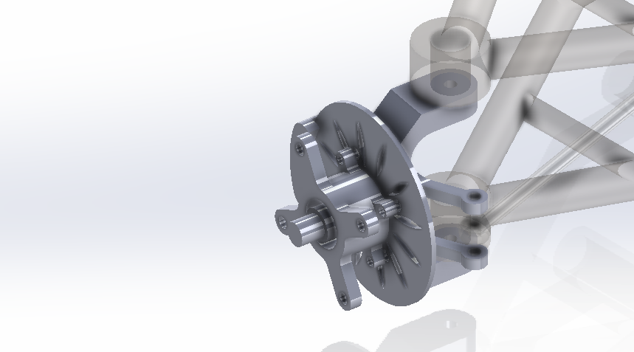
BRAKE SYSTEM (CAD)
Brake Caliper
Shaft
Hub
Brake Disk
Omer/ SAE Baja/10-15-2021

Slide 6
Engineering Requirements:
Sr. | Engineering requirement | Unit | Target value | Tolerance
1 | Track Width | inch | 60 | +2
2 | Able to carry driver weight | lb | <225 | +5
3 | Weight of vehicle | lb | 370 | +5
4 | Spring Compression | in | 4.5 | +0.5
5 | Braking Distance @ v=12.169 m/s | meters | 7 | +0.5
6 | Braking Time @ v=12.169 m/s | sec | < 5 | -
7 | Brakes Temperature | ºC | <100 | -
8 | Steering Degree | - | 30 | +5
9 | Speed detection accuracy | km/h | < 5 | -
10 | Display delay | ms | < 25 | +10
Musaed/ SAE Baja/10-15-2021

Slide 7
BRAKE SYSTEM (IMPLEMENTATION PLAN)
Motion Analysis
  Knuckle Design
  Caliper Design
  Fasteners
  Wheel and Rim
    For ground clearance and good visualization
Musaed/ SAE Baja/10-15-2021

Slide 8
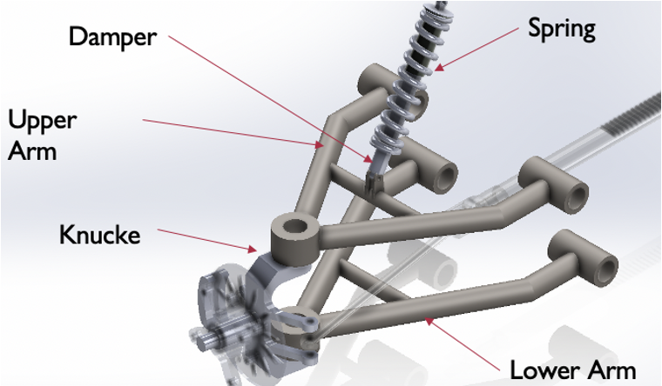
Design Description
• Suspension System Designed
• Lower Arm
• Upper Arm
• Shock absorber and spring
• Knuckle steering
Rashid/ SAE Baja/10-15-2021

Slide 9
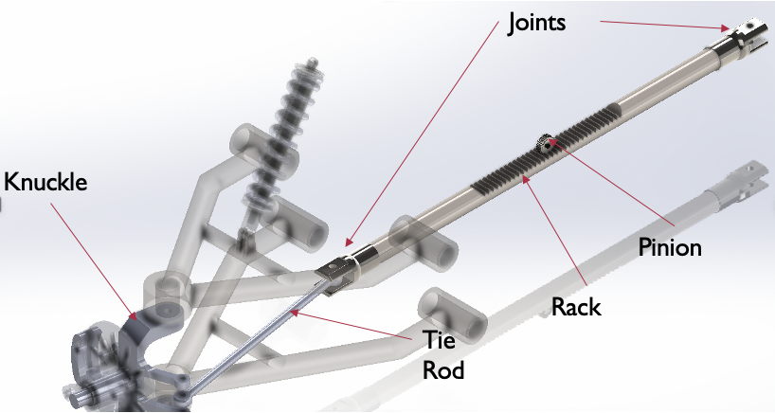
Design Description
• Steering
• Rack and pinion
• Tie Road
• Colum and wheel steering
Salem / SAE Baja/10-15-2021

Slide 10
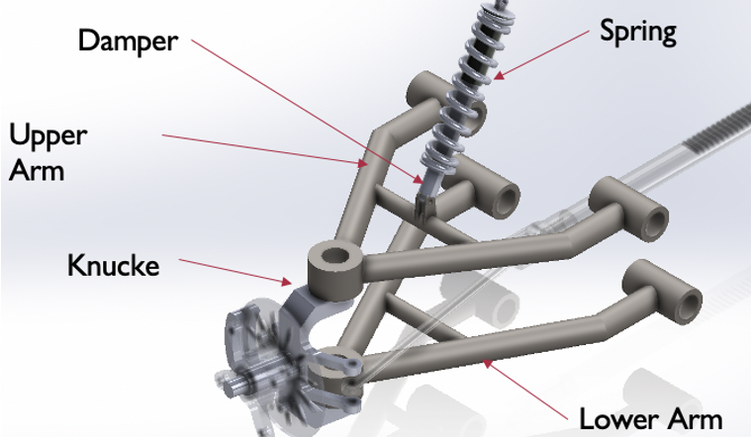
SUSPENSION SYSTEM (CURRENT STATE CAD )
• Suspension System Designed
• Analysis performed
• Force has been completed
• FEA performed to verify
Rahid/ SAE Baja/10-15-2021

Slide 11
SUSPENSION SYSTEM (IMPLANTATION PLAN)
• Analyzing the arms
• Analysis the Steering
FEA
Colum
Wheel steering
Salem / SAE Baja/10-15-2021

Slide 12

Dashboard (CURRENT STATE)
Sensor selection
Measurement method selection
Dashboard circuit design
  Arduino programming
  Schematic
Engineering Requirements met
Wang / SAE Baja/10-15-2021

Slide 13
Bill of Materials
Arduino board 5 $
LM393 IR speed sensor 2 $
Step motor and L298N module 3 $
LCD with I2C 5 $
A small wheel 0.5 $
Overall 15.5 $
Wang / SAE Baja/10-15-2021

Slide 14
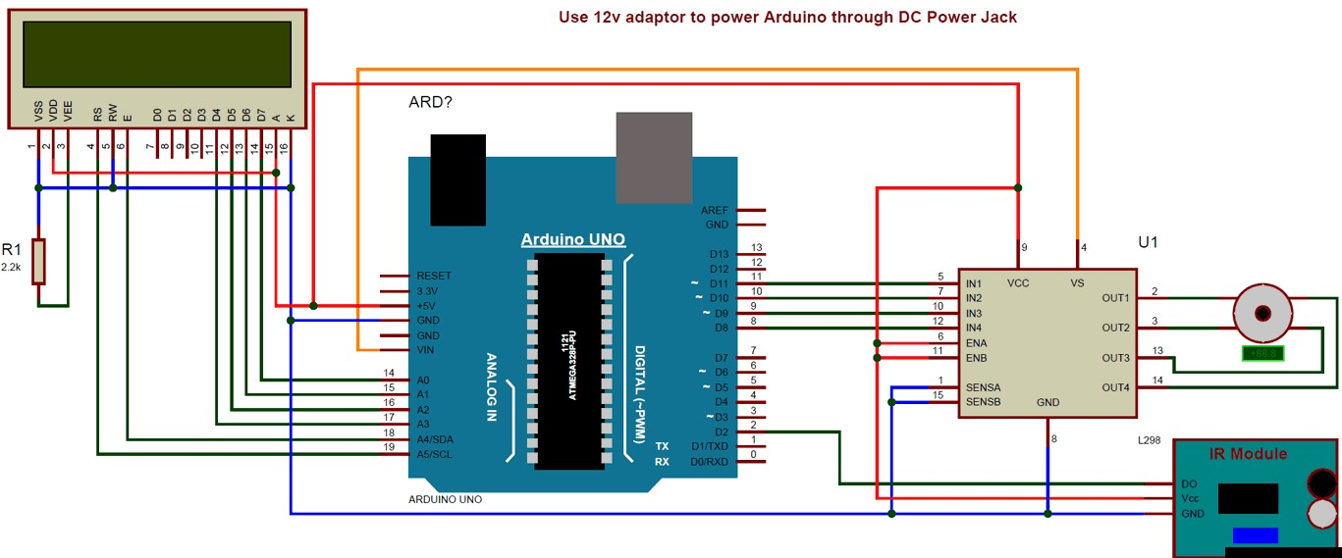
Dashboard (Schematic)

Slide 15
Dashboard (IMPLEMENTATION PLAN)
Sensor installation
The installation position of the sensor in the vehicle
Dashboard LCD display
The content displayed on the dashboard LCD
Display delay
Wang / SAE Baja/10-15-2021

Slide 16
FUTURE WORK OF SAE BAJA
Motion Analysis for Brakes
  Brake Pads
  Modification
    Brake Caliper
Musaed/ SAE Baja/10-15-2021

Slide 17
FUTURE WORK OF SAE BAJA
•Motion Analysis for Steering
• Steering Column
• Steering Wheel
• Rack and pinion
•Motion Analysis for Suspension
• Arms and shock absorber
Salem / SAE Baja/10-15-2021

Slide 18
FUTURE WORK OF SAE BAJA
The construction of imitation dashboard
  Stepper motor control
  Dashboard scale design
Wang/ SAE Baja/10-15-2021

Slide 19
FUTURE WORK OF SAE BAJA
Motion Analysis
  Brakes
  Suspension
  Steering
Final CAD Design
Modifications
  Brake Caliper
  Wishbones
  Rack
  Pinion
  Tie Rod
CAD (New)
  Ball Joints
  Chassis
  Steering Column
  Steering Wheel
Musaed SAE Baja/10-15-2021

Slide 20
ANY QUESTION?
Omer/ SAE Baja/10-15-2021

