Slide 1


Northrop Grumman Umbilical
Jonathan Armijo - Leah Blakney - Griffin Brandt - Jack Shields
November 3rd, 2021

Slide 2
Project Description
Client:
  Northrop Grumman
  Kaitlyn Barr – Northrop Grumman Mechanical Engineer
  Kevin Padilla – Northrop Grumman Sr. Department Manager
Background:
  Umbilical cables provide electrical power, communications, pressurized gasses, etc. to launch vehicles
  To avoid interference, it is important to retract these umbilical's
Goal:
  Design an umbilical retraction system to pull the umbilical away from the vehicle during launch
NG – 11/03/2021
Jonathan Armijo - 2

Slide 3

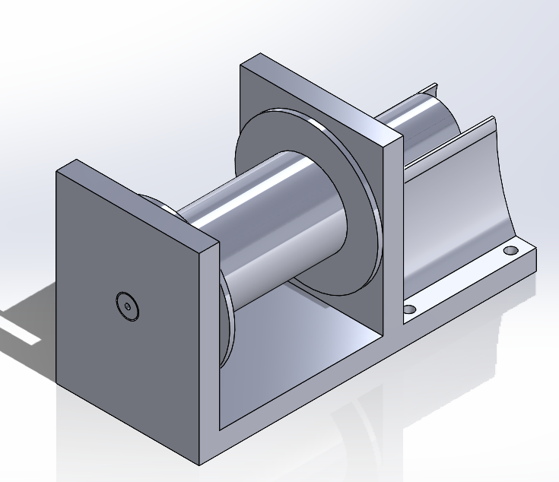
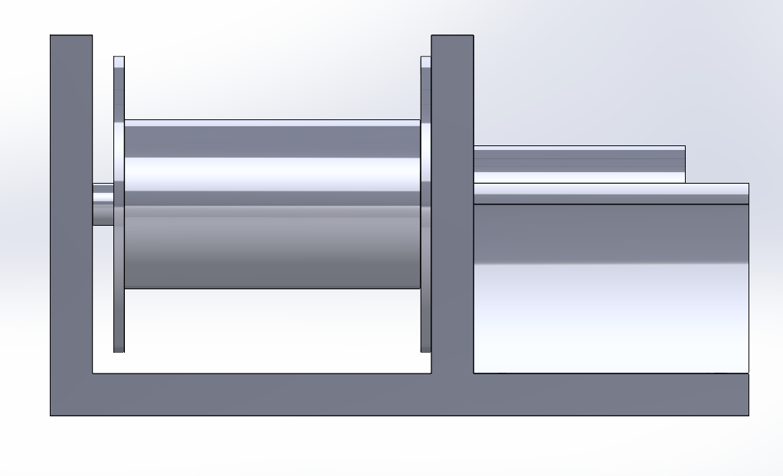
Design Description
Modeled for 1st Prototype
Scalable Design
Future Improvements
Figure 1: Isometric View Current Design
Better fastener positions
Lower center of Gravity
Gear reduction
Closer tolerances
Cost improvement
Figure 2: Side View Current Design
NG – 11/03/2021
Griffin Brandt - 3

Slide 4
Customer Requirements
High Manufacturability – minimal number of parts
High Reliability – prevent probability of malfunction through part selection
Easy Installation/Replacement – heavy but requires little to no replacement
High Durability – can withstand launch conditions
ESD Safe – materials used meet standards
NG – 11/03/2021
Leah Blakney - 4

Slide 5
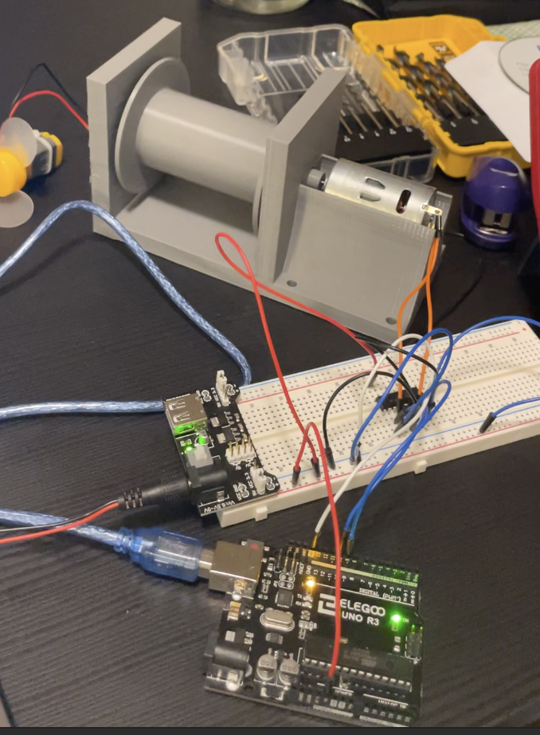
Engineering Requirements
Table 1: ER’s Over Time
ER | 1st Prototype | 2nd Prototype | Actual
Cost ($) | 70 | 1245 | 3754
Retraction Speed (ft/s) | Low, Approx. 2 | 6 | 6
Side Force (lb) | Low, Approx. 0.5 | 5 | 10
Temperature Limit (F), ref. | 374 [25] | 850 [26] | 5800 [27]
Weight (lb) | 0.5 | 60 | N/A
Retraction Length (ft) | 6 | 6 | 6
Success Rate (%) | 100 | 100 | 100
Figure 3: Working Prototype
NG – 11/03/2021
Griffin Brandt - 5

Slide 6
Failure Modes and Effects Analysis
Main Takeaways:
  Lots of dependence on input signal from microcontroller
    Actuation timing is essential
  Motor selection is crucial
    Too big and our design is inefficient
    Too small and we can't pull umbilical
  Lots of moving parts
    Proper maintenance guidelines will have to be established
    Thorough analysis to ensure proper fits
NG – 11/03/2021
Jonathan Armijo - 6

Slide 7
Testing Procedures
Initial Testing:
Retraction Speed
Cable Type
Heat Resistance
Final Testing:
Retraction Speed
Heat Resistance
Space:
Allows full extension of 6ft cable
Team members in safe proximity to testing zone
Equipment:
Our design
Supplemental parts
Stopwatch
Heat/Cooling source
Scale
Tape measure
Equipment:
Our design
Parts supplied by client
Stopwatch
Heat/Cooling source
Scale
Tape measure
NG – 11/03/2021
Leah Blakney - 7

Slide 8
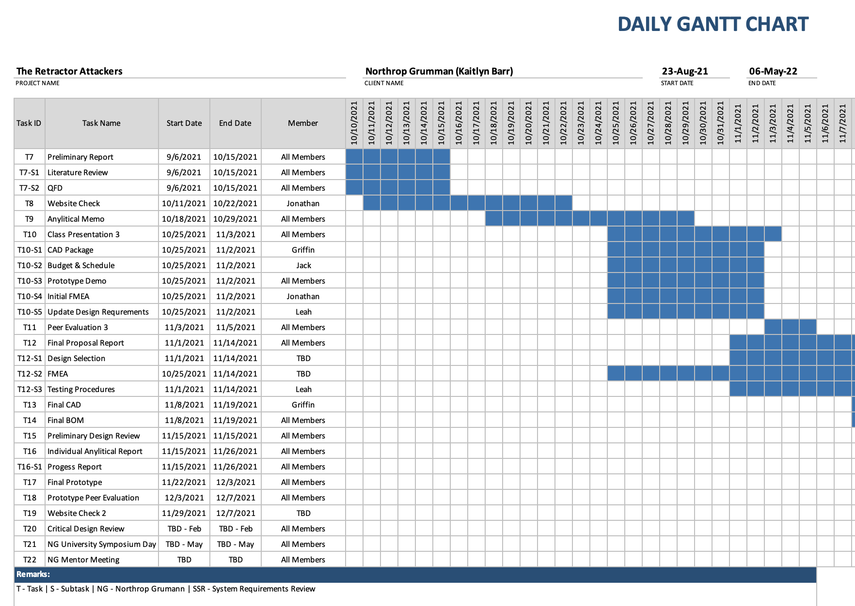
Schedule
NG – 11/03/2021
Figure 4: Partial Gantt Chart
Jack Shields - 8

Slide 9
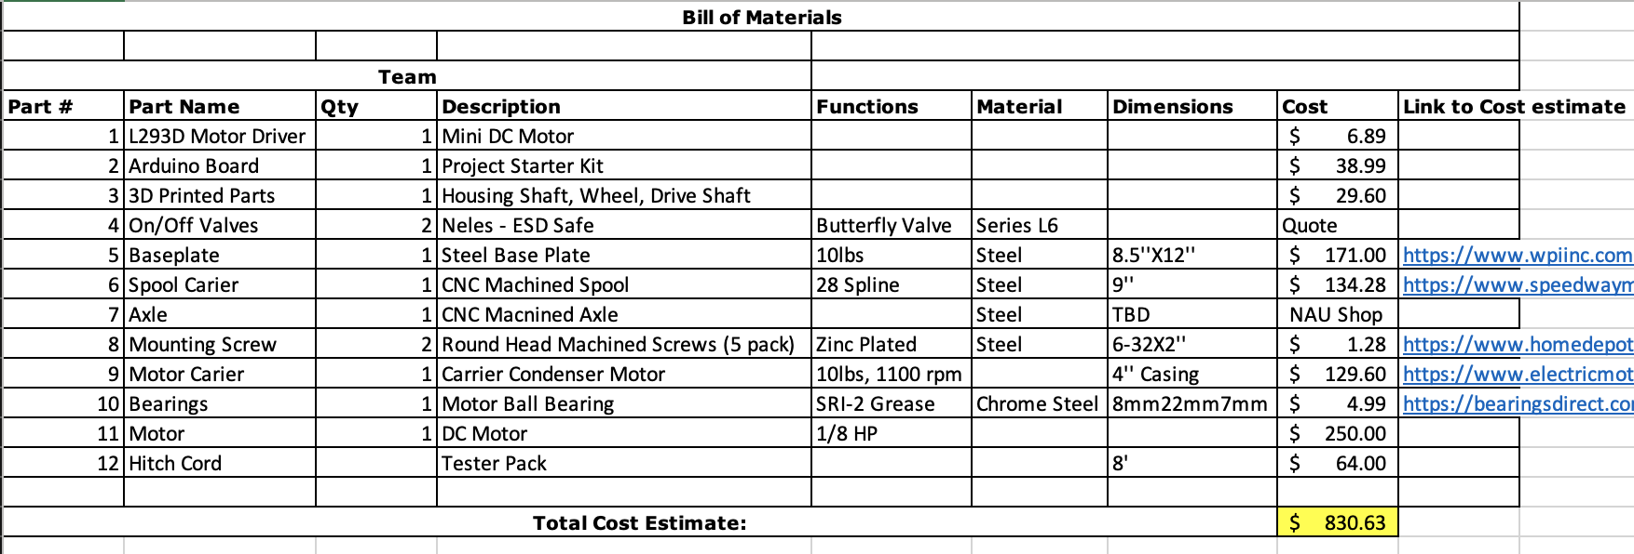
Bill of Materials
Table 2: Bill of Materials for Dog Leash Design
NG – 11/03/2021
Jack Shields - 9

Slide 10
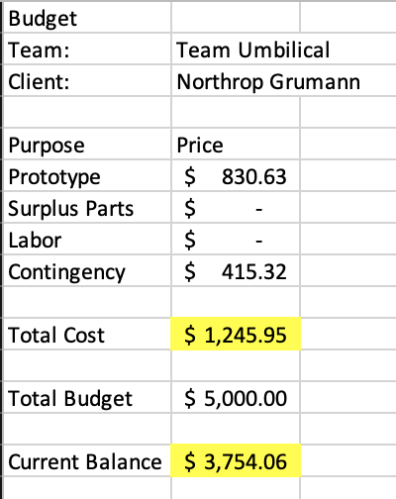
Budget
Table 3: Budget
NG – 11/03/2021
Jack Shields - 10

Slide 11
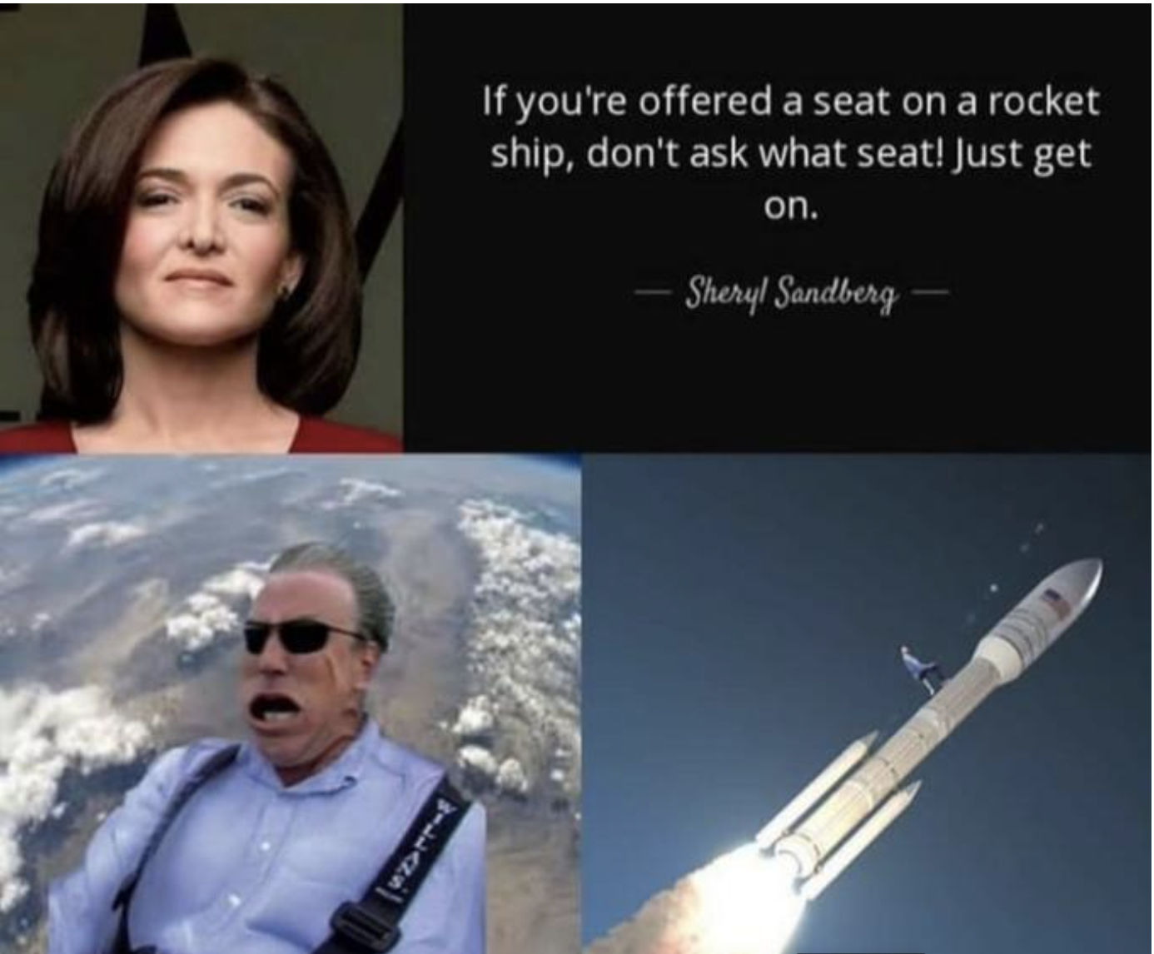
Questions?
Figure 6: Comedic Relief [28]
NG – 11/03/2021

Slide 12
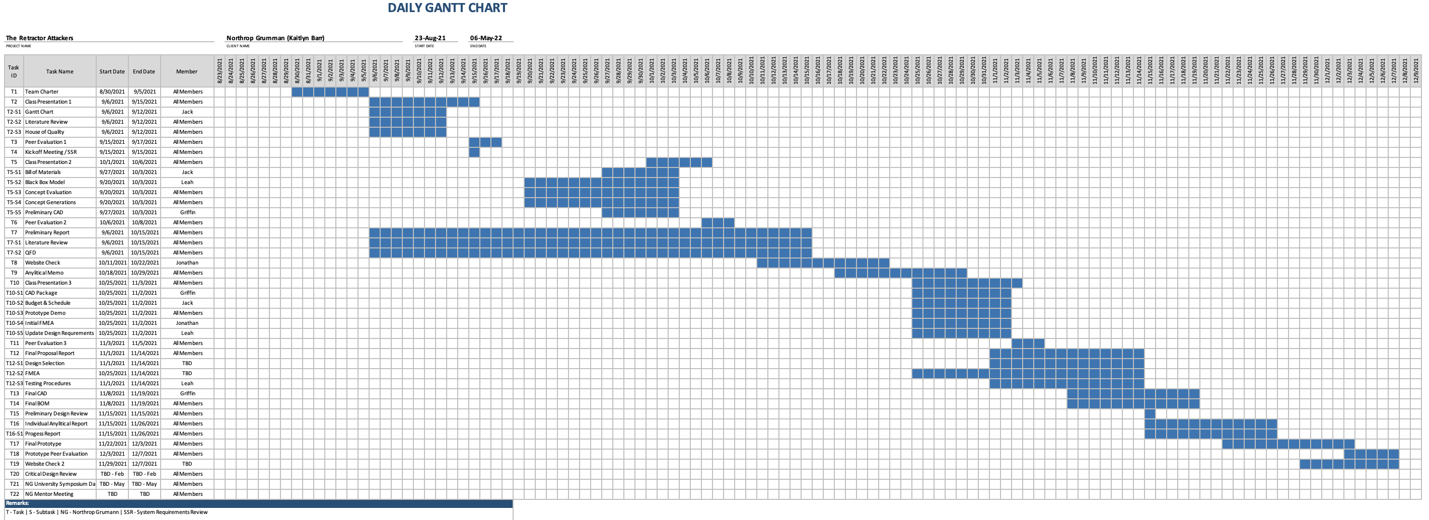
Appendix
Figure 7: ME476C Gantt Chart
NG – 11/03/2021

Slide 13
FMEA
Part # and Functions | Potential Failure Mode | Potential Effect(s) of Failure | Severity (S) | Potential Causes and Mechanisms of Failure | Occurrence (O) | Detection (D) | RPN | Recommended Action
Baseplate - Where all components will connect to and what will be mounted to tower. | Impact Fatigue | Erratic Operation, vibrations | 5 | Assembly errors, poor maintenance | 3 | 2 | 30 | Ensure that proper estimates are made for load
Spool Carrier/Housing - Responsible for supporting axle and spool. | Plastic Deformation | Appearance, possible tangling of cable | 3 | Overloading | 2 | 2 | 12 | Select material with high surface hardness. Maybe look into a guiding system for the cable
Axle - Motor driven rod that our spool will rotate about. | Yielding | Possible system failure depending of severity of bend | 4 | Overloading | 4 | 1 | 16 | Select material with high resistance to yielding
Motor - Used to convert electric energy to mechanical energy, in this case rotational | Burnout | Lots of heat, bad performance or even failure | 7 | Too little or too much voltage/current, overloading | 5 | 3 | 105 | Properly size motor by calculating possible loads with a reasonable factor of safety.
Gear Box - Will allow us to increase or decrease rotational speed and torque coming from the motor. Ensures stress isn't put directly onto motor. | Contact fatigue, abrasive wear | Noise, lower performance, cracking | 3 | Overloading, improper maintenance | 3 | 8 | 72 | Ensure that proper maintenance is well defined. May need lubrication from oil based on operating temperatures and interference
Mounting Screw - These screws will mount our baseplate to the launch tower. | Failure from lack of locking mechanism, Fatigue | Erratic operation, vibrations | 6 | Overloading | 2 | 4 | 48 | Jack will perform shear analysis for our mounting screws with reasonable factor of safety
Arduino Board - Microcontroller for motor | Electrical failure | System will not operate | 8 | Improper connections, manufacturers error | 4 | 6 | 192 | Jonathan will test Arduino board and programming to ensure everything runs okay. Look into voltage supplies.
Motor Carrier - Responsible for holding motor in place | Release | Erratic Operation, vibrations | 6 | Falty restraining systems, vibrations | 4 | 5 | 120 | Griffin will determine a way to fasten our motor to where little vibration is introduced into the system
L293D Motor Driver - Responsible for controlling the speed and direction of our motor. | Electrical failure | System will not operate | 8 | Improper connections, manufacturers error | 4 | 6 | 192 | Jonathan will test driver to ensure all points are working correctly
Bearings - Will be used to allow shaft to rotate, attached to spool carrier. | Fatigue Wear | Poor performance, erratic operation | 4 | Improper maintenance, Overloading | 2 | 8 | 64 | Ensure that proper maintenance is carried out. Possible lubrication. Ensure that correct loads are used.

Slide 14
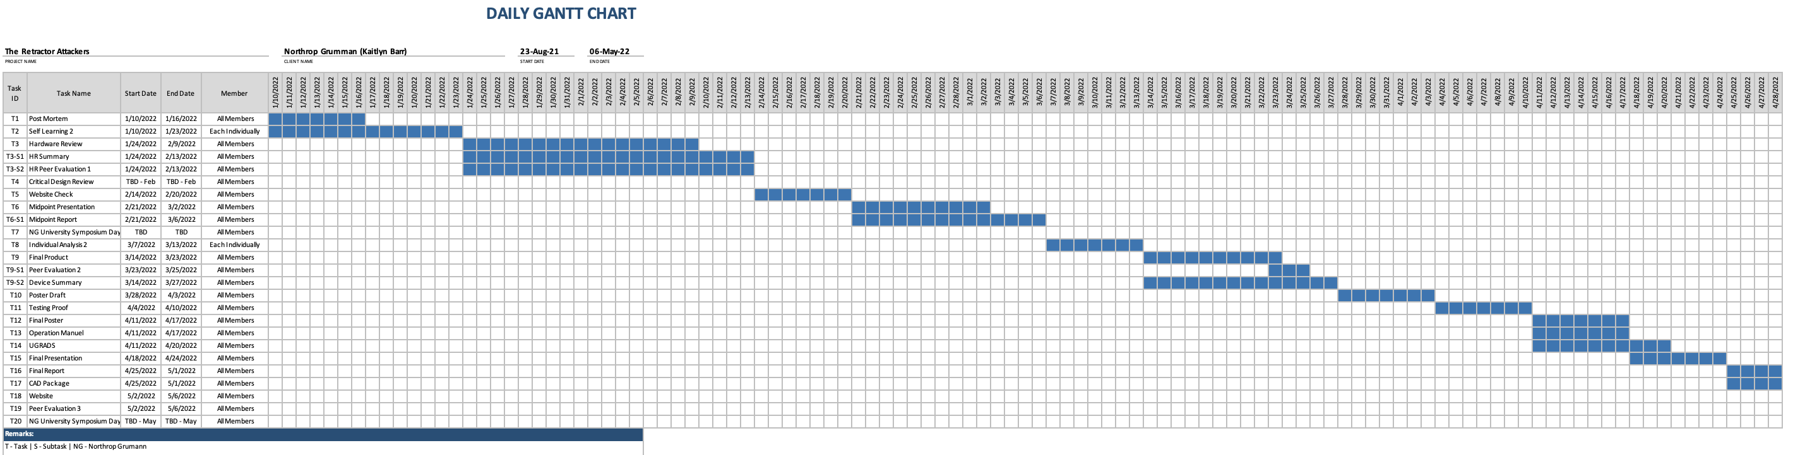
Appendix
Figure 8: ME486C Gantt Chart
NG – 11/03/2021

Slide 15
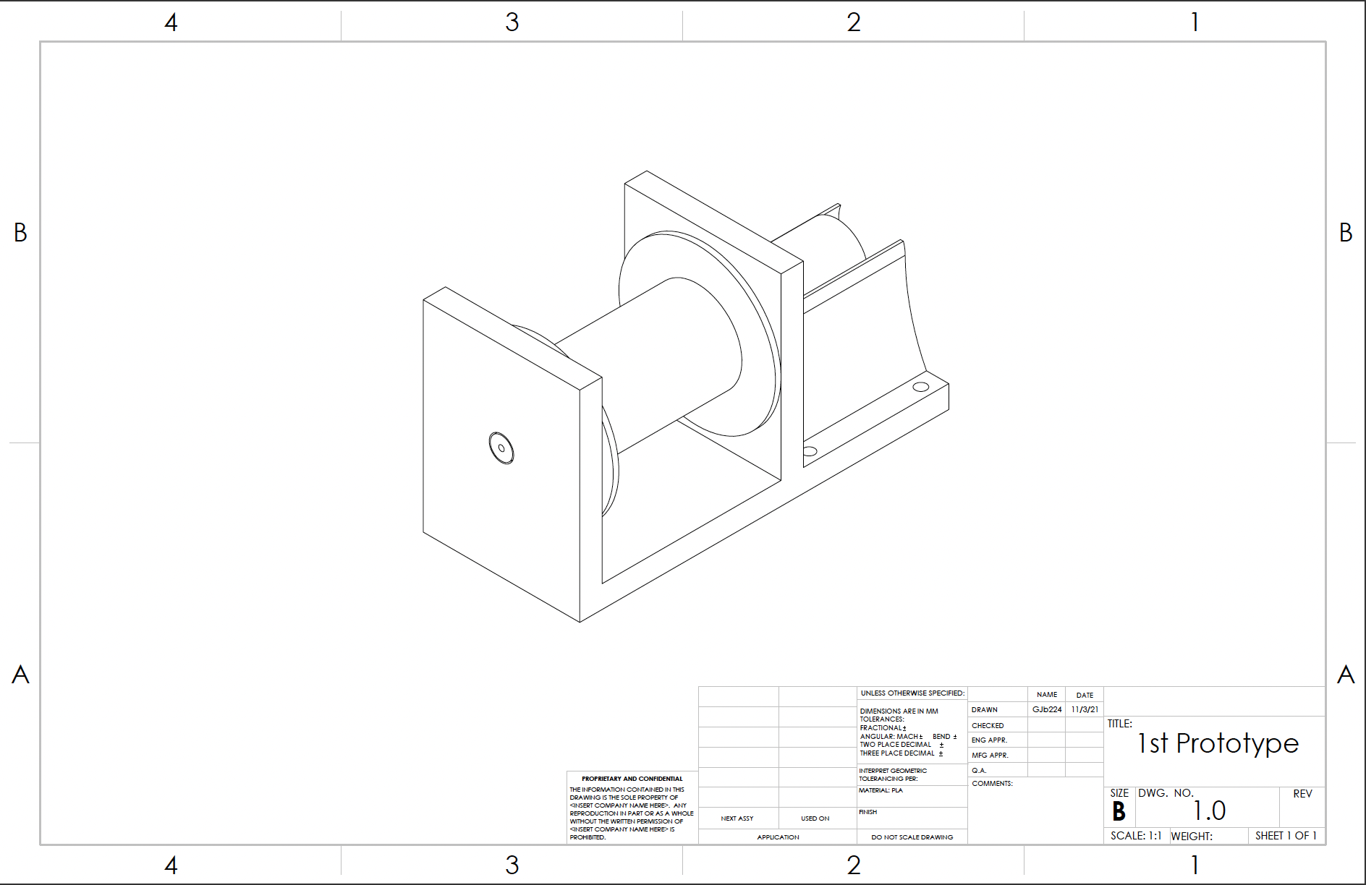
Appendix
Figure 9: Full Assembly

Slide 16
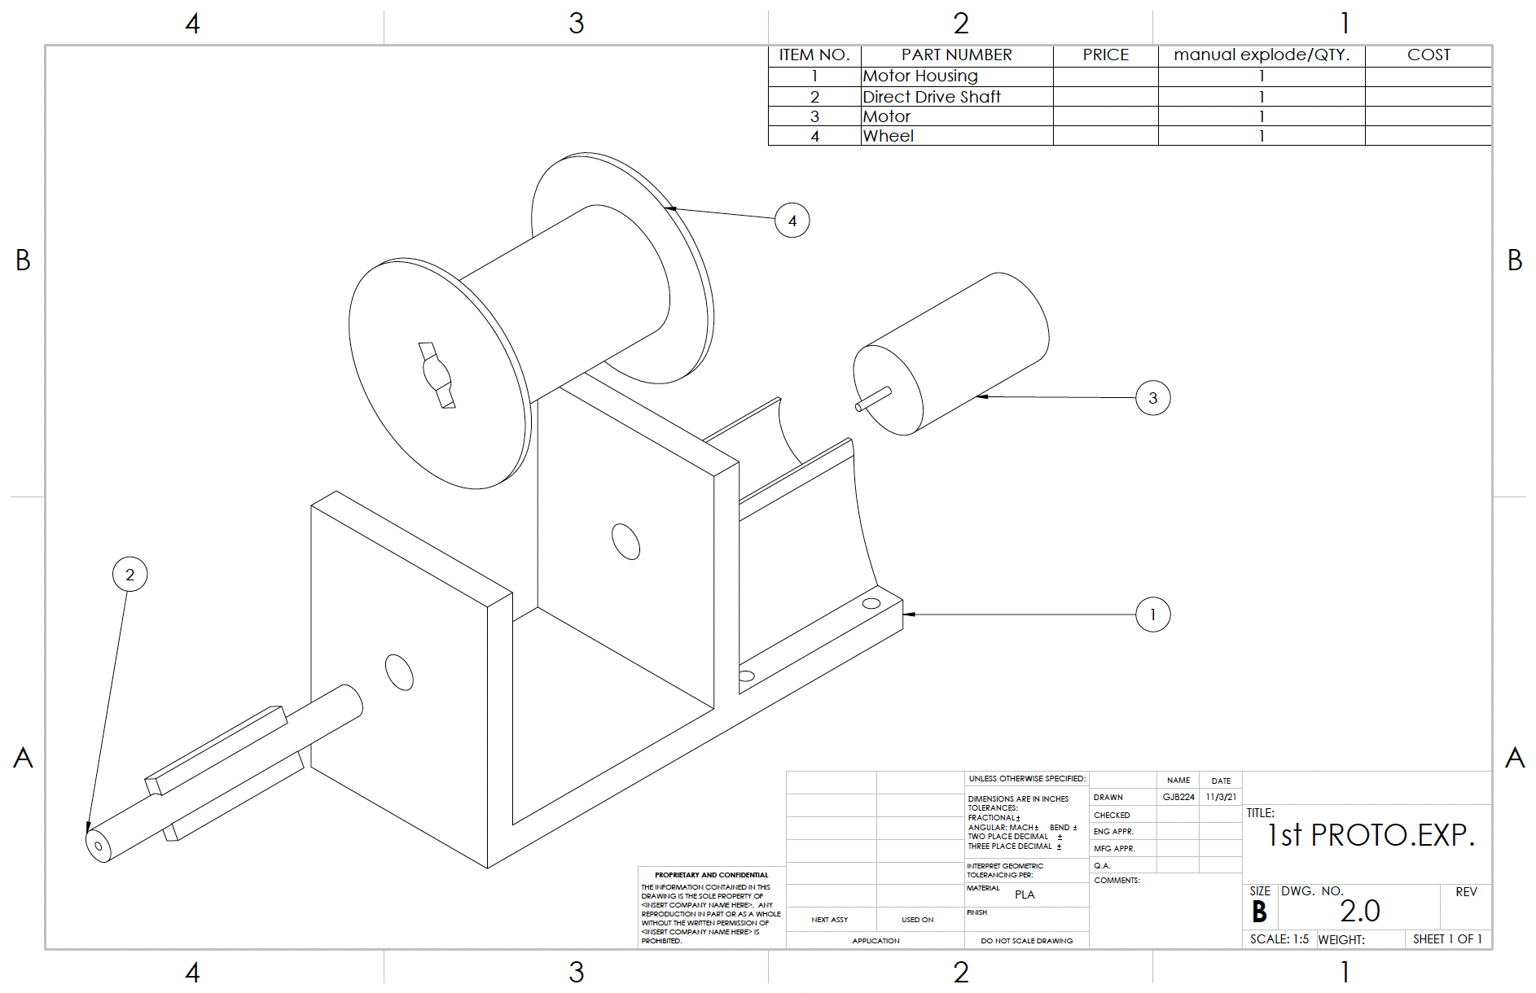
Appendix
Figure 10: Exploded Assembly

Slide 17
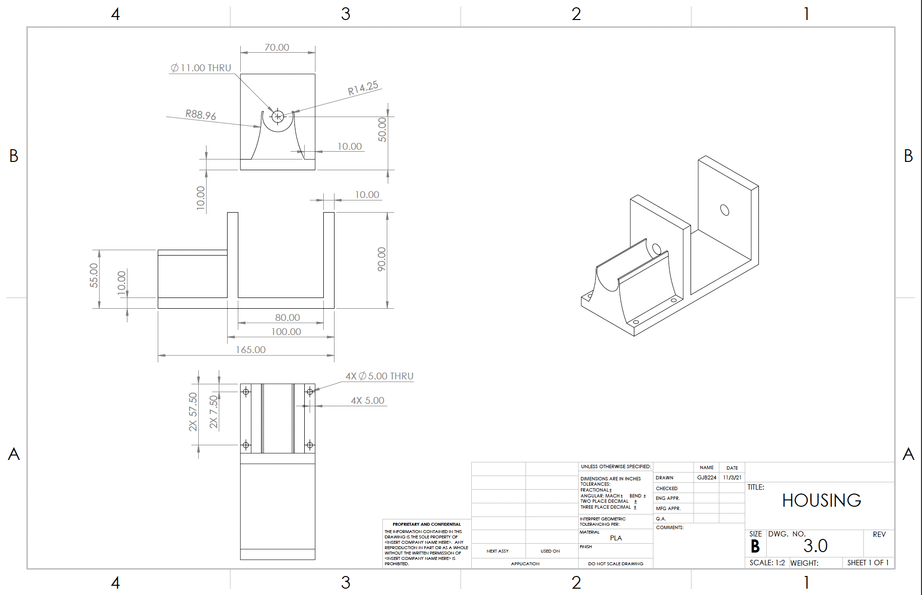
Appendix
Figure 11: Housing

Slide 18
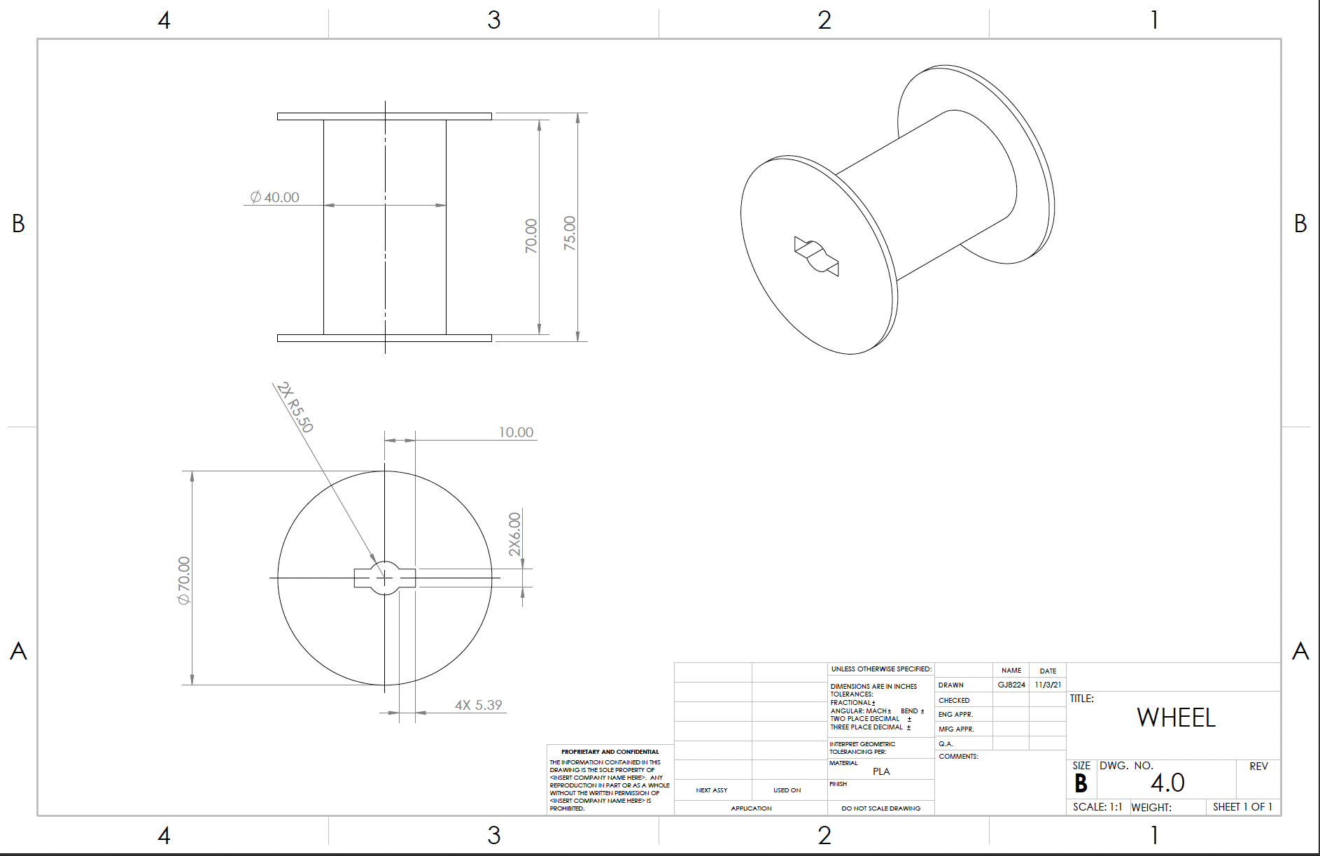
Appendix
Figure 12: Wheel

Slide 19
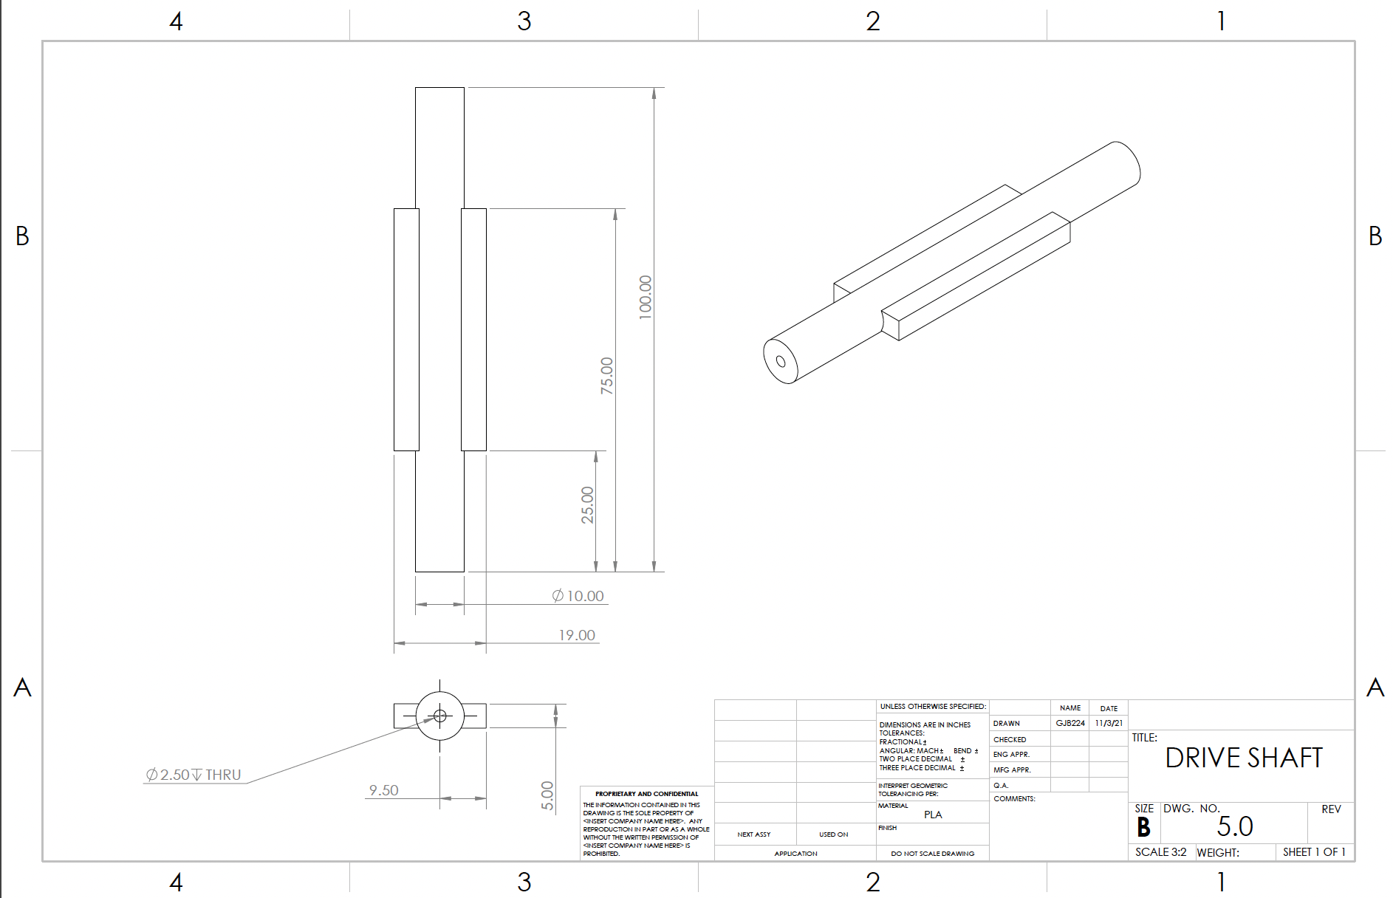
Appendix
Figure 13: Drive Shaft

Slide 20
References
[1] | S. E.P., "The use of INductive Wireless Power and Data Transfer System as Sounding Rocket Umbilical," Delft University , 2011. [Online]. Available: https://oatd.org/oatd/record?record=oai%5C%3Atudelft.nl%5C%3Auuid%5C%3A3321bfbe-f792-4a3d-b341-5ea9a492a1a8. [Accessed September 2021].
​[2] | ​S. Doroudgar, "Static and Dynamic Modeling and Simulation of the Umbilical Cable in a Tethered Unmanned Aerial System," Simon Fraser University , 17 June 2016. [Online]. Available: https://summit.sfu.ca/item/16604. [Accessed September 2021].
​[3] | ​D. C. Han Tao, "Adaptive Impredence Control of a Novel Automated Umbilical System for Propellent Loading," Harbin Institute of Technology , 11 August 2021. [Online]. Available: https://www.mdpi.com/1996-1073/14/16/4900/htm. [Accessed September 2021].
​[4] | ​A. Gosselin, "Technical Paper Session I-A- Automated Ground Umbilical Systems (AGUS) Project," Space Visions Congress , 2007. [Online]. Available: https://commons.erau.edu/cgi/viewcontent.cgi?article=3435&context=space-congress-proceedings. [Accessed September 2021 ].
​[5] | ​E. Boesiger, "41st Aerospace Mechanisms Symposium," NASA, 18 May 2021. [Online]. Available: https://core.ac.uk/reader/42739970#page=359. [Accessed Septmeber 2021].
​[6] | ​G. S. M. Alan C. Littlefield, "Design, Development,and Testing of Umbillical System Mechanisms for the X-33 Advanced Technology Demonstrator," NASA, U.S. Government, Kennedy Space Center, Merrit Island, FL, 1999.
​[7] | ​J. Bemis C. Tatum, "Rolling Beam Umbilical System," NASA, U.S. Government, Kennedy Space Center, Merritt Island, FL.
​[8] | ​G. J. T. P. M. William C. Manley, "Ares I Linear Mate Umbilical Plate and Collet," NASA, U.S. Government, Kennedy Space Center, Merritt Island, FL, 2012.
​[9] | ​B. G. Valentin Guinet, "ARES14BI “Hydra” - a two-stage experimental rocket project within the PRESEUS program," EUCASS Association, 2015.
​[10] | ​R. W. Calvert, "Umbilical Arms for the Saturn V Vehicle," IEEE Transactions on Aerospace, 1963.
​[11] | ​National Aeronautics and Space Administration, "Launch Complex 39, Pads A and B," NASA Facts, p. 8, 2004.
​[12] | ​Blue Origin, "Blue Origin New Shepard," Blue Origin, 2021. [Online]. Available: https://www.blueorigin.com/new-shepard/. [Accessed 8 2021].
​[13] | ​Tokai Spring, "Flat Sprial Springs," Tokai Spring, 2021. [Online]. Available: https://www.tokaibane.com/en/spring-design/flat-spiral-springs-formulas. [Accessed 9 2021].
​[14] | ​J. Tang, "Motor Sizing Basics," Oriental Motor, 17 January 2020. [Online]. Available: https://blog.orientalmotor.com/motor-sizing-basics-part-2-load-inertia?hsCtaTracking=95e3b5c5-570b-4403-9b54-aa346abde034%7C773a672a-9bbb-411d-ae39-0276910ef191. [Accessed 9 2021].
​[15] | ​R. G. Budynas, "Mechanical Engineering Design 11th Edition," McGraw Hill Education, 2020, pp. 681-791.
​[16] | ​R. J. Dalby, "V2 Rocket History," July 2019. [Online]. Available: v2rockethistory.com. [Accessed 9 2021].
​[17] | ​Nitra Pneumatics, "Pneumatic Cylinders," Nitra Pneumatics, 2020. [Online]. Available: https://cdn.automationdirect.com/static/press/nitra_cylinders_intro.pdf. [Accessed 9 2021].
​[18] | ​Conductix Wampfler, "Motor Driven Reels," Conductix Wampfler, 2021. [Online]. Available: https://www.conductix.us/en/products/motor-driven-reels. [Accessed 10 2021].
​[19] | ​NASA, "Artemis," NASA, 2021. [Online]. Available: https://www.nasa.gov/specials/artemis/. [Accessed 10 2021].
​[20] | ​R. Budyas and K. Nisbett, Shigley's Mechanical Engineering Design, vol. Eleven, McGraw Hill Education, 2020.
​[21] | ​D. Christensen, A. Lawrie and D. Zube, "Heroicrelics," Heroicrelics, [Online]. Available: http://heroicrelics.org/info/lut/mobile-launcher.html. [Accessed 14 October 2021].
​[22] | ​Department of Energy, Office of Science, "Science," Department of Energy, [Online]. Available: https://www.science.gov/topicpages/l/launch+umbilical+tower. [Accessed 14 October 2021].
​[23] | ​Z. Wang, D. Lan, T. Wang and B. Zhang, "Design of A Measuring Device and Winch Structure for Detecting the Distance of Two Seabed Pipelines," Marine Science and Engineering, 18 February 2020.
​[24] | ​American Society for Testing and Materials International, Form and Style for ASTM Standards, West Conshohocken, PA: ASTM International.

Slide 21
References Cont.
[25] | B. T. Lee Sin, "Injection Molding and Three-Dimmensional Printing of Poly(Latic Acid)," Science Direct, 2019. [Online]. Available: https://www.sciencedirect.com/topics/engineering/poly-lactic-acid. [Accessed 3 November 2021].
[26] | "High- Temperature Characteristics of Stainless Steel," Nickel Developement Institute , [Online]. Available: https://www.associatedsteel.com/does-heat-affect-steel/. [Accessed 3 Novemebr 2021].
[27] | Wikipedia, "Rocket Engine," Wikipedia, [Online]. Available: https://en.wikipedia.org/wiki/Rocket_engine. [Accessed 3 Novemeber 2021].
[28] | K. Your, "blasting off!," Know Your Meme, [Online]. Available: https://news.knowyourmeme.com/photos/1958576-tonight-on-bottom-gear. [Accessed 3 November 2021].

