Slide 1



Northrop Grumman Umbilical
The Retractor Attackers
Jonathan Armijo – Project Manager
Leah Blakney – Test and Manufacturing Engineer
Griffin Brandt – Design and Manufacturing Engineer
Jack Shields – Financial and Logistics

Slide 2
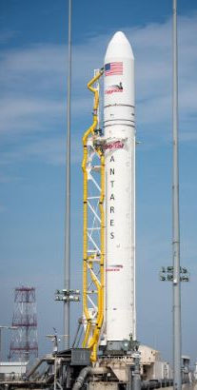
Client
Kaitlyn Barr – Mechanical Engineer, Space Systems
Northrop Grumman – Defining Possible
"We design, develop, build and support some of the world’s most advanced products, from cutting-edge aircraft and next-generation spacecraft to unrivaled cyber security systems and all-seeing radars."
9/15/2021 Leah Blakney - 2

Slide 3
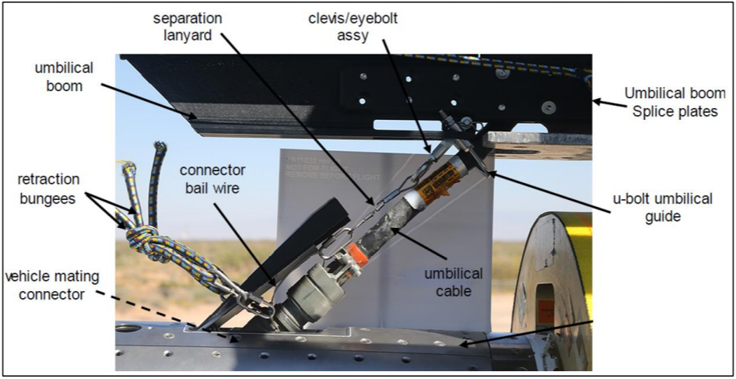
Project Description
Northrop Grumman Umbilical Retraction Mechanism
Umbilical
  Consists of cables and hoses
  Connect vehicle to Ground Support Equipment (GSE)
  Provides electrical power to vehicle
Retraction
  Pulls umbilical away from vehicle
  Prevents damage to vehicle during lift off
Figure 1: Umbilical diagram on vehicle

Slide 4
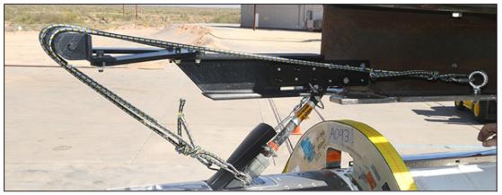
Background
Bungee cords currently used at Northrop Grumman to safely retract umbilical from craft
Applies side force which can affect takeoff in the event of detachment failure
Figure 2: Current Bungee Cord Assembly

Slide 5
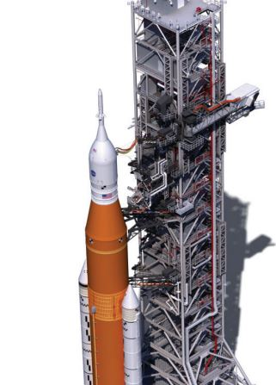
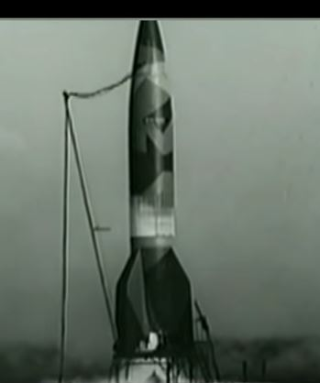
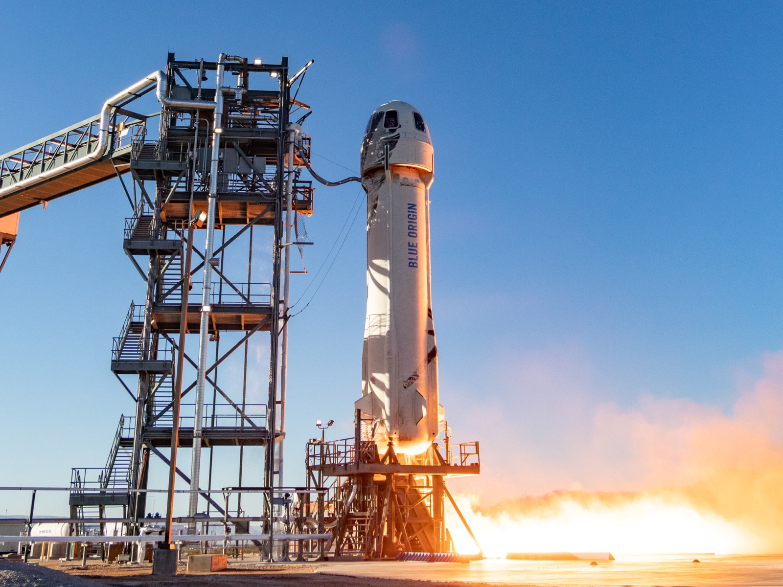
Benchmarking
NASA's Kennedy Launch Complex utilizes multiple swing arms and secondary retraction systems [10]
WWII German A4-V2 missiles used tall poles that would fall away after the umbilical separated [12]
Blue Origin's New Shepard had its umbilical retracted to the tower by a series of cables [11]
Figure 3: NASA [10]
Figure 4: GERMAN WWII [12]
Figure 5: BLUE ORIGIN [11]

Slide 6
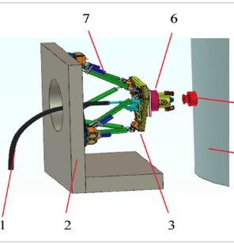
Literature Review
Presented by Tao and Cong; an in-depth study of the subsystems and actuators of an umbilical system for propellent loading. Excessive details about dynamic forces the cables may experience during the process. [1]
Smit proposed an idea to wirelessly transmit power to the rocket using an umbilical with magnetic cores surrounded by two coupling coils. Creates magnetic field that can store power to then be transferred. [2]
Gosselin created a review of different umbilical systems used in Saturn, Shuttle, X-33, and Atlas V rockets. [3]
NASA article of the review and design of the Ares 1 vehicle [4]
Figure 6: Subsystem of Propellent Umbilical [1]

Slide 7
Literature Review
Applied Thermal Engineering – Response of Reusable Launch Vehicle from temperature measurements [15]
Umbilical Cable Crushing Analysis - Numerical model for prediction of the stress and strain fields in the umbilical cable components [13]
Umbilical in Low Cycle Fatigue - Modeling flexible umbilical cable using a nonlinear finite element method to three-dimensional space [16]
Behavior of Umbilical - Mechanical behavior of core structure of an umbilical due to polymer material [14]

Slide 8
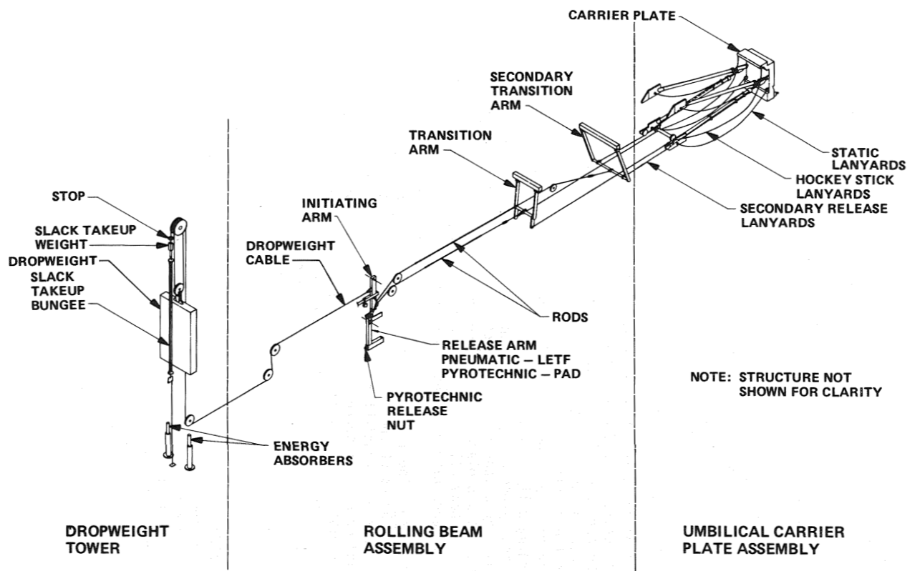
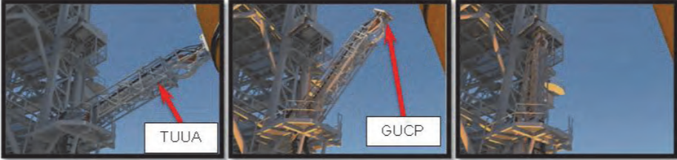
Literature Review
Ares I Linear Mate Umbilical Plate and Collet - Details the tilt up umbilical arm (TUUA) on Ares I Vehicle [8]
X-33 Advanced Technology Demonstrator – Details the design, development, and testing of umbilical system mechanisms [6]
Rolling Beam Umbilical System – Details RBUS of Centaur vehicle [5]
ARES14BI “Hydra” - Details the two-stage experimental rocket project within the PERSEUS program [7]
Figure 7: Tilt Up Umbilical Arm [8]
Figure 8: RBUS [5]

Slide 9
Literature Review
Mobile Launcher Tower Umbilical and Launch Accessories – Details the type of umbilical used in the NASA SLS rocket [9]
Launch Complex 39, Pads A and B – Details retraction system used at the Kennedy Space Center's Launch Complex [10]
Blue Origin New Shepard Rocket – Details about Blue Origin's rocket: New Shepard that recently was in the news [11]
History of the German A4- V2 Rocket – Explains the types of umbilical retraction systems used for V2 rockets [12]

Slide 10
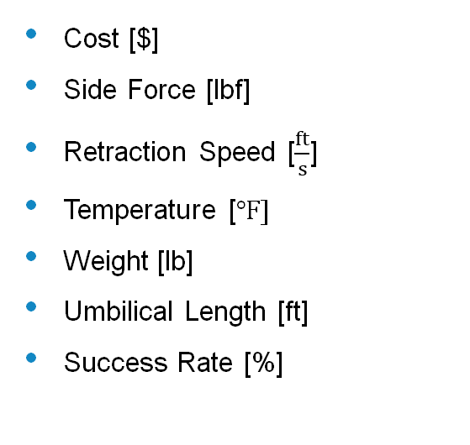
Engineering Requirements
Table 1: Engineering Requirement Evaluation
1 | Cost
2 | Side Force |  | 3
3 | Retraction Speed |  | 3 | 9
4 | Temperature |  | 1 | 0 | 1
5 | Weight |  | 9 | 9 | 3 | 0
6 | Umbilical Length |  | 0 | 9 | 9 | 0 | 9
7 | Success Rate |  | 9 | 3 | 9 | 9 | 1 | 3
Cost [$]
Side Force [lbf]
Retraction Speed [$\frac{ft}{s}$]
Temperature [$℉]$
Weight [lb]
Umbilical Length [ft]
Success Rate [%]

Slide 11
Customer Requirements
Table 2: Engineering and Customer requirements
 |  |  | Technical Req. |  |  |  |  |  |  | Customer Option Survey
 | Customer Needs | Customer Weights | Cost | Side Force | Retraction Speed | Temperature | Weight | Length | Success Rate (%) | 1. Poor | 2 | 3. Average | 4 | 5. Good
1 | High Manufacturability | 3 | 3 | 0 | 0 | 0 | 3 | 1 | 3 |  | A |  | C | B
2 | High Reliability | 5 | 3 | 9 | 9 | 3 | 3 | 1 | 9 |  | C |  | B | A
3 | Easily Installed/Removed | 4 | 1 | 0 | 0 | 0 | 9 | 3 | 3 | A | C |  | A | B
4 | High Durability | 4 | 9 | 9 | 9 | 9 | 3 | 9 | 9 | B |  |  |  | AC
5 | ESD Safe | 3 | 1 | 1 | 3 | 3 | 0 | 0 | 1 |  |  |  |  | ABC
 | Tech Req.Units |  | Dollars($) | Pounds (lbs) | Speed (ft/s) | Fahrenheit (F) | Force (lb/ft) | Feet (ft) | Success Rate (%)
 | Tech Req. Targets |  | 5000 | <10 | 6ft / 1s | -30F to 160F | 1lb / 1ft | 2ft to 6ft | 100
 | Absolute Tech. Importance |  | 67 | 84 | 90 | 60 | 72 | 56 | 105
 | Relative Tech Importance |  | 5 | 3 | 2 | 6 | 4 | 7 | 1
High Manufacturability
High Reliability
Easy Installation/Replacement
High Durability
ESD Safe
Table 3: Legend for Customer Option Survey
Legend
A | NASA Kennedy
B | WWII German
C | Blue Origin

Slide 12
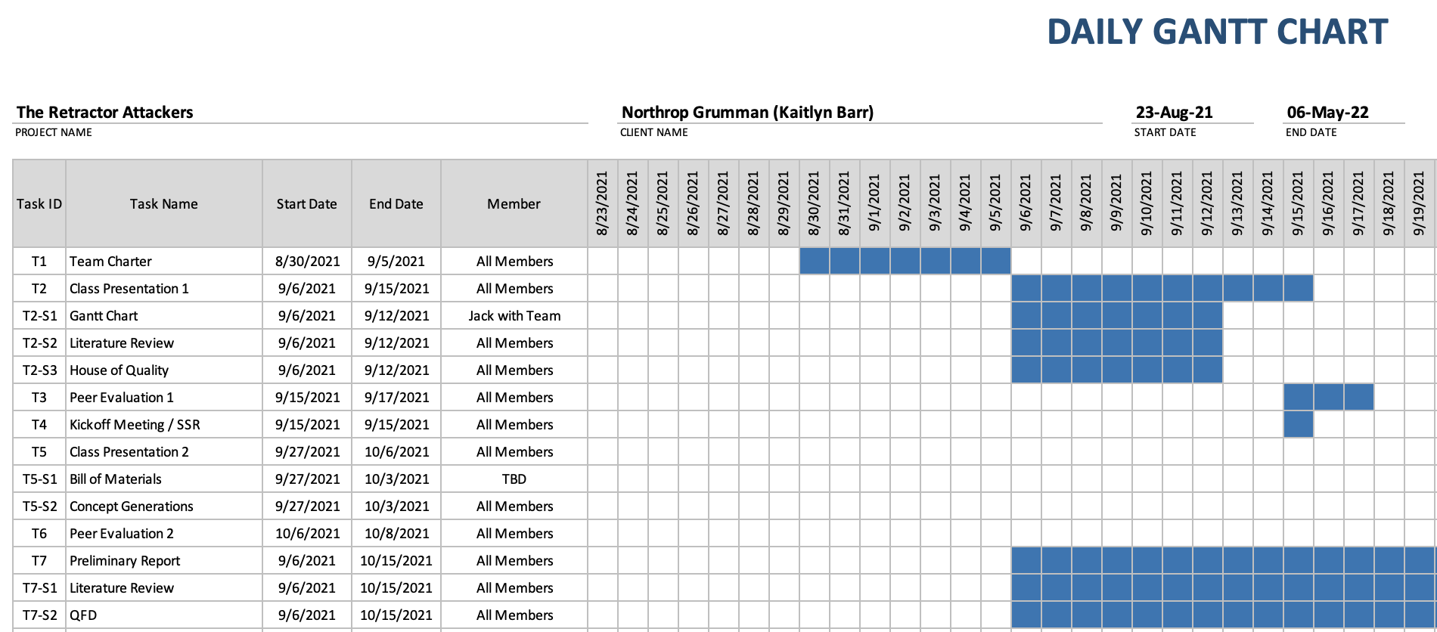
Schedule
Table 4: Gantt Chart for Previous and Current Assignments Until Presentation 2

Slide 13
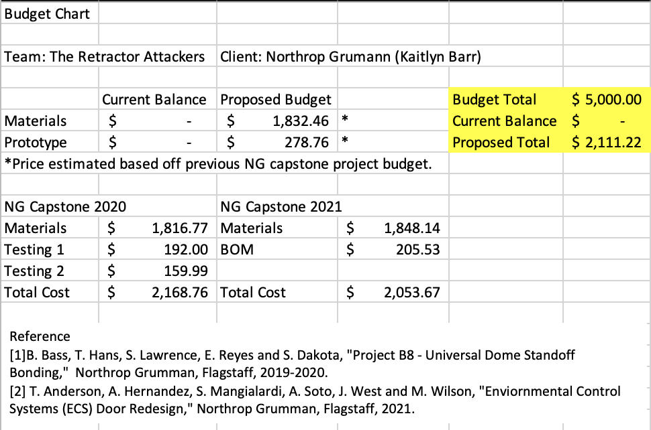
Budget
Table 5: Project Budget

Slide 14
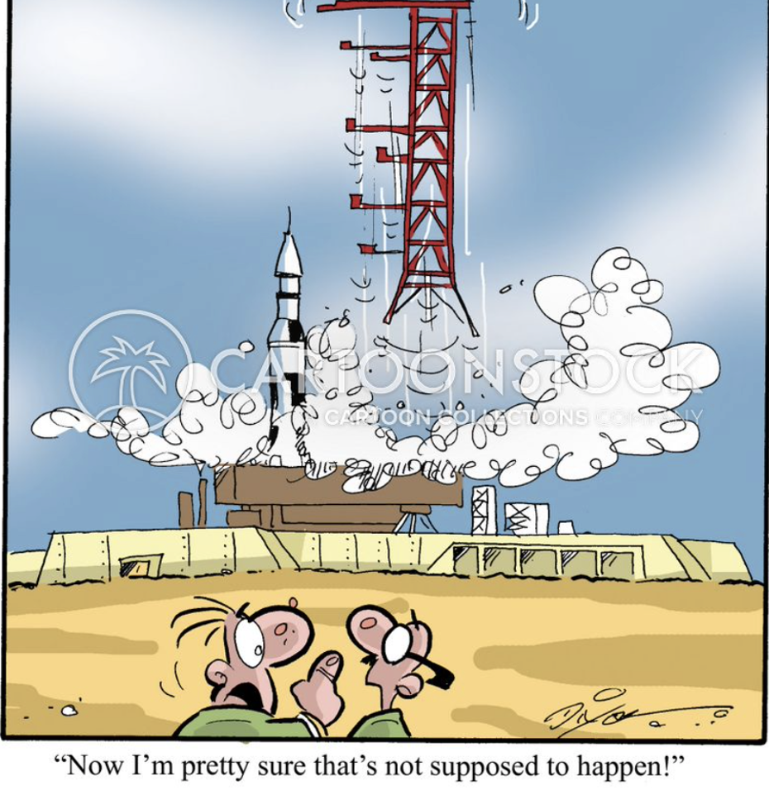
Questions?
Figure 9: Comedic Relief [17]
9/15/2021 The Retractor Attackers- 14

Slide 15
Appendix 1
Table 6: Full QFD
QFD
1 | Cost |  |  |  |  |  |  |  |  |  | Legend
2 | Side Force |  | 3 |  |  |  |  |  |  |  | A: NASA Kennedy
3 | Retraction Speed |  | 3 | 9 |  |  |  |  |  |  | B: WWII German
4 | Temperature |  | 1 | 0 | 1 |  |  |  |  |  | C: Blue Origin
5 | Weight |  | 9 | 9 | 3 | 0
6 | Umbilical Length |  | 0 | 9 | 9 | 0 | 9
7 | Success Rate |  | 9 | 3 | 9 | 9 | 1 | 3
 |  |  | Technical Req. |  |  |  |  |  |  | Customer Option Survery
 | Customer Needs | Customer Weights | Cost | Side Force | Retraction Speed | Temperature | Weight | Length | Success Rate (%) | 1. Poor | 2 | 3. Average | 4 | 5. Good
1 | High Manufacturability | 3 | 3 | 0 | 0 | 0 | 3 | 1 | 3 |  | A |  | C | B
2 | High Reliabilty | 5 | 3 | 9 | 9 | 3 | 3 | 1 | 9 |  | C |  | B | A
3 | Easily Installed/Removed | 4 | 1 | 0 | 0 | 0 | 9 | 3 | 3 | A | C |  |  | B
6 | ESD Safe | 3 | 1 | 1 | 3 | 3 | 0 | 0 | 1 |  |  | A | C B
 | Tech Req.Units |  | Dollars($) | Pounds (lbs) | Feet Per Second(ft/s) | Fahrenheit (F) | Pound Per Foot (lb/ft) | Feet (ft) | Success Rate (%)
 | Tech Req. Targets |  | 5000 | <10 | 6ft / s | -30F to 160F | 1lb / 1ft | 2ft to 6ft | 100
 | Absolute Tech. Importence |  | 67 | 84 | 90 | 60 | 72 | 56 | 105
 | Relative Tech Importance |  | 5 | 3 | 2 | 6 | 4 | 7 | 1
9/15/2021 The Retractor Attackers- 15

Slide 16
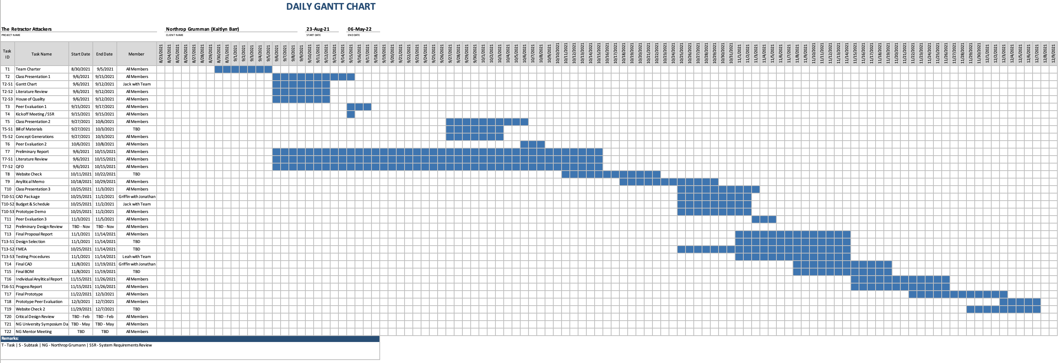
Appendix 2
Table 7: Full Project Schedule
9/15/2021 The Retractor Attackers- 16

Slide 17
References
[1] | H. T. D. Cong, "Adaptive Impedence Control of a Novel Automated Umbilical System for Propellent Loading," MPDI, 11 August 2021. [Online]. Available: https://www.mdpi.com/1996-1073/14/16/4900. [Accessed 8 September 2021].
[2] | S. E.P., "The Use of an Inductive Wireless Power and Data Transfer System as Sounding Rocket Umbilical," Delft University , 2011. [Online]. Available: https://oatd.org/oatd/record?record=oai%5C%3Atudelft.nl%5C%3Auuid%5C%3A3321bfbe-f792-4a3d-b341-5ea9a492a1a8. [Accessed 8 September 2021].
[3] | A. Gosselin, "Technical Paper Session I-A- Automated Ground Umbilical Sysrems (AGUS) Project," 27 April 2007. [Online]. Available: https://commons.erau.edu/space-congress-proceedings/proceedings-2007/april-27-2007/9/. [Accessed 9 September 2021].
[4] | E. Boesiger, "41st Aerospace Mechanisms Symposiums," NASA, 18 May 2021. [Online]. Available: https://core.ac.uk/reader/42739970#page=359. [Accessed 8 September 2021].
[5] B. C. T. Jr., "Rolling Beam Umbilical System," NASA, U.S. Government, Merritt Island, FL.
[6] G. S. M. Alan C. Littlefield, "Design, Development,and Testing of Umbillical System Mechanisms for the X-33 Advanced Technology Demonstrator," NASA, U.S. Government, Merritt Island, FL, 1999.
[7] B. G. Valentin Guinet, "ARES14BI “HYDRA” – A TWO-STAGE EXPERIMENTAL ROCKET PROJECT WITHIN THE PERSEUS," EUCASS Association, 2015.
[8] G. J. T. P. M. William C. Manley, "Ares I Linear Mate Umbilical Plate and Collet," NASA, U.S. Government, Merritt Island, FL, 2012.
[9] National Aeronautics and Space Administration, "Mobile Launcher Tower Umbilicals and Launch Accessories," NASA, October 2019. [Online]. Available: https://www.nasa.gov/sites/default/files/atoms/files/fs-2018-02-250-ksc-ml_umbilical_fact_sheet.pdf. [Accessed September 2021].
[10] National Aeronatucis and Space Administration, "NASA Facts: Launch Complex 39, Pads A and B," NASA, March 2004. [Online]. Available: https://www.nasa.gov/pdf/110689main_LC39.pdf. [Accessed September 2021].
[11] Blue Origin, "Blue Origin New Shepard," Blue Origin, 2021. [Online]. Available: https://www.blueorigin.com/new-shepard/. [Accessed September 2021].
[12] R. J. Dalby, "V2 Rocket History," V2 Rocket History, 24 February 2019. [Online]. Available: https://v2rockethistory.com/. [Accessed September 2021].
[13] R. C. Hibbeler, "Engineering Mechanics," in Dynamics, Chicago, Prentice Hall, 2012.
9/15/2021 The Retractor Attackers- 17

Slide 18
References 2
[13] | C. Santos, C. Pesce, R. Salles, G. Franzini and R. Tanaka, A Finite Element Model for Umbilical Cable Crushing Analysis, vol. Pipeline and Riser Technology, St. John's, Newfoundland: ASME 2015 34th International Conference on Ocean, Offshore and Artic Engineering, 2015.
[14] | W. C. Quan, Z. Y. Zhang, A. Q. Zhang and Q. F. Zhang, Three-Dimensional Dynamic Behavior of the Flexible Umbilical Cable System, vol. Applied Mechanics and Materials, D. Hoxha, Ed., Trans Tech Publications, 2013, pp. 225-229.
[15] | S. Kumar and S. P. Mahulikar, Reconstruction of aero-thermal heating and thermal protection material response of a Resuable Launch Vehicle using inverse method, vol. Applied Thermal Engineering, Applied Thermal Engineering, 2016, pp. 344-355.
[16] | Z. Yang, Q. Su, S. Wu, Y. Mao, Q. Lu and H. Wang, Study on the nonlinear mechanical behavior of an umbilical under combined loads of tension and torsion, vol. Ocean Engineering, Harbin: Harbin Engineering University, 2021.
[17] | C. Stock, "Cartoon Stock," [Online]. Available: https://www.cartoonstock.com/directory/c/cape_canaveral.asp. [Accessed 12 September 2021].
9/15/2021 The Retractor Attackers- 18

