Slide 1


Human Powered
Vehicle Competition
Capstone 2020
Team Members: Anu Alujjage, Allison Bedrin, Ryan Podell, Samantha Robbins, Sebastian Ruvalcaba and Paolo Quattrociocchi
Team Client: Perry Wood

Slide 2
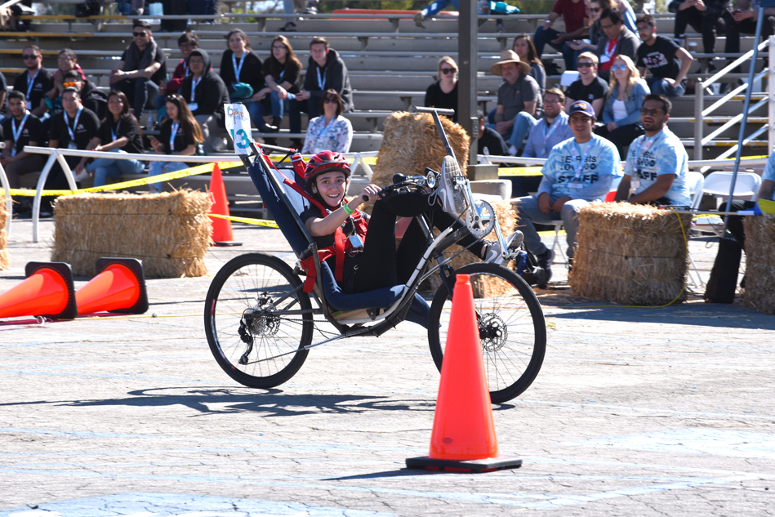
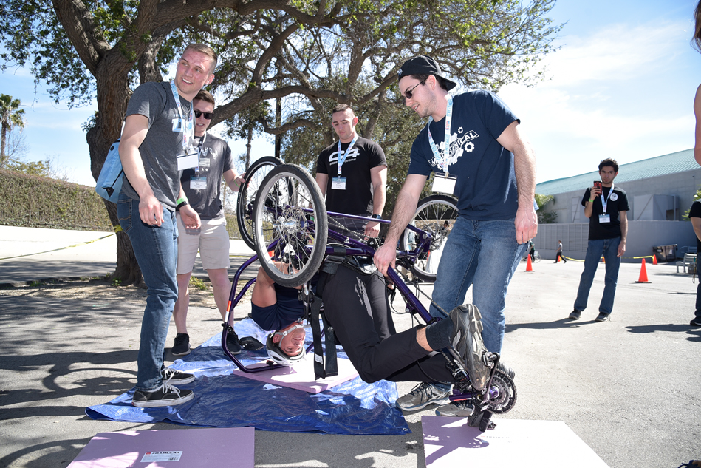

Project Description
Sponsored by the American Society of Mechanical Engineers (ASME)
Objective:
  Students use sound engineering principles to create a sustainable, innovative and safe vehicle.
Problem Solved:
  Bringing human powered transportation to underdeveloped or inaccessible parts of the world while also creating a more sustainable mode of transportation.
Events:
  Design
  Endurance
  Men and Women’s Speed
Notes:
Sponsorship is important due to the amount of networking opportunities the organization can bring to students. This is becoming a world known competition and allows for students a unique addition to their resume and to stay connected to the mechanical engineering community after college.
The HPVC allows students to create and build an innovative mode of transportation by being able to use years of past research to compare upon. There are several events, allowing the students to base their design off of each of them. A final report will be submitted and initial testing of the vehicle will be done to ensure the riders safety throughout the competition. These vehicles can go up to about 40 mph.

Slide 3
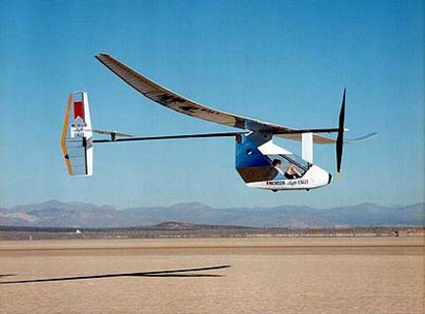
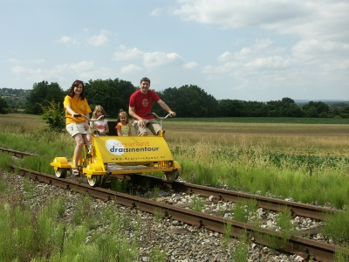
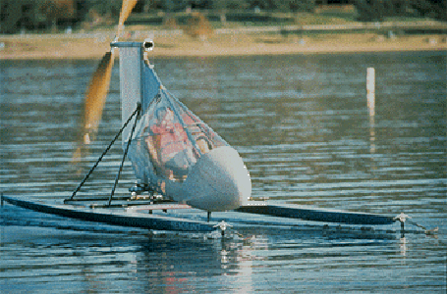
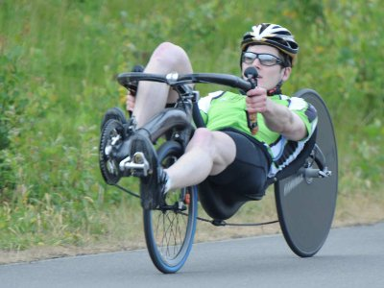
Background/Current State of the Art
Human Powered Vehicle (HPV): Vehicle that is powered only by muscular strength. [1]
HPV Categories: [1]
  Land
    Bicycles
    Velomobiles
  Water
    Canoes
    Row Boats
    Pedal Boats
    Submarines
  Rail
    Pedal Trains
  Air
    Airplanes
    Balloons
    Helicopters
Figure 1.1: HPV Aeroplane
Figure 1.2: HPV Pedal trains
Figure 1.3: HPV Pedal Boats
Figure 1.4: HPV Bicycle

Slide 4
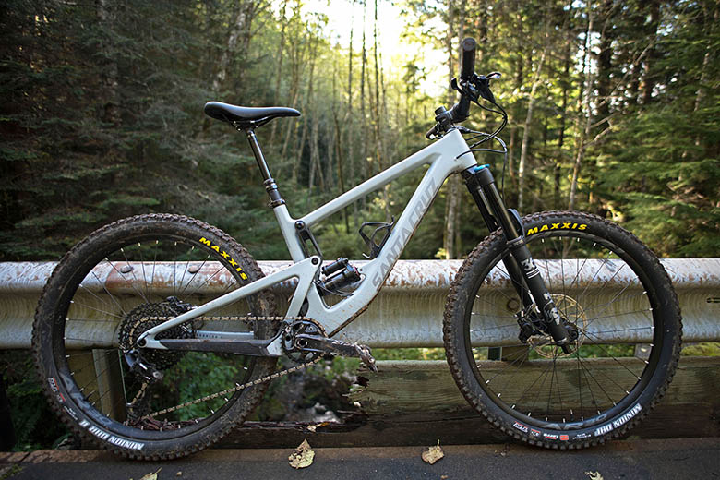
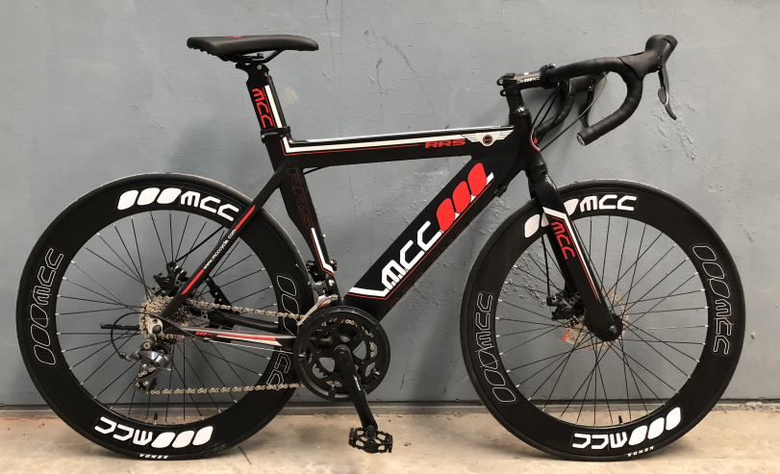
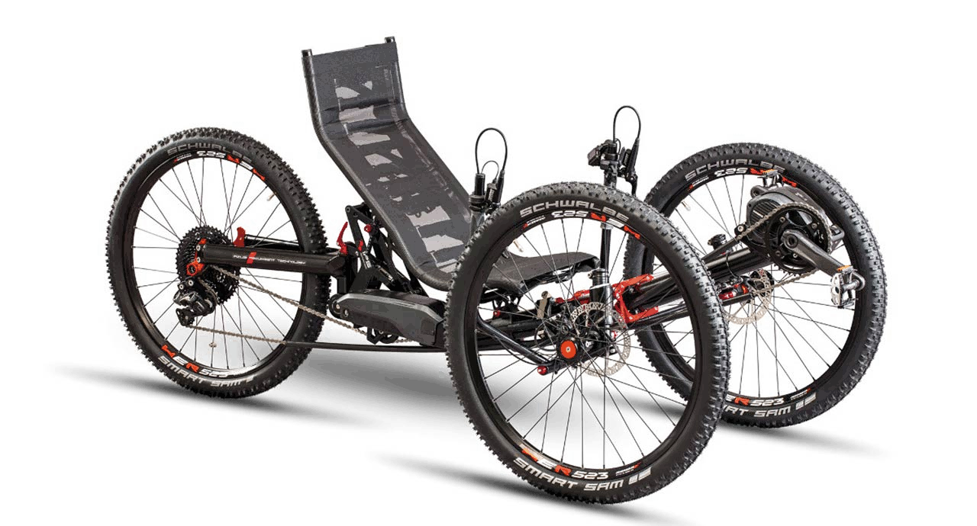
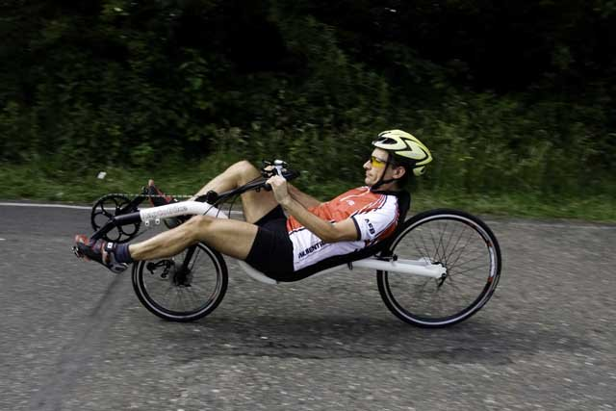
Background/Current State of the Art Cont.
Focus: Land HPV (Bicycle)
Current Solutions:
  Upright Bicycle
  Recumbent Bicycle
    2 Wheel and 3 Wheel Tricycle
Figure 1.5: 2 wheel Upright
Figure 1.6 : 2 wheel upright
Figure 1.7: Recumbent Tricycle
Figure 1.8: 2 wheel Recumbent

Slide 5
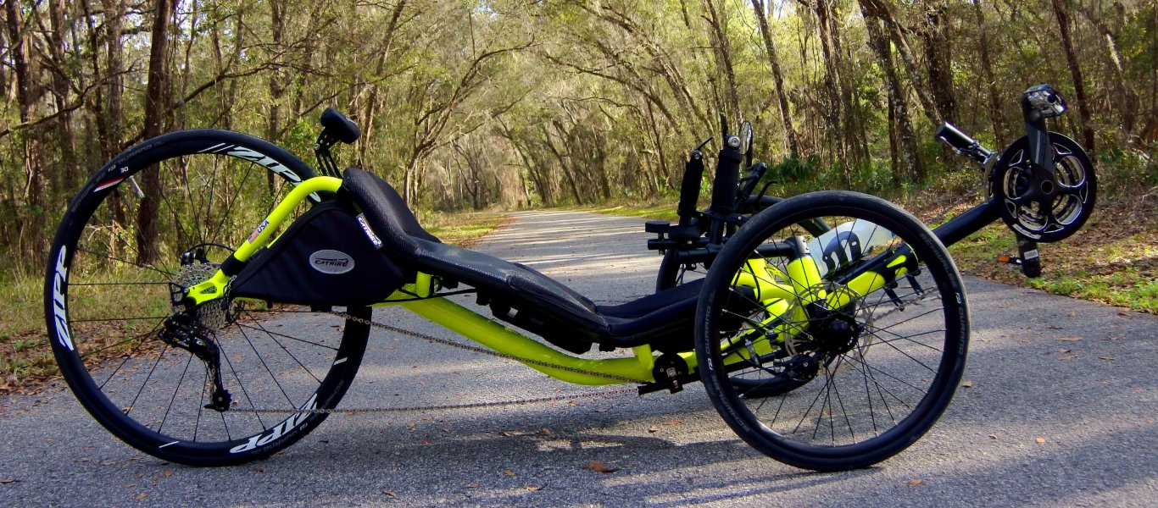
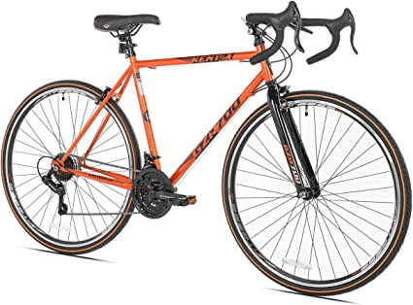
Background/Current State of the Art Cont.
Figure 1.9: 2 wheel upright
Figure 1.10 : 2 wheel Recumbent
Upright [2,4]
Pros
Power
Balance Flexibility
Inexpensive
Cons
Back Strain/Fatigue
Higher Injury Risk
Uncomfortable
Recumbent [3,4]
Pros
Comfort
Speed
Safety
Cons
Weight
Power
Visibility

Slide 6

Customer Requirements
Design, prototype, test, and manufacture an ASME HPV
  High speed
  High strength-to-weight ratio
  Maneuverable
  Cargo space
  Unobstructed view
  Safety
  Aerodynamic

Slide 7
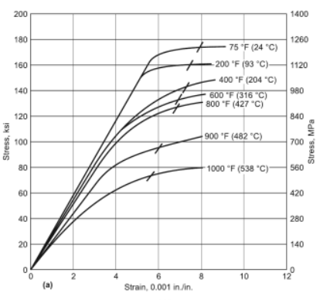
Engineering Requirements
Optimal turning radius (feet)
Effective gearing (input vs output RPM)
Lightweight design (pounds)
Top speed 45 miles per hour (mph)
Ensure safety of rider (ksi)
Adjustable (inches)
Figure 1.11: Stress vs Strain graph

Slide 8
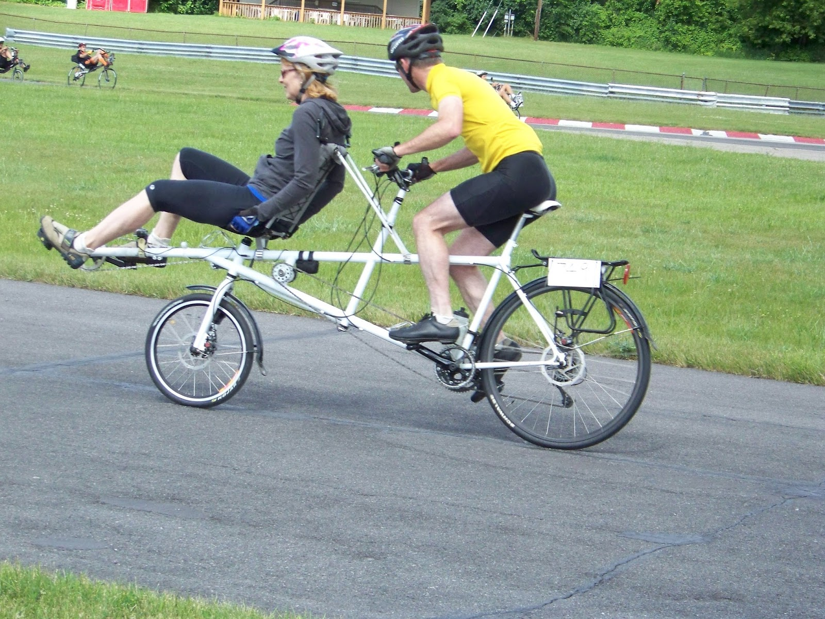
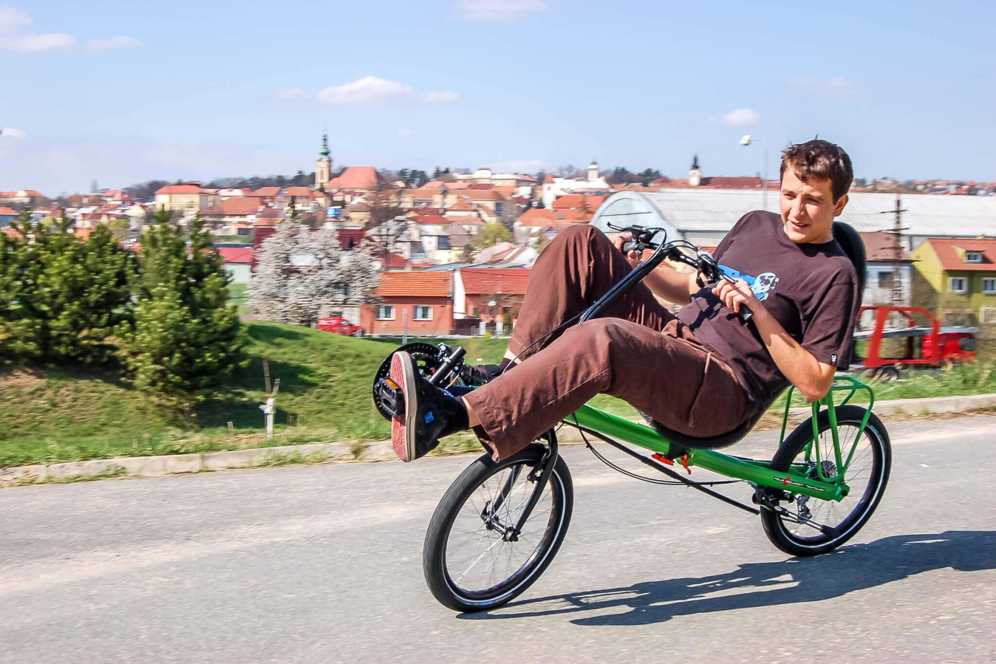
Concept Generation
Concept Selected
Single rider
Two wheels
Recumbent
Selection Method- mainly through decision matrices
Other Concepts
Three wheels
Tandem
Upright
Training Wheels
Figure 1.12: Tandem, 2 Wheel, Recumbent/Upright
Figure 1.13: Single Rider, 2 Wheel, Recumbent
Notes:
The generated concepts sections for the HPVC design are as the following: rider count, rider position, and wheel count.
The generated concepts for the number of riders are a single rider and dual rider also known as a tandem design. After researching into the speed and weight difference between a single and tandem design, we found that there was not a significant difference in speed. Thus, the team went with a single rider design to keep the it lighter and simpler.
Next, the generated concepts for the rider position involve following a upright, recumbent, and a laying down position. The upright position, most commonly used in bicycles, allows the rider to quickly gain speed when starting from a standstill. Next, the recumbent position decreases chances of rollover when braking due to the lower center of gravity. In addition, this allows the rider comfort while cycling for extended periods of time. Lastly the laying down position allows the rider to reach high speeds depending on the fairing and drag forces. However, this position is not comfortable for extended periods of time and decreases oxygen intake. Therefore, the team voted for a recumbent position design.
Finally, the concept for the wheel count is between 2 and 3 wheel designs. The 2-wheel design allows the rider to lean into turns and avoid braking / losing speed. On the other hand, the three-wheel design allows the rider to mount from a stationary position and include options for an Ackerman Angle (which allows the design to decrease its turning radius). In all, the team voted for a 2-wheel design that allows the possibility of adding training wheels for balance and innovation aspects.
After discussions, research, and previous knowledge of riding bicycles, the team voted to have a single rider, recumbent, 2-wheel HPVC with the option of training wheels.

Slide 9
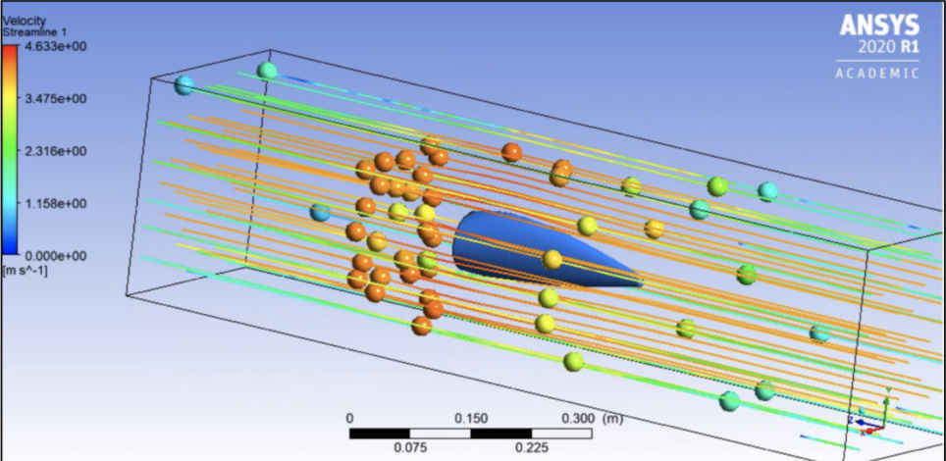
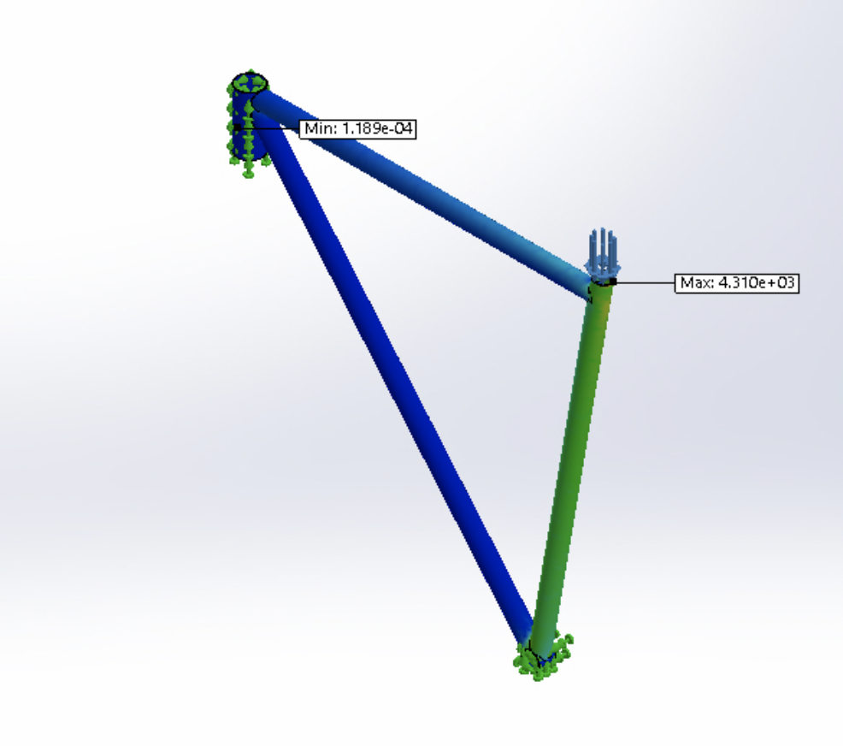
Skills Acquired
  FEA Simulations
  Ansys Fluent
  Design for manufacturing and costing tools on SolidWorks
  Advance SolidWorks Techniques
  SolidWorks design tables and equations
  SolidWorks toolbox
  Skills for the future: Manufacturing and Assembly
Figure 1.14 : Air flow over a fairing
Figure 1.15 :FEA analysis for a frame
Notes:
FEA simulation skills can be used to determine the peak stresses, deflections and to analyze if any part of the design has a chance of failing before the fabrication process.
Fluent software was used to carry out aerodynamics analysis on different fairing designs to determine which design gives the best Coefficient of drag, Coefficient of lift and to see the air flow patterns around the fairing. This information can be used to design a fairing that has lower drag and can attain a higher speed
Design for manufacturing and costing tools on Solidworks were used to estimate the price of parts with instant feedback as you change them. This is a very useful skill that can help the team to save money when choosing material and manufacturing
Advance Solidworks Techniques include weldments, toolbox and the hole wizard. This skill can be used to sketch and connect square tubes with welds, for adding holes into parts and use standard nuts and screw bolts to assemble parts together.
Some skills gained from the design tables and equations were creating different variations of parts, writing code for solidworks equations, suppressing/unsuppressing states and features .This technique can be applied to determine different wheel sizes the HPV can have
The toolbox feature can used to identify different types of nuts/bolts and to customize them depending on the requirements such as putting them on gears , bike seats and handlebars before purchasing them.
The team will also need to acquire manufacturing and assembly skills in the future that will help us to build the vehicle

Slide 10
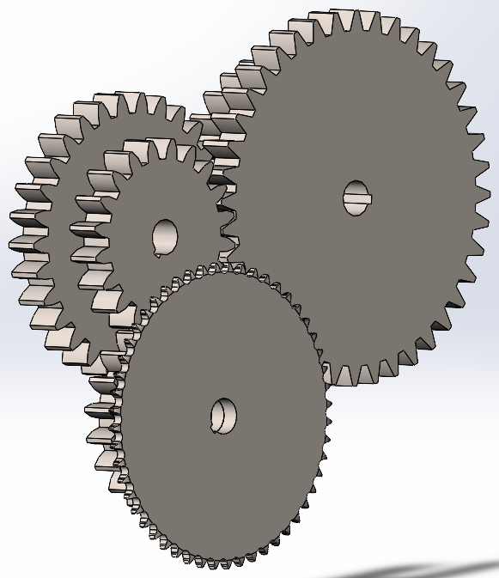
Concept Evaluation
Prototyping fairing in wind tunnel
2 Frame designs, 60" and 80"
Recumbent, 2-wheel, single rider
2-speed transmission attached to standard bicycle gear train allowing for double the output speed when desired
Figure 1.16: Gear Train

Slide 11
Any Questions?

Slide 12
References
"World Human Powered Vehicle Association," [Online]. Available: http://www.whpva.org/hpv.html. [Accessed 14 July 2020].
"If Fit Fitness Magazine," 2 April 2020. [Online]. Available: https://if-fit.com/recumbent-vs-upright-bike/. [Accessed 14 July 2020].
J. Andersen, "Bicycling Life," Bicycling Life Website, 16 August 2011. [Online]. http://www.bicyclinglife.com/PracticalCycling/FancyBikes.htm#:~:text=Knee%20Stress&text=On%20the%20upright%20you%20can,the%20pedals%20%2D%20and%20your%20knees.. [Accessed 14 July 2020].
T. Hadland and H.-E. Lessing, Bicycle Design, Cambridge, Massachussetts: The MIT Press, 2014.
"Rules for the 2021 Human Powered Vehicle Challenge," [Online]. Available: https://efests.asme.org/competitions/human-powered-vehicle-challenge-(hpvc). [Accessed 15 July 2020].

