Slide 1

Human Powered ​
Vehicle Competition​
Capstone 2020​
Team Members: Anu Alujjage, Allison Bedrin, Ryan Podell, Samantha Robbins, Sebastian Ruvalcaba and Paolo Quattrociocchi​
Team Client: Perry Wood​

Slide 2
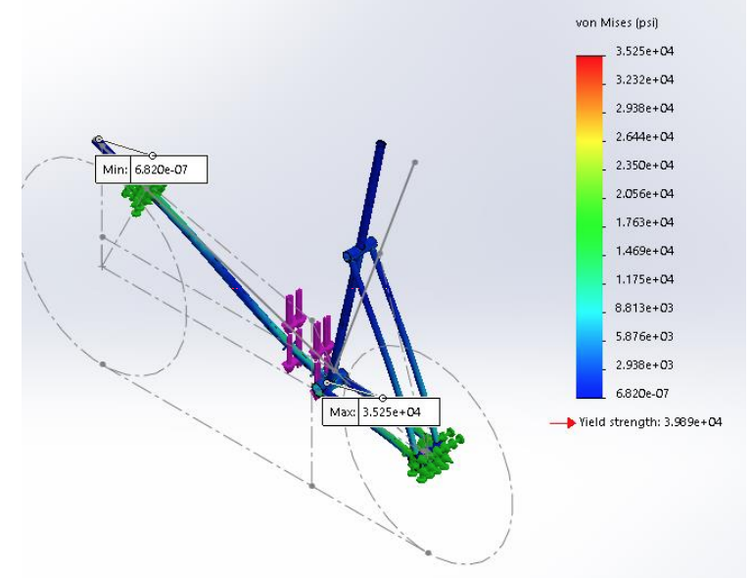
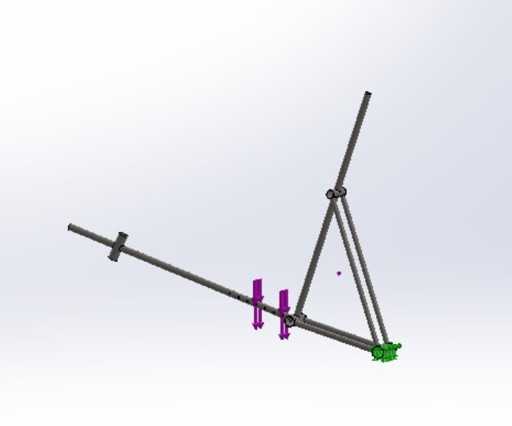

CAD Model and/or Computational Output
Figure 1.1 : FEA simulations on the frame
Preliminary frame design with FEA simulation
Yield FOS: 1.6

Slide 3
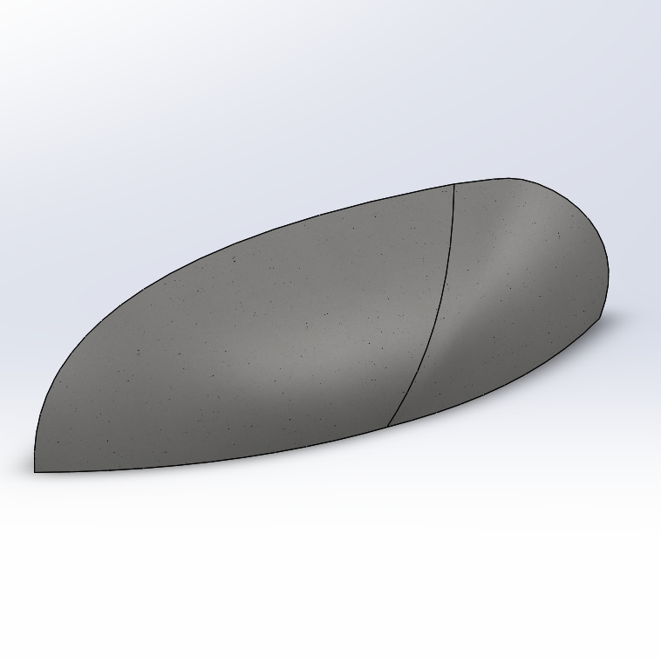
Proposed Fairing Design
Fairing types: partial and full
Selected fairing : Fully enclosed
Rough Dimensions : H=0.6m, W=1m, L=2m
Suggested materials: Carbon Fiber and Kevlar
Coeffcient of Drag: target value < 0.1
Figure 1.2 : Fairing design

Slide 4
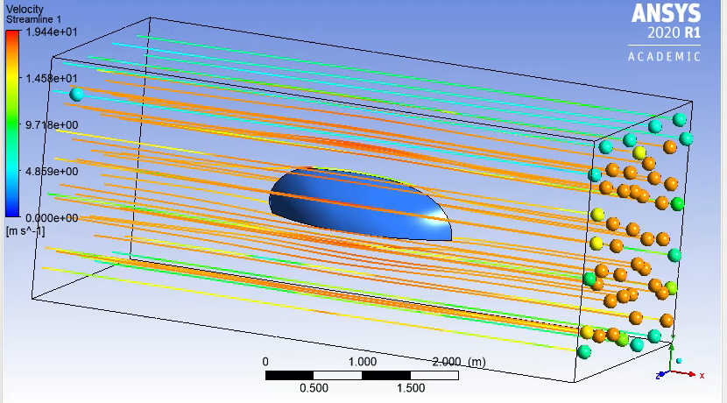

CFD analysis was carried out on Ansys Fluent
Frontal Area of the fairing : 0.397$m^{2}$
Velocity 17m/s (~40mph)
Coeffcient of Drag: 0.1629
CdA=0.05 $m^{2}$
CdA of a traditional cyclist ranges from 0.2-0.3
Figure 1.3 : CFD Simulations

Slide 5
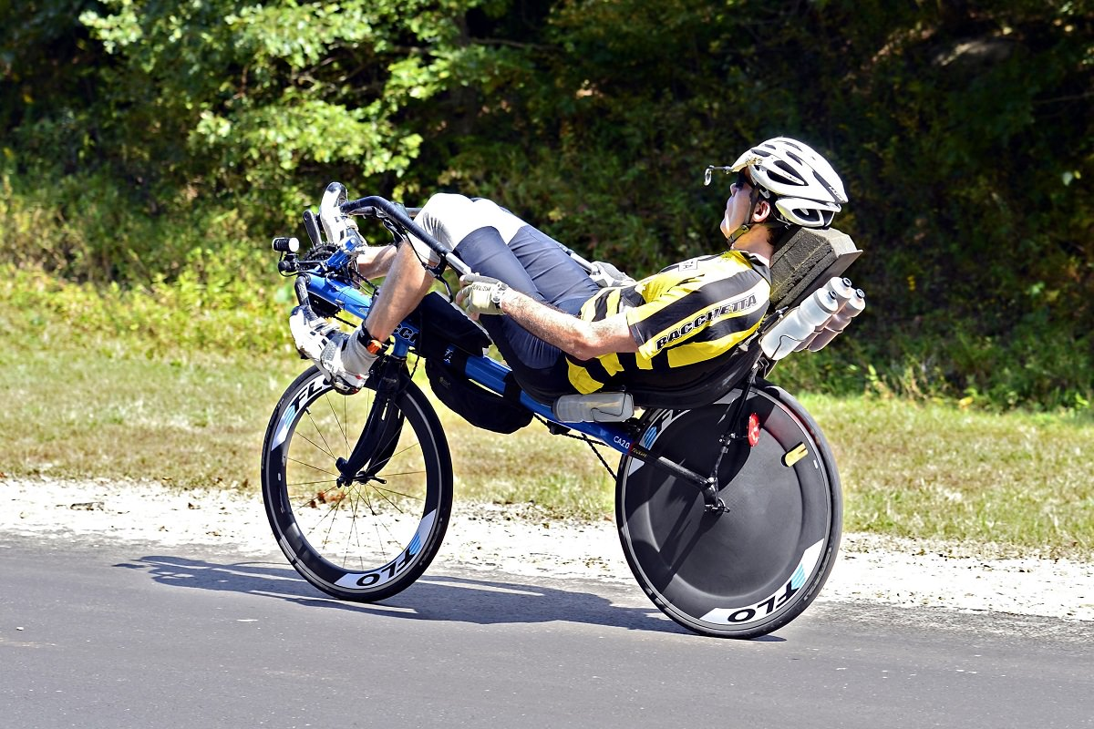
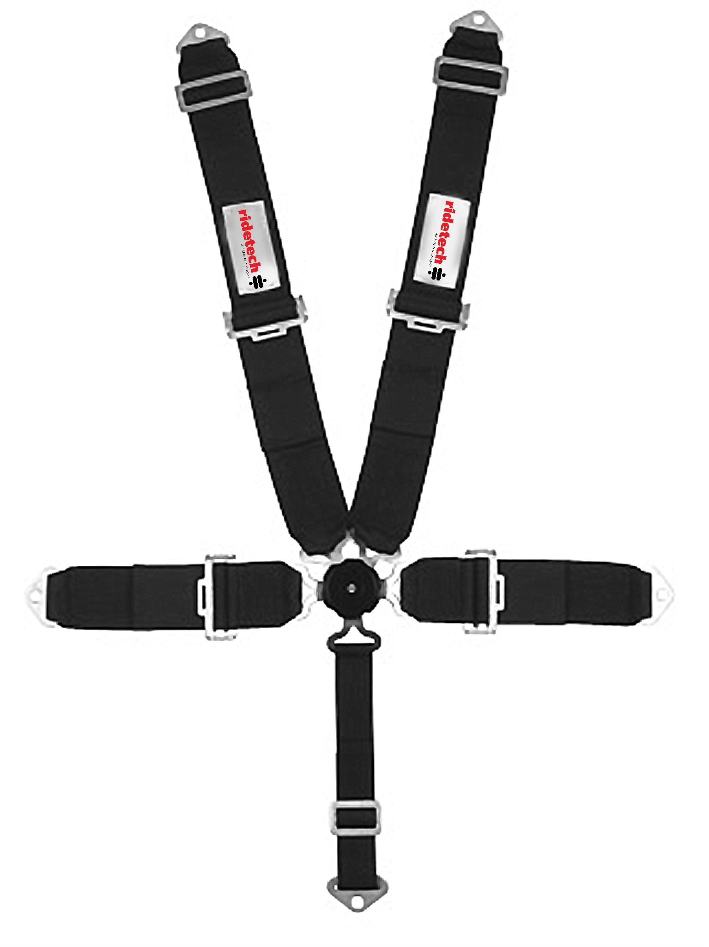
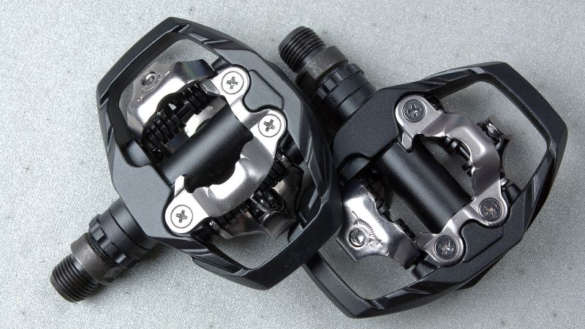
Design Description
How does it work?
  All power inputted directly from the rider
  Rider will be harnessed into vehicle seat and feet clipped onto pedals for safety
  A pedaling motion will propel the vehicle forward
  Specifically engineered gearbox will allow higher speeds to be achieved

Slide 6
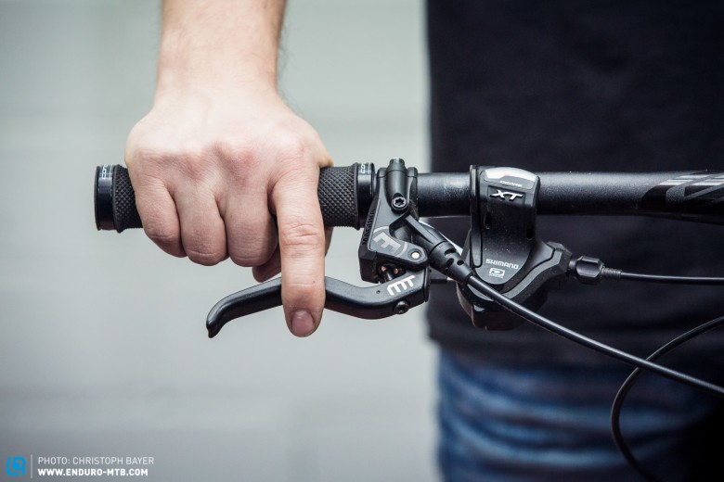
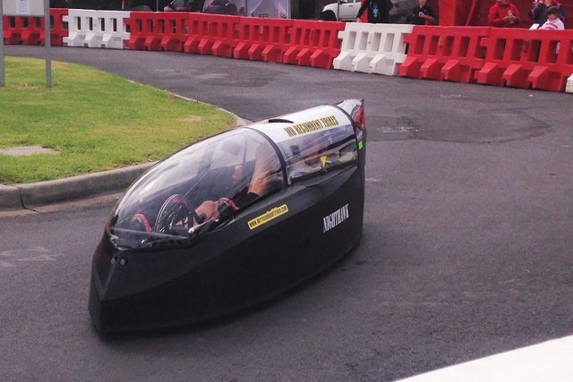
Design Description Continued
How does it work?
  Steering controlled through handlebar
  Gearing and braking controlled via handlebar grip controls and levers
  Full body fairing will minimize aerodynamic drag effects for more efficient performance

Slide 7
Customer Requirements and Engineering Requirements
Aerodynamic
Safe for rider
Cargo space
Maneuverable
High strength-weight ratio
Universal Riders
Currently meeting all customer requirements

Slide 8
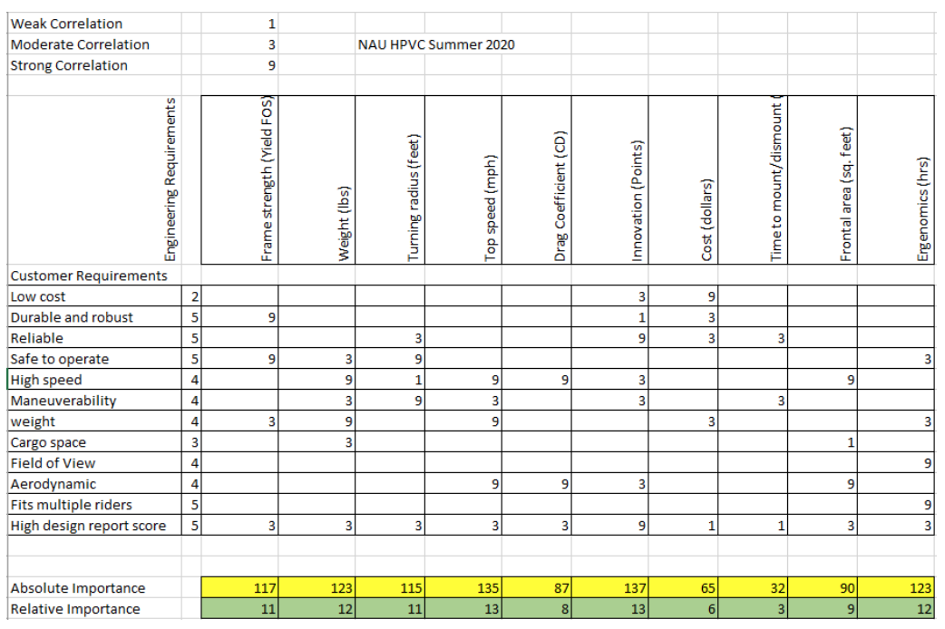
Customer Requirements and Engineering Requirements
ER’s in order of importance
Innovation
Top Speed
Weight
Ergonomics
Frame Strength
Turning Radius
Frontal Area
Drag Coefficient
Cost
Figure 1.4 : House of Quality

Slide 9
Standards, Codes, and Regulations
ASME Y14.24/Y14.3/Y14.5 (Types and Applications of Engineering Drawings)
16 GFR Part 1203 (CPSC Safety for Bicycle helmets)
2021 HPVC Rules Section V (Safety)
ASTM (Dimensioning and Tolerancing Standards)
AGMA (Gear Design)

Slide 10
Design Validation
Why will this design work?
Thorough Preliminary Analysis (FEA, CFD)
Two-Speed Transmission (Doubling Vehicle Speed)
Immediate Start to Building in the Fall allowing for Prototype Testing and Iteration
Awesome Teamwork, Problem Solving Skills, and Drive

Slide 11
Testing Procedures
Wind Tunnel Testing
Small scale 3D printed fairing
Check the accuracy of CFD and analysis of results
Safety
FEA and Physical testing of roll cage design as will be completed during competition
Speed and Maneuverability
Time trials and obstacle course testing of prototype
Iteration and Re-Testing of all systems as needed

Slide 12
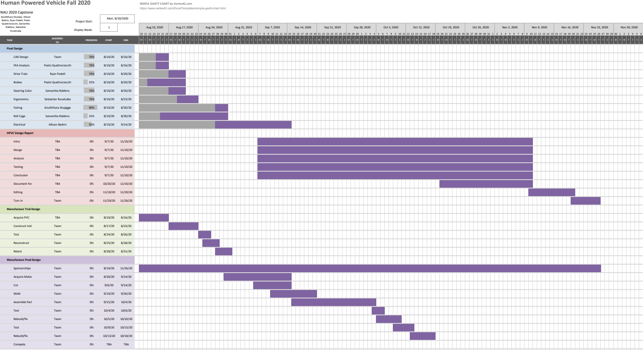
Gantt Chart
Figure 1.5 :Gantt Chart

Slide 13
Expected Costs
Table 1.1 : Cost Approximations
Item | Approximate Amount | Approximate Cost
Frame Tubing | 12 feet | $80
Frame Model | 12 feet | $7
Pedals | 2 units | $37
Seat | 1 unit | $130
Safety Features | 2 units | $200
Full Fairing | 1 unit | $1500
Fairing Model | 1 unit | $50
Drive Train | 1 unit | $1,200
Tires | 2 units | $90
Steering Column | 1 unit | $140
Steering Model | 7 feet | $4
Total (Approximate) |  | $4,000
Total Model (Approximate) |  | $80.00

Slide 14
  Thank you!
  Any Questions?

Slide 15
References
BOM

