Slide 1
NAU Gore Capstone Team
Ashley Blood, Nick Green, Jenny Lawson, Cameron Lissarrague

Slide 2
Background
WHAT ARE STENTS USED FOR?
Expanding narrow or clogged arteries
Restoring blood to obstructed artery
TYPES OF STENTS
Coronary
Vascular
Intracranial
Esophageal

Slide 3
GOAL STATEMENT
Design and develop an automatic stent crimping device that utilizes an iris design with a radial force output.

Slide 4
SOTA LITERATURE RESEARCH
Topics
Purpose of crimping
Stent dimensions
Pre-existing designs

Slide 5
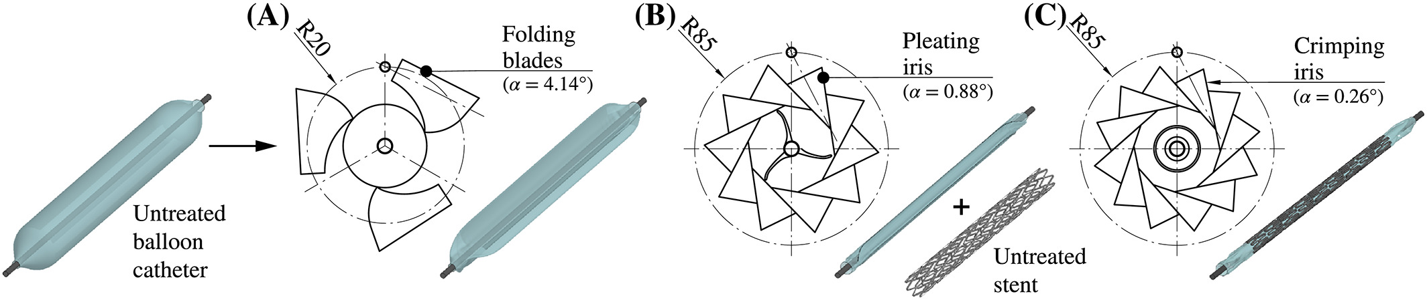
Purpose of crimping
Stent crimping onto balloon catheters is necessary for the successful deployment of balloon-expandable stents [1].
A) Folding of the balloon over the catheter until a star-like shape with 3 wings is achieved B) Pleating or folding of the balloon until the wings are pressed against the catheter C) Crimping of the stent to secure stent to the balloon and catheter
Fig. 1: Preoperative process for preparing catheter [2]

Slide 6
Stent Dimensions
Table 1: Stent Dimensions
Coronary stents | Length: 8 to 38 mm [3]
 | Diameter: 2.5 to 4.0 mm [3]
Intracranial Stents | Length: 8 to 28 mm [4]
 | Diameter 2 to 4 mm [4]
Vascular Stent | Length: 20 to 100 mm [5]
 | Diameter: 5 to 9 mm [5]
Esophageal stent | Length: 10 to 15 cm [6]
 | Diameter: 12 to 16 mm [6]

Slide 7
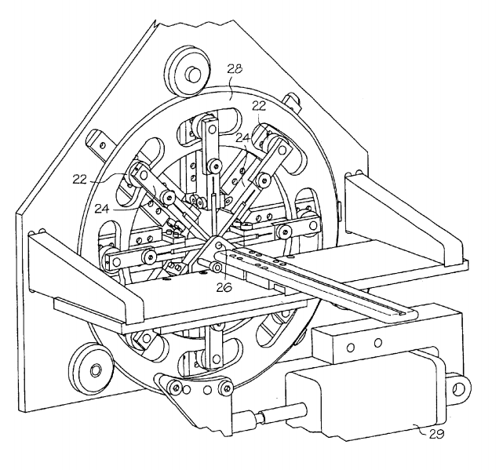
PRE-EXISTING DESIGNS
Fig. 2: Parts of Apparatus [7]
28- rotating apparatus
22- bearing
24-linear bearing (moves blades inward or outward)
29- pneumatic drive

Slide 8
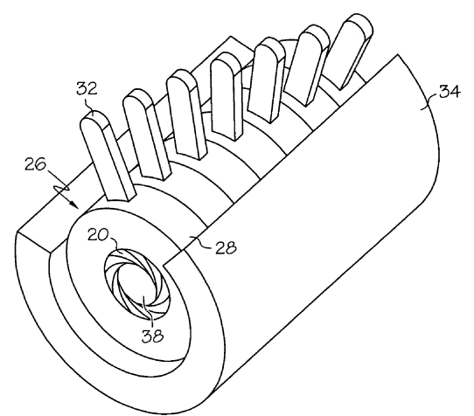
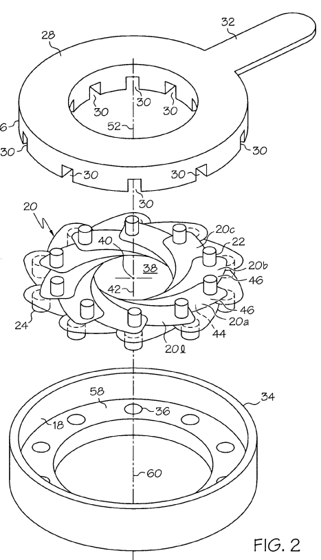

Fig. 3: Stent Crimper Apparatus [8]
34- stationary mount
28-rotating collar
24- pivot pins

Slide 9
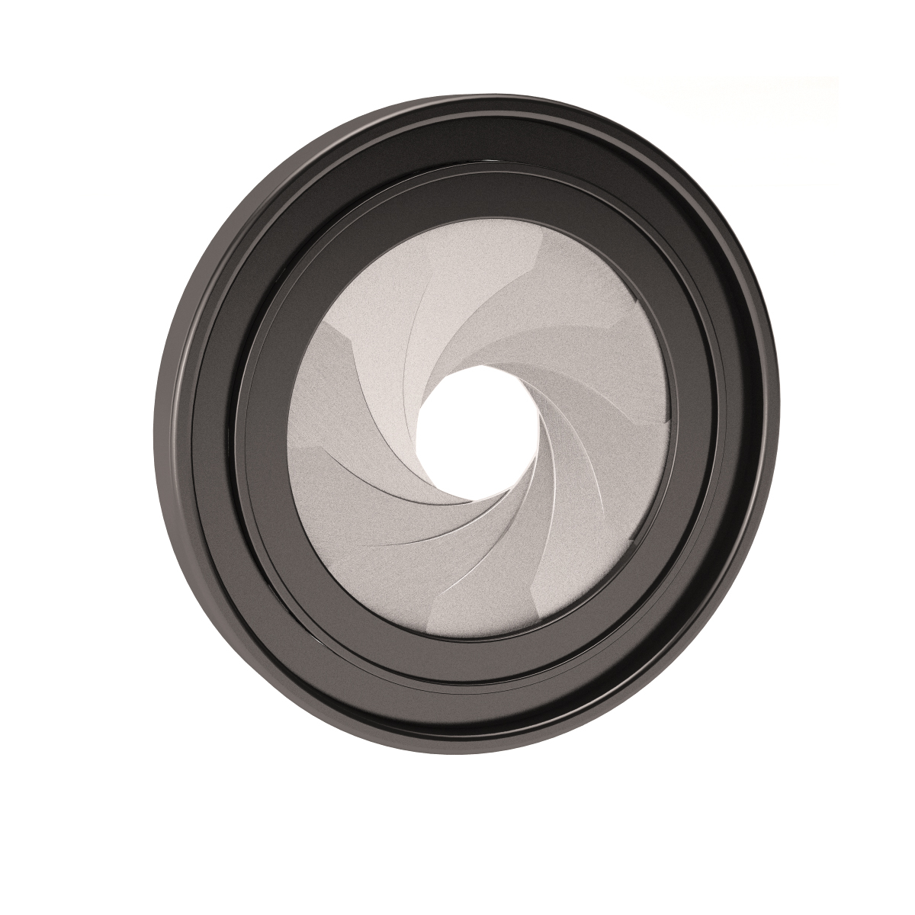
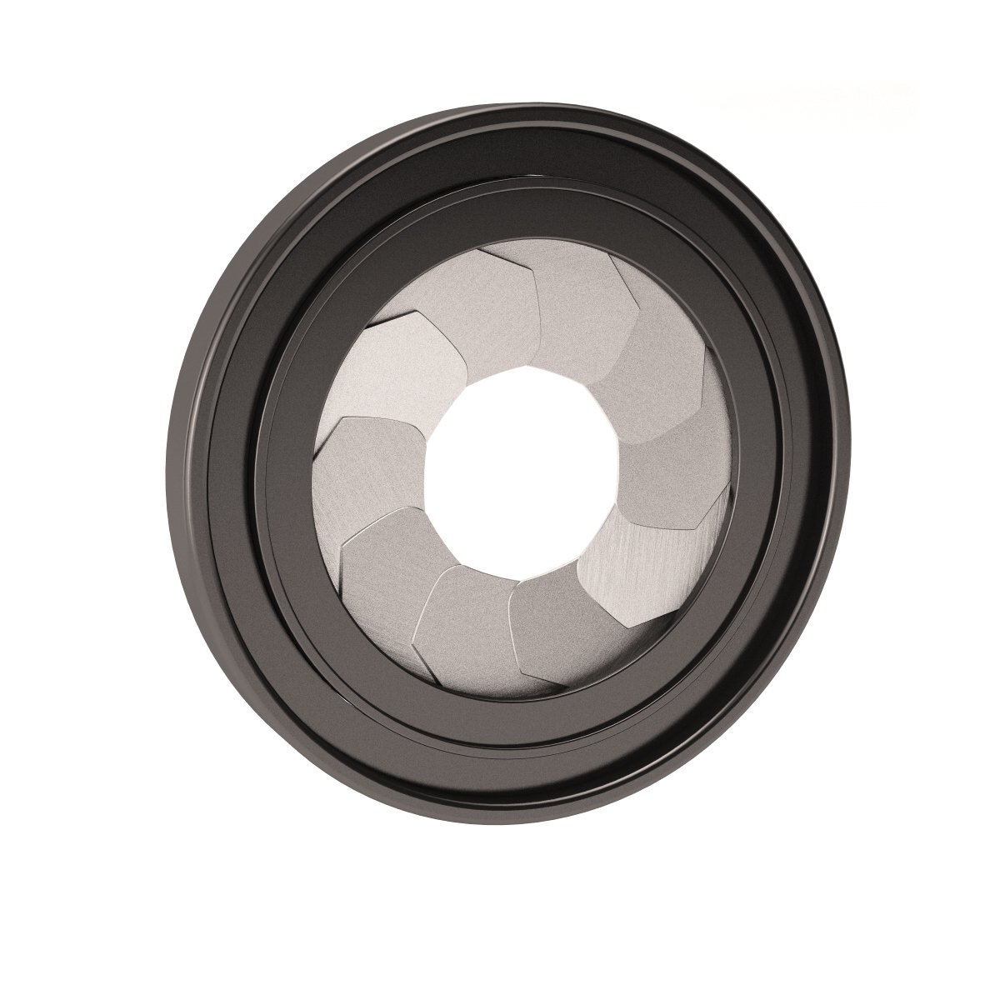
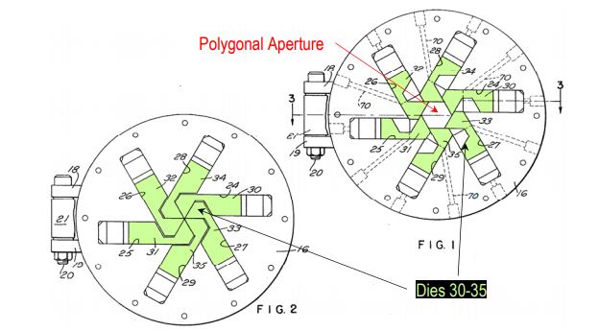
PRE-EXISTING DESIGNS- IRIS
Fig. 4: Camera Irises [9]
Fig. 5: Crimping Iris [7]

Slide 10
CUSTOMER NEEDS/ ENGINEERING REQUIREMENTS
CUSTOMER NEED | ENGINEERING REQUIREMENT | RANK
Iris design | Device must perform like an iris | 5
Meets safety standards | Must meet ANSI and OSHA standards | 5
Accommodates a range of stent diameters | Diameter range of 0 - 30mm | 4
Accommodates a range of stent lengths | Length range 0 - 40mm | 2
Appropriate radial force | Radial Force 0 - 17.5 N | 4
Outputs data | GUI that can receive input and outputs both diameter and radial force | 1

Slide 11
CONCLUSION
Why are stents important?
Team goal
  Design and develop an automatic stent crimping device that utilizes an iris design with a radial force output.
SOTA Literature Review
  Purpose of crimping stents
  Stent dimensions
  Pre-existing Designs
Customer needs and Engineering requirements

Slide 12
REFERENCES
[1] S. Zhao, L. Gu, and S. R. Froemming, “On the importance of modeling stent procedure for predicting arterial mechanics,” J. Biomech. Eng., vol. 134, no. 12, pp. 2–7, 2012.
[2] M. A. Geith, K. Swidergal, B. Hochholdinger, T. G. Schratzenstaller, M. Wagner, and G. A. Holzapfel, “On the importance of modeling balloon folding, pleating, and stent crimping: An FE study comparing experimental inflation tests,” Int. j. numer. method. biomed. eng., vol. 35, no. 11, pp. 1–19, 2019.
[3] K. Anders, “Coronary artery stents,” Card. CT, Second Ed., vol. 284, no. 14, pp. 199–224, 2014.
[4] S. Hähnel et al., “Small-vessel stents for intracranial angioplasty: In vitro comparison of different stent designs and sizes by using CT angiography,” Am. J. Neuroradiol., vol. 24, no. 8, pp. 1512–1516, 2003.
[5] V. Stent, “Zilver Vascular Stent,” Biomed. Saf. Stand., vol. 46, no. 6, p. 45, 2016.
[6] P. Hindy, J. Hong, Y. Lam-Tsai, and F. Gress, “A comprehensive review of esophageal stents,” Clin. Adv. Hematol. Oncol., vol. 10, no. 8, pp. 526–534, 2012.

Slide 13
[7] M. Austin, “Apparatus for Contracting, Loading, or Crimping Self-expanding and Balloon Expandable Stent Devices,” 6,915,560 B2, 2005.
[8] M. Edin, “Stent Crimper,” 7,143,625 B2, 2005.
[9] Asbemaister and 10 products, “Camera Aperture Model,” Camera iris aperture 3D model - TurboSquid 1325444, 09-Sep-2018. [Online]. Available: https://www.turbosquid.com/3d-models/camera-iris-aperture-3d-model-1325444. [Accessed: 04-Feb-2020].

Slide 14
Any questions?

