Slide 1
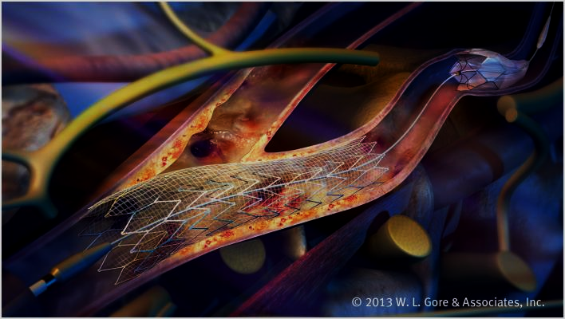

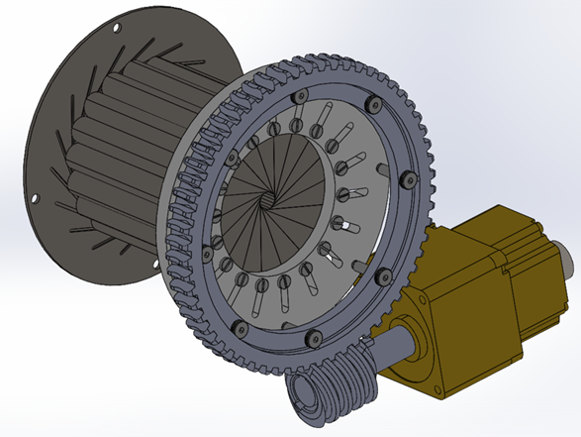
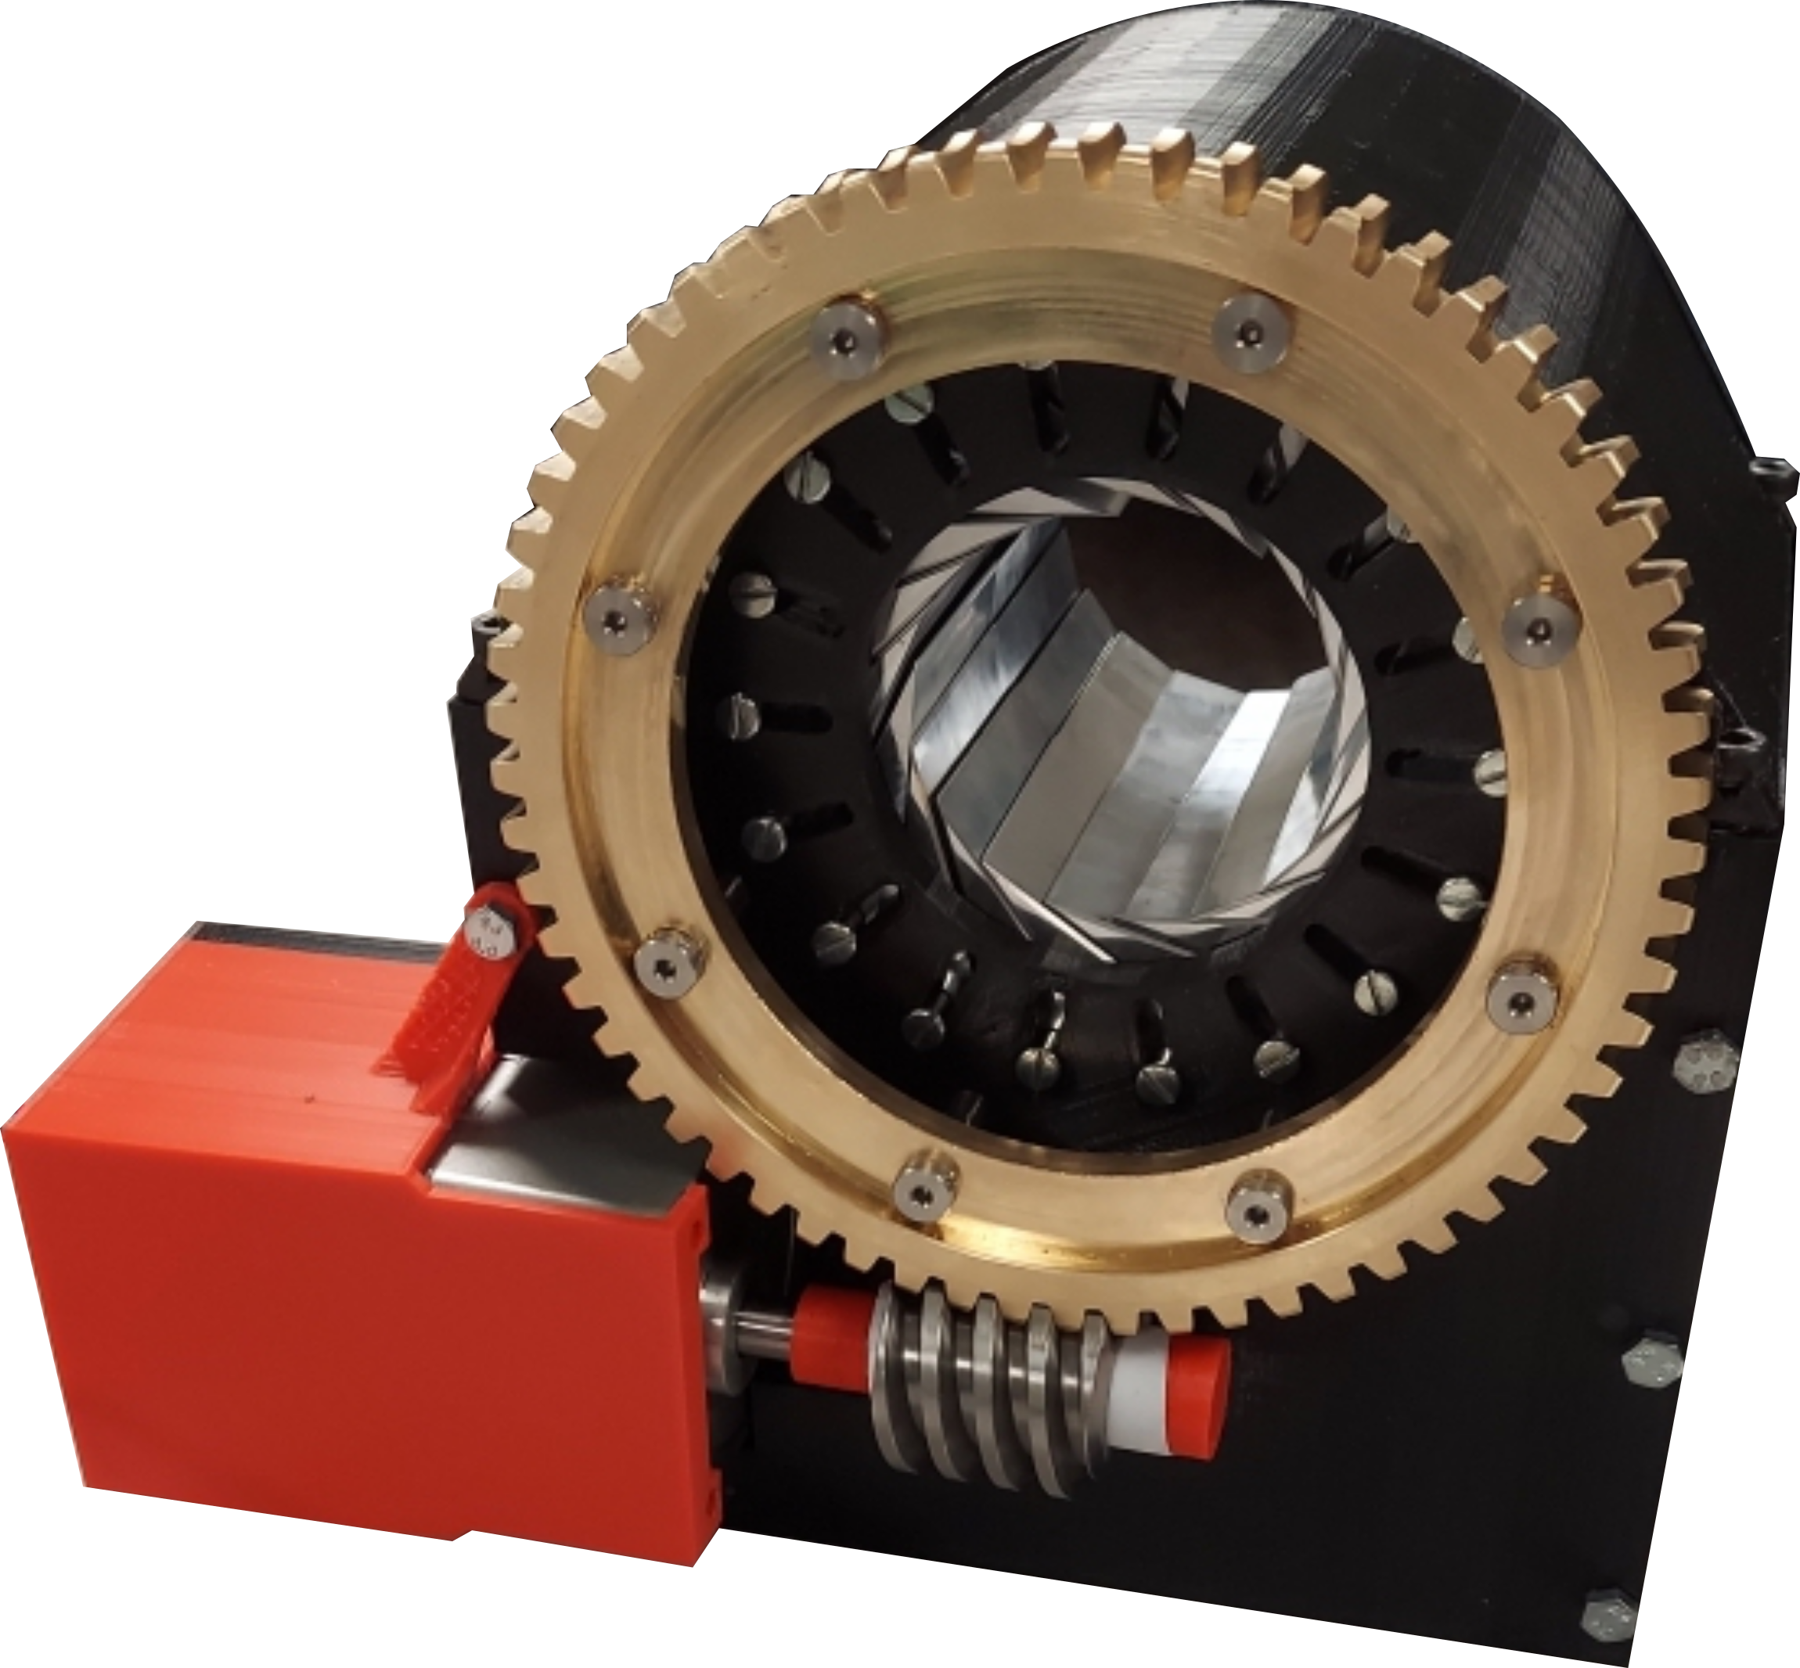
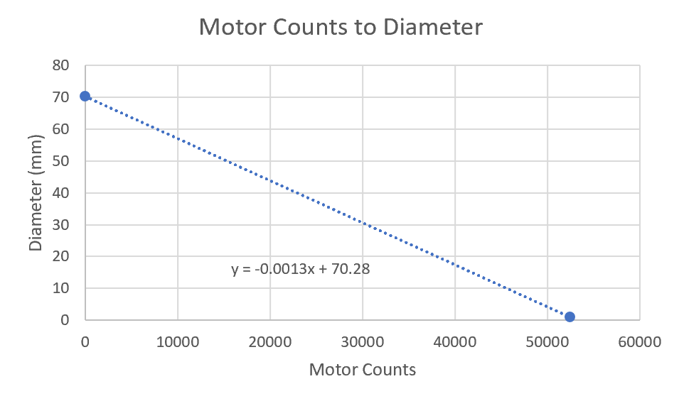
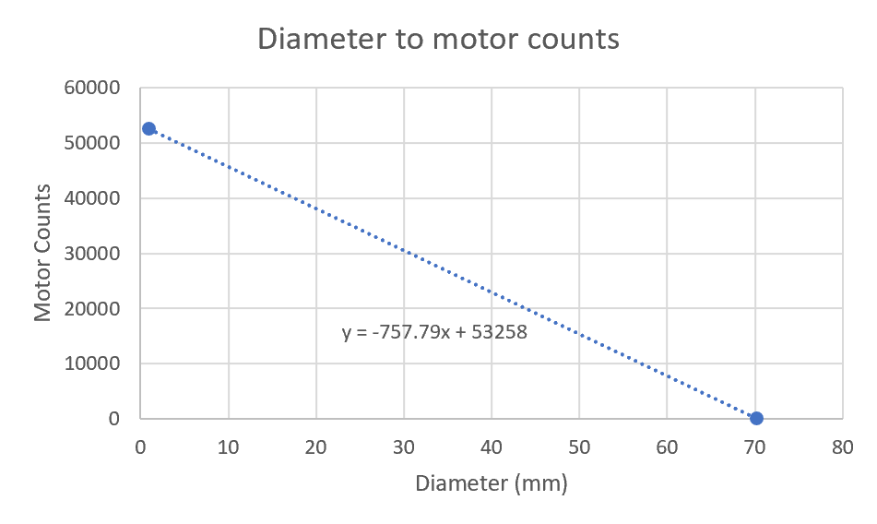
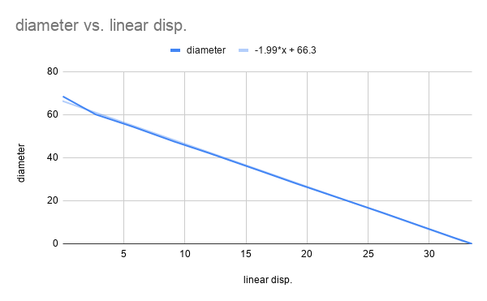

W.L. Gore Stent Crimper Project
Ashley Blood, Nick Green, Jennifer Lawson, Cameron Lissarrague
Department of Mechanical Engineering, Northern Arizona University, Flagstaff, AZ 86011
Abstract
Design
Testing
Manufacturing
Arteries within the body can become narrowed due to lipid deposition in the arterial wall [1]. A stent is utilized to restore blood flow by expanding the obstructed arteries. To implement a stent within the body, the stent must first be crimped or reduced in diameter. A stent crimping device is utilized to crimp a stent onto a delivery system known as a catheter.
This device includes 18 leaflets that are held in place by the stationary back plate and rotating front plate. The worm gear is attached to the front plate for actuation and is powered by a stepper motor and arduino system. The stepper motor is also used to keep track of the diameter of the iris. A load cell is positioned behind the stepper motor to obtain the force. The housing holds and protects all the components.
The current prototype is inoperable due to material selection and a tolerance stackup issue for the 3D printed plates The design must be modified to allow leaflets to move within the guides on the front and back plates. Future endeavors would include these changes to resolve the current issues.
Testing Procedure 1 (Diameter):
Measure diameter in increments using pin gauges of multiple sizes: 0.25, 3, 15, and 25 mm
Testing Procedure 2 (Radial Force):
Calibrate load cell with known weight
Count stepper motor steps to determine diameter
Measure Force from load cell
The housing is constructed out of PLA filament. The main body of the design has been constructed utilizing a machined gear, standardized screws, and 3D printed plates and leaflets. An updated design should be manufactured out of 316 steel for medical safety.
Figure 1. Final Design CAD model
Device includes:
18 leaflets worm and gear
stationary back plate stepper motor
rotating front plate load cell
Arduino mega
Radial force was determined using equation 1 where F is the linear force and K is the change in diameter over change in displacement. K was found by taking measurements in solidworks and plotting values in excel to obtain the slope (Figure 2). The linear force is equivalent to the tangential force of the gear.
RF = 2/k*F (1)
Figure 3. Final prototype
References
[1] “Atherosclerosis: MedlinePlus Medical Encyclopedia,” MedlinePlus. [Online]. Available: https://medlineplus.gov/ency/article/000171.htm. [Accessed: 31-Oct-2020].
[2] J. Parodi, “Endovascular repair of abdominal aortic aneurysms and ...,” 1995. [Online]. Available: https://www.jvascsurg.org/article/S0741-5214(95)70186-9/abstract. [Accessed: 12-Sep-2020].
[3]S. Hähnel et al., “Small-vessel stents for intracranial angioplasty: In vitro comparison of different stent designs and sizes by using CT angiography,” Am. J. Neuroradiol., vol. 24, no. 8, pp. 1512–1516, 2003.
[4] P. Hindy, J. Hong, Y. Lam-Tsai, and F. Gress, “A comprehensive review of esophageal stents,” Clin. Adv. Hematol. Oncol., vol. 10, no. 8, pp. 526–534, 2012.
[5]S. H. Duda et al., “Physical properties of endovascular stents: An experimental comparison,” J. Vasc. Interv. Radiol., vol. 11, no. 5, pp. 645–654, 2000.
Requirements
Device must perform like an iris.
Must meet ANSI and OSHA standards.
Diameter range of 0.5-30mm [2].
Length range of 8-100mm [3,4].
Radial force range of 108-823N [5].
Budget of $3,000.
Tolerances for diameter, length and radial force.
GUI for input/output.
Acknowledgements
Technical Advisor: Sarah Oman
Sponsors: W.L Gore and Associates, INC
Clients: Tanner Moll and William Reilly
Figure 2. Slope of diameter vs. displacement

