Slide 1
SRP Solar Air Heater
Carl Aaker
Ahmad Abuouf
Wyatt Bain
Tatum Begay
Alonzo Bizahaloni
Brandon Dunn
Taylor McCormAck
William Senseman

Slide 2

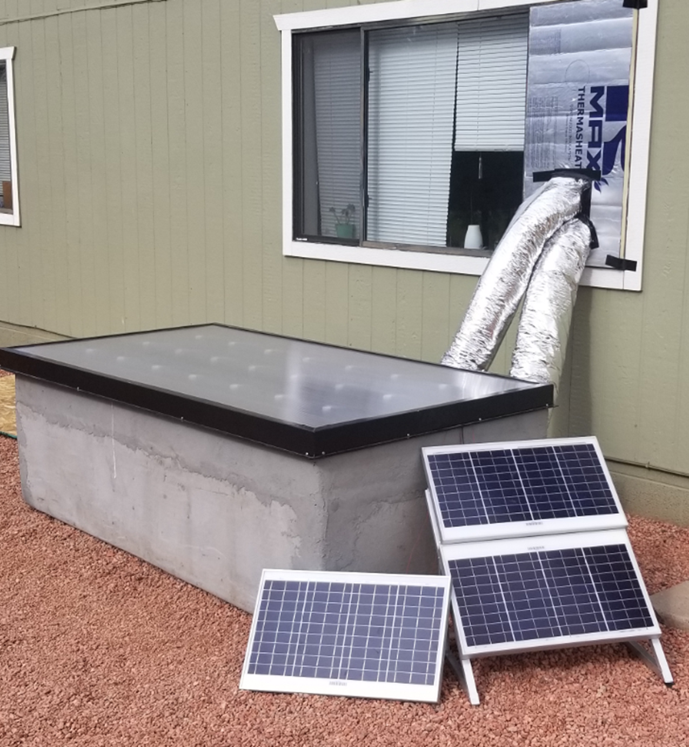
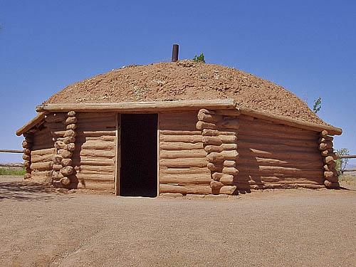
Project Description
Testing the efficiency of phase change material (PCM) when pairing with a solar air heater.
Tested the efficiency on a modern Hogan and a modern insulated home.
Our goal is to reduce or eliminate the coal, wood, or propane heaters for residents of the Navajo Nation.
Figure 1: Modern Hogan
Figure 2: Final Product

Slide 3
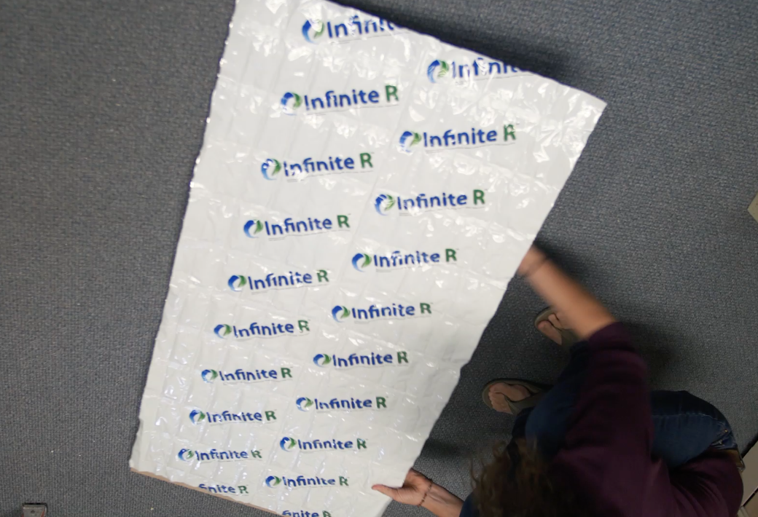
Phase Change Material (PCM)
PCM melts or thaws to reach a target temperature while using the process of phase change.
Has melting point of 73 degrees Fahrenheit.
Figure 3: Modern Hogan

Slide 4
Consumer Requirements
Table 1: Consumer Requirements
Customer Requirements | Weight (Total = 100) | Rationale
Ease of Use | 14 | Ensures that the solar air heater can be operated and maintained by the average consumer.
Simplicity of Design | 14 | The simplicity of the design would reduce costs for prototyping and testing.
Low Cost | 14 | By having a low cost, this ensures that Navajo families can heat their home safely and can be accessible to everyone.
Safety | 14 | This ensures that the PCM would not put the contents of the home at risk for fires or damages.
Feasibility | 14 | This ensures that the operation of the solar heater can be operated by all ages.
Efficiency | 14 | Shows how much energy the solar air heater can produce and how much energy can be converted to heat the home.
Size | 8 | The size of the SolarThermiX STX 7000 is 4x8x2 ft. and must be able to be place outside the home.
Aesthetics | 8 | The overall design must fits client’s needs and blend within the desert landscape.

Slide 5
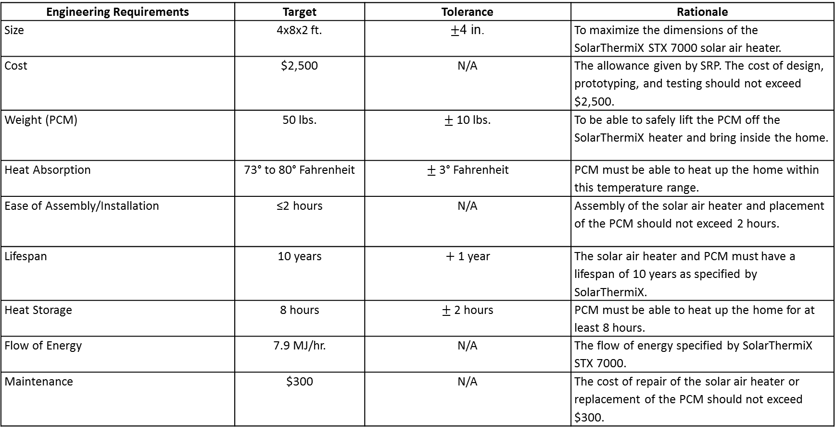
Engineering Requirements
Table 2: Engineering Requirements
Engineering Requirements | Target | Tolerance | Rationale
Size | 4x8x2 ft. | $±$4 in. | To maximize the dimensions of the SolarThermiX STX 7000 solar air heater.
Cost | $2,500 | N/A | The allowance given by SRP. The cost of design, prototyping, and testing should not exceed $2,500.
Weight (PCM) | 50 lbs. | $±$10 lbs. | To be able to safely lift the PCM off the SolarThermiX heater and bring inside the home.
Heat Absorption | 73° to 80° Fahrenheit | $±$3° Fahrenheit | PCM must be able to heat up the home within this temperature range.
Ease of Assembly/Installation | ≤2 hours | N/A | Assembly of the solar air heater and placement of the PCM should not exceed 2 hours.
Lifespan | 10 years | $+$ 1 year | The solar air heater and PCM must have a lifespan of 10 years as specified by SolarThermiX.
Heat Storage | 8 hours | $±$ 2 hours | PCM must be able to heat up the home for at least 8 hours.
Flow of Energy | 7.9 MJ/hr. | N/A | The flow of energy specified by SolarThermiX STX 7000.
Maintenance | $300 | N/A | The cost of repair of the solar air heater or replacement of the PCM should not exceed $300.

Slide 6
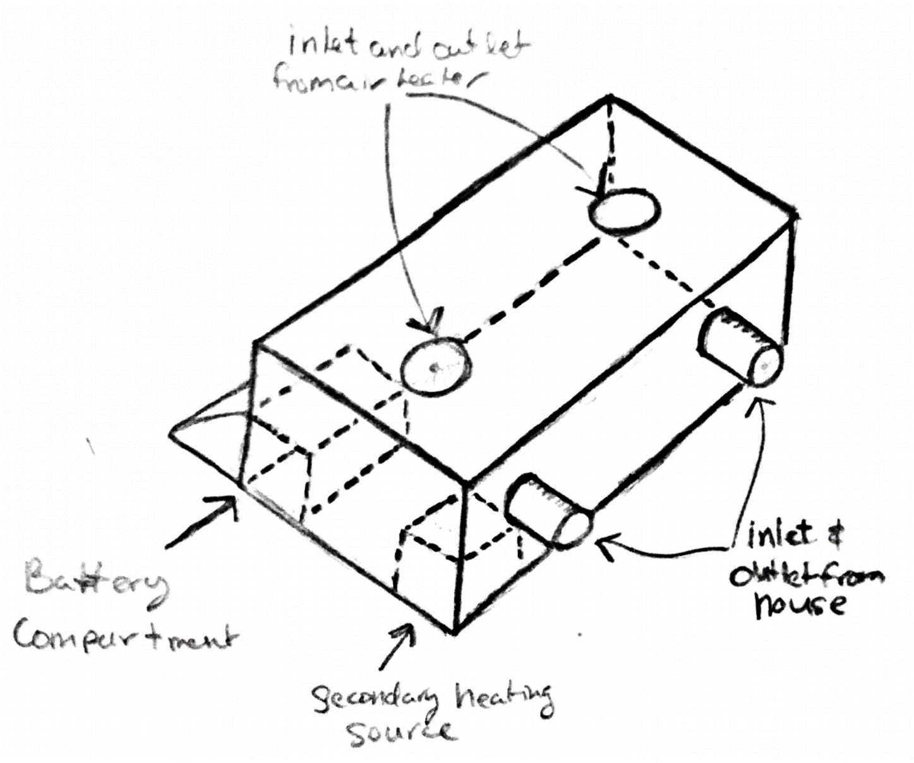
Original Design
Solar Air Heater Box
Solar air heater rests on top
PCM held inside with a coil heating unit
Utilized photoresistor and an Arduino to run 4 fans
  2 through the solar air heater 2 through the home
Power from battery and solar panels
During the day solar air heater warmed up the home
At night stored energy in PCM and coil heating unit kept home warm
Figure 4: Original Design

Slide 7
Analytical Analyses
Calculated the battery power needed to power the circuit and coil system.
Had four fans: two fans that were 1.6 Amps and 1.8 Amps.
The coil system was 5 Amps.
Determined that the battery would not power the fans and the coil for eight hours.
Decided to not implement the coil system.

Slide 8
Analytical Analyses
  Calculated our box design with a coil heating method to help heat at night.
  Used room where solar air heater was tested for calculations.
  Assumed home was insulated up to the city of Flagstaff standards.
  Assumed heat would distribute evenly into room.
  Found that the coil would be useful.
  But battery wasn’t strong enough to run the coil.

Slide 9
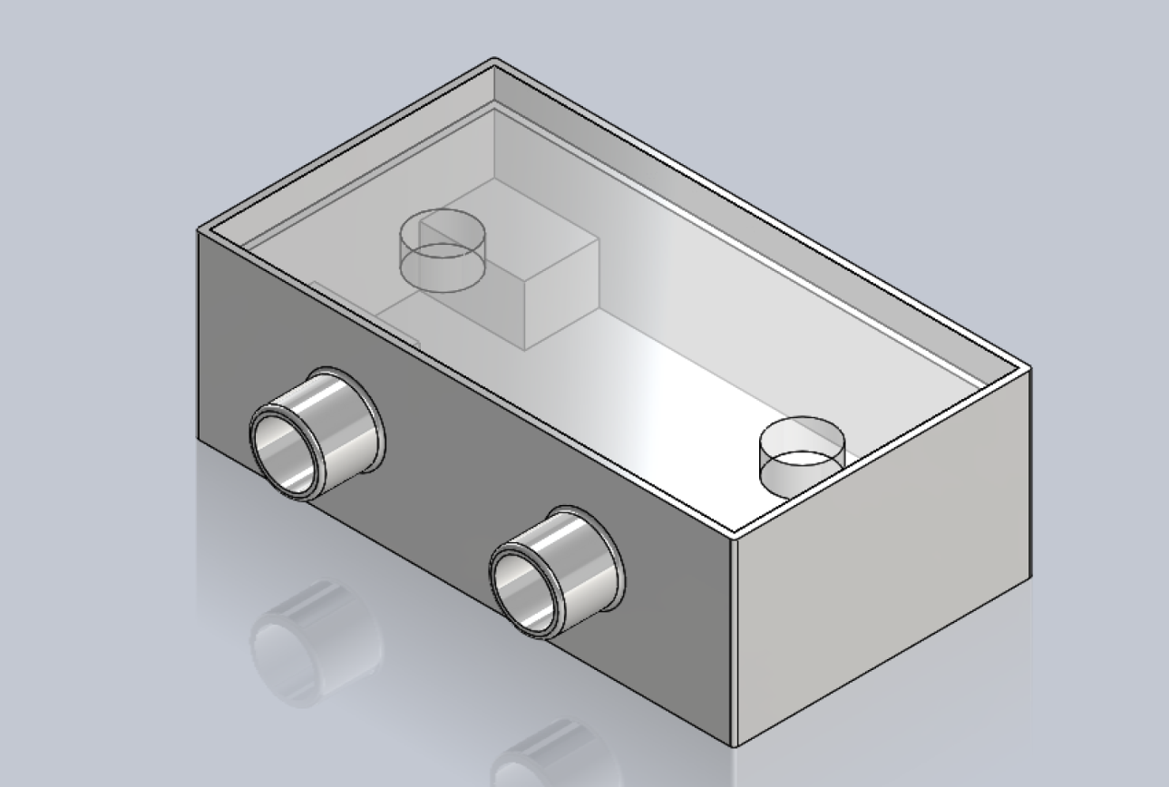
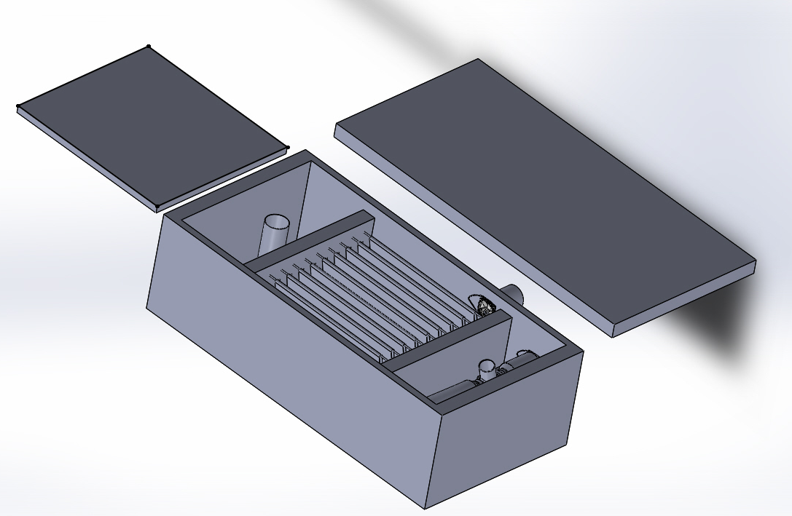
Design Changes
Figure 5: Original CAD Design
Figure 6: Final CAD Design

Slide 10
Design Changes
After calculating the power needed for the fans and the heating coil, the team have decided to not use the heating coil because of the fans needing mass amount of power from the battery.
After complications in the building process, the team decided to take out the photoresistor and Arduino.
Instead of the heating coil at night, we will use the energy from the PCM to keep the heat flowing throughout the night.
We also designed a shut off valve for the solar air heater at night, so the intake air doesn’t flow through the air heater.
To make the PCM more efficient we put it inside of an insulated box.

Slide 11
Fan Circuit
User would turn on circuit manually by connecting the fans to the negative terminal on the breadboard.
Circuit consist of:
  12 Volt 55 Amp Hour Battery
  NPN Transistor
  Two 1.6 Amps Fans
  Two 1.8 Amps Fans

Slide 12
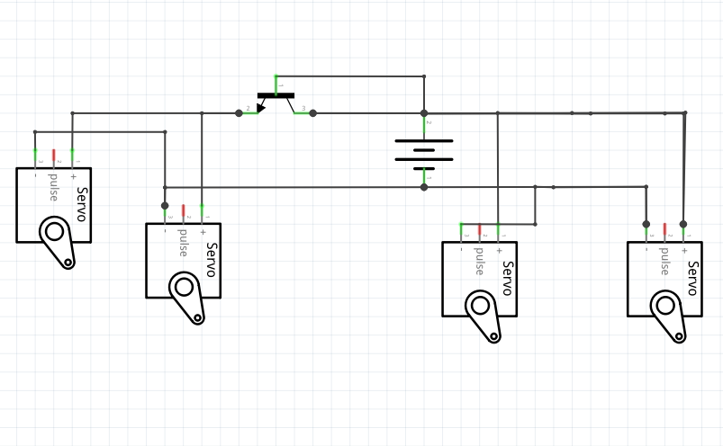
Figure 7: Circuit for Solar Air Heater

Slide 13
Cost for Solar Air Heater Parts
Table 3: Cost

Slide 14
Testing Procedures (Main Box)
Testing how long the system lasts:
  Turn box device on and close shutoff valve to air heater after 7pm and measure room temperature using three glass thermometers spaced at 9 inches, 14 feet, and 23 feet.
  Keep windows and doors closed throughout the night.
  Monitored the thermometers to get temperature readings every hour.
  Repeated for several days to get accurate measurements.

Slide 15
Testing Procedures (EnergyPlus+)
IDFeditor - IDF editor is used to create the IDF that EnergyPlus+ uses for all simulation results. It takes the inputs from the user on heating types, materials, building sizing, HVAC, equipment, building use, ventilation, lighting etc. (uses metric unit system)
EP - Launch - Main EnergyPlus+ GUI implements weather file and idf created by user to run energy simulation
In EnergyPlus+ program modeled a modern Hogan.
Weather file used data from Four-Corners Intl. Airport in NM
  Winter Months: AVG. 32 Degrees F, Low of -4 Degrees F.
Ran three simulations and a test bed for the efficiency of the PCM at night. Ran one with PCM as insulation in all walls, one with one wall and one without to test how well it keeps the Hogan warm. As well as an overall test bed for the project.

Slide 16
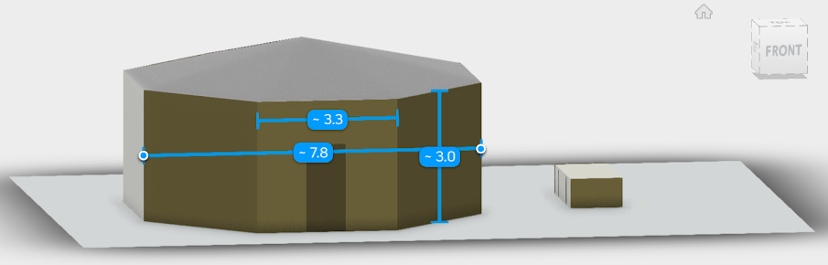
Hogan EnergyPlus+ Model
Figure 8: Model of Hogan in Meters

Slide 17
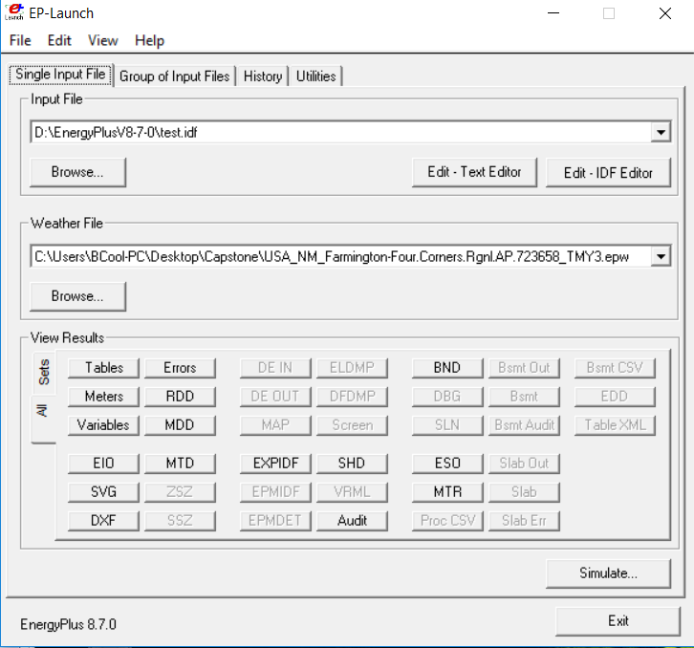
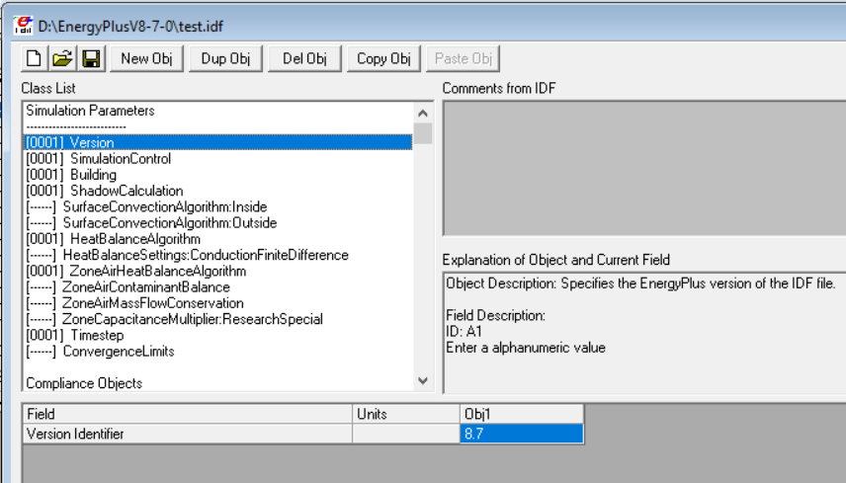
Figure 9: Testing Files
Figure 10: EnergyPlus+ Software Testing Window

Slide 18
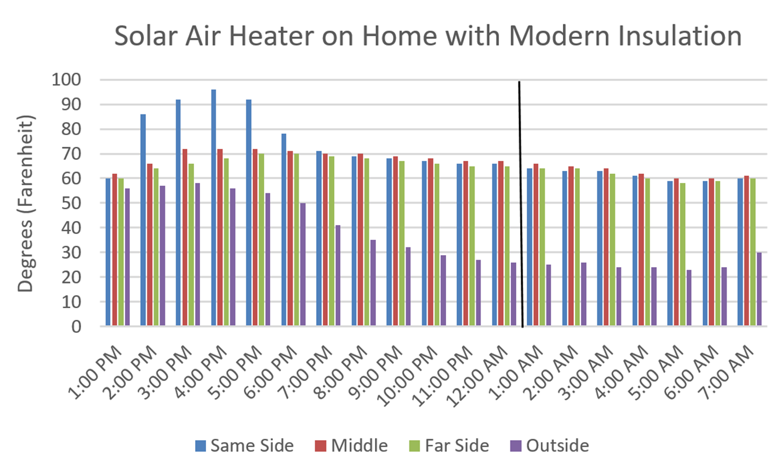
Results for Solar Air Heater
PCM Solidified
Figure 11: Results for Solar Air Heater

Slide 19
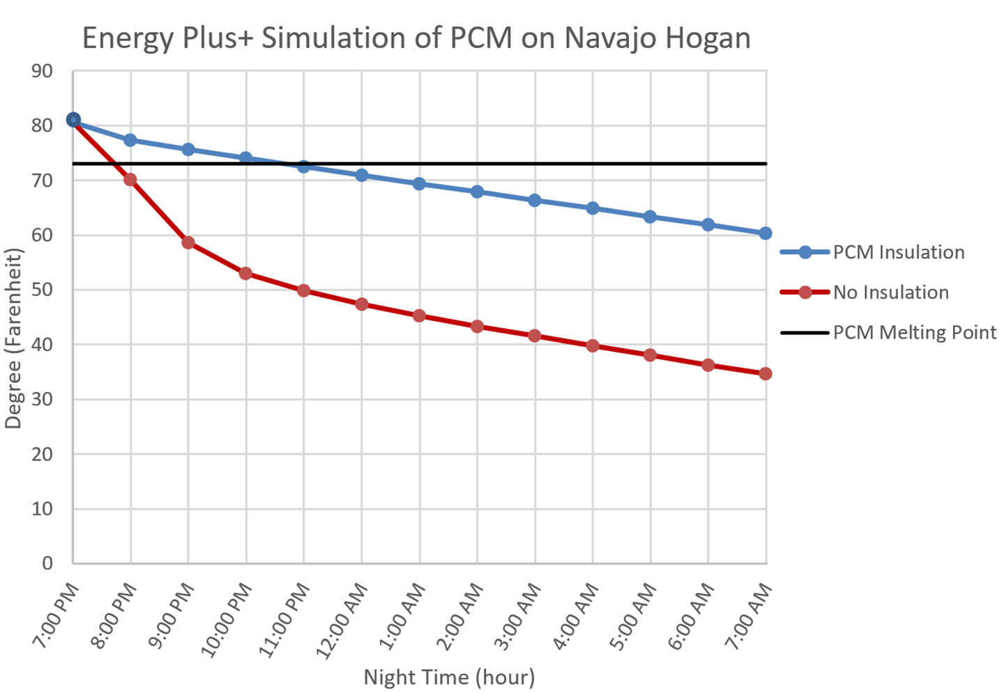
Results for EnergyPlus+
Figure 12: EnergyPlus+ Results

Slide 20
Conclusions:
Solar Air Heater operates as intended but is only efficient enough to work on a home that is moderately insulated.
Even though the temperature was not held above 73 degrees Fahrenheit, the box was designed so that more PCM can be added to suit the users needs.
From the EnergyPlus+ analysis on a home with no insulation the most efficient way for the PCM to work would be as insulation not in the box.
For a 566 Sq. Ft. Hogan that was modeled in EnergyPlus+ you would need 177 sheets of 2 Ft. by 4 Ft. PCM at $24 a piece equals $4,248 not counting the $1500 Solar Air Heater to heat the home up during the day.

Slide 21
Any Questions?

Slide 22
References
[1] Daly, M. (2017) Solar Air Heater – SolarThermiX [Online]. Available: www.solarthermix.net/heat. [Accessed: Sept. 21, 2017].
[2] Daly, M. (2017) Phase Change Material – SolarThermiX [Online]. Available: www.solarthermix.net/phase- change. [Accessed: Sept. 21, 2017].
[3] Insolcorp. (2017) Infinite R™ | Phase Change Materials | Thermal Storage | Insolcorp, Inc. [Online]. Available: http://www.insolcorp.com. [Accessed Nov. 7 2017].
[4] Bertola, M. (2017). Hogan [Online]. Available: http://www.so-utah.com/features/hogan/. [Accessed Nov. 5, 2017].
[5] GR Building Systems LLC. (2017) Green Rhino Building Systems [Online]. Available: grbuildingsystems.com. [Accessed: Sept. 18, 2017].
[6] Batt, A. (2018). Power-Sonic PS-12550, 12V 55Ah Sealed Lead Acid Battery [Online] Available: https://atbatt.com/power-sonic-ps-12550-12v-55ah-sealed-lead-acid battery/?gclid=CjwKCAiA_ojVBRAlEiwAOLRxIyo3OB_KSXYQ7vCDgIfMITqMbQLyJDM- z2LeRKQtGOGBHF4bZIivahoCxOQQAvD_BwE. [Accessed Mar. 9, 2018].

