Slide 1
SRP Solar Air Heater
Carl Aaker
Ahmad Abuouf
Wyatt Bain
Tatum Begay
Alonzo Bizahaloni
Brandon Dunn
Taylor McCormAck
William Senseman

Slide 2

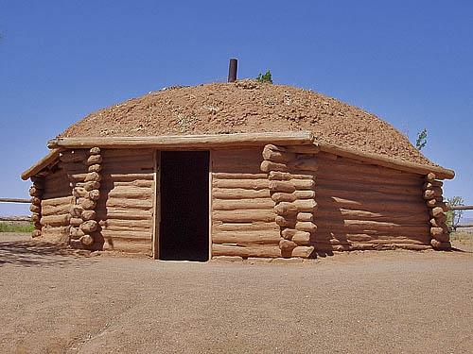
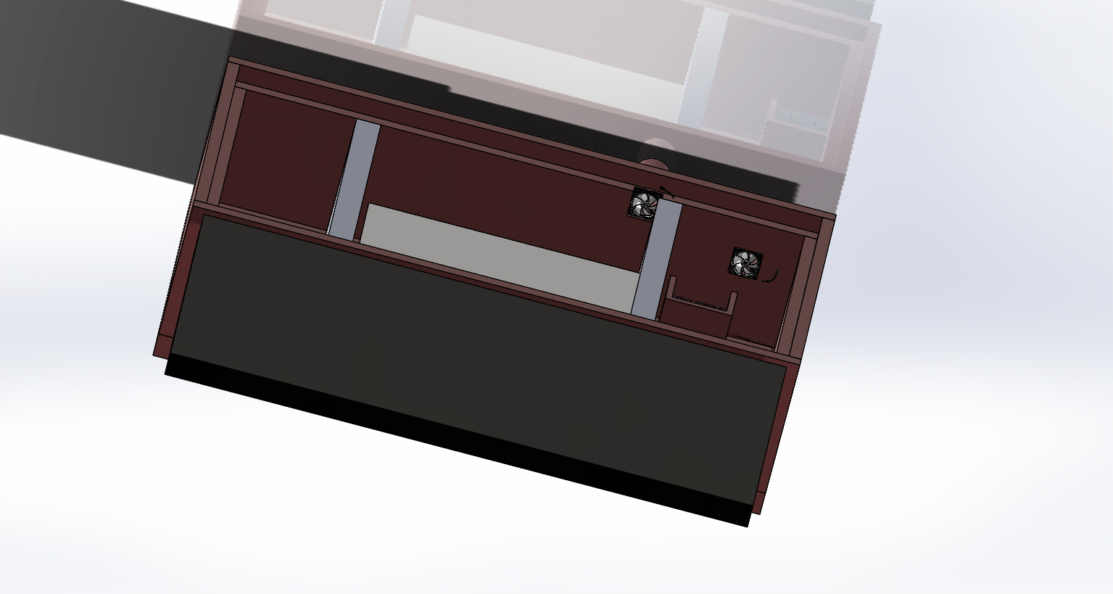
Project Description
We are observing the effectiveness of phase change material (PCM) and a solar air heater for hogans off the grid on the Navajo Nation.
A hogan is a traditional Navajo dwelling which is usually made from clay, wood, and stone.
Our goal is to reduce or eliminate the coal, wood, or propane heaters residents currently used.
Figure 1: Modern Hogan
Figure 2: Final CAD Design

Slide 3
Construction
Cut the intake and outtake holes in the GreenRhino (GR) box
Cut the insulation for the insulated box to hold PCM inside the GR box
Sealed the insulated box using Great Stuff Gap Filler
Cut rebar for rods inside insulated box to create a rack for PCM
Cut excess plastic off of fans and attached them to intake and outtake holes on GR box

Slide 4
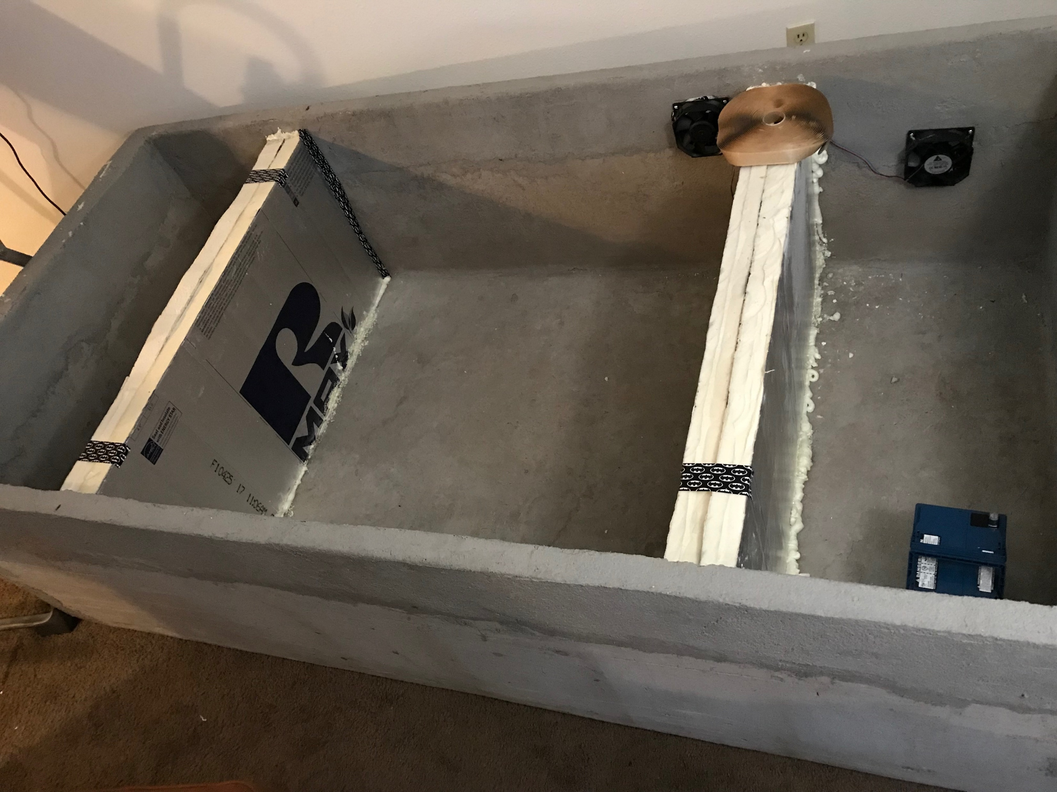
Figure 3: Current System

Slide 5
Fan and Photoresistor Circuit and Code
Built the fan and photoresistor circuits separately to make sure they work individually.
Tested threshold values for the photoresistor.
Combined the fans and tested the photoresistor with darkness and light threshold values.
Connected the 12V 55Ah battery to the completed circuit.

Slide 6
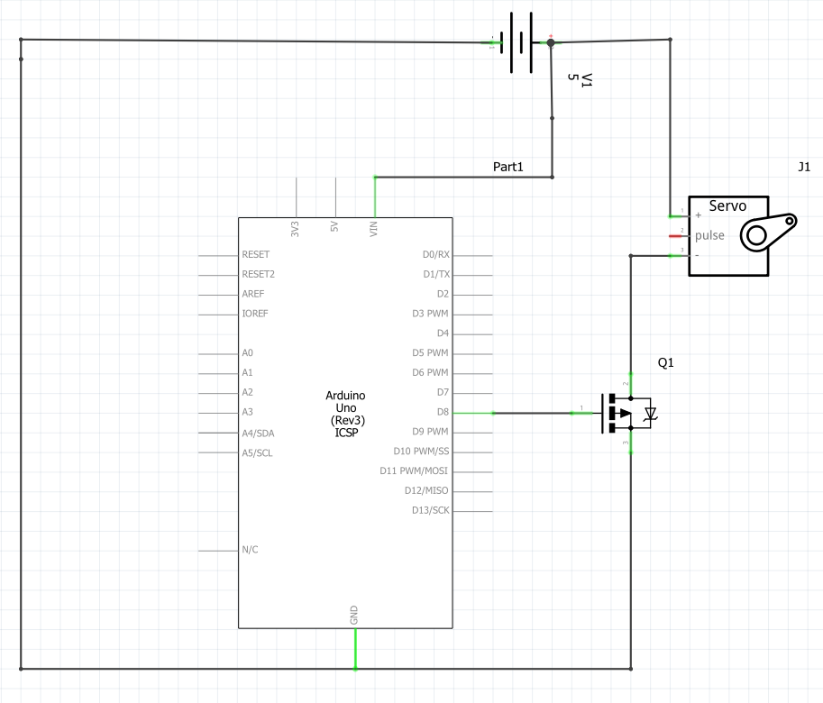
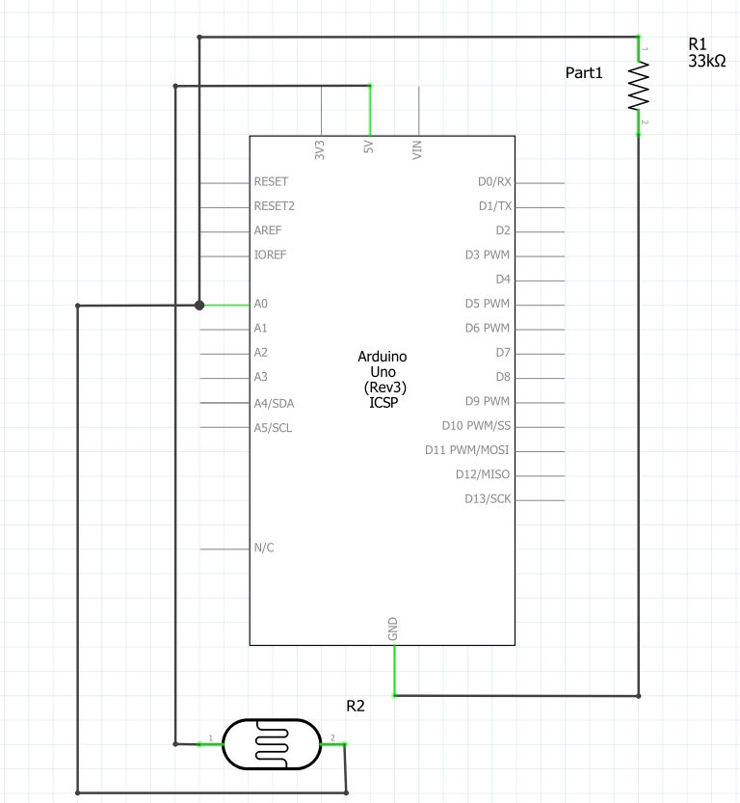
Figure 4: Schematic for fan
Figure 5: Schematic for photoresistor

Slide 7
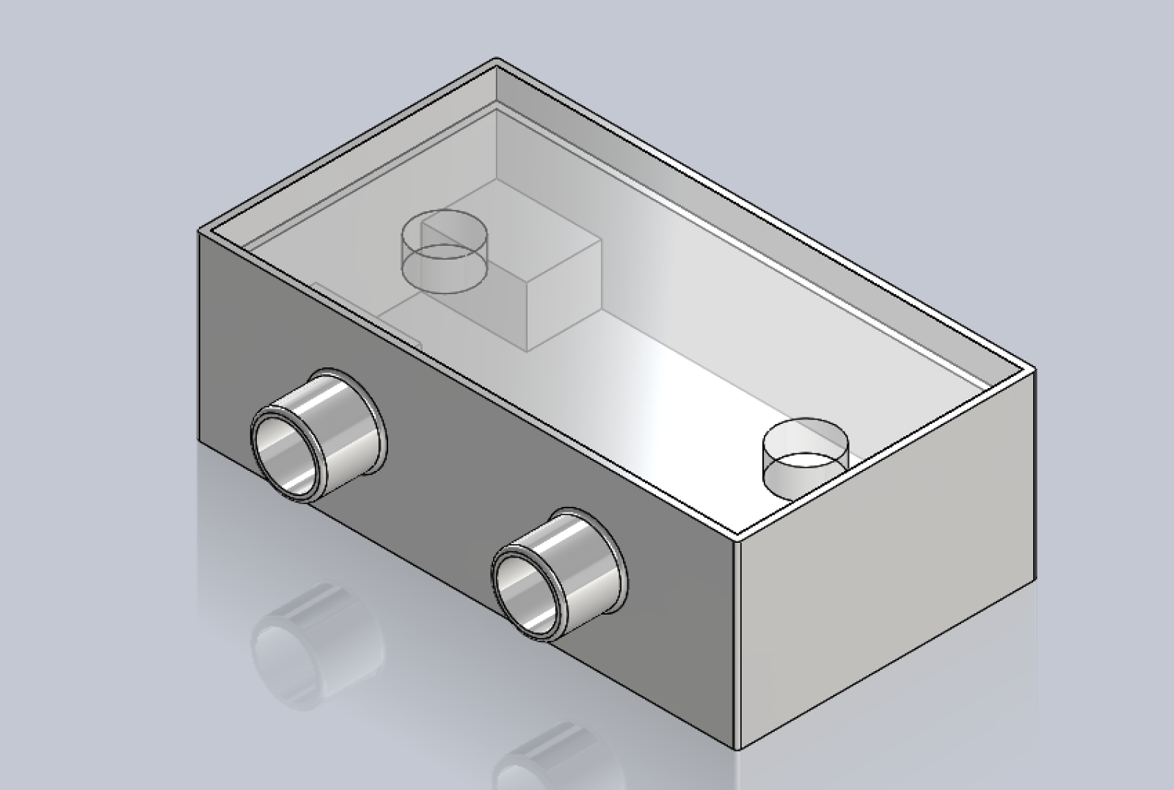
Design Changes
After calculating the power needed for the fans and the heating coil, the team have decided to not use the heating coil because of the fans needing all the power from the battery
Instead of the heating coil at night, we will use the energy from the PCM to keep the heat flowing throughout the night.
We also designed a shut off valve for the solar air heater at night, so the intake air doesn’t flow through the air heater.
To make the PCM more efficient we put it inside of an insulated box.
Figure 6: First Design CAD
Figure 7: Final CAD Design

Slide 8
Manufacturing
Manufacturing Plans:
  Adding and cutting rebar for PCM holder
  Strip wires for fan circuit
  Assemble all parts together

Slide 9
Analytical Analyses
2 different cases
  Case 1- set the box on a metal frame
  Case 2- set the box on the ground
  The metal frames will be made of ASTM-A36, Stainless steel (18-8) annealed, and AISI 1040- hot rolled steels.
  AISI 1040 hot rolled would be best for the frame, however, it would cost a little bit extra
  Setting the box on the ground would be best because it won’t sink and it will cost the least

Slide 10
Testing Procedures (Main Box)
Testing how long the system lasts:
  Turn box device on and close shutoff valve to air heater after 7pm and measure room temperature via digital thermometer every 15min.
  Keep windows and doors closed throughout the night.
  At about 7am the next day open shutoff valve to air heater and warm up heater during the day.
  Repeat for several days to get accurate measurements.

Slide 11
Testing Procedures (Energy+)
IDFeditor - IDF editor is used to create the IDF that EnergyPlus uses for all simulation results. It takes the inputs from the user on heating types, materials, building sizing, HVAC, equipment, building use, ventilation, lighting etc. (uses metric unit system)
EP-Launch - Main EnergyPlus GUI implements weather file and idf created by user to run energy simulation

Slide 12
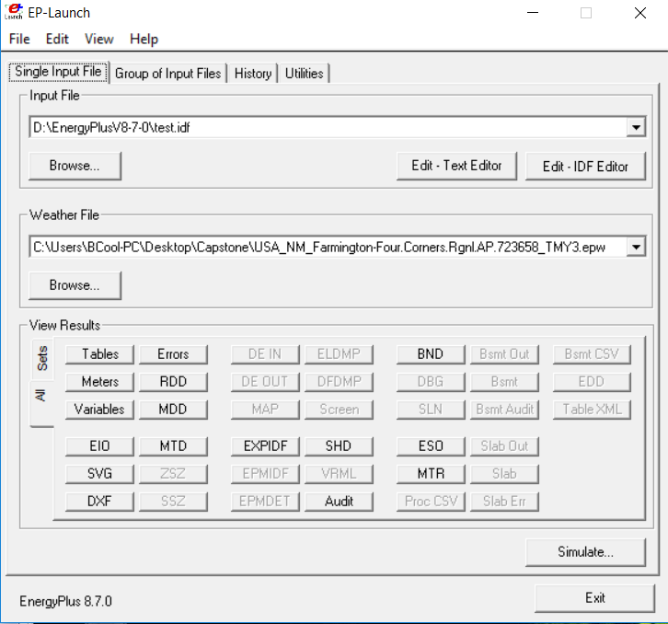
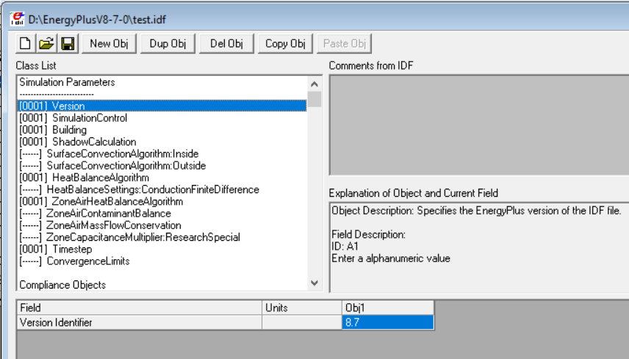
Figure 8: Testing Files
Figure 9: EnergyPlus+ Software Testing Window

Slide 13
Schedule
The Gantt Chart shows the teams schedule for the whole semester
The team is on schedule for all class and personal team due dates
The team has had many different design changes however, it hasn’t affected the teams schedule

Slide 14
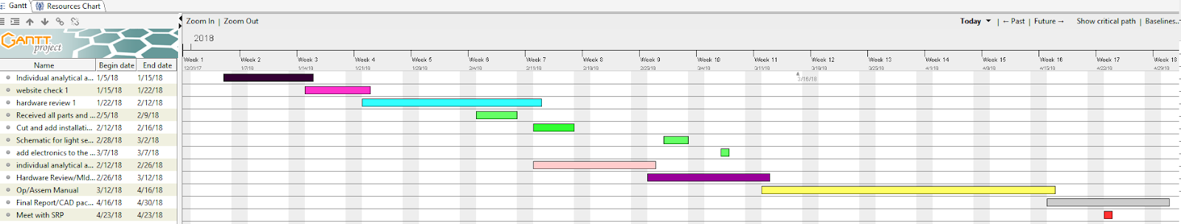
Figure 10: Update Gantt Chart

Slide 15
Budget
Table 1: Update Budget

Slide 16
Final Product Testing Proof
Dxf file - 3D model of building created in IDFeditor
Variables file - contains the information output requested from the user about Energy, Temperature, Heating and Cooling.
Table file - contains simulation information about the location chosen, scheduling, user defined information and heat transfer information.
Shd file - contains simulation information about the shading used and calculated between faces input by the user. EnergyPlus uses this information as variables in the heating and cooling of a structure.

Slide 17
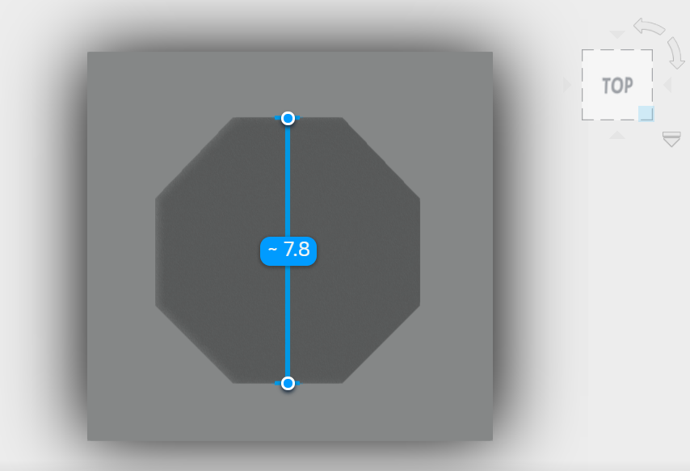
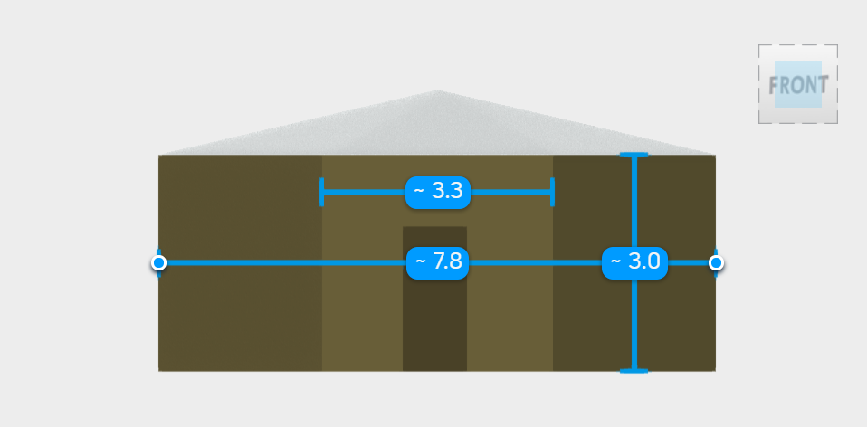
Figure 11: EnergyPlus+ Model (Side View)
Figure 12: Top View of EnergyPlus+ Model

Slide 18
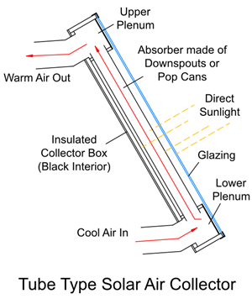
System Implementation vs. Market Providing
Currently on the market there are no other systems that pair together the solar air heater and phase change material.
There are other solar air heaters and other kinds of phase change material
Screen, tube, and back pass are the different solar air heaters on the market
Salt hydrate, eutectics, and organics are the different types of PCM
Figure 13: Tube Type Solar Air Heater

Slide 19
Any Questions?

Slide 20
References
[1] Daly, Michael. “Solar Air Heater.” SolarThermiX, www.solarthermix.net/heat Date accessed:September 21, 2017.
[2] Daly, Michael. “Phase Change Material.” SolarThermiX, www.solarthermix.net/phase-change/ Date accessed:September 21, 2017.
[3] Infinite R™ | Phase Change Materials | Thermal Storage | Insolcorp, Inc. (2017). [online] Available at: http://www.insolcorp.com/ [Accessed 7 Nov. 2017].
[4] Bertola, Max. So-utah.com. (2017). Hogan. [online] Available at: http://www.so-utah.com/features/hogan/ Accessed 5Nov. 2017.
[5] “Green Rhino Building Systems.” GR Building Systems LLC, grbuildingsystems.com/ Date accessed: September 18, 2017.
[6] AtBatt. (2018). Power-Sonic PS-12550, 12V 55Ah Sealed Lead Acid Battery. [online] Available at: https://atbatt.com/power-sonic-ps-12550-12v-55ah-sealed-lead-acid-battery/?gclid=CjwKCAiA_ojVBRAlEiwAOLRxIyo3OB_KSXYQ7vCDgIfMITqMbQLyJDM-z2LeRKQtGOGBHF4bZIivahoCxOQQAvD_BwE [Accessed 9 Mar. 2018].

