Slide 1
Test Fixture for Flight Components
Shanna Lechelt
Israel Sotelo
Alexandra Spotts
Abdulaziz Alzaid
Capstone – Spring 2018

Slide 2
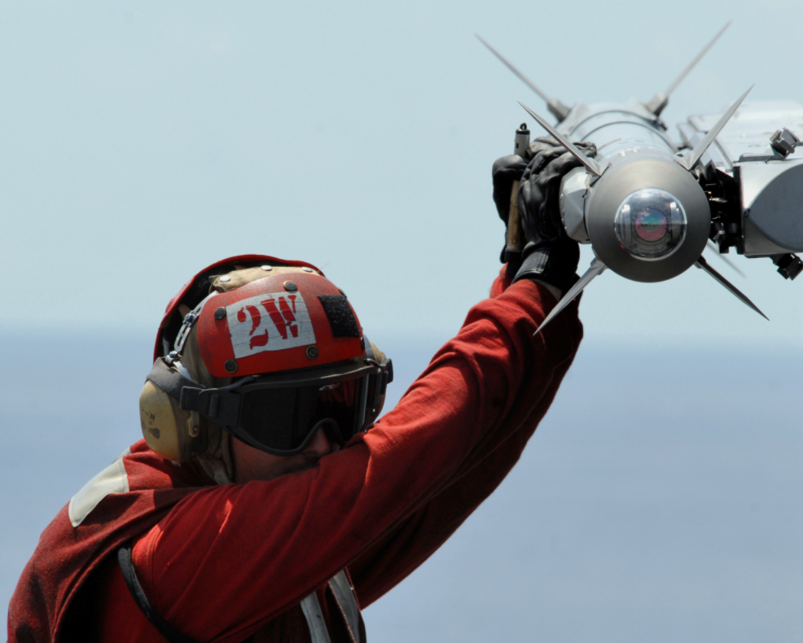
Project Description
The goal of this project is to improve upon a test fixture utilized by Raytheon.
The test fixture simulates flight conditions experienced by supersonic missiles.
Our intention is to design a test fixture which is more diverse and has quicker assembly.
Our Client is Chuck Vallance
formerly of Raytheon.
Client Deliverables
1)Parameters of Missile Parts
2)Test/Flight Conditions
3)CAD Model & Simulation
4)Scale Model
[1] Raytheon
1
Test Fixture for Flight Components ● Lexie Spots ● 26 Feb 2018

Slide 3
Black Box Model
Import: Fixture, Missile Parts
Test Missile Part
Export: Fixture, Missile Parts
Human Energy, Hydraulic, Heat, Electricity
Human Energy
Load Signals
Sensor Signals, Visual Signals
Test Fixture for Flight Components ● Aziz Alzaid ● 26 Feb 2018
2

Slide 4
Functional Model
Signal
Apply Thermal Load
Heat
Signal
Export Fixture, Parts & Sensors
Strain Missile Part
Electricity
Sensor Output
Collect Strain Data
Electricity
Apply Mech. Load
Hydraulic
Human Signal
Import Control
Center
Signal
Import Sensors
Electricity
Human Energy
Import
Test Fixture
Import Missile Part
Test Fixture for Flight Components ● Aziz Alzaid ● 26 Feb 2018
2

Slide 5
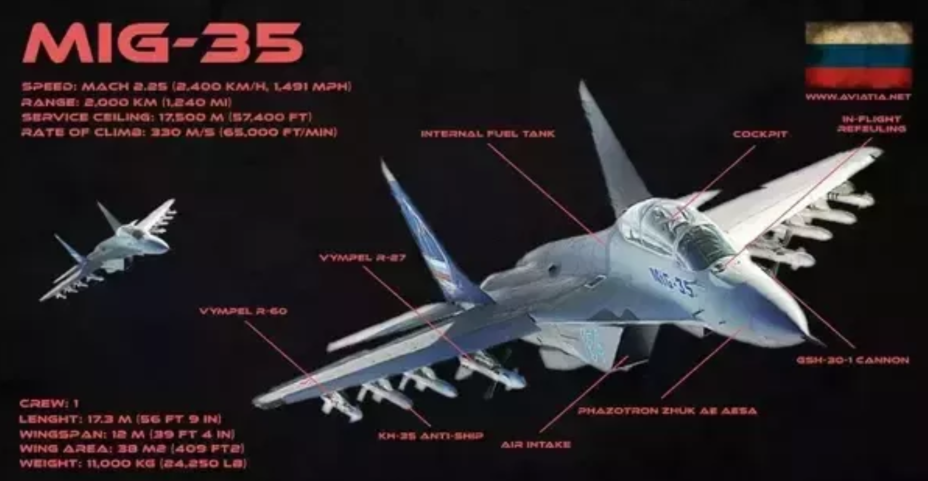
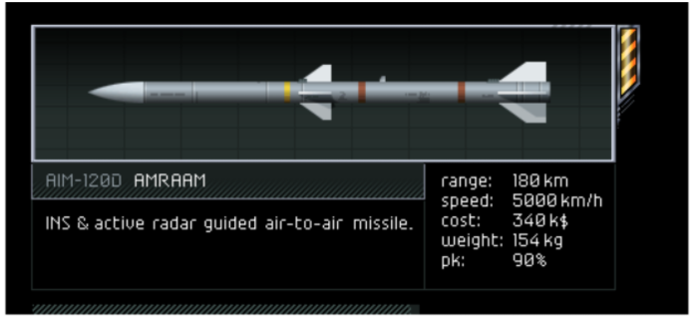
Flight Envelope
[2] Airforce-Technology
[1] Raytheon
Mikoyan MiG-35
AIM-120D AMRAAM
Maximum Speed
Mach 2.25 at 16km Altitude
Mach 1.1 at Sea Level
Maximum Altitude 22km
Speed Unknown
Maximum Speed
Mach 4 (4,900 km/hr)
Test Fixture for Flight Components ● Israel Sotelo ● 26 Feb 2018
2

Slide 6
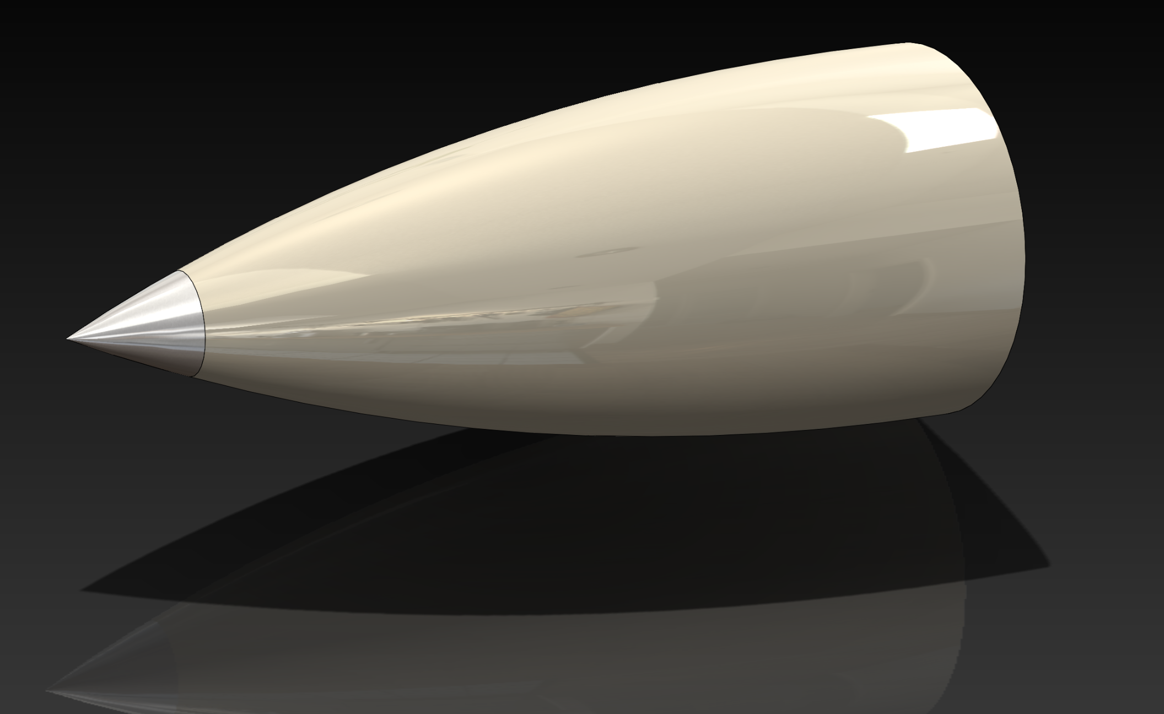
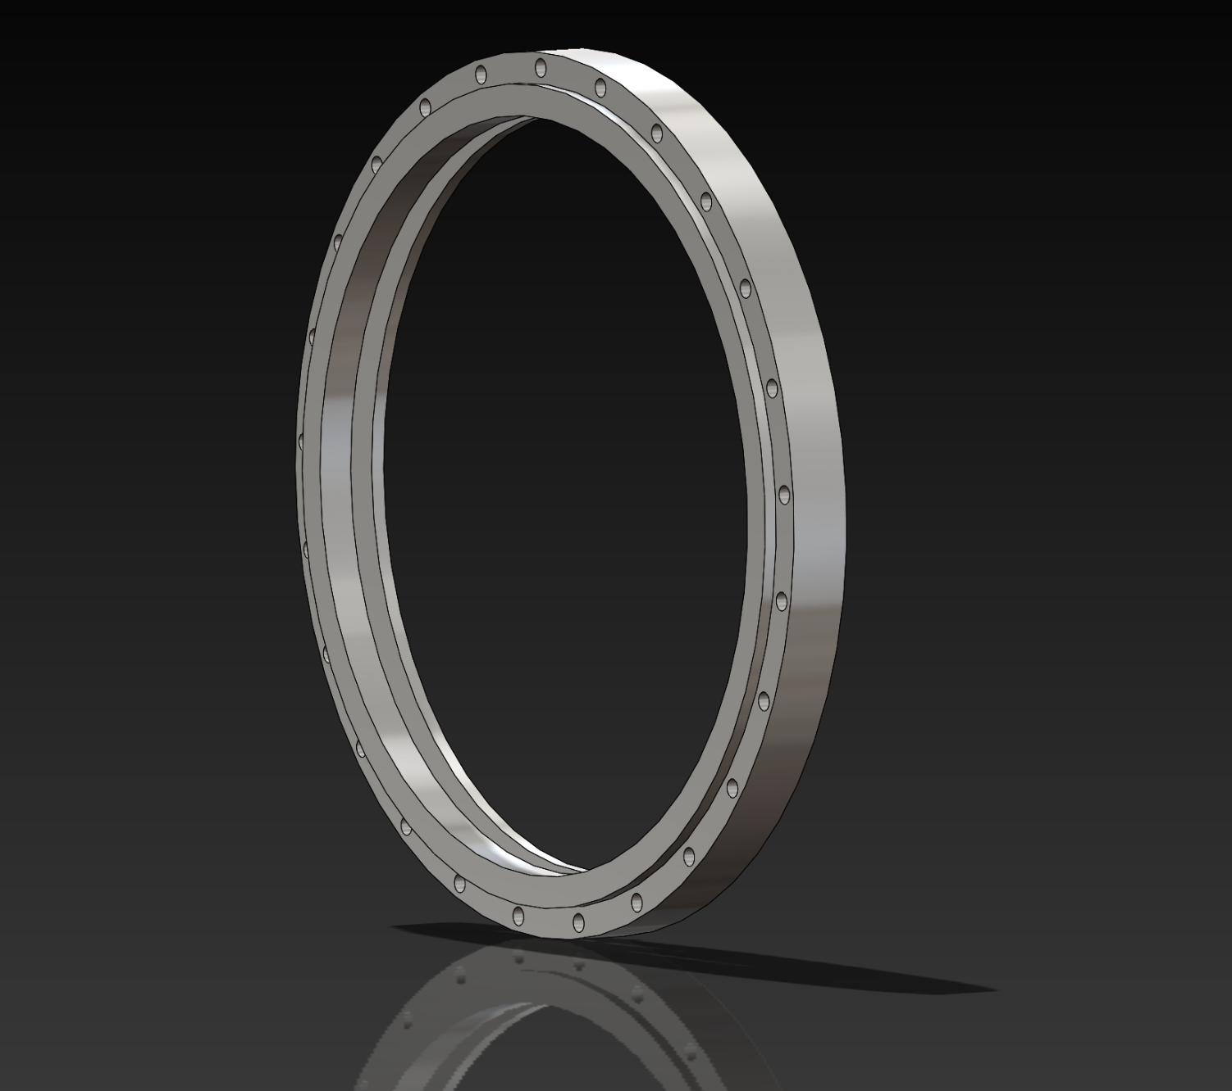
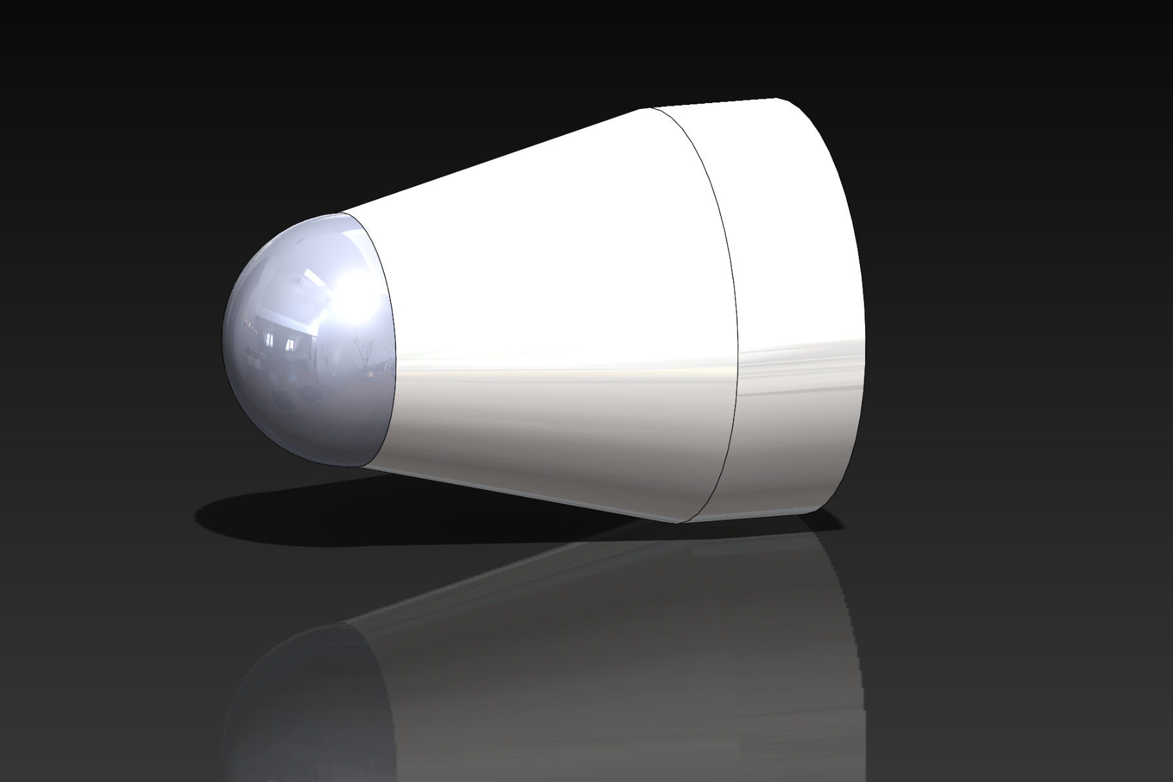
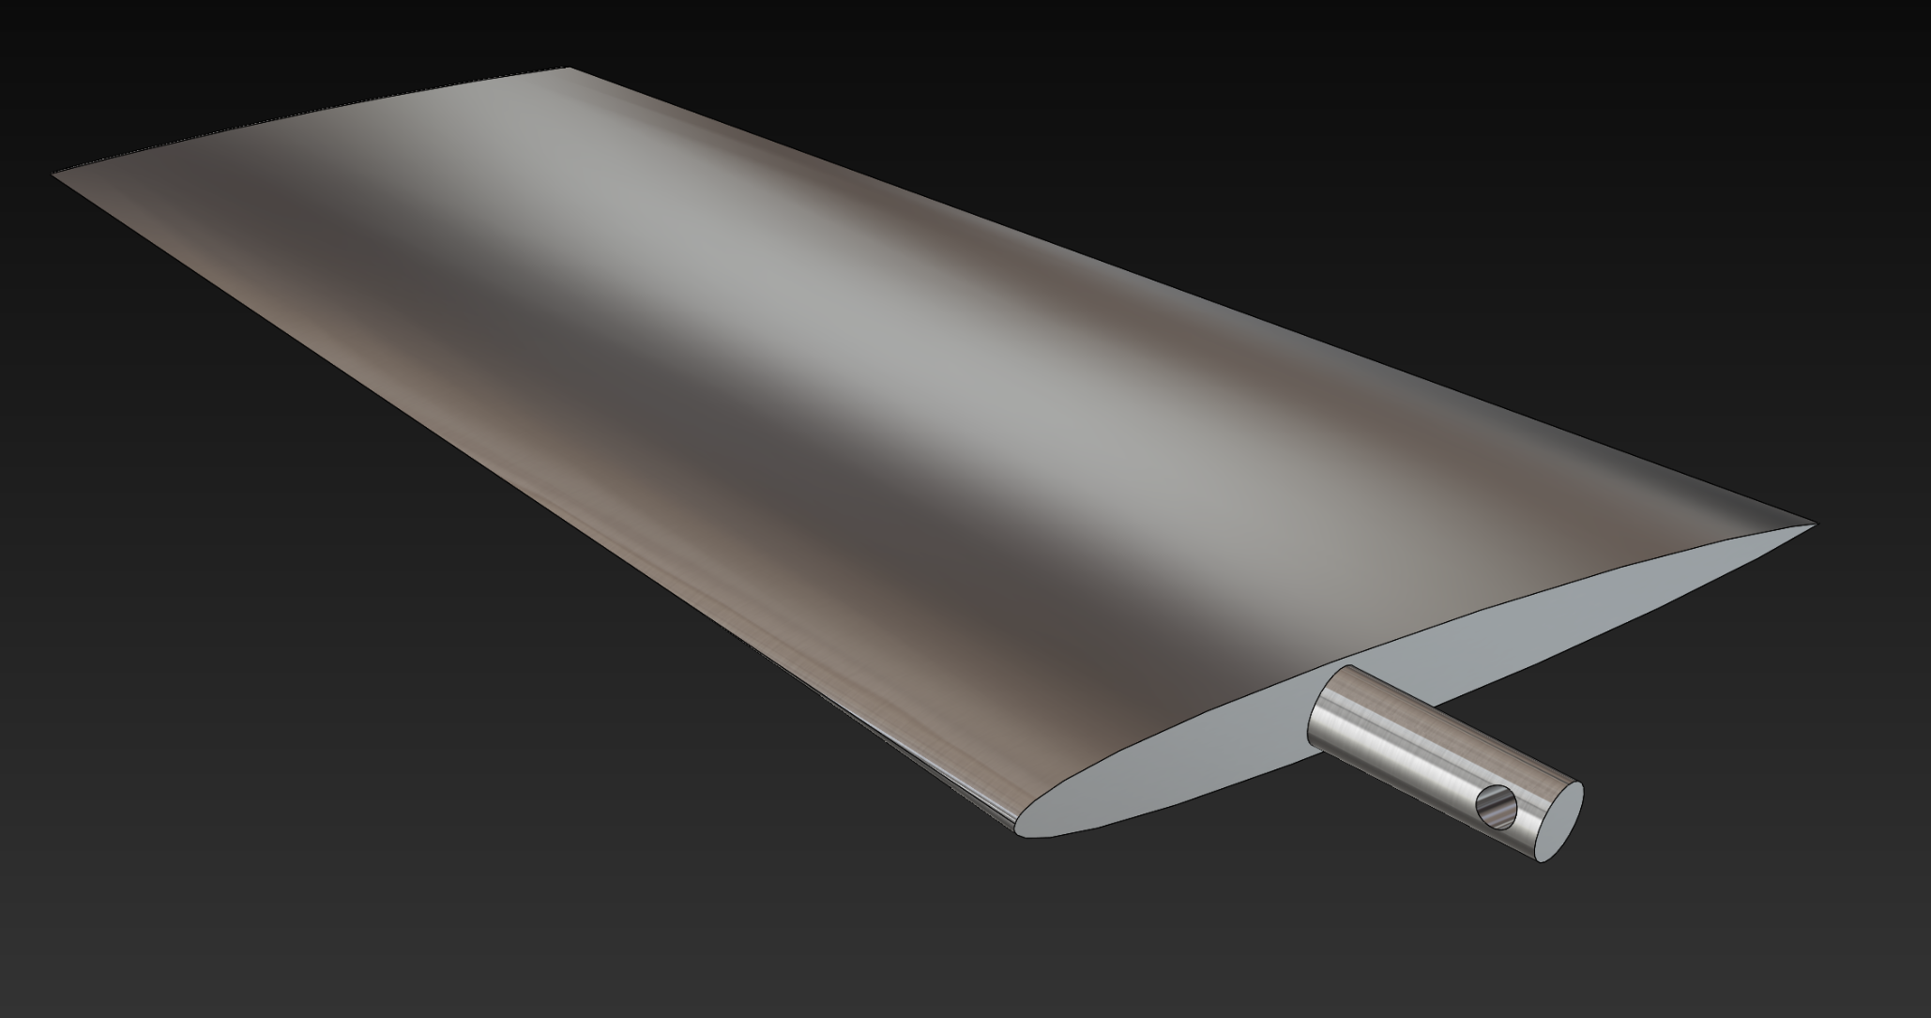
Parts Selected
AMRAAM Radome
AMRAAM Radome Mounting Ring
Sidewinder Radome
AMRAAM Control Surface
Test Fixture for Flight Components ● Israel Sotelo ● 26 Feb 2018
2

Slide 7
Mechanical Loading Calculations
Black Box Model
Assuming steady level flight for a leading edge (N = 1)
q(y) = L’(y) – N*g*m’(y)
q = net beam loading for a leading edge
L’ = Lift/span distribution
N = Load factor
g = gravity acceleration
m’ = wing mass/span distribution
Test Fixture for Flight Components ● Lexie Spots ● 26 Feb 2018

Slide 8
Thermal Loading Calculations
Black Box Model
We’re not accounting for temperature profiles
To calculate fluxes we will use stagnation point heating as well as flat plate boundary layer heating
We will interpolate between laminar and turbulent fluxes to get the transient flux
$Q=C∗\sqrt{\frac{ρ}{r}}∗{\left(V/10000\right)}^{3}$ (stagnation point heat flux)
Some other variables required for laminar and turbulent flux calculations – Nusselt number, Reynolds number, heat transfer coefficient, thermal conductivity, Prandtl number, specific heat capacity, adiabatic wall temperature
For example: when a missile is at 32000 ft and is at a speed of about 1200 m/s (nearly mach 4) its transient heat flux is 88.6 W/cm^2
Test Fixture for Flight Components ● Lexie Spots ● 26 Feb 2018

Slide 9
Designs Considered
Test Fixture for Flight Components ● Lexie Spots ● 26 Feb 2018

Slide 10
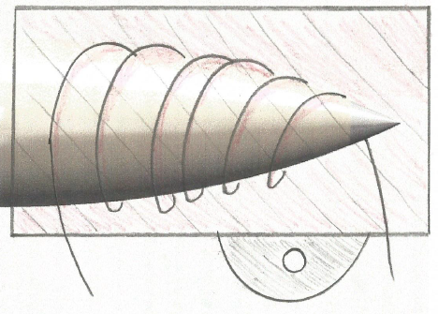
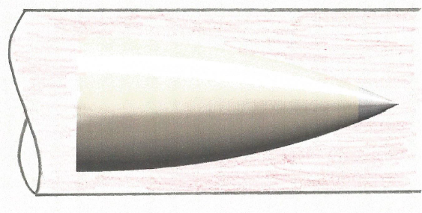
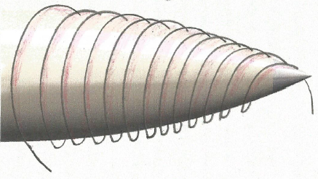
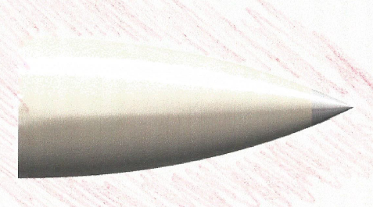
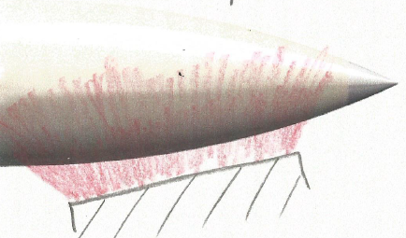
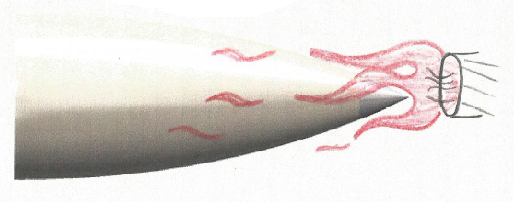
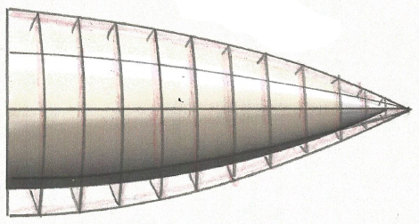
Pugh Chart – Heat Load
Technical Requirements | Heating Coils | Oven | Heat Lamp | Fixture | Flame/ Plasma | Fluid | Cage
Allows for Both Loads | - | + | - | + | + | - | +
Even Distribution of Both Loads | - | + | - | + | 0 | 0 | +
Safe | + | + | + | + | - | + | +
Quick Assembly | + | + | - | + | + | - | +
Non Destructive | + | + | + | + | - | - | +
Universal | 0 | + | + | - | + | + | -
Quick Assembly | + | + | 0 | + | + | - | +
Net | 2 | 7 | 0 | 5 | 2 | -2 | 5
Rank | 3 | 1 | 4 | 2 | 3 | 5 | 2
Continue ? | N | Y | N | Y | Y | N | Y
4
Test Fixture for Flight Components ● Israel Sotelo ● 26 Feb 2018

Slide 11
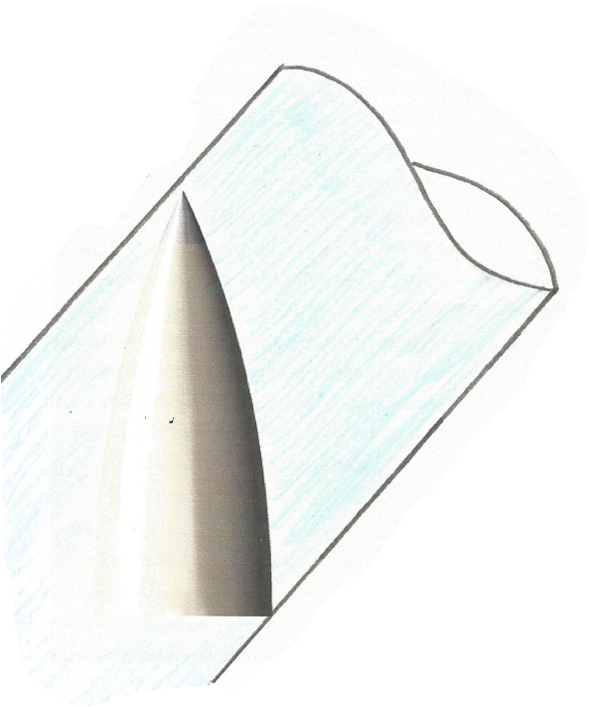
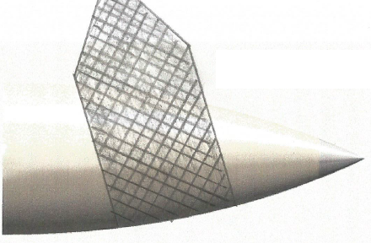
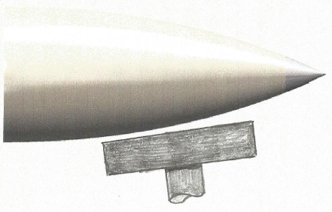
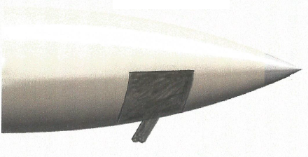
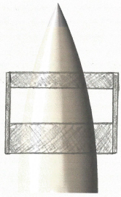
Pugh Chart – Mechanical Load
Technical Requirements | Strap | Block | Cradle | Fixture | Rings | Fluid
Allows for Both Loads | - | - | - | 1 | - | 0
Even Distribution of Both Loads | - | - | - | 1 | - | +
Safe | + | + | + | 1 | + | +
Quick Assembly | + | + | + | 1 | + | -
Non Destructive | + | 0 | + | 1 | + | -
Universal | + | + | - | - | - | +
Quick Assembly | + | + | + | + | + | -
Net | 5 | 2 | 1 | 6 | 1 | 0
Rank | 2 | 3 | 4 | 1 | 4 | 5
Continue ? | Y | N | N | Y | N | N
4
Test Fixture for Flight Components ● Israel Sotelo ● 26 Feb 2018

Slide 12
Schedule
Schedule
First Semester Task / Objective* | Estimated Date of Completion*
Research Areas of Focus | February 8th , 2018
Initial Research / Calculations
Determine Environmental Loading Due to Flight Conditions | February 27th ,2018
Determine Flight Conditions for Supersonic Uses
Preliminary Sizing Calculations
Subsystem Concept Generation
Determine How to Apply Loads Simultaneously | April 19th , 2018
Design Mechanical System
Produce Specifications
Initial CAD Demonstration and BOM | May 3rd ,2018
* Objectives and schedule order are subject to change
= current location on schedule
Test Fixture for Flight Components ● Shanna Lechelt ● 26 Feb 2018
5

Slide 13
Schedule Continued
Schedule
Team Member | Current Team Technical Role
Lexie | Heat Flux Calculations, FEA
Shanna | Mechanical Loading Calculations
Israel | Flight Envelope Calculations, SolidWorks, FEA
Aziz | Sensors, Data Collection
Second Semester Task / Objective*
Total Loads and Power Estimates
Produce Drawings and Simulations
2nd (and possibly 3rd) Iteration – Calculations and Drawings
Produce Prototype and Demonstrate Usage
Technical roles will be flexible and periodically adjusted to assure that we meet both client and capstone requirements
More specific technical roles will arise and be assigned respectively as the project progresses
Test Fixture for Flight Components ● Shanna Lechelt ● 26 Feb 2018
5

Slide 14
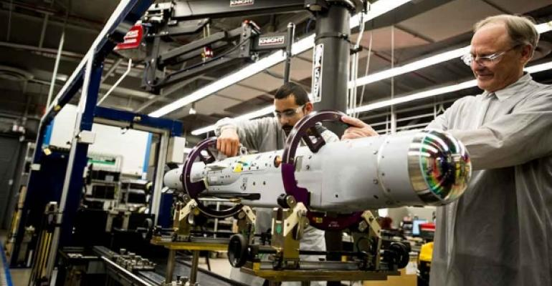
Budget
Available Capstone funds: $800
Anticipated Prototype expense: $200
No plans for any purchases until 2nd Semester
3D printed model
Any required computational software
[1] Raytheon
6
Test Fixture for Flight Components ● Shanna Lechelt ● 26 Feb 2018

Slide 15
Budget Continued
Currently Existing, Full Size, Major Design Expenses | Cost (USD, $)
Quartz Lamps | $2000 each x (8 – 10) units = $16,000 - $20,000
Hydraulic Ram | $1,000 - $2,000
Temperature Sensors | $20 each x (100 – 300) units = $2,000 - $6,000
3” Steel I-Beams, 10’ Long | $50 each x (53 – 70) units = $2,650 - $3,500
Man-Hours | ($20 - $40) x (400 – 480) hours = $8,000 - $19,200
Other Equipment / Costs | ~ $50,000 - $60,000
TOTAL: | ~ $79,650 - $110,700
Other equipment costs account for smaller parts of test fixture, data collection methods, any man-hours not accounted for, and any extra costs required to improve safety
Unit prices and required amounts are based on numbers given by the client
6
Test Fixture for Flight Components ● Shanna Lechelt ● 26 Feb 2018

Slide 16
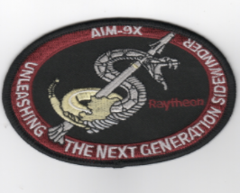
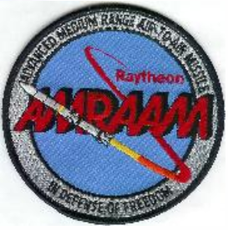
Conclusion
As this Project progresses throughout the next semester we intend to continue to refine our calculations and simulations. With several iterations of the design process we hope to find an adequate means to improve this aerospace test fixture.
7
Test Fixture for Flight Components ● Shanna Lechelt ● 26 Feb 2018

Slide 17
Questions ?
References
[1] Raytheon.com, ‘Mission, Golbal Defense’, 2017. [Online]. Available: https://www.raytheon.com/capabilities/missiledefense. [Accessed 2/7/2018]
[2] Airforce.com, ‘MiG-35 Fulcrum – F Fighter Multirole fighter’, 2007. [Online]. Available: https://www.airforce-technology.com/projects/mig35/.
[Accessed 2/24/2018]
8

