Slide 1

Alternative Power Source for Dental Hygiene Device
Team Concussion
Nizar Almansouri
Ningbiao Jiang
Francisco Heath
Jin Niu
Jiaqi Xie

Slide 2
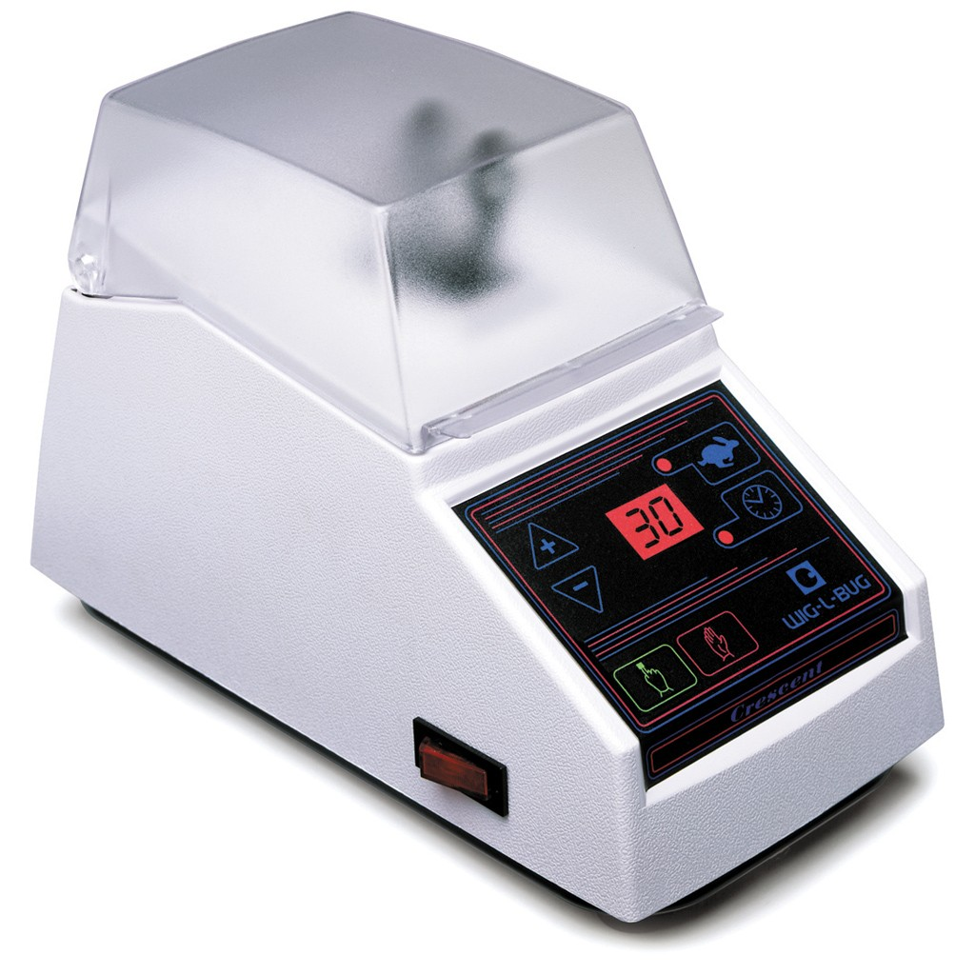
Contents of Presentation
Sponsor information
Objectives/Constraints
Criteria
Timeline
Wig-L-Bug

Slide 3
Sponsor Information
Department of Dental Hygiene
College of Health and Human Services
Northern Arizona University
Provides Humanitarian services in India
Dental inspections and fillings
No power on site

Slide 4
Need Statement
Department of Dental Hygiene wants a portable power source for Wig-L-Bug
    A. Cannot mix by hand
B. No power source

Slide 5
Goal/Scope
Design and build a portable power source for Wig-L-Bug
Not for a commercial scale but for one or two units

Slide 6
Objectives Chart
Objective | Basis for Measurement | Units
Durable | Drop from height | meter
Long Life Span | Number of charge cycles | cycles
Low Cost | Manufacturing cost | dollar
Portable - Size | Dimension of the power source | cm*cm*cm
Energy Capacity | Energy stored | W*h
Portable - Weight | Weight of the power source | kg

Slide 7
Constraints
Must have a stable AC voltage output of 110 V @ 60 Hz
Maximum output of 1.2 Amps
Must be able to power device continuously for 10 hours
Cannot weigh more than 12 kg
Must be able to fit in 56 * 45 * 25 cubic cm container
Must be able to charge on 220 V @ 50Hz
Must be able to charge 0 - 100% in eight hours

Slide 8
Criteria Chart
Objectives | Criteria
Powerful | Output Power
Portable(Size) | Size
Portable(Weight) | Weight
Energy Capacity | Energy Stored
Long Time Span | Number of Charge Cycles
Inexpensive | Cost

Slide 9
Quality Functional Deployment

Slide 10
House of Quality

Slide 11
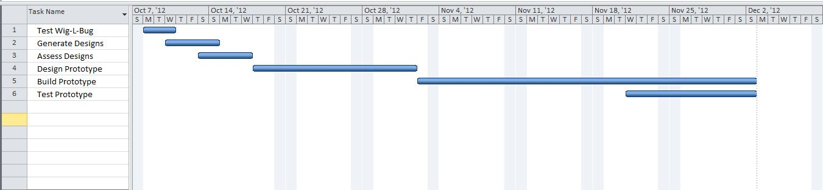
Gantt Charts

Slide 12
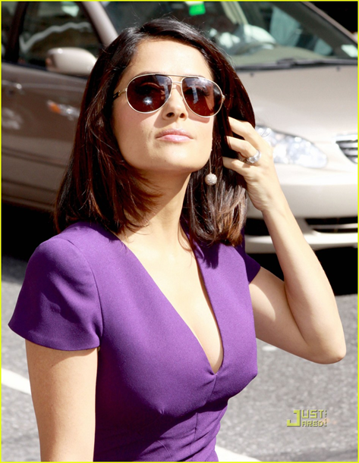
Questions?

