Slide 1
Smart Board
Team members: Yanjun Duan, Mohammad Ahmad, Wenkun Xiao
Date: 14 October 2022

Slide 2
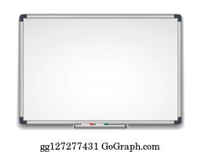
Introduction
What is the smart board?
Easy to control
Have database
Privacy

Slide 3
Statement of Needs
Recording what is on the white board, erasing parts, or adding more to notes on the board when not physically present is difficult.
This project seeks to cross the divide between physical and digital white board use, making a system that cleanly integrates with the old school white board technologies, but provide features not possible with traditional white boards.

Slide 4
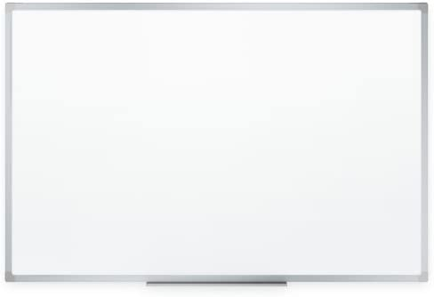
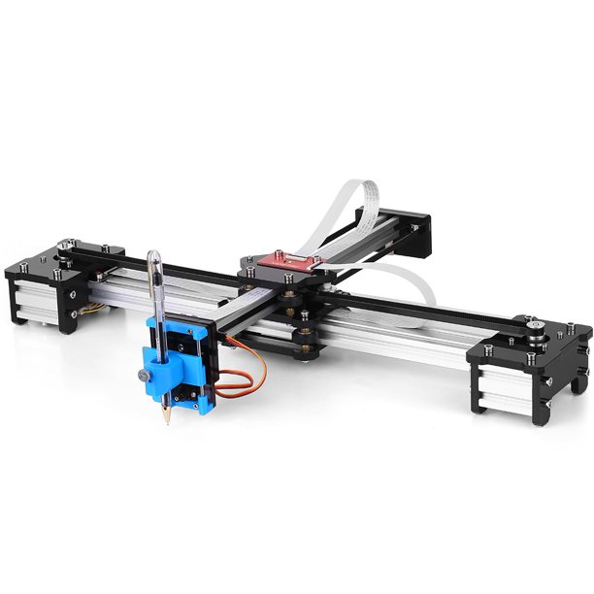
Statement of Objective
Smart Board
Our idea is to combine a traditional whiteboard with an xy plotter

Slide 5
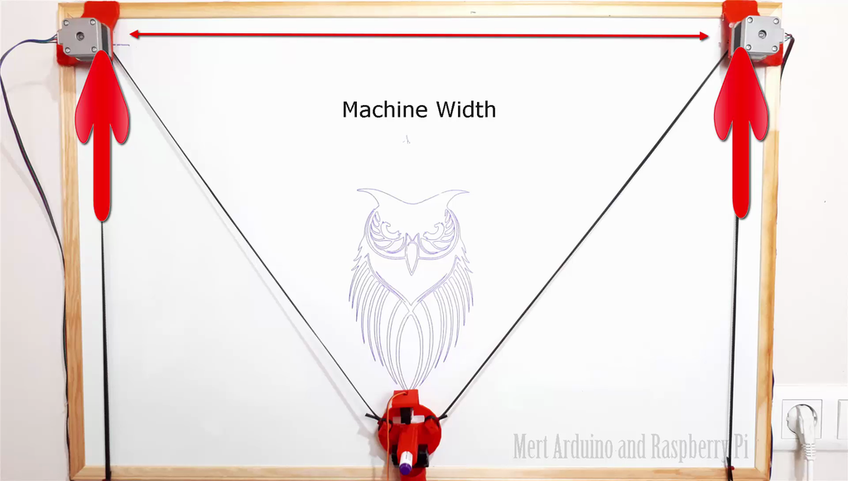
The robot that we need to design
XY Plotter Drawing robot

Slide 6
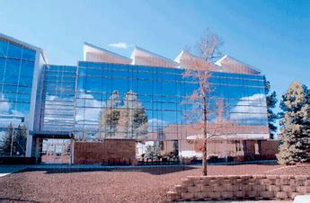
Someone may ask what exactly the function and scenario of our project?
Please imagine this condition, our engineering building
What we can do on the facade of the building？

Slide 7
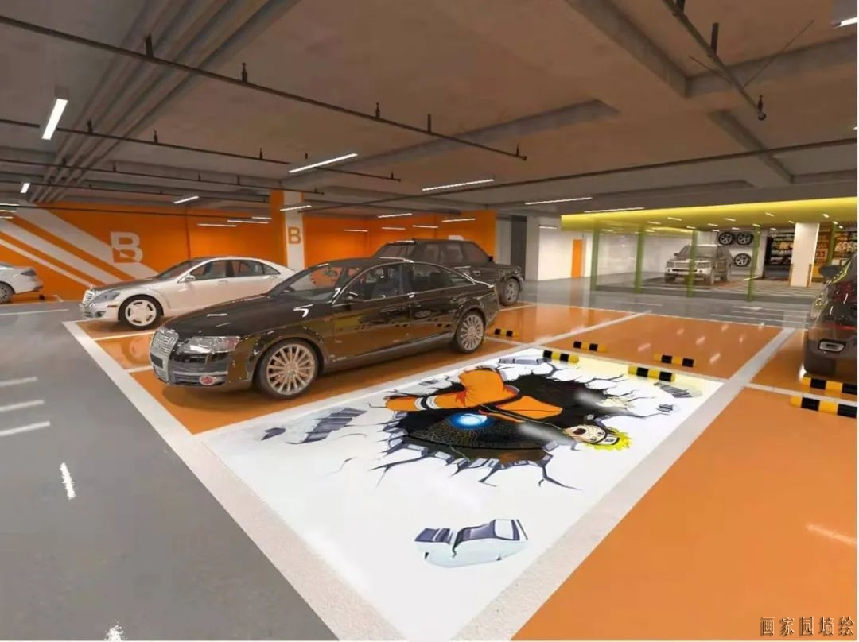
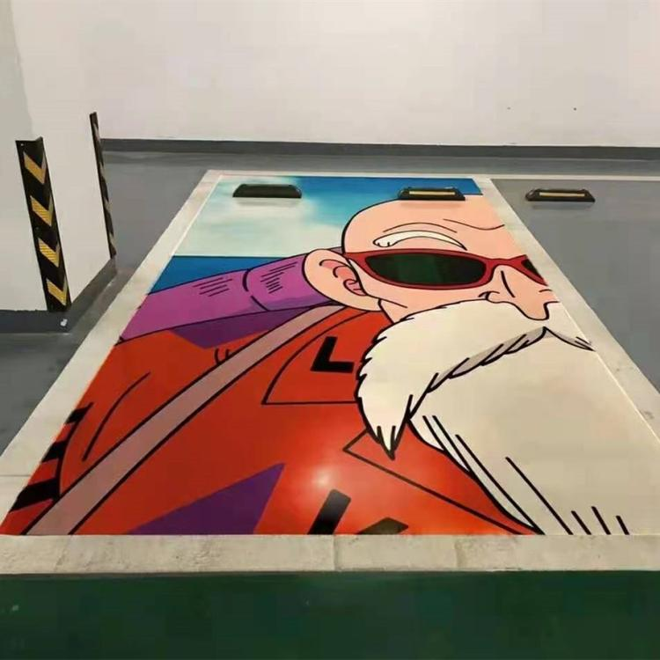
Our whiteboard is not only limited to whiteboards, it can be anywhere you can draw
It allows every building in the city to have a different style every day
Also can give your parking space a different style every day

Slide 8
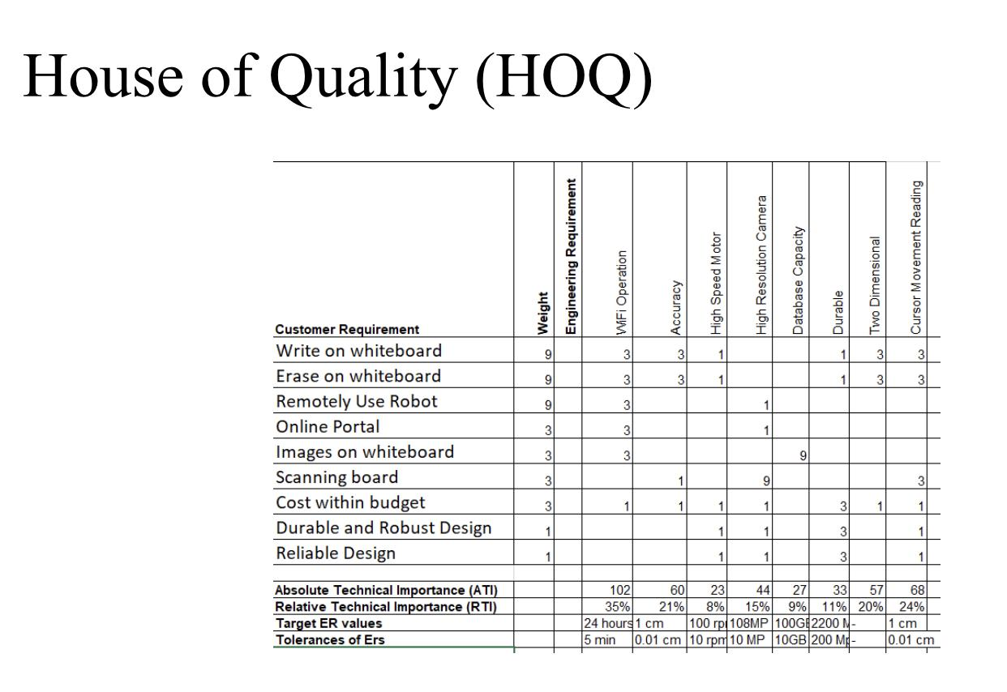

Slide 9
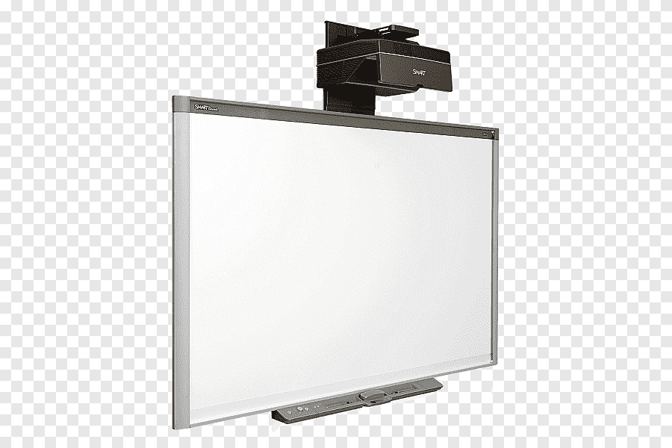
Conclusion
Make Life easier
Saving time
effective

Slide 10
Reference
https://www.instructables.com/XY-Plotter-Drawing-Robot-Arduino-Polargraph/
https://www.maslowcnc.com/
https://youtu.be/gYv5TzKNsK4
https://eltra-encoder.eu/news/quadrature-encoder

Slide 11
Question

