Slide 1

Wind Power Converter
Group Members: Mohammad Alenezi, Fahad Alazemi, Hamad Abdulmalek, Abdullah Alghasab
Client: Dr. Yaramasu Mentor: Ashwija Korenda
Abdullah Alghasab

Slide 2
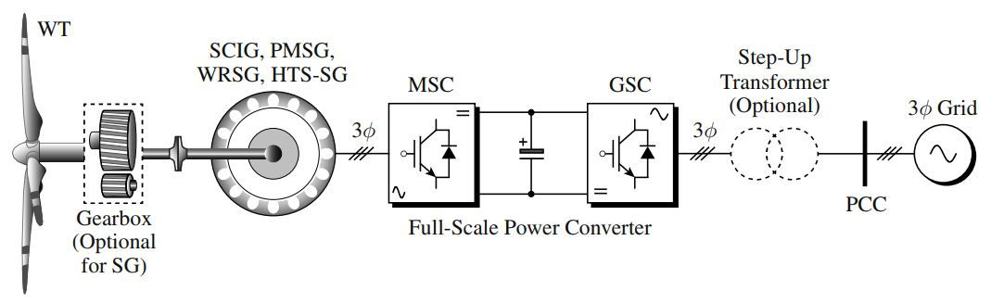
Introduction
What is Wind Turbine?
Our goal in this project is to build a power converter that used in Wind Turbine.
NPC (Neutral Point Clamped) converter.
[1] Type 4 : WECS
Abdullah Alghasab

Slide 3
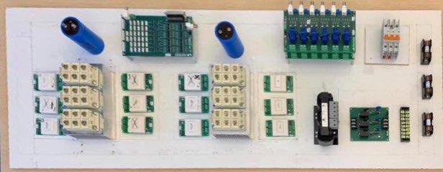
Layout
Abdullah Alghasab

Slide 4
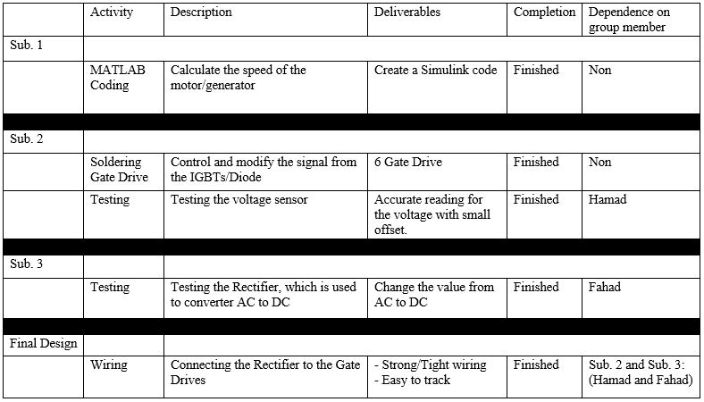
Mohammad’s WBS
Mohammad Alenezi

Slide 5
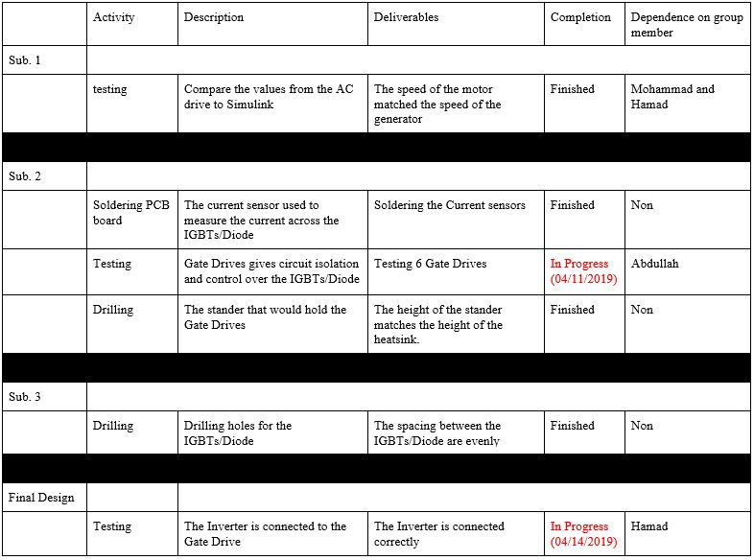
Fahad’s WBS
Fahad Alazemi

Slide 6
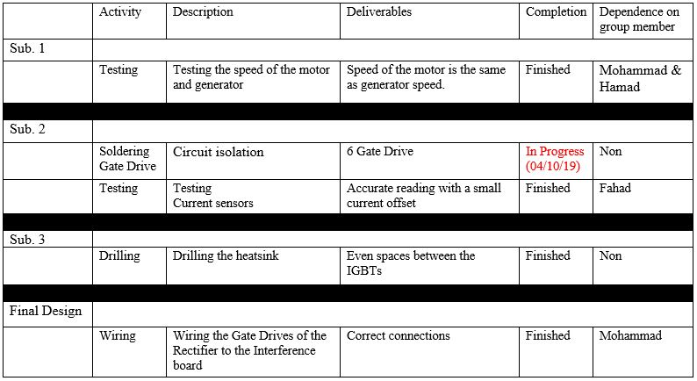
Abdullah’s WBS
Abdullah Alghasab

Slide 7
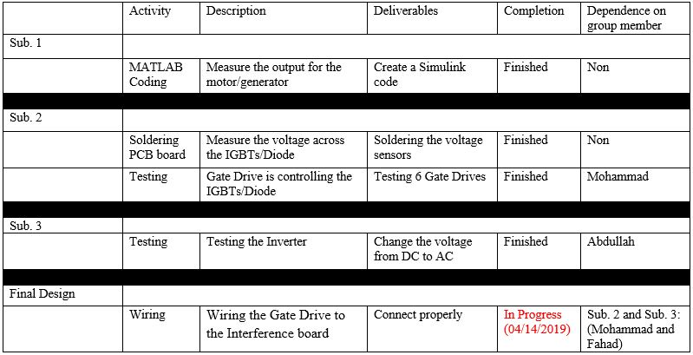
Hamad’s WBS
Hamad Abdulmalek

Slide 8
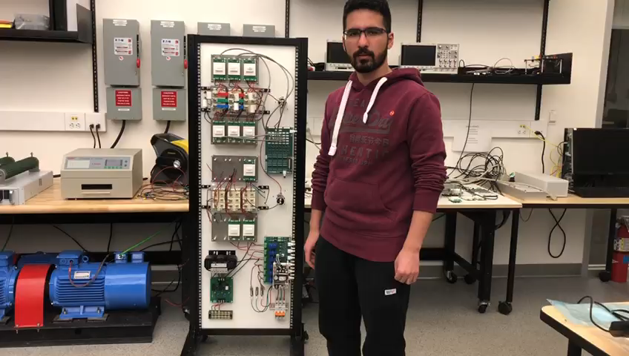
Demonstration
Mohammad Alenezi

Slide 9
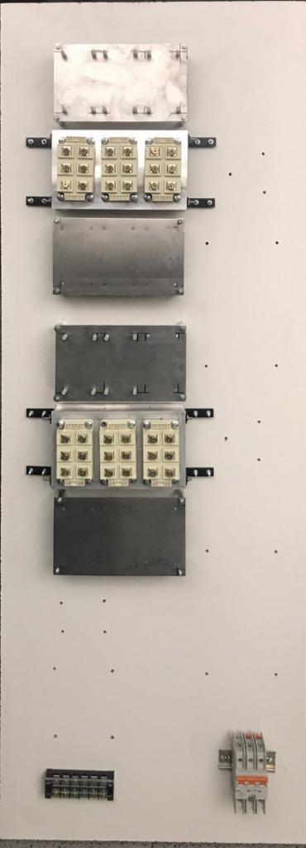
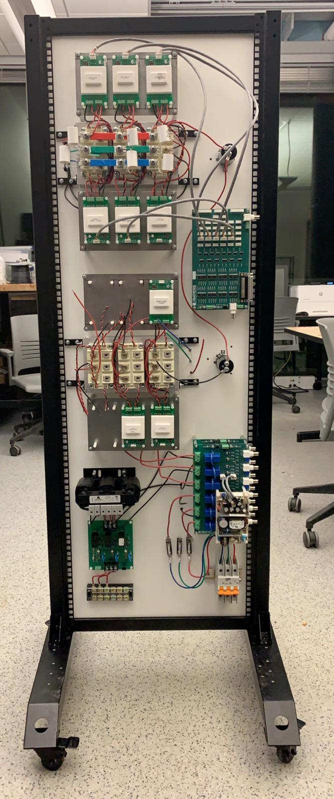
Conclusion
Finished Objective:
  Motor/Generator
  Power Converter
  Voltage/Current Sensors
In Progress:
  Gate Drives
  Final Design
    NPC Converter
Progress in 02/26/2019
Progress in 04/02/2019
Hamad Abdulmalek

Slide 10
Reference
[1] Y. Venkata & W. Bin. “BASICS OF WIND ENERGY CONVERSION SYSTEMS (WECS)”.

Slide 11
Questions?

