Slide 1
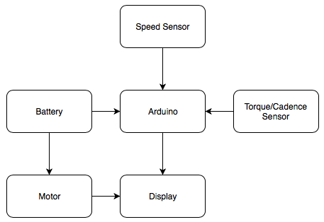
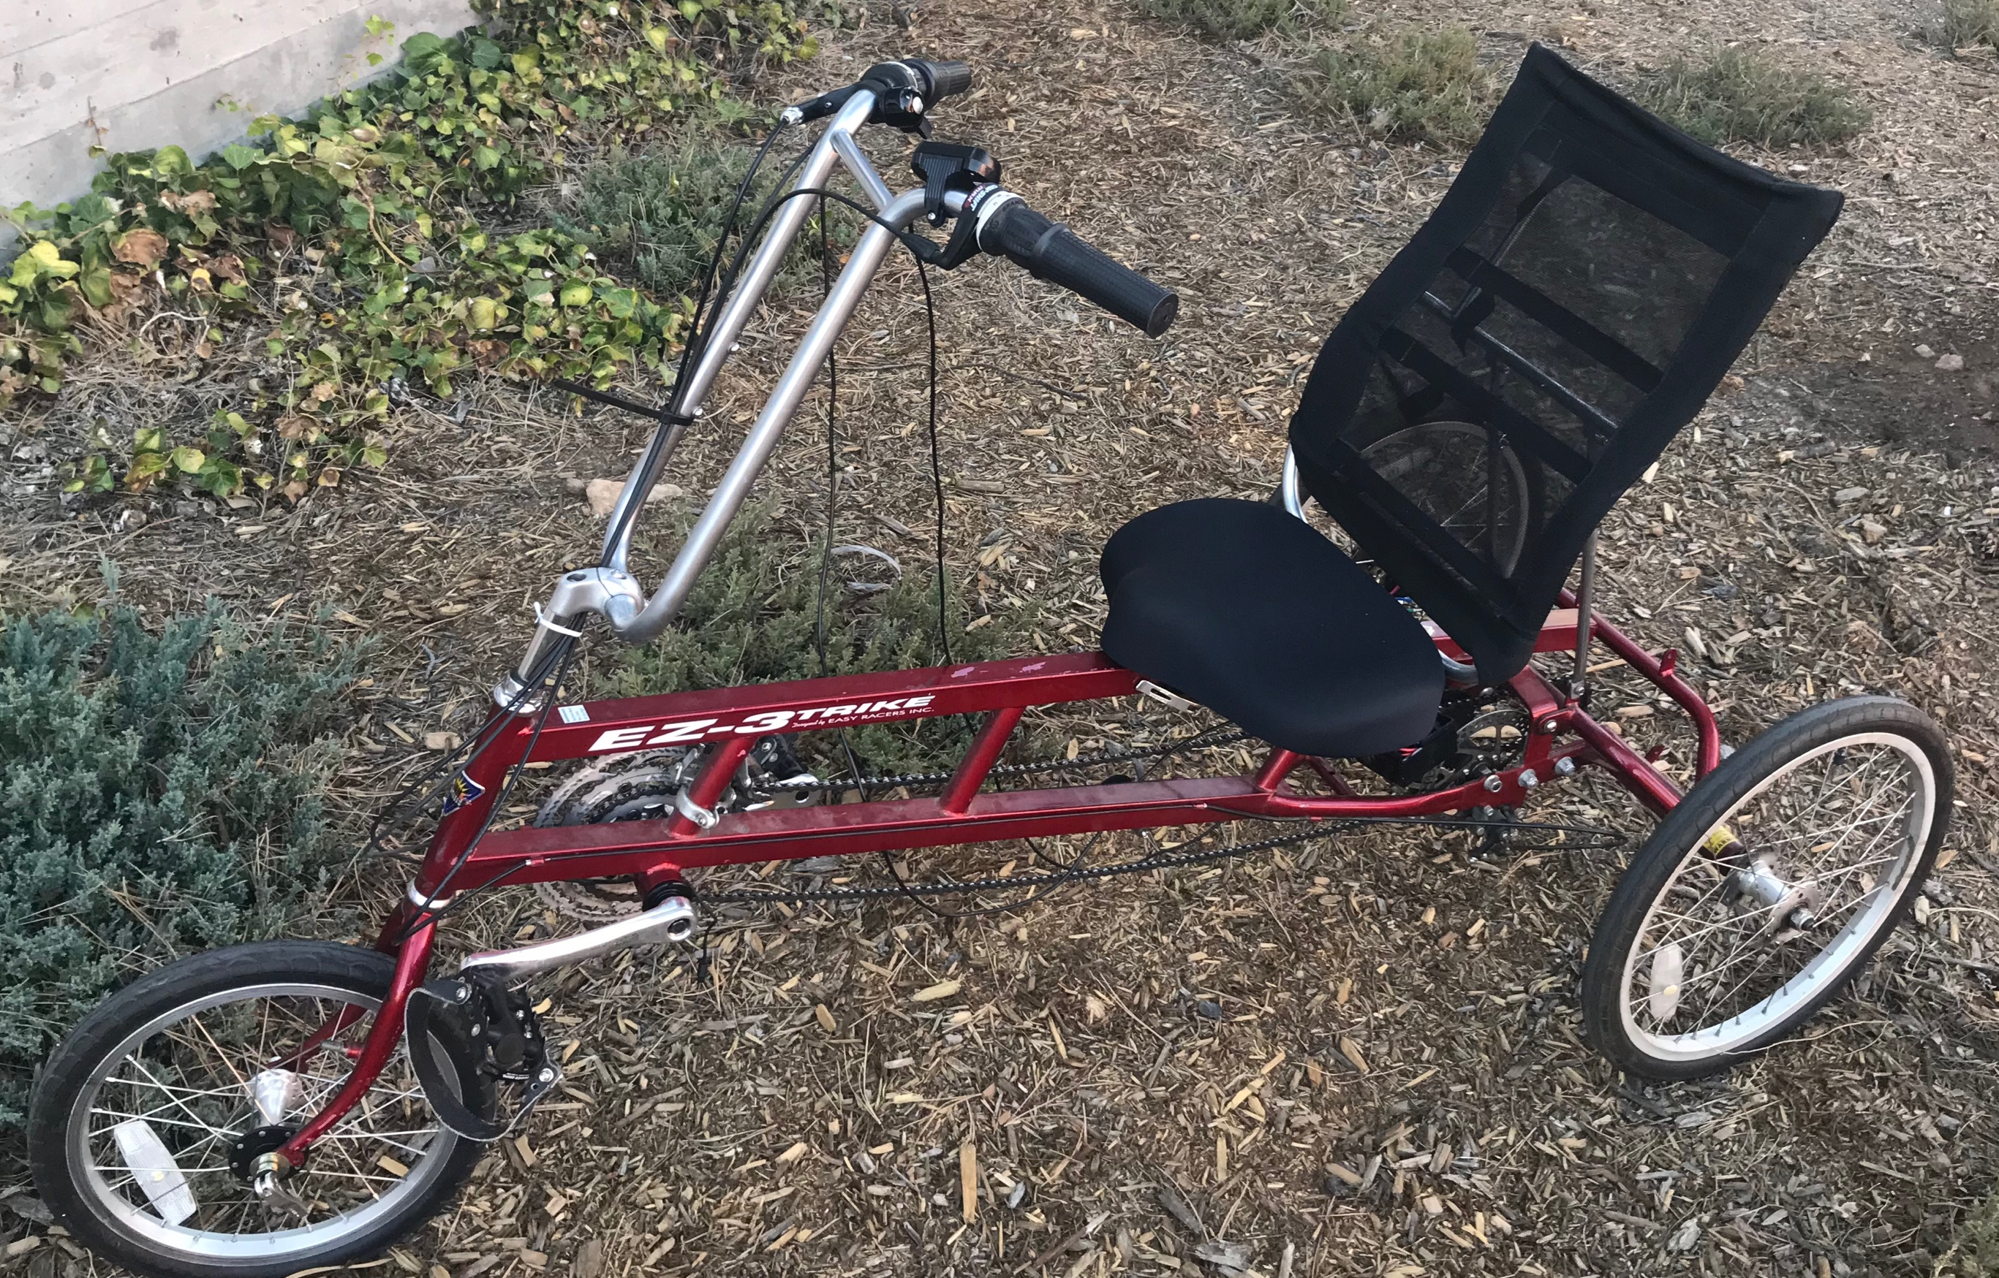
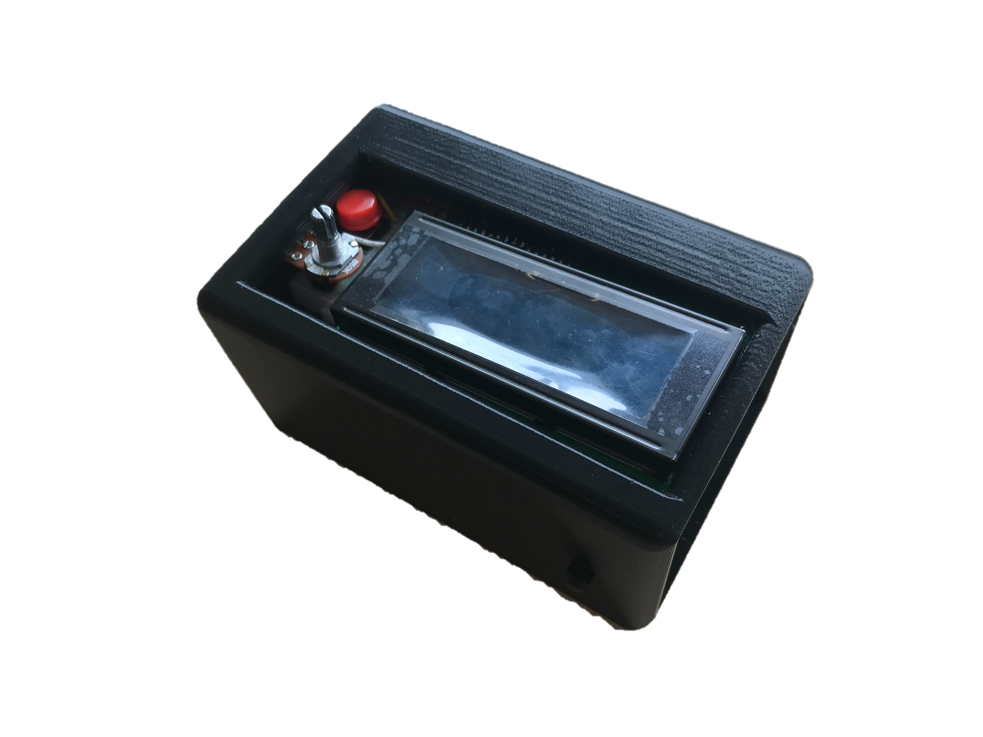
Motorized Tricycle
James Sigler, Mohammed Allahyani, Khalid Alghamdi, Yu Sun
School of Informatics, Computing, and Cyber Systems; Northern Arizona University
Abstract
Specifications
Final Design
As technology improves, the popularity of electric bicycles has exponentially increased. Many people are using electric bicycles as their primary form of transportation. One major problem is that not many of these bicycles are designed for users with physical conditions. Our client requires us to use a recumbent tricycle and which will then be converted to an electric tricycle to provide additional assistance to the user. We will be adding an electric motor and multiple sensors to aid the user even further during their ride. This tricycle will be designed to be user friendly so that many different people will be able to use this tricycle.
The battery will power the two main subsystems of the project. The two main systems it will power are the motor and the Arduino. The Arduino will be obtaining data from the torque, cadence, and speed sensor. This data will then output the information to the display to show the user important information about their ride. The display will prompt the user to use the assist if they are above certain levels. This will prevent the user from overexertion.
The final product consists of five major subsystems: motor, speed sensor, cadence sensor, torque sensor, and display. The motor can convert electrical energy into mechanical energy. The motor gets powered from the battery and is placed on the front wheel. This will provide power assist to the user when they are pedaling. The motor controller can adjust the speed of the tricycle depending on the user's need. When the full assist mode is activated, the user can then ride without pedaling at all. The controller adjusts the width of the pulses delivered to the motor, which can change the speed. The sensors consist of speed sensor, cadence sensor, and torque sensor. The speed sensor is used to detect the revolutions of the wheel, this information will then be used to calculate the speed at which the tricycle is traveling. The cadence sensor will calculate the revolutions the rider pedals. For this sensor there is a circular device with eight magnet patches on it that are attached to the crank and a sensor reader is placed on the crankarms to measure the riders current cadence. When the wheel revolves one round, the sensor will interact with magnets and send the signal to the Arduino. Arduino receives the signal and can give speed of pedal revolution by calculating that data. The torque sensor is used to calculate how much force the rider is applying to the cranks. This information can be used to inform the rider to use the assistance if needed. The display subsystem is used to display important information such as speed of tricycle, torque data, and battery level on LCD screen to the user. The user can adjust their speed and power assist according to this information.
Figure 2: Diagram of subsystems
Project Challenges
Figure 1: Completed motorized tricycle
The first challenge we had was fitting the motor on the tricycle.
The motor would not fit using the original fork because the motor was originally designed to be on the rear of a bicycle.
The solution was originally to replace the fork, due to sizing problems, we then decided to cut and weld the original fork to the size that was needed and would fit the motor correctly.
The second challenge we had was getting the torque sensor to work correctly
The outputs on the torque sensor were not giving us accurate information that was shown on the display.
Our solution to this was to rewire the torque sensor to ensure that the information was correct. Doing this, we obtained more accurate information
The third challenge we had was housing for the various components.
We couldn’t find a commercially made housing that would store all of the components neatly.
We decided to 3D print a housing that would custom fit our components make it look user friendly.
Requirements
The range of a fully charged system should be about 10 miles depending on the incline of the road.
The maximum weight including cargo on this bike must be less than 225 lbs.
The system needs to be user friendly so that any normal rider would be able to easily use the bike.
The user must be able to pedal at the same time as the assistance from the motor is on.
The user must be able to easily turn on and off the assist depending on what they want to use.
The user must be able to see important information during their ride, so they can adjust accordingly.
Figure 3: User Interface
Acknowledgments
Special thanks to Jane Scott, Dr. Kyle N. Winfree, and Dr. Scott. We would like to thank all the SICCS educators that helped us along the way to successfully complete this project.

