Slide 1

Design Review 2:
Team 12 HelloWorldByMe
Facilitating Communication Between
Local Gov’ts and Non-Profit Service Providers
Notes:
Hello everyone! We are Team HelloWorldByMe and our project focuses on facilitating communication between local governments and non-profit service providers

Slide 2
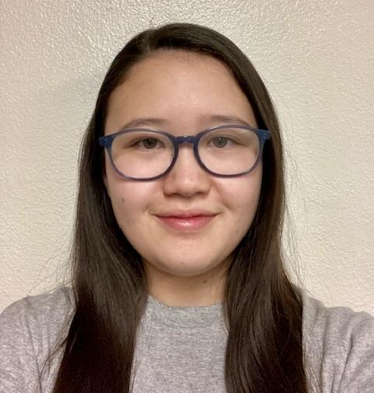


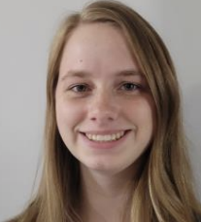
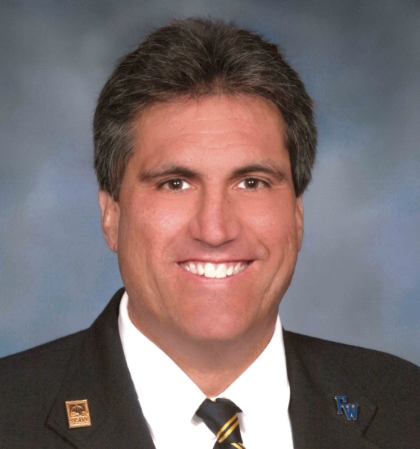


The Team
Elizabeth Knight
Team Lead
Client Communicator
Coder
Joey Banaszak
Architect
Coder
Jessica Maldonado Olivas
Release Manager
Coder
Samantha Madderom
Recorder
Coder
Kevin Daily
Client
Savannah Chappus
Mentor
Brian Donnelly
Mentor
Notes:
Before we get started, we would love to reintroduce ourselves! My name is Elizabeth Knight and I’m the team lead, client communicator, full stack coder
On the bottom right is our 2 mentors: Savannah and Brian and on the bottom left is our client, Kevin Daily. Kevin is the president of EKA Labs and the creator of the role-based education model, WorldByMe.

Slide 3
Understanding the Problem
Tucson is facing increasing rates of homelessness, leading to inefficiencies in coordinating services that focus on treating substance disorders and improving mental health.
Inconsistent communication
Updates
Assistance that prevents effective help
Notes:
With Kevin working in the public service sector, he came to us to help him resolve an issue that is way bigger than software, as the city of Tucson and beyond are experiencing high homelessness rates. Despite services being available to those with no proper shelter, local service providers are facing a lack of communication, vague updates, and ineffective assistance.

Slide 4
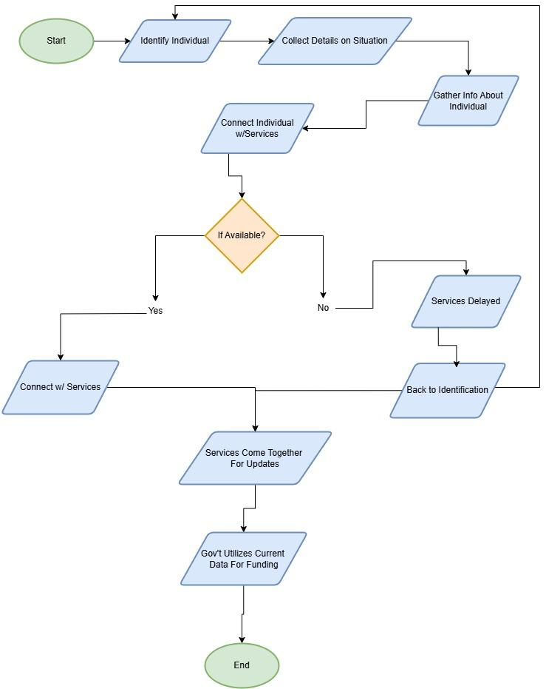
Current Workflow
Current Flaws:
Individuals have to rely on nearby service providers having availability
When services give updates on their progress with clients, it is very minimal
Appropriate government funding is not possible from a one-day-a-year community health check
Notes:
Looking deeper into the current workflow, we can see that it starts by identifying and connecting with an individual through a navigator, a volunteer working for a service provider, and then leads to trying to connect the individual in need with local services.
From there, helping people becomes heavily reliant on the availability of these services, which could easily lead to a waiting game of being discovered again.
Whether an individual gets help or not, the cycle moves on with local services getting together once a month to give vague updates on their progress with current clients and their availabilities.
Finally, local governments gather data from the local service providers and conduct a 1-day community check to determine funding.
One of the biggest issues with this one-day data collection is that it often doesn’t accurately reflect the help people in need receive.
Now I’m handing it off to Samantha to talk about the solution

Slide 5

Our Solution
Robust messaging crossing company boundaries
Role based access control
Shared access to information and resources
Data for research and better funding procurement
Notes:
Our solution begins with communication. As Elizabeth mentioned, one of the biggest problems currently is a lack of communication between these service providers and the local governments. We will create a robust communication system that will allow for intercompany communication based on common roles within the system. Role based access is yet another important component of our solution. Users will only have access to resources associated with their given role or roles within the system.
Our solution includes a database to store all the information regarding entities, employees, and users. As these nonprofits interact with people on the streets, they will be able to collect information about them and their habits. If the company allows it, this information can be shared across organizations. The organizations can also broadcast what services they have available to others. The result is that one individual has access to more resources than they would with just a single organization.
Finally, this information can be condensed and delivered to local governments and investors to increase research and funding. Funding is often based on the demographic information on the people they typically help, and with the current system only doing a single search every year, the data is often outdated and inaccurate, leading to funding problems. Our solution provides a method to alleviate some of those issues.

Slide 6
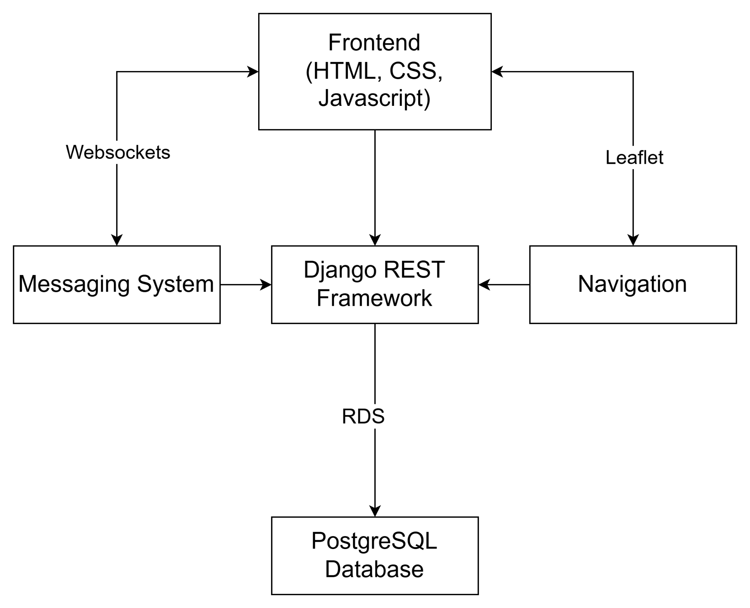
Implementation Requirements
Query the database in real-time
Security
Create an organization
Add new employees to organizations
A system that fosters communication between employees across organizations
Store critical information on individuals in need
Notes:
Samantha -> add requirements slide?
These are the major requirements for our project. We must be able to query the database in real time, create organizations, add employees, provide a method of communication, and store critical information in our database, all while maintaining security and protecting our client’s information.
We will now go into more detail about our implementation.

Slide 7
Implementation Details
Notes:
Now to get into some details of our implementation

Slide 8
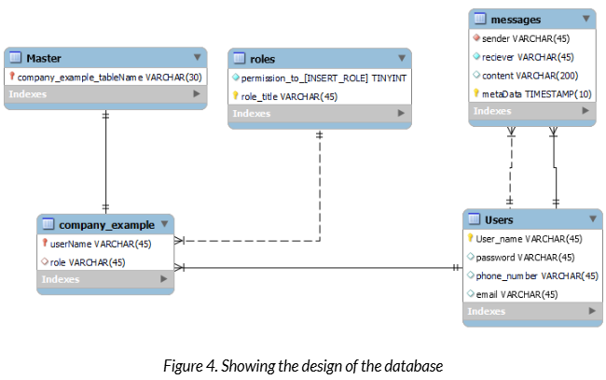
Database
Database
Navigation information
Data objects
Notes:
Joey - Firstly, Our database is hosted on an Amazon RDS instance through an EC2 server, with a postgreSQL engine. We chose postgres because it is a relational database which allows us to easily and better organize different tables. It will store information regarding role definitions, user information, what roles a user takes on, hashed passwords, entity information, as well as message history. The master table will store information about a particular company, acting as a table of contents for a distributed system so that each company will have its own table in our database allowing for a high degree of scalability. With each company having the capacity to store employee information, roles and the permissions associated with them and more.
The database will also be responsible for storing data objects associated with different users. This will include collected demographic information to be used for research purposes, and possibly government funding for organizations.
Now for our role based access control

Slide 9
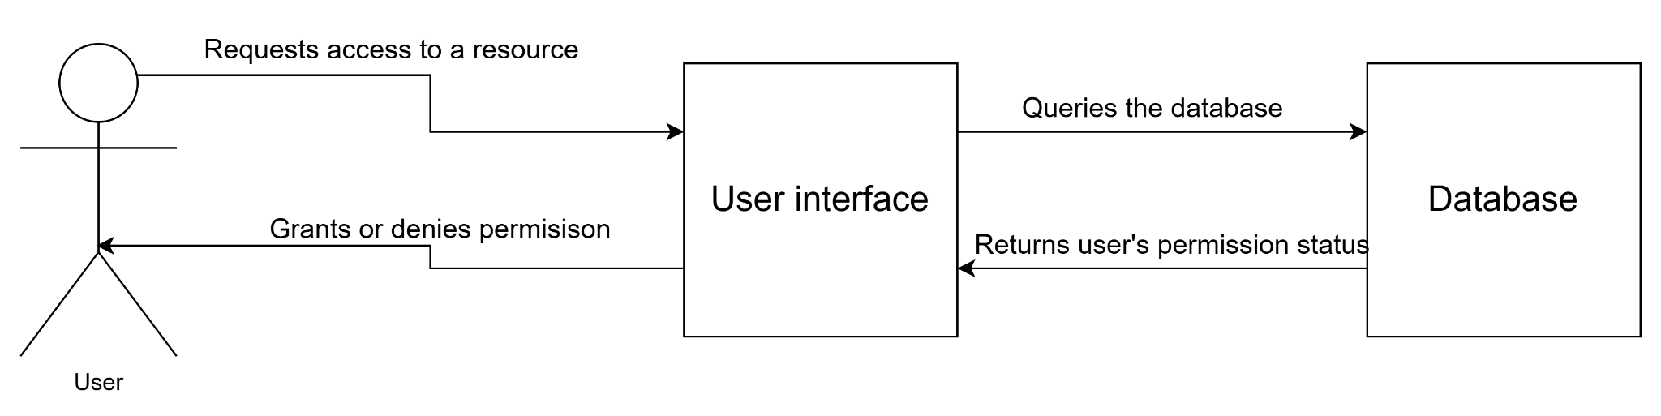
Role-Based Access Control
RBAC
Login/logout auditing
Notes:
Joey - A major aspect of our project is our clients proprietary role based access system. Users will have access to different actions and resources based on their assigned role or roles in the system. Our role based access feature will be implemented through the database. Storing a user’s role and the permissions associated with it. Roles will be associated with user’s data, and will be checked before the system will allow a user to perform certain actions, or access certain resources. The database will also have a table that specifies the roles and their level of access and if a user does not have the proper permissions, the system will simply not allow them to perform the action they were trying to perform.
We will also implement a login/logout auditing feature will will log which users make what changes to their system while they are logged in to track changes in the system. This will be hosted on our Amazon RDS database, and will connect to the User interface.
Now back to Samantha with the messaging system

Slide 10
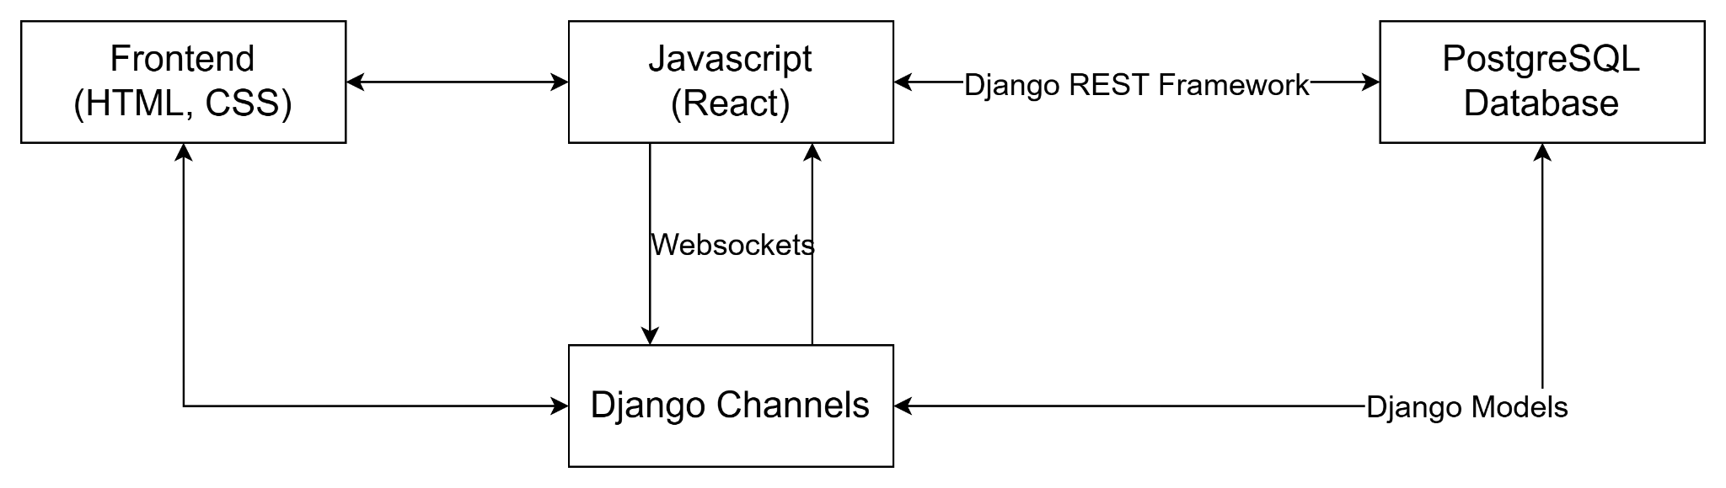
Messaging System
Notes:
Samantha
Our solution features a messaging system to facilitate cross entity communication. Users will be able to contact each other based on their assigned roles, including those with the same roles that belong to different entities. In this way, different companies can communicate with the right people easily. They will also be able to communicate with specific individuals if they so desire.
The system is built using Django channels in conjunction with websockets to provide asynchronous communication. It is connected to the UI through a backend javascript file that opens the websocket and sends information through it. Django channels picks up the communication and delivers it to the right group. Any messages that are generated get stored in the database.
Other elements of the messaging system include SMS and email. We will use email primarily for account verification, and SMS can be used to notify individuals when services are ready for them, such as housing. SMS will be implemented through Twilio, and we will use AWS Simple Email Service for the email aspect.

Slide 11
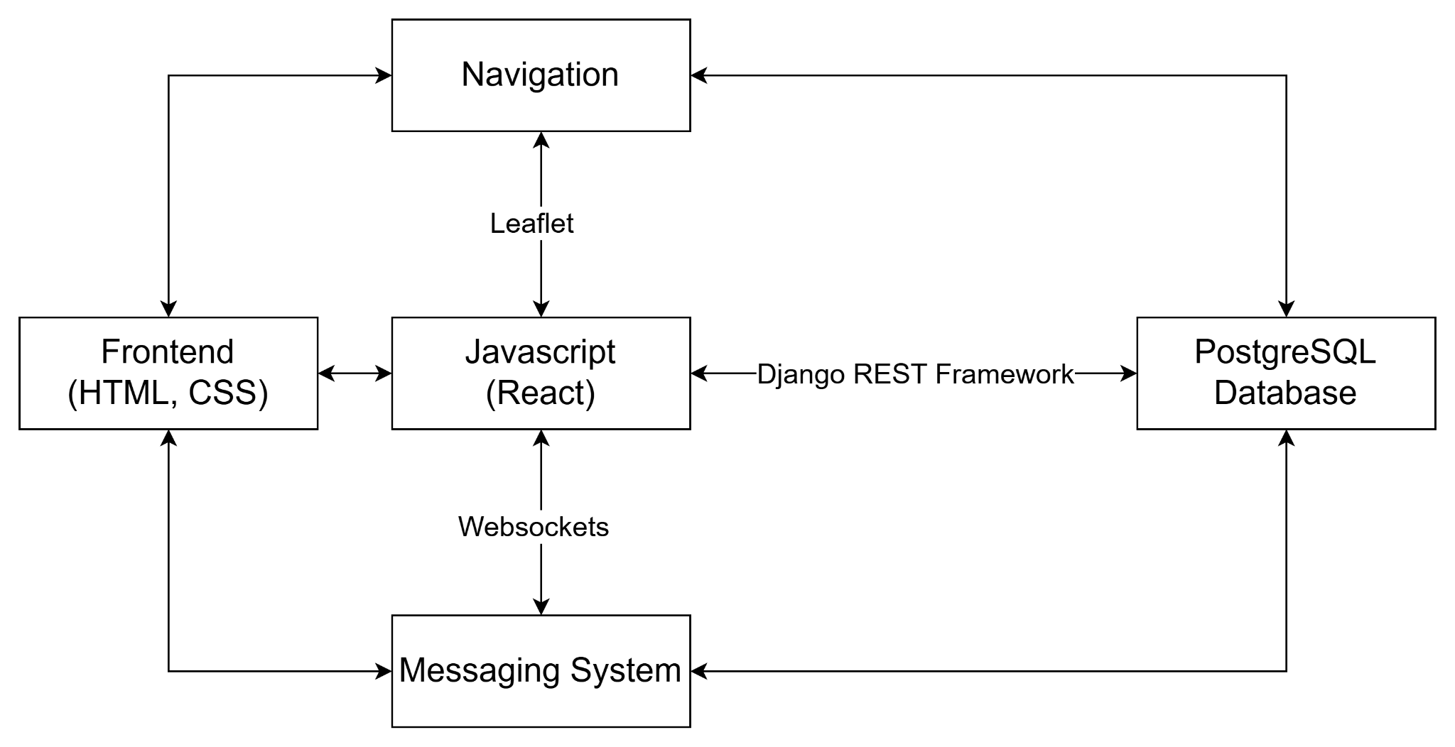
User Interface
Notes:
Finally, we will have an interactive and easy to use UI that connects everything together. The user interface is made using HTML, CSS, and Javascript. We use the React library to manage the UI components and HTTP requests. Through the UI, users will be able to edit data objects, send messages to other users,

Slide 12
Challenges & Resolutions
Blocked Database Connections
AWS RDS
Django Migrations
Adjusting version control access
Learning curve
(Django, AWS, Postgres)
New Technologies
Notes:
Note that if any challenges that are currently facing and haven’t solved

Slide 13
Our Schedule
March
March
April
April
Finalize Real Time Messaging
Final Navigation Edits
Finalize Role-Based Access
Validation & Testing
Connect the two existing systems for a coherent messaging system on the website
Finalize the navigational aspect of the webpage by including stored markers per user.
The final productions step is ensuring each user has their appropriate role
Testing and validating the aspects of the website.
Notes:
Make sure to spend time with detail about what has happened and what has yet to happen

Slide 14
Conclusion
Thank you for listening!
Any questions?
Notes:
Need a full conclusion slide

Slide 15
Thanks!
Do you have any questions?
youremail@freepik.com
+91 620 421 838
yourcompany.com
Please keep this slide for attribution

