Slide 1

Mini Update
Team:
Zachary Garza, Sean Weston, Jared Kagie, Christian Butler
Mentor:
Veerendernath Surendernath Komala

Slide 2
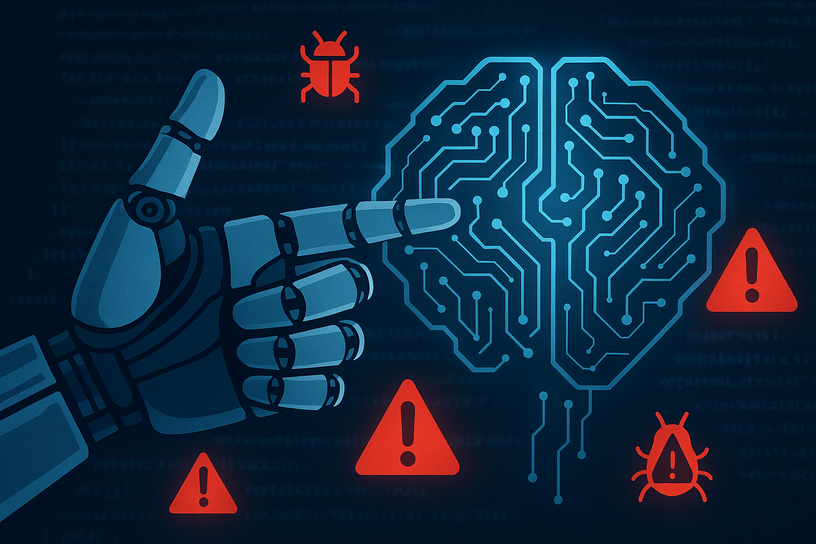
Introduction
• What we’re working on: automating vulnerability analysis and prioritization
• Why it matters: reducing manual analysis time, cutting false positives, and strengthening cybersecurity defenses

Slide 3

Overview
• Our collaboration with HighViz Security to define clear requirements
• Key design decisions: a hybrid AI approach (NLP + structured ML), local-first execution on MacBook Pro M2, and secure cloud augmentation for retraining
• Emphasis on using free, open-source tools (Python, Pandas, PyTorch, HuggingFace, TensorFlow, SQLite/SQLAlchemy)

Slide 4
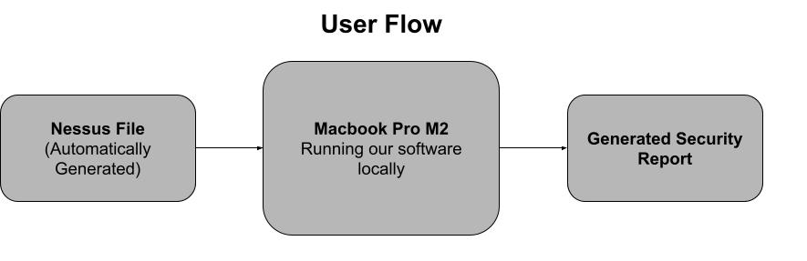
Tech Challenges
Data Ingestion: Efficient parsing of Nessus CSV/JSON files using Pandas and Python’s JSON module—processing around 10,000 entries in under 5 seconds
Security & Scalability: Ensuring our AI operates solely on local, sensitive data and can scale if needed
Performance Optimization: Balancing the computational load of a hybrid model on the MacBook Pro M2 while maintaining real-time responsiveness
UI Design: Crafting an interface that presents complex data in a clear, actionable way
Notes:
Jared * outline how project will work, user flow kind of

Slide 5

Results
Prototype Success: Our feasibility tests confirm the hybrid model correctly identifies high-risk vulnerabilities 90% of the time.
Technical Findings:
AI model: Ensemble of NLP (BERT fine-tuned on CVE data) and structured ML to capture both context and numerical threat intelligence.
Data ingestion: Python’s Pandas and JSON modules deliver fast, accurate parsing.
Execution strategy: Local-first on MacBook Pro M2 with optional secure cloud integration for model updates.
Products Chosen: Python, Pandas, PyTorch, HuggingFace, SQLite/SQLAlchemy

Slide 6

Plan Going Forward
Remaining Challenges: Fine-tuning the risk scoring engine, further UI enhancements, and deeper integration of cloud-based model retraining while preserving data security.
Next Steps: Finalize technical requirements, address identified quandaries, and explore advanced methods (potential reinforcement learning for patch scheduling) as the project matures.
Collaboration & Feedback: We welcome insights on additional features or improvements.

