Slide 1

Cyber Recon
Using AI To
“Uncover the Unseen”
Spring 2025

Slide 2
01
Background
Notes:
zach

Slide 3
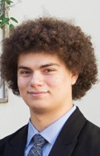

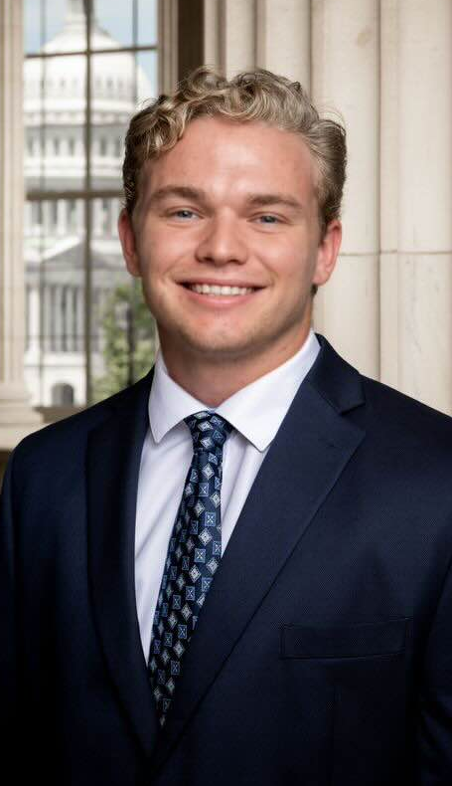

05
Zachary Garza
Sean Weston
Christian Butler
Jared Kagie
Computer Science Major
Team Lead
Software Engineering Major
UI/UX Designer
Computer Science Major (Cybersecurity Minor)
Release Manager
Software Engineering Major
Recorder
The Team
We’re a group of NAU students who love tackling real-world problems using our combined expertise in software engineering, computer science, and cybersecurity. From building full‐stack apps and mobile solutions to exploring AI, LLM‐based NLP, and advanced security testing, we strive to create practical, user‐friendly technology. We’re driven by a shared passion for continuous learning, innovation, and collaboration, ensuring we never stop growing or supporting each other as we shape tomorrow’s digital landscape.
Notes:
zach

Slide 4
Cybersecurity
Why do YOU think it’s important?
Notes:
zach

Slide 5
02
Our Client

Slide 6
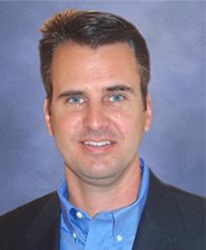
HighViz Security
Rick Belisle is the CEO and co-founder of the company with over 25 years of experience.
Had training from the Army in cyber-warfare and created the first defense unit
Other co-founders include Greag Johnson, Scott Miles, and Marty Sells

Slide 7

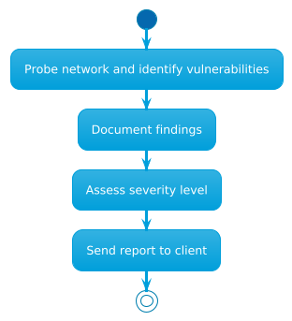

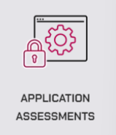

Operation
There are four main services that they provide, being penetration testing, app assessments, enterprise testing, and device security. Each service coincides with their skills that allow them to probe into the network and get a sense of what is a problem. The information and documentation of these findings is then assessed by the team by severity level and sent to the client.

Slide 8
03
The Problem

Slide 9
Current Issues
Their initial automated vulnerability scanner is the only automated section of the process
Much of the remaining processes are manual, requiring individuals to add to the data given by the automated scanner

Slide 10
Impact
By having team members spend time working on this report, they are pulled away from other projects they may be working on
Manual work is often slower that automated work, meaning that not having an automated system results in longer time to complete

Slide 11
04
The Solution

Slide 12
Key Points
Current Testing Approach
Proposed AI Integration
Goals and Objectives
Automated Scans: Use Nessus to identify vulnerabilities.
Spreadsheet Mapping: Convert .nessus files into CSV, map them to a custom spreadsheet, and track exploitability, false positives, etc.
Final Reporting: Copy “Yes” findings into a Word doc for delivery.
Native Mapping: Let AI handle parsing and mapping directly from .nessus files.
Enhanced Insights: Automate CVE lookups, recommend new findings or known exploits, and prioritize easily exploited vulnerabilities.
Interactive Process: Provide smaller “batches” of findings so testers can quickly confirm or reject issues in real time.
Model Selection: Find an open‐source AI model that works locally on a MacBook Pro.
Data Management: Maintain the “mapping file” and any new vulnerability DB with version control.
Scalable & Secure: Ensure the solution can expand to handle large datasets and remain private (local or cloud as needed).

Slide 13
Action Plan
Step 1
Data Ingestion
Step 4
Integration
Automate ingestion of .nessus files, plus CSV/JSON/XML outputs.
Use scripts or libraries (e.g., parse-nessus.py, Pandas) for immediate processing.
Build a local web app (Flask/FastAPI) to review test results in smaller “chunks.”
• Let testers mark successes or new findings in real time; store feedback in a local DB.
Step 2
Preprocessing & NLP
Step 5
Ongoing Feedback
Clean up vulnerability descriptions (tokenization, stop‐word removal).
Normalize data to standardize severities and references (e.g., CVEs).
Maintain a separate DB of exploited findings for quick references.
• Dynamically rank vulnerabilities higher if they’re commonly or easily exploited.
• Adjust risk levels and output grouping based on real‐time tester input.
Step 3
Feature Engineering
Vectorize text (TF‐IDF) and classify vulnerabilities (valid vs. false positive).
Cluster similar issues for easier grouping (KMeans).
(Optional) Reinforcement Learning for exploit simulation.

Slide 14

Conclusion
Notes:
zach

Slide 15
Questions?

Slide 16
THANK YOU
Cyber Recon

