Slide 1


CPCESU Project
Management System
+
Joseph Remy [Team Lead], Colton Nunley, Jasque Saydyk
Notes:
Intro: Names
Question:
Who agrees that organization is one of the most important elements of success in a project/task?
Hook:
We’ve all dealt with organizing tasks for school or work and had to prioritize certain objectives based on deadlines or how much of a time sink a certain project would be. Managing our tasks and personal data is time consuming, but luckily it’s made easier through these (show phone). We have calendars, task managers, and digital reminders that allow us to focus more on the task at hand. What if we were running an organization and didn’t have a reliable system of tracking and organizing important data? Data which helps us make reliable and accurate decisions on projects. What if our current system was holding us back from achieving our goals efficiently? We’d be treading water trying to fix how we manage our data rather than analyzing it. Well, that's what the Colorado Plateau is dealing with right now. And our objective this year is to develop a solution to solve their organizational problems.

Slide 2
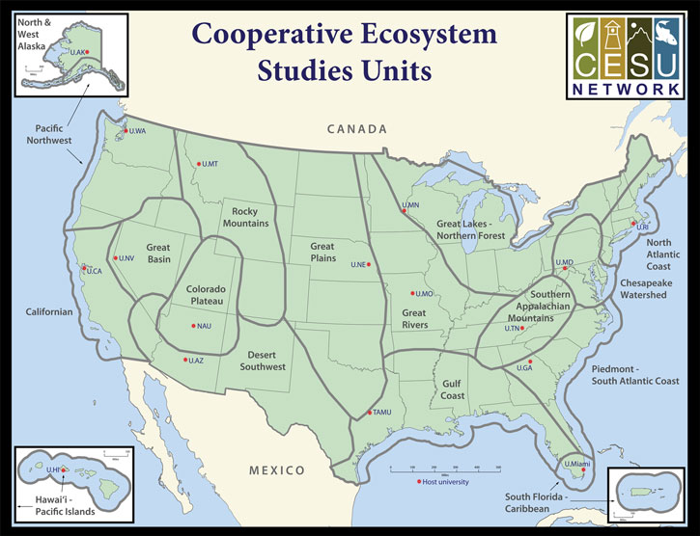
Colorado Plateau Cooperative Ecosystem Studies Unit
CPCESU is a part of a national consortium for resource stewardship
  Anthropology to Zoology
17 units, 15 federal agencies, and 425+ nonfederal partners
Northern Arizona University hosts CPCESU
Notes:
CPCESU:
The CPCESU is a derivative of the CESU which a national organization which is spread among many different biogeographical areas of the US. The CPCESU is hosted by NAU with Dr. Todd Chaudhry as the Research Coordinator and Laurie Thom as the Program Coordinator. They are going to be the main users for our end product. Both of them help many different federal agencies come up with a viable ecological project plans based on past project experience and statistics. The Colorado Plateau helps other federal agencies work on ecological projects. Whether that's studies, help building and maintaining a trail, or ecological investigations.
Big picture
Organization as a key aspect of success
Highlight organizational problem

Slide 3
CPCESU Project Workflow
Proposal
Federal agency contacts and starts an inquiry with CPCESU
Contract Acceptance
All parties accept the Master Cooperative Agreement and CPCESU keeps track of it
Termination
Once a project is being closed, the final report is created and sent out
Drafting
Rough drafts for a project contract are passed back and forth between the requesting federal agency and target organizations through CPCESU
Project
Tracking
CPCESU manages the project for both parties and tracks progress and modifications
Archive
Any contracts and relevant documents are stored in a file system for future reference
Notes:
Proposal is initiated by a federal agency, such as the NPS. For example if there was project involving the Grand Canyon then NPS would send out a proposal to the CPCESU to start a query and investigation. Once CPCESU gets the proposal and delivers a final contract, then it has the chance to get accepted. If it gets accepted by the targeted organization, then comes the implementation & tracking of tasks. Finally, once a project is completed, they have to collect data for future projects and reports and finally archiving it. Archiving the data is essential for future projects.It is important to CPCESU to store this data efficiently and effectively that way they can utilize past data for future projects.
Problems with current system in the workflow
Unable to track projects easily, takes too much time
Microsoft Access and Excel
Projects get entered with bad data
No user input validation
Single file in a networked file system. Single MS Access file.
Difficult to find projects and track their status
Ex. table - 2000+ entries and 59 columns
Null fields, No restrictions on user input
No querying or analysis capability

Slide 4
Our Solution - Project Management System
Proposal
Allow for partners to create proposals using a standardized form.
Contract Acceptance
Agreements can be viewed in an online dashboard with condensed, relevant information
Termination
Projects can be easily tracked and viewed, without manual database queries or Excel spreadsheets
Drafting
Drafts are accessible to CPCESU employees and relevant parties easily without the hassle of email, fax, etc.
Project
Tracking
CPCESU can manage project, partners can submit modifications, general public can view general information
Archive
CPCESU and partners can view archived data for future projects and generate reports
Notes:
Our Solution:
Our big picture solution is going to be a web based project management system that will help them organize and manage data. We want the management system to be adaptive; easy to use with little to no experience or training required for not only by employees, but by their partners and the general public; and finally scalable for supporting future modifications. We’re definitely leaning towards a web framework that will support full stack development since they not only need a working back end, so the employees can query and conduct analysis, but also a solid front end as well to manage and analyze their past, and current data. But since we’re still in the beginning stages of our project, we don’t want to commit to a tool before we get all the necessary requirements.
Solution
Web application that is usable not only by employees, but by their partners and the general public
Can query and conduct analysis for statistics reporting
Approachable and accessible data with minimal training
Technical challenges:
20+ years of data - needs to be translated (malformed and inconsistent). We definitely anticipate a few technical challenges already. There is 20+ years of data that needs to mined and translated without redundancy into our new system.
Our management system needs to be durable enough to last a decade as well as generic and scalable.
If our solution works for CPCESU, then our project has the potential to become the national system for the CESU network.

Slide 5
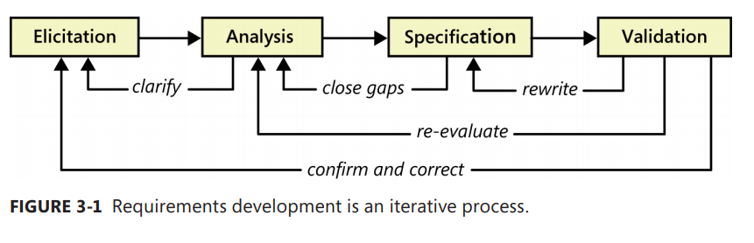
Requirements Process
Notes:
This is our gathering requirements during our future meetings with our sponsors.
First we’ll elicit requirements from the client. Sprouting and gathering ideas
Second, we will analyze the requirement while then honing in on the specifications.
Once that's done, we’ll validate and then correct if need be.

Slide 6
CPCESU Project
Management System
+
Joseph Remy [remy@nau.edu], Colton Nunley, Jasque Saydyk
http://bit.ly/ECOders
Notes:
So as ECOders, we’re gonna provide the CPCESU with the ability to work on things that matter, such as project statistics, and predictions to help them with future projects. They shouldn’t be wasting their time on scouring an ad hoc database.
Project management system
Project reporting, querying, and statistics
Reduce paper waste
Decrease lost work hours
Uniformed system and processes
Validation of data

