Slide 1
KineJax
Mentor: Kyle Winfree
Team: Anthony Black, Cherie Parsons, Christopher Whitney, Grant Swenson, Jack Jenkins
Notes:
Chris

Slide 2
Team Intro
Lead: Christopher D. Whitney
Security Assurance: Anthony Black
Recorder: Cherie Parsons
Editor: Grant Swenson
Release Manager: Jack Jenkins
Notes:
Chris

Slide 3
Client: Kyle Winfree
Education:
PhD, Biomechanics and Movement Science, University of Delaware
MSE, Robotics, University of Pennsylvania
BS, Physics, Northern Arizona University
Uses wearable devices to measure and improve health care
Interested in studying neurological impairments including:
Stroke
Parkinsons
“Locked-in” Syndrome
Data analysis & machine learning algorithms to diagnose conditions
Notes:
Chris

Slide 4
Background
Approximately 500,000 people in the US alone have Parkinson’s disease
Over 20,000 have Amyotrophic Lateral Sclerosis
Over 400,000 have Multiple Sclerosis
One in every 360 children have Tourette Syndrome
Approximately 10 million Americans have essential tremor
All of these disabilities cause mobility issues
Notes:
Grant

Slide 5
Current Limitation
Current data collection methods of individuals with mobility impairments are extremely limited
Require clinical examinations
Examinations are timely to set up and perform
Limited in the scope of measureable activity (i.e. number of steps)
Can’t evaluate different treatments
These clinical examinations do not tell the full story of the individual's activity which can lead to inadequate treatment
Notes:
Anthony

Slide 6
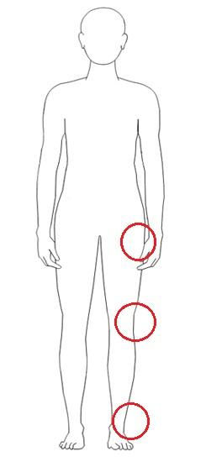
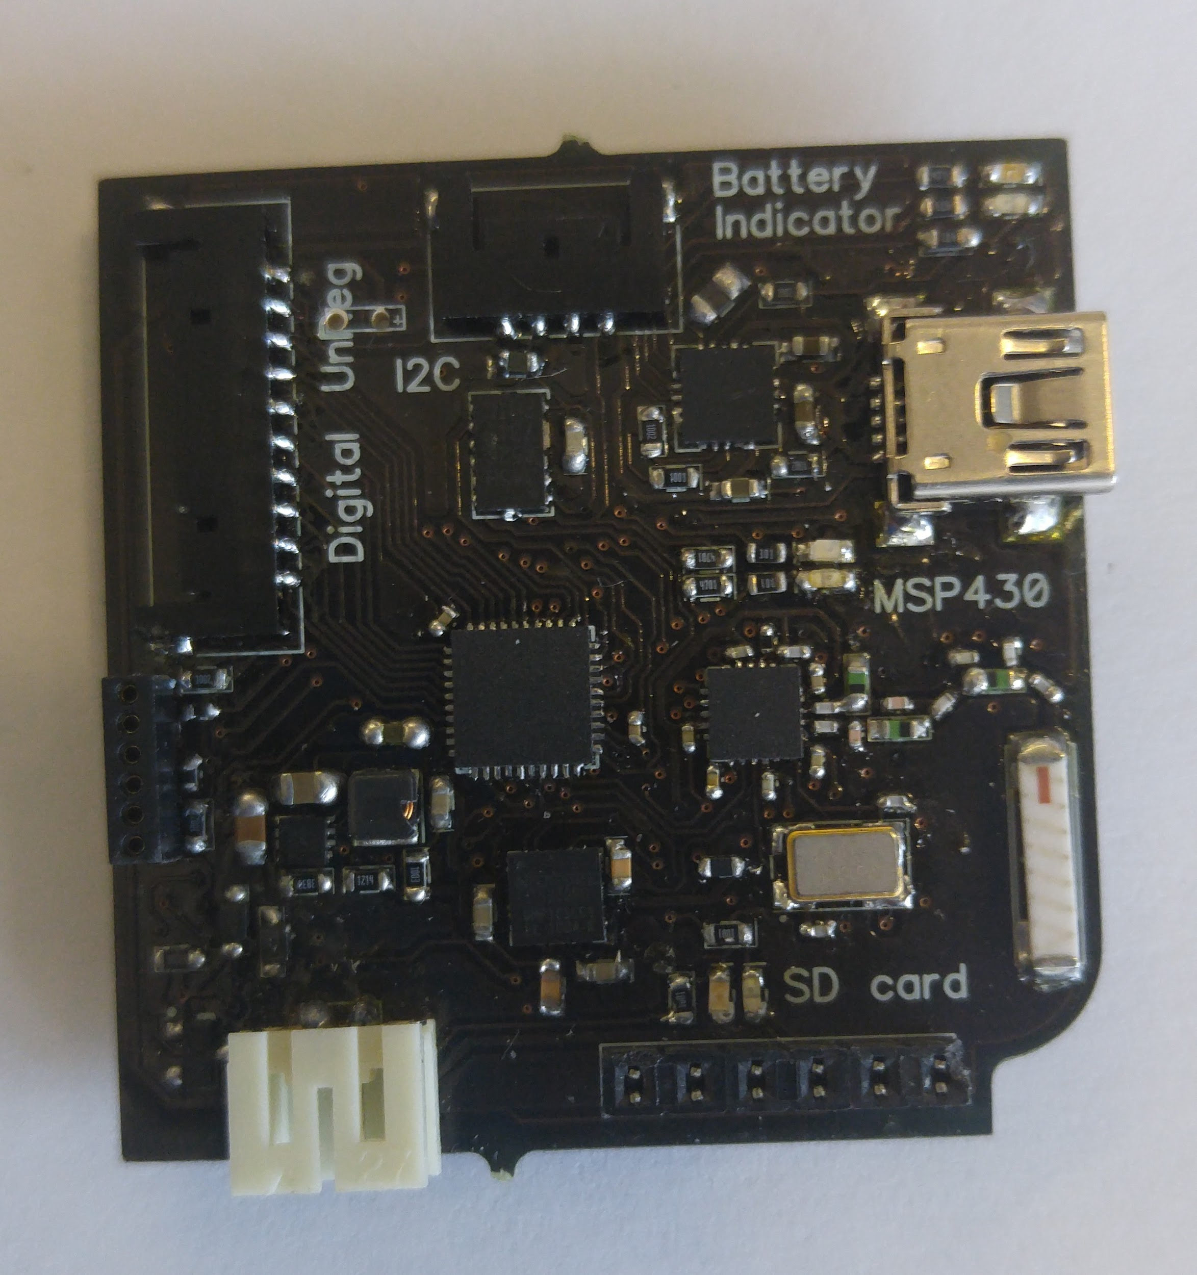
The Solution: KineTrax
A meshed network of wearable devices that can log individual's gait over an extend period of time
Collect up to a month of data at a time
Inexpensive compared to usual lab techniques
Notes:
Jack

Slide 7
Plan of Action
Methods:
Weekly meetings with sponsor
Weekly group lab development (Kanban)
Bi-weekly reviews
Code reviews
Presentation review
Documentation review
Semester Objectives:
Prototype wireless network
Prototype device time synchronization
Prototype GUI (processing.org)
Prototype data logging
Initial validation test using NAU’s Human Performance Lab
Notes:
Cherie

Slide 8
In Summary...
Sponsor: Kyle Winfree
Problem: Millions of people worldwide suffer from walking impairments
Solution: The KineTrax project will allow doctors to collect essential data required to better treat these patients
Notes:
Cherie

Slide 9
“I think in this century we’ll largely eliminate disability through a sophisticated machine-human interaction”
- Hugh Herr, 2010
Notes:
Cherie

