Slide 1
File-Mate 1500
Keven Abbott
Tyler Crouse
Kiana Delventhal
Liam Westby

Slide 2
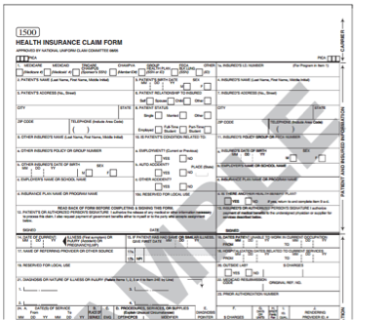
Introduction
CMS 1500 Health Insurance Claim Form
Issued by the Centers for Medicare and Medicaid Services
Health insurance claims
Widely accepted
2
Notes:
Kiana Approved by the American Medical Association, among other groups; industry standard form

Slide 3
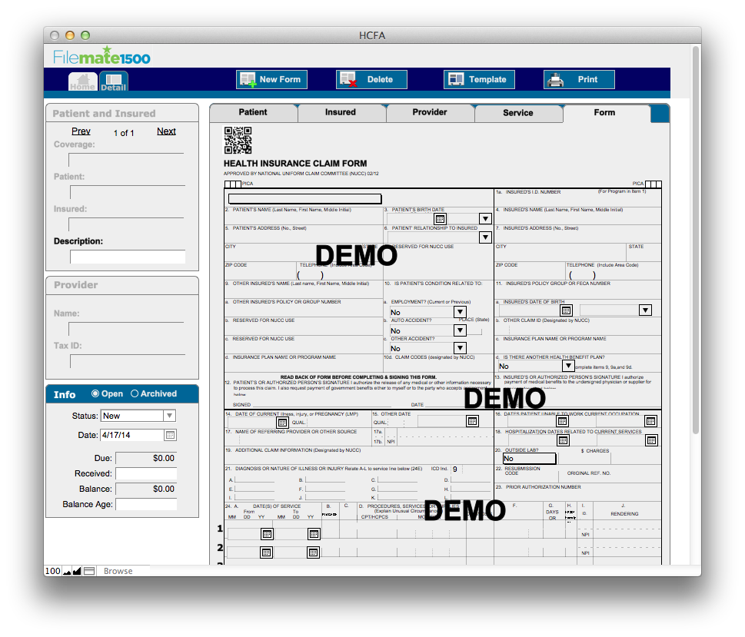
Introduction
File-Mate 1500
Automates filling of forms
Stores data for fast recall
Saves completed form digitally
3
Notes:
Kiana

Slide 4
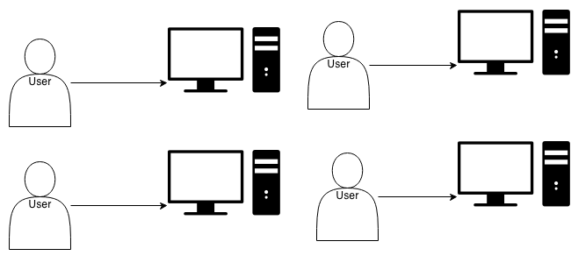
Problem
While the existing application is useful, it is a desktop client that lacks:
Scalability
Portability
Accessibility
4
Notes:
Tyler
Can’t share information between multiple computers in an office, or between multiple offices
Need to install software on all computers (and make sure it is compatible)

Slide 5
Solution
The web-based system will
Allow concurrent access to a shared data set
Enable access to the system without needing to install software
Scale to support the needs of an entire medical practice
Selected Technologies
MySQL/PHP
HTML/CSS
FPDF
5
Notes:
Tyler.
Create a web-based version of the File-Mate 1500 application, accessible from any computer or tablet with a modern web browser.

Slide 6
Key Requirements
Support for major web browsers
Support for tablet devices
Secure concurrent access
Creation of different user groups
Administrator, Registered, Trial
Generation of documents
Import/export of data
6
Notes:
Tyler

Slide 7
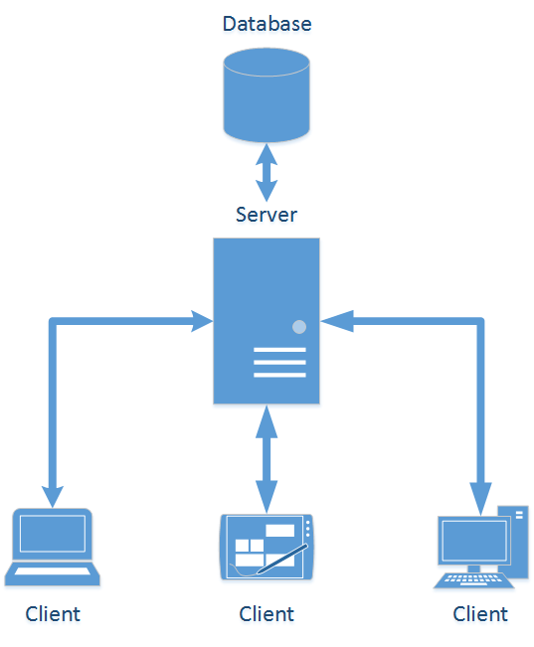
Architecture
Client-Server Pattern
7
Notes:
Keven

Slide 8
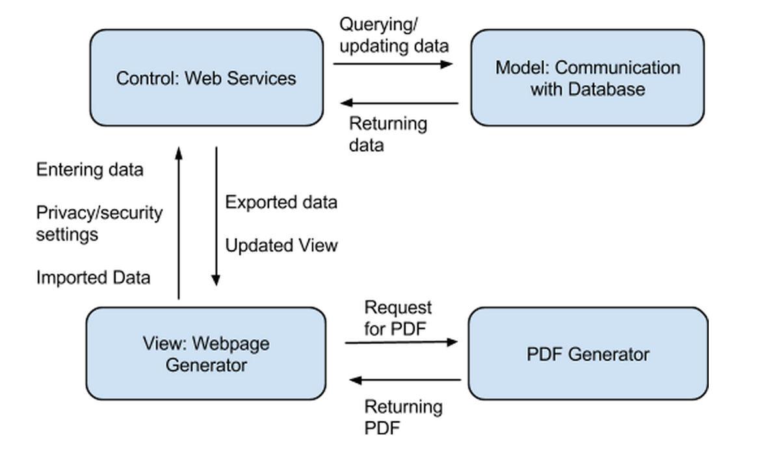
Server Side
8
Notes:
keven use case: user accesses webpage. user adds a new patient to the office. database is updated with new data added by the user.
use case2: user wants to generate the CMS 1500 form for a returning patient. user queries database for desired info. database returns info to control and then to view. User then requests for a PDF and the PDF is generated

Slide 9
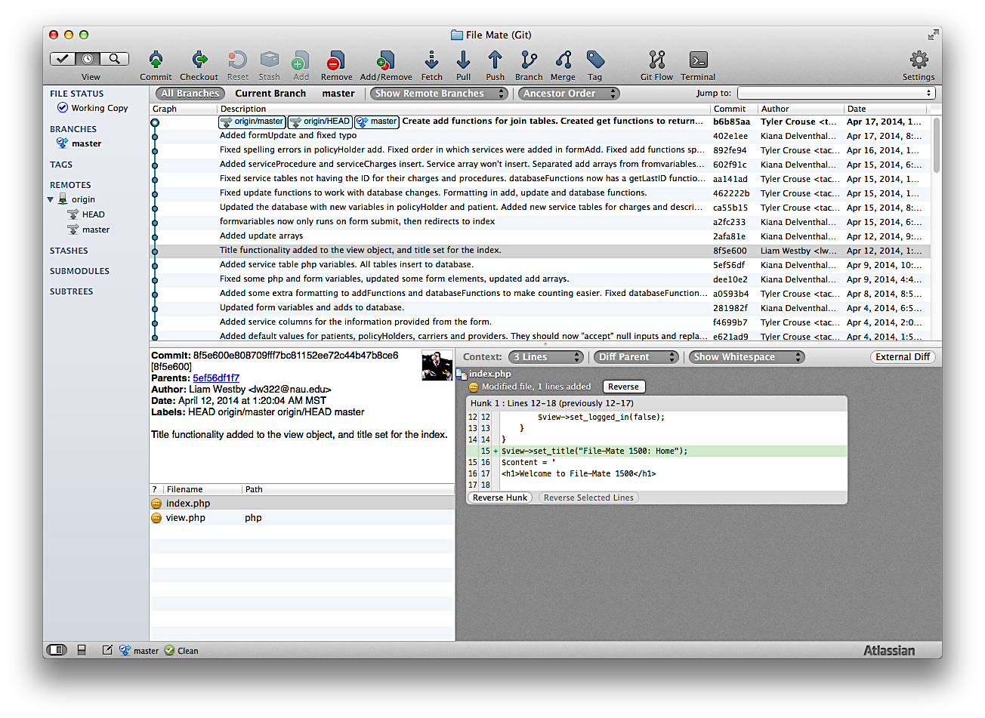
Development Process
Iterative Waterfall Cycle
(multiple versions of each)
Bitbucket Repository and SourceTree for version control
Focus on implementing core pieces of functionality, then integrating them together
9
Notes:
keven

Slide 10
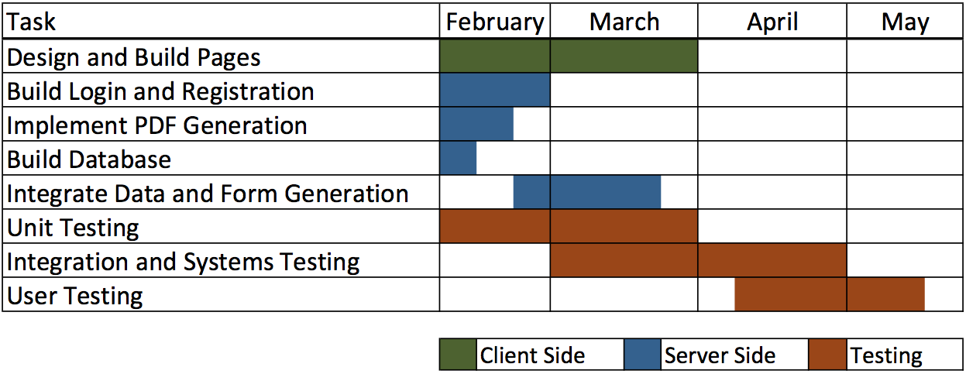
Implementation
10
Notes:
liam

Slide 11
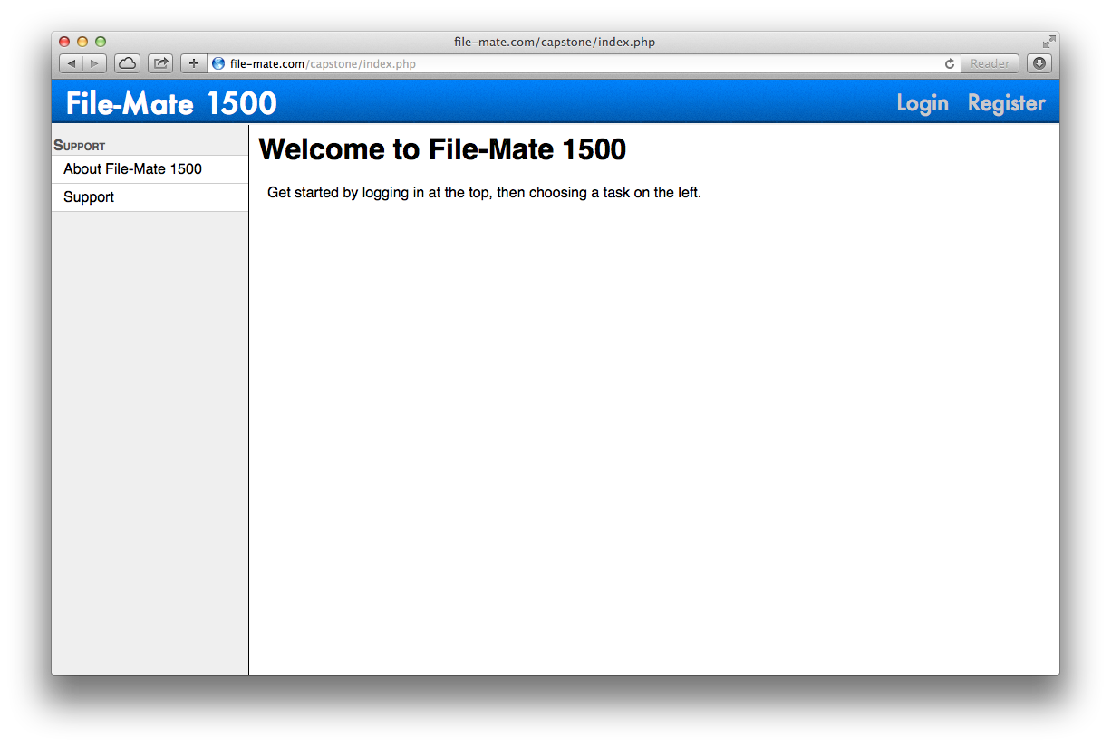
11
Notes:
liam

Slide 12
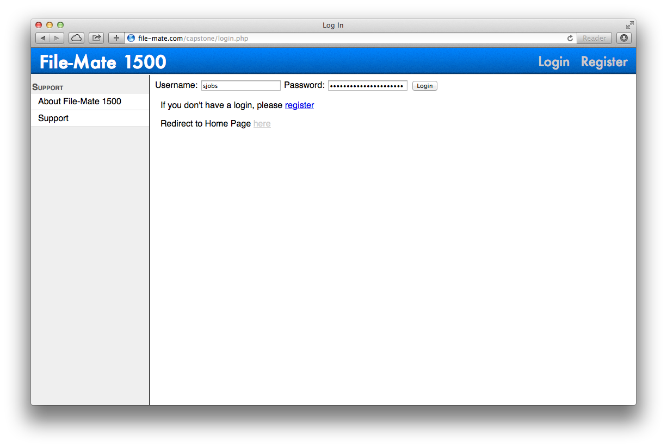
12
Notes:
liam

Slide 13
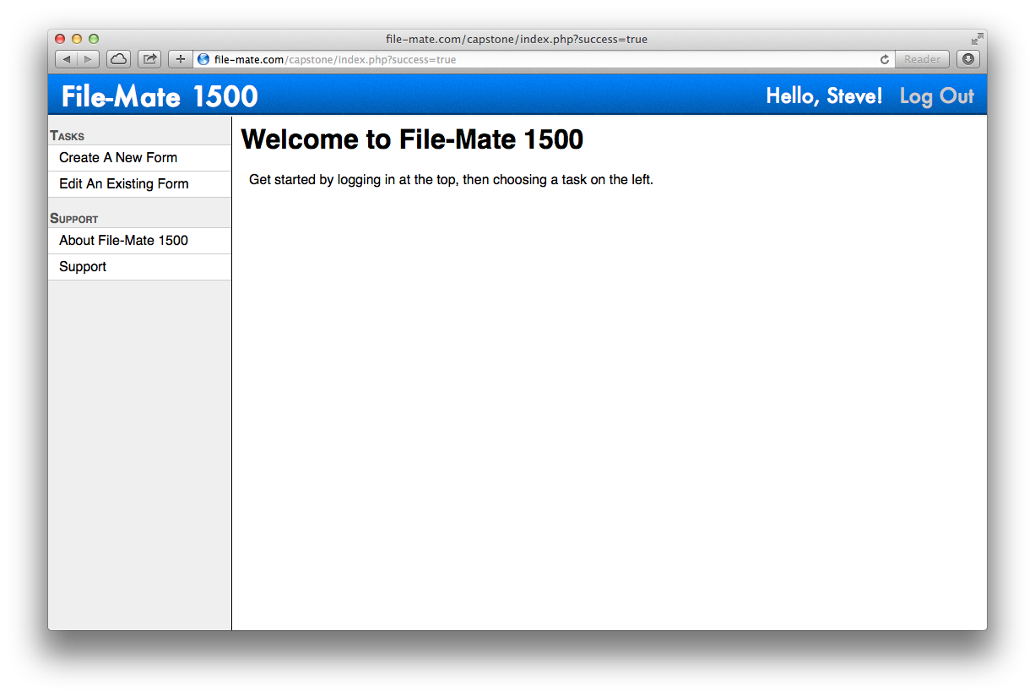
13
Notes:
liam

Slide 14
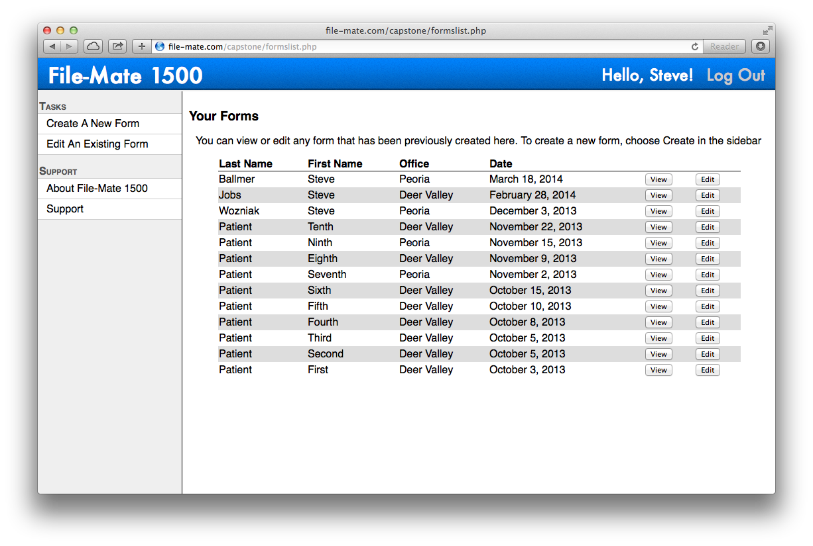
14
Notes:
liam

Slide 15
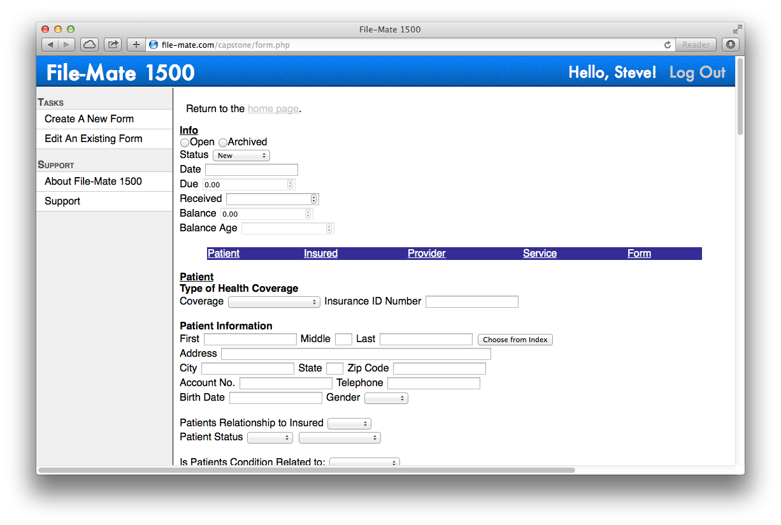
15
Notes:
liam

Slide 16
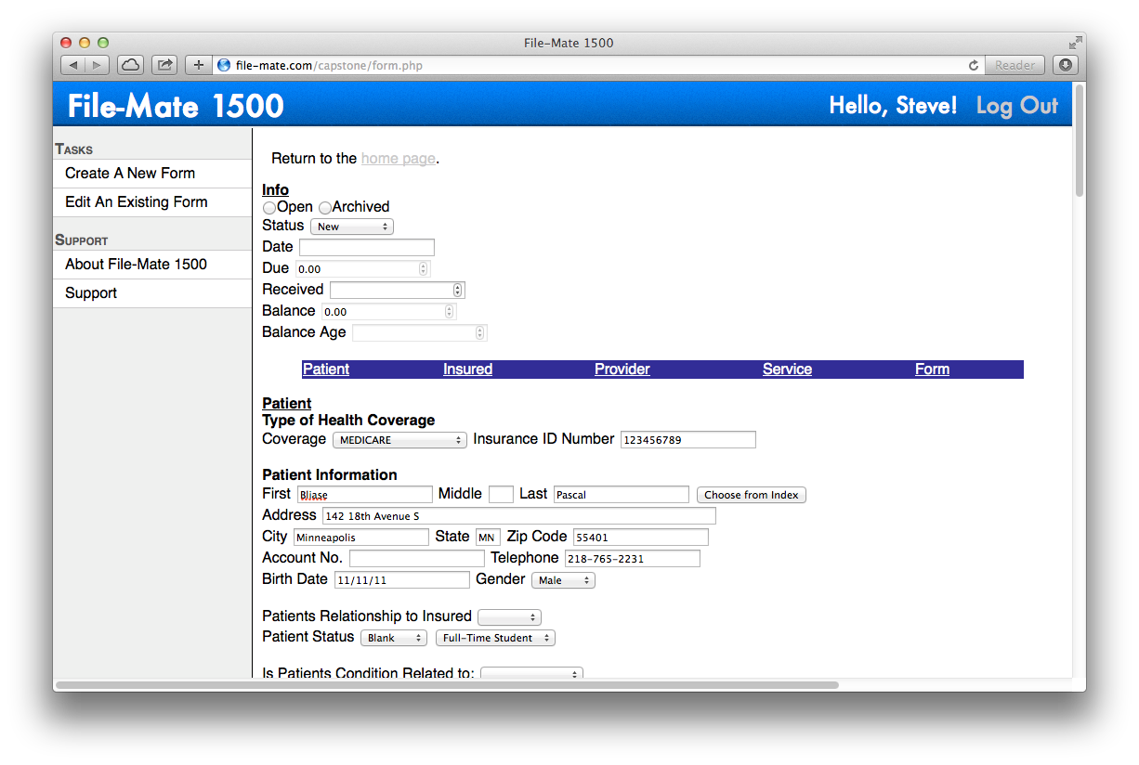
16
Notes:
liam

Slide 17
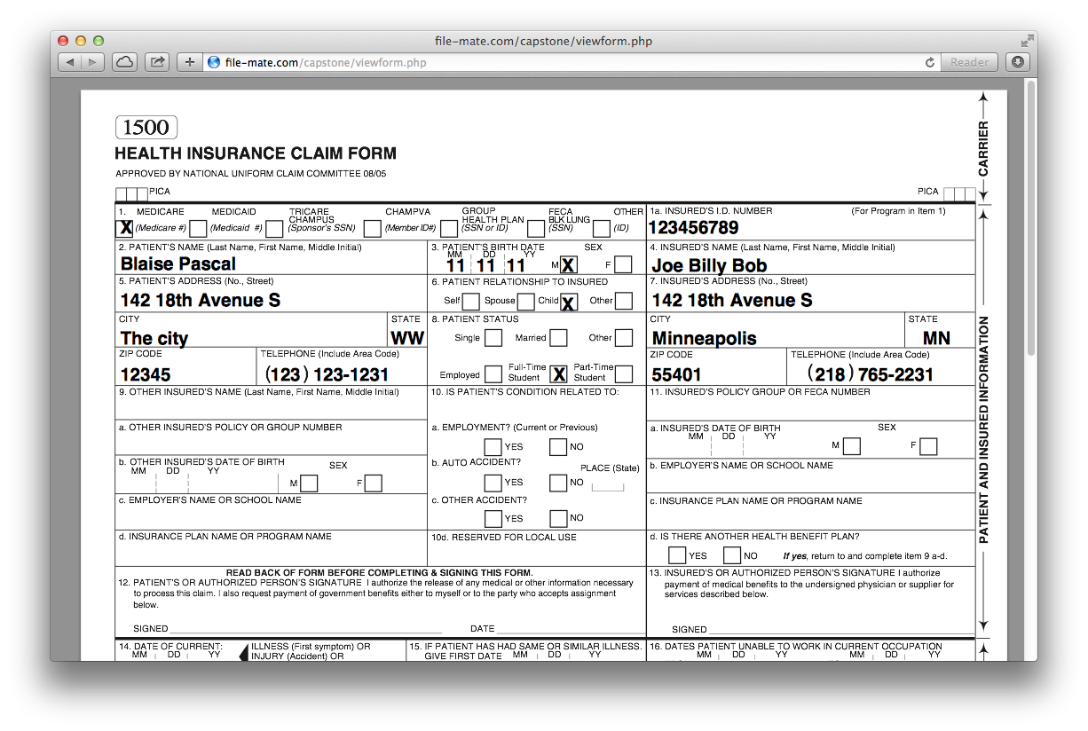
17
Notes:
liam

Slide 18
Testing and Validation
Goals
Verify each functionality as it was built
Ensure users only see their data
Verify integration between components
Ensure consistent, useful interface
18
Notes:
keven

Slide 19
Testing and Validation Cont.
Unit Testing
PHPUnit, DBUnit (add, delete, update, select)
Login and Registration functions
19
Notes:
keven

Slide 20
Testing and Validation Cont.
Integration Testing:
Database and web service front end integration
PDF Generation
Acceptance Testing:
Expert review
Non-expert review
20
Notes:
tyler

Slide 21
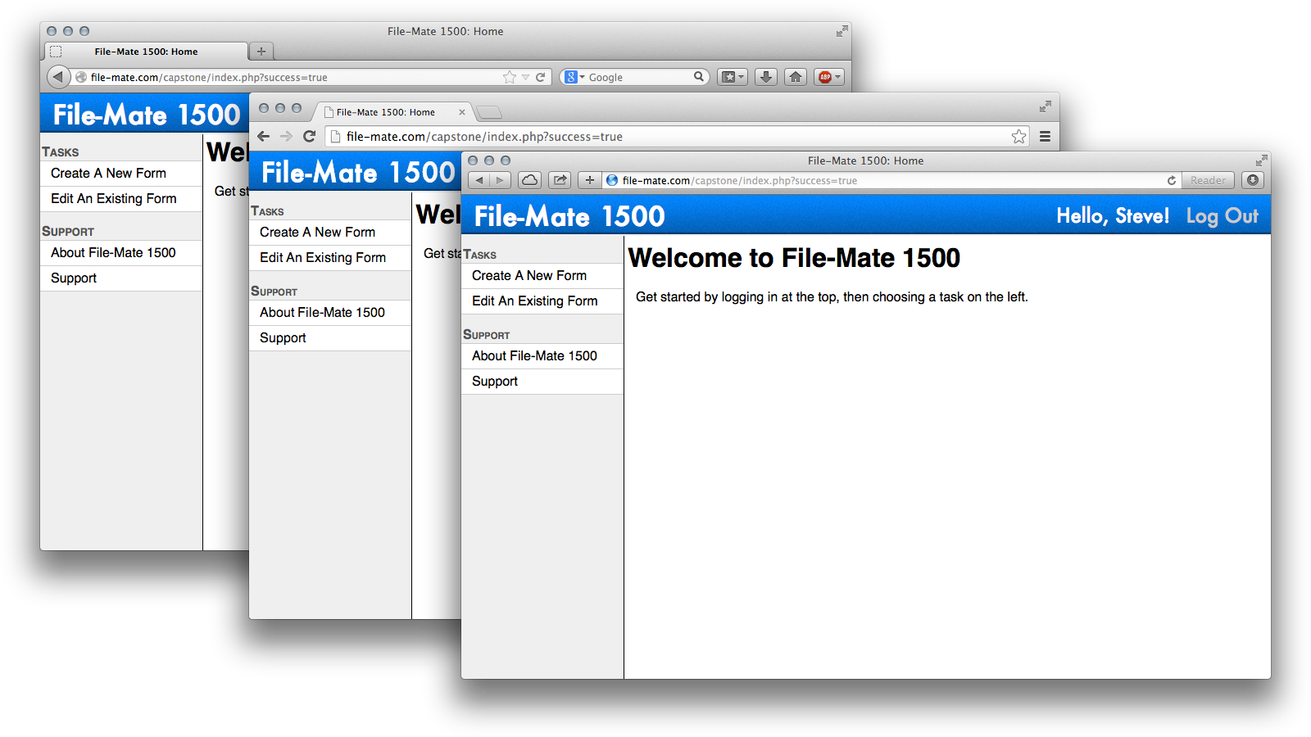
Testing and Validation Cont.
21
Notes:
tyler

Slide 22
HIPAA
Health Insurance Portability and Accountability Act of 1996
22
Notes:
Motivates our challenges and risks, governs all health insurance info to protect doctor patient confidentiality, steep fines

Slide 23
Challenges and Risks
Risk | Likelihood | Severity | Mitigation Strategy
Loss of Data Integrity | Moderate | High | Ensure integrity is preserved by testing database and related modules throughout implementation.
Confidential Data Leak | Low | Extreme | Use strong encryption, ensure accounts cannot be accessed by anyone other than the user.
System Availability Compromised | Moderate | Moderate | Design system for concurrent access and conduct load testing
23
Notes:
Kiana
Because our application is data driven, we must pay attention to common risks to information security: integrity, availability, and confidentiality

Slide 24
Future Work
Implementation of Advanced Features of Desktop Software
Full HIPAA Compliance
24
Notes:
Core functionality implemented. Order preprinted forms, copy protection, pre-defined data to easily add to form. Basic security implemented, not to HIPAA scope. Binded Parameter queries, escape queries.

Slide 25
Conclusion
File-Mate 1500 is a desktop application; we are taking it to the network.
To that end, we have produced a database-backed client-server system.
With this solution, we are bringing a new level of scalability, portability, and accessibility to the File-Mate product.
25
Notes:
Kiana

Slide 26
File-Mate 1500
Come see our poster:
Session II (2:00 PM – 4:00 PM)
Board 13D

Slide 27
Questions?
27

