Slide 1
File-Mate 1500
Design Review III
Keven Abbott
Tyler Crouse
Kiana Delventhal
Liam Westby

Slide 2
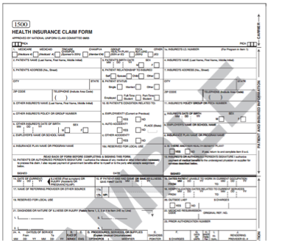
Introduction
CMS 1500 Health Insurance Claim Form
Issued by the Centers for Medicare and Medicaid Services
Health insurance claims
Widely accepted
2
Notes:
Kiana
Approved by the American Medical Association, among other groups; industry standard form

Slide 3
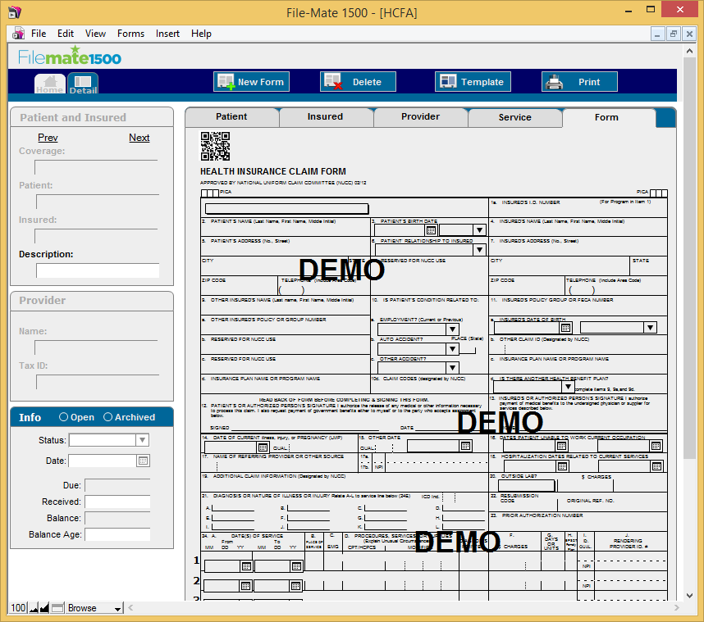
Introduction
File-Mate 1500
Automates filling of forms
Stores data for fast recall
Saves completed form digitally
3
Notes:
Kiana

Slide 4
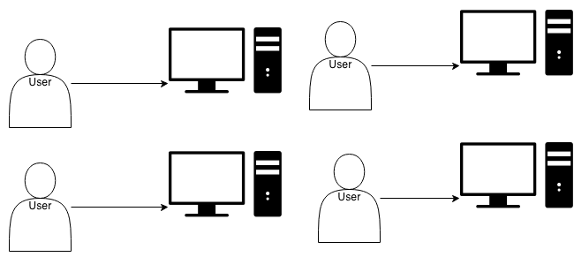
Problem
While the existing application is useful, it is a desktop client that lacks:
Scalability
Portability
Accessibility
4
Notes:
Tyler
Can’t share information between multiple computers in an office, or between multiple offices
Need to install software on all computers (and make sure it is compatible)

Slide 5
Solution
The web-based system will
Allow concurrent access to a shared data set
Enable access to the system without needing to install software
Scale to support the needs of an entire medical practice
Selected Technologies
MySQL/PHP
HTML/CSS
FPDF
5
Notes:
Tyler.
Create a web-based version of the File-Mate 1500 application, accessible from any computer or tablet with a modern web browser.

Slide 6
Key Requirements
Support for major web browsers
Support for tablet devices
Secure concurrent access
Creation of different user groups
  Administrator, Registered, Trial
Generation of documents
Import/export of data
6
Notes:
Tyler

Slide 7
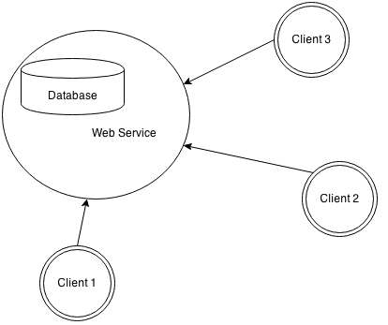
Architecture
Client-Server
7
Notes:
Keven

Slide 8
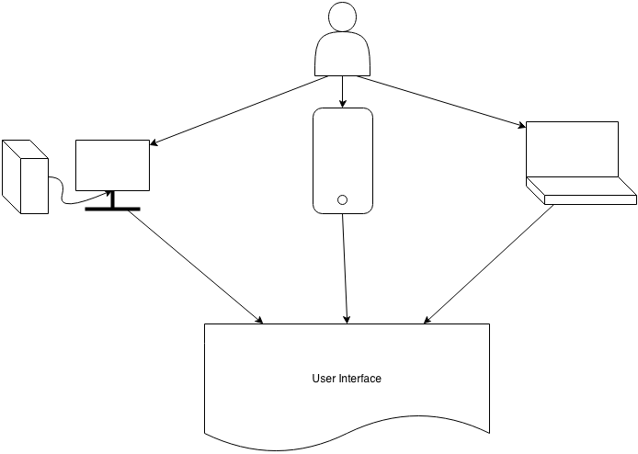
Client Side
8
Notes:
Keven. Computers, tablets and laptops

Slide 9
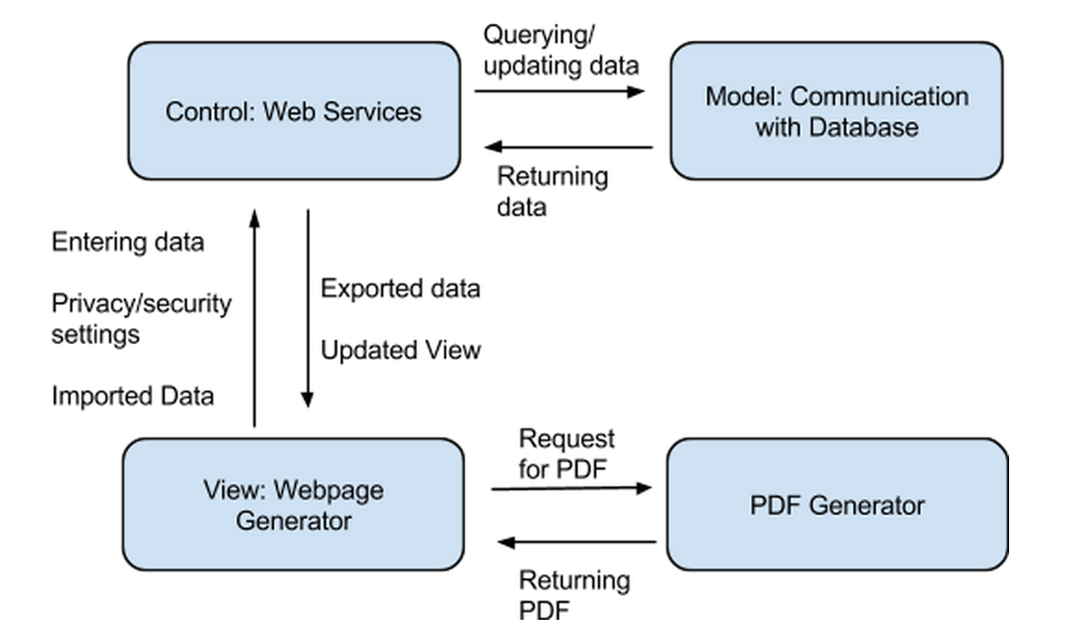
Server Side
9
Notes:
keven use case: user accesses webpage. user adds a new patient to the office. database is updated with new data added by the user.
use case2: user wants to generate the CMS 1500 form for a returning patient. user queries database for desired info. database returns info to control and then to view. User then requests for a PDF and the PDF is generated

Slide 10
Implementation
Client Side: Kiana and Liam
Server and Database Side: Tyler and Keven
Notes:
liam

Slide 11
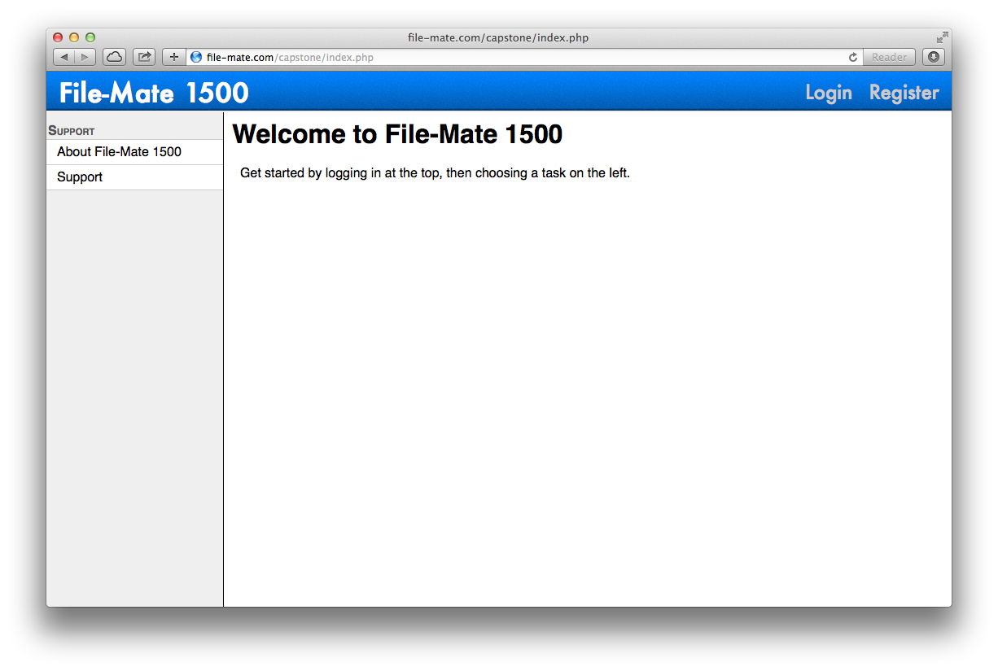
Notes:
liam

Slide 12
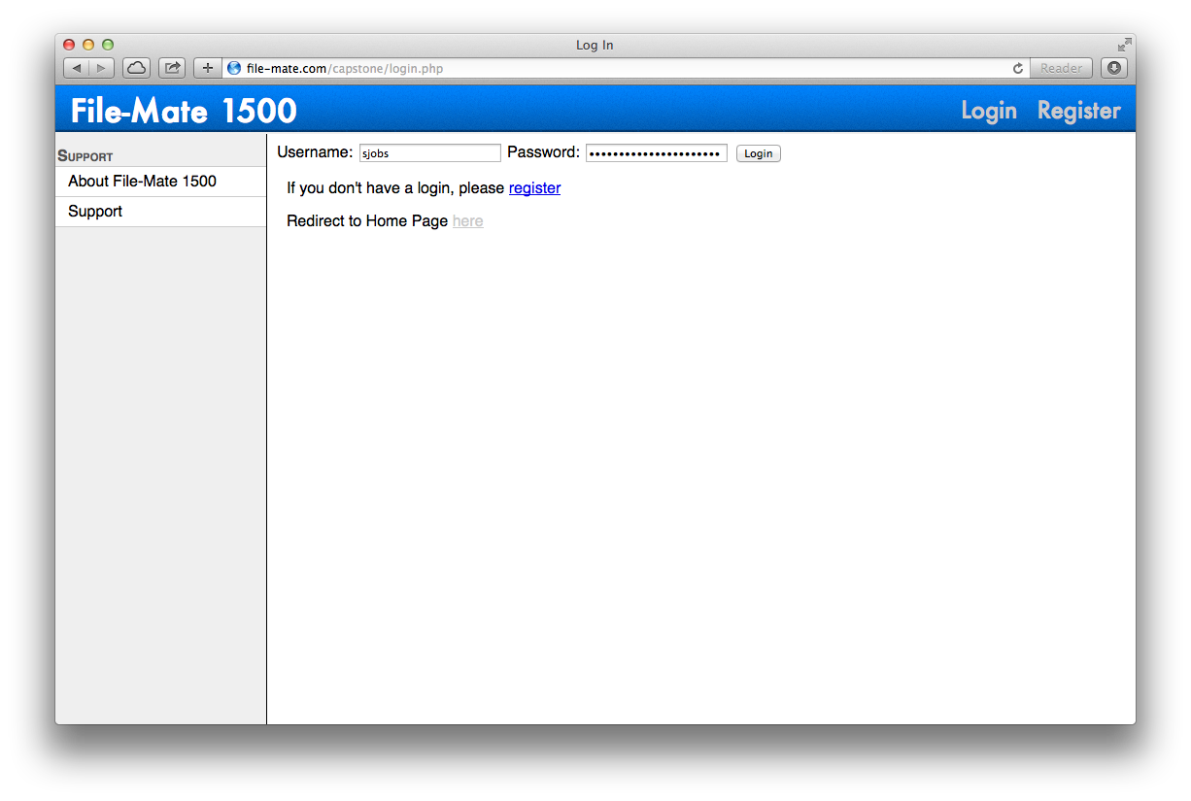
Notes:
liam

Slide 13
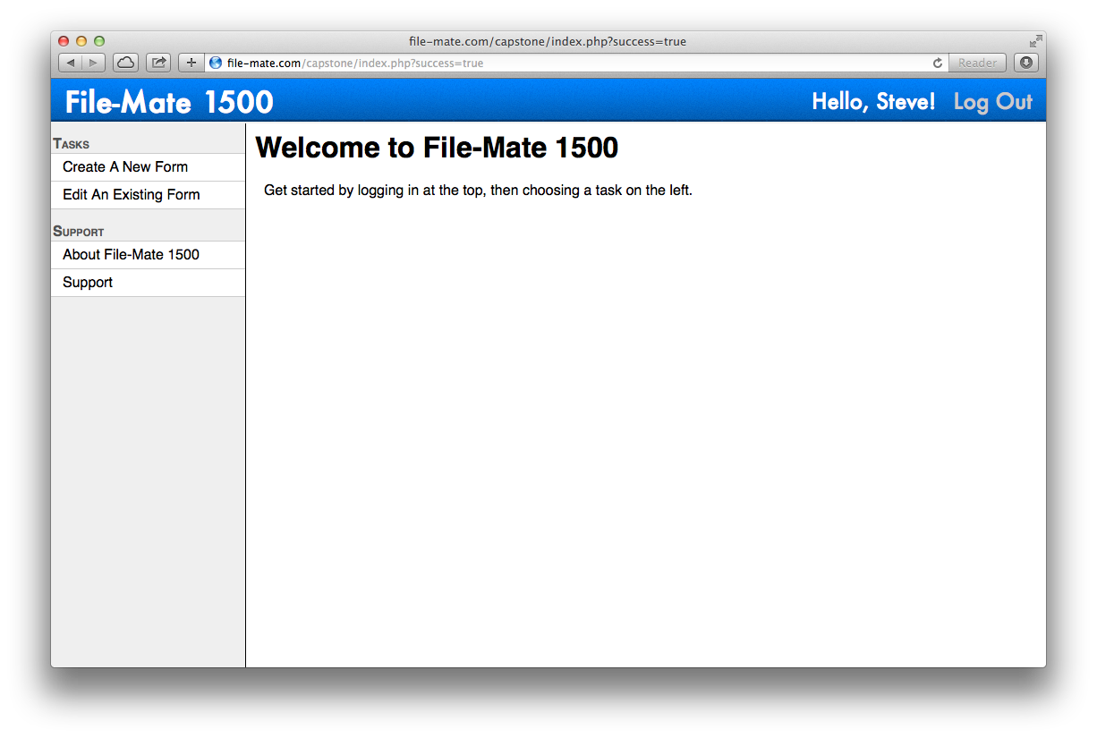
Notes:
liam

Slide 14
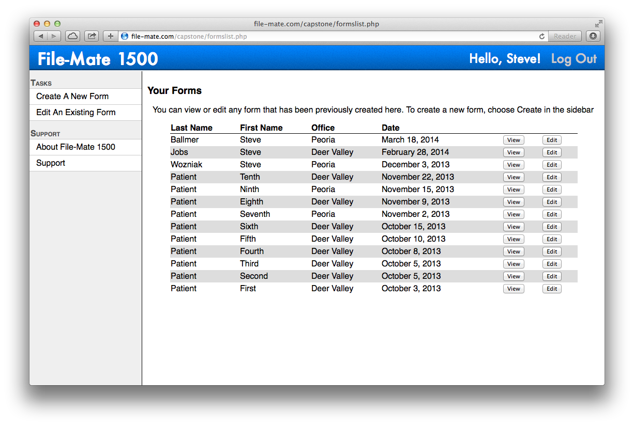
Notes:
liam

Slide 15
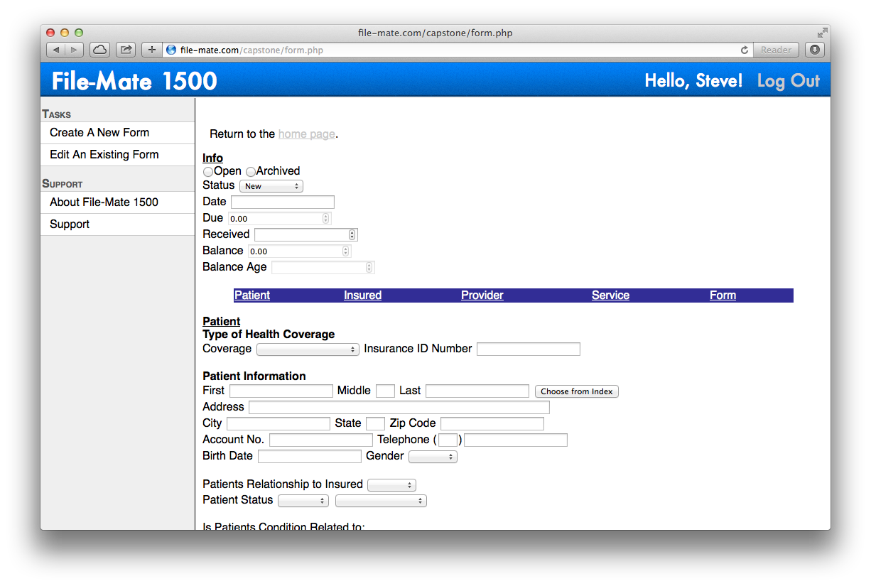
Notes:
liam

Slide 16
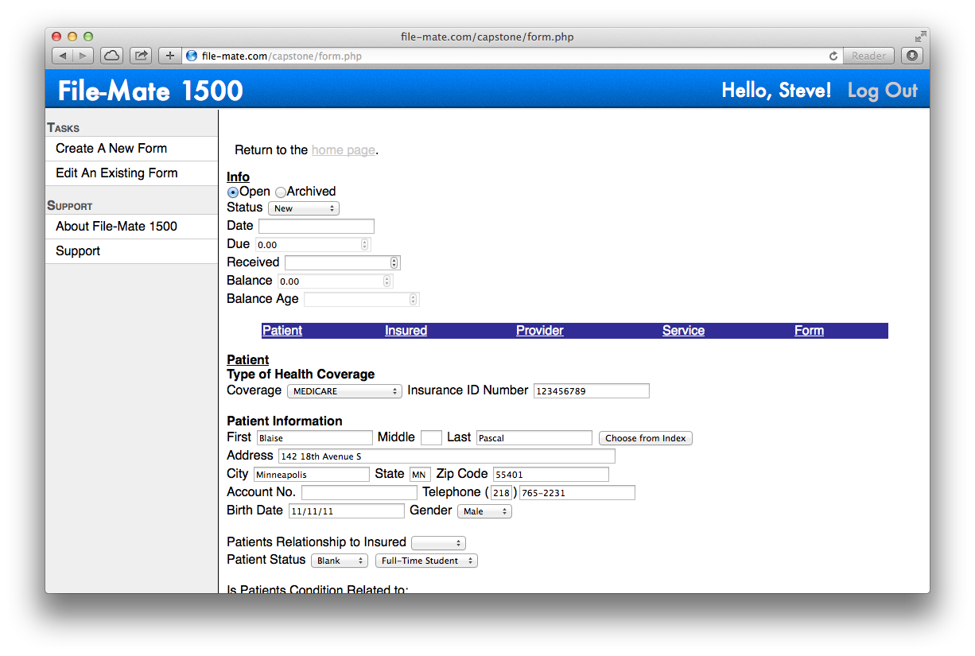
Notes:
liam

Slide 17
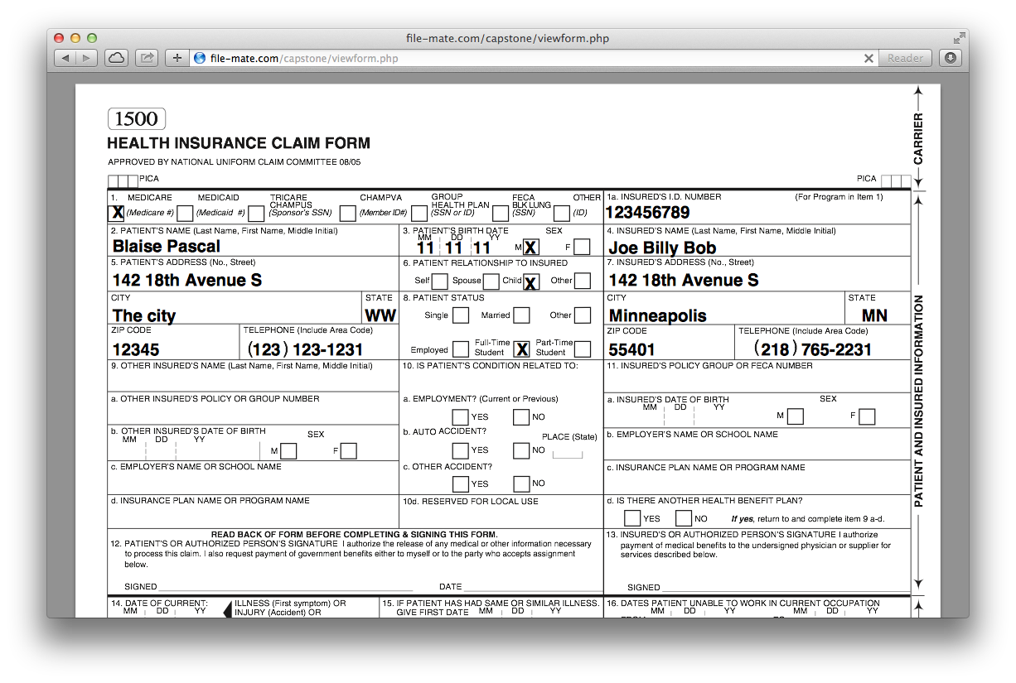
Notes:
liam

Slide 18
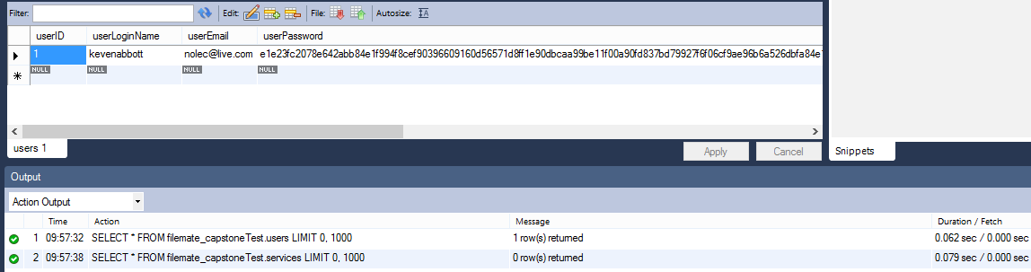
Testing
SQL Queries
Notes:
liam

Slide 19
Testing Cont.
Unit Testing
  PHPunit, DBunit
Integration Testing
Acceptance Testing
Usability Testing
Notes:
liam

Slide 20
Challenges and Risks
Risk | Likelihood | Severity | Mitigation Strategy
Loss of Data Integrity | Moderate | High | Ensure integrity is preserved by testing database and related modules throughout implementation.
Confidential Data Leak | Low | Extreme | Use strong encryption, ensure accounts cannot be accessed by anyone other than the user.
System Availability Compromised | Moderate | Moderate | Design system for concurrent access and conduct load testing
20
Notes:
Kiana
Because our application is data driven, we must pay attention to common risks to information security: integrity, availability, and confidentiality

Slide 21
HIPAA
Health Insurance Portability and Accountability Act of 1996
Notes:
governs all health insurance info to protect doctor patient confidentiality, steep fines

Slide 22
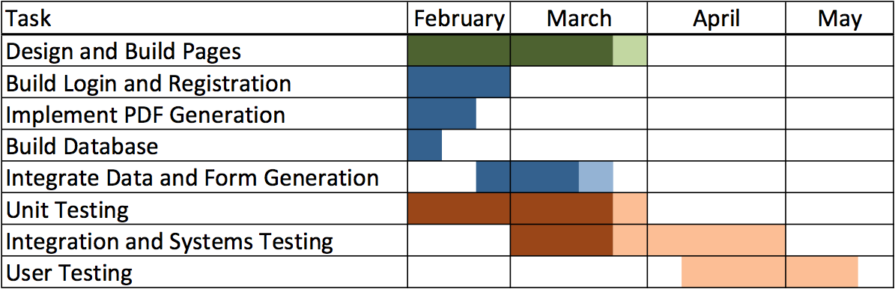
Schedule
22
Notes:
Kiana
client, server/database, testing

Slide 23
Conclusion
File-Mate 1500 is a desktop application; we are taking it to the network.
To that end, we have produced a database-backed client-server system.
With this solution, we are bringing a new level of scalability, portability, and accessibility to the File-Mate product.
23
Notes:
Kiana

Slide 24
Questions?
24

