Slide 1
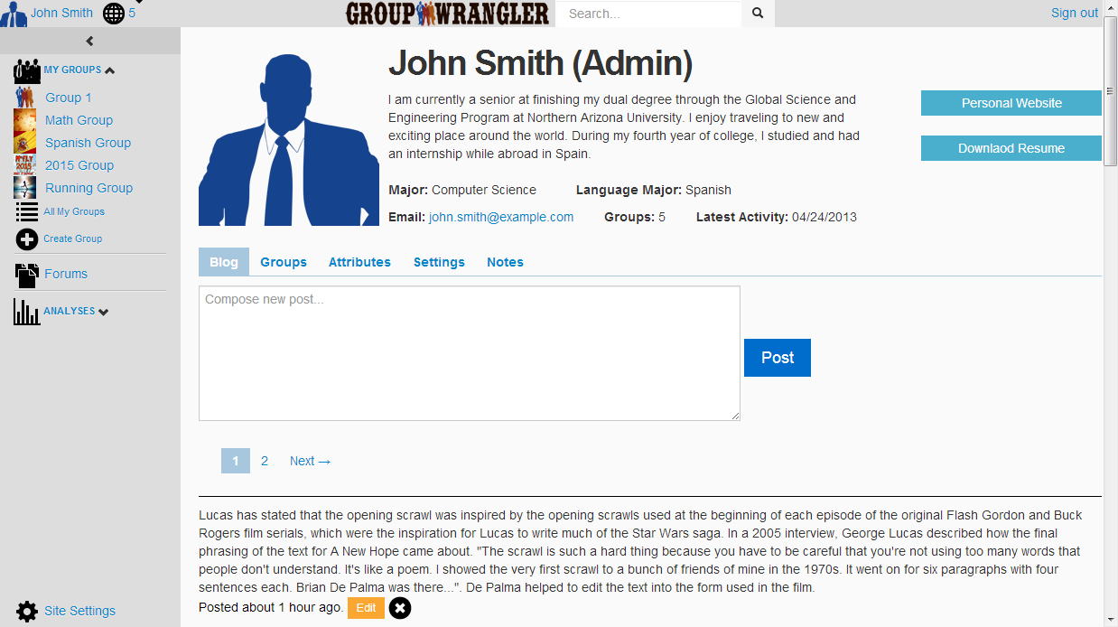
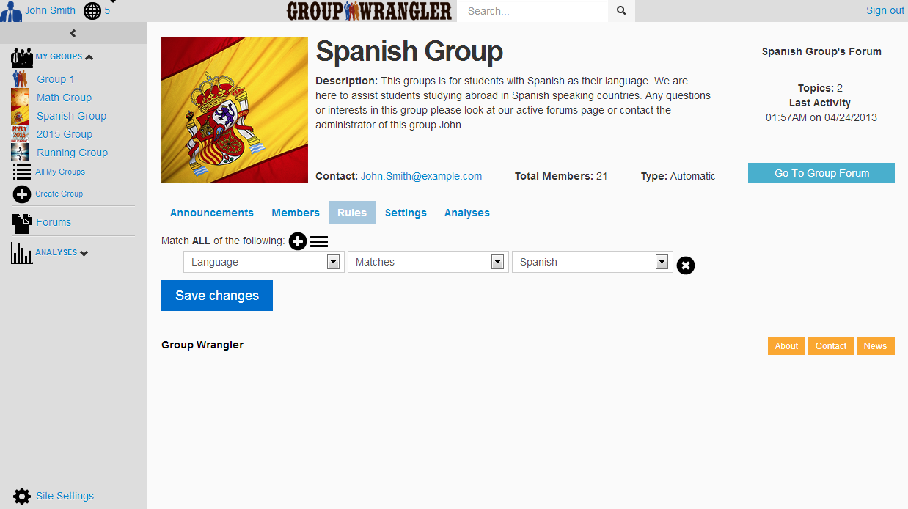
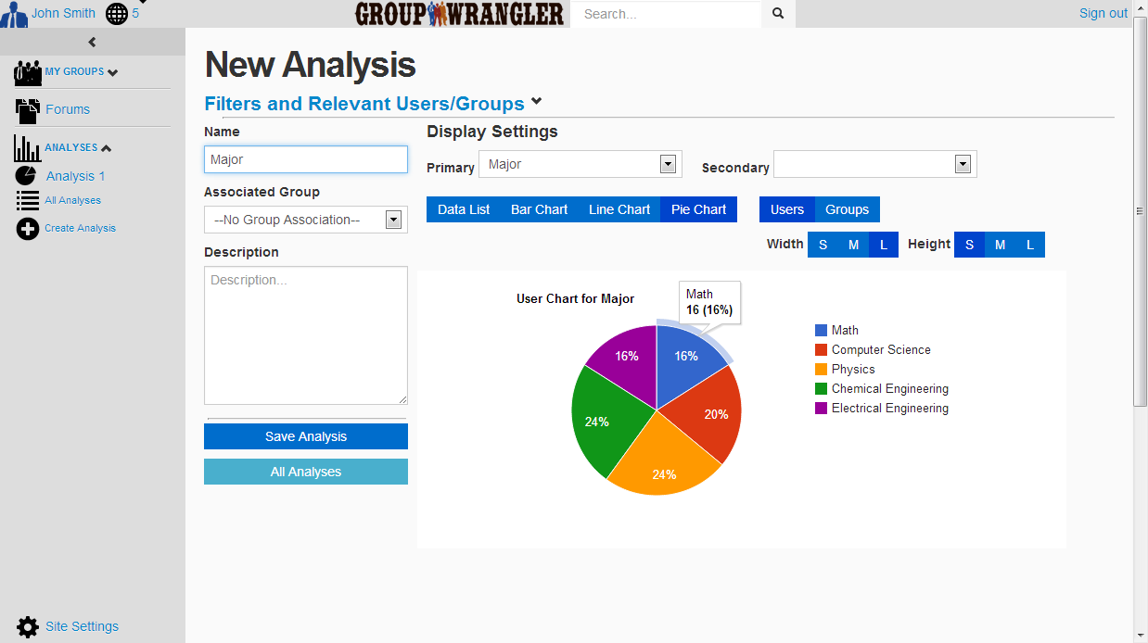
Greg Andolshek Alex Koch Michael McCormick
Melissa Armstrong – Sponsor Dr. Eck Doerry – Mentor
Department of Computer Science
Problem
Solution
Design
Groups are a fundamental concept in any large organization or social circle. Managing groups is a complex challenge. Currently, there is no single tool that can:
Manage members – Add and track members
Define groups manually and automatically – Use custom attributes to determine membership
Analyze members and groups – View graphical and statistical breakdowns
Facilitate group communication – Support for blogs, forums, and email.
Products today focus on social aspects or administrative group management. There is no hybrid system available.
Group Wrangler is a web-based application that supports an intuitive experience for creating and managing groups in a social community. It is a free and open-source system that uses a variety of modern web technologies. Group Wrangler is designed for usability; it is simple and easy to learn. The system allows for future developers to easily modify and adapt existing functionality to meet any organization’s needs. The screenshots below highlight some of the important features of Group Wrangler.
Group Wrangler was developed using an agile approach. We created multiple prototypes that incorporated results from testing and user feedback.
User Profile
Architecture
Group Wrangler uses client-server architecture.
The server side uses a model-view-controller for:
Login
Data manipulation
Persistent storage
The client side presents data to the user.
Ruby on Rails Server
Display basic user information
Post to user’s blog
Manage user’s groups
Create and update user attributes
Manage user’s privacy settings
Create notes for administrator use
Heroku Database
Global Science and Engineering Program
Client
The Global Science and Engineering Program (GSEP) is a dual-degree curricular track that combines studies in any science or engineering discipline with studies in language and culture. The Assistant Director of GSEP, Melissa
Hartl, Michael. Ruby on Rails Tutorial. 2013.
http://ruby.railstutorial.org/ruby-on-rails-tutorial-book
Group Profile
Model-View-Controller Process:
User requests specific page
Controller processes request
Server accesses database to get model information
View dynamically renders page content for user
Display basic group information
Post to group announcements
Manage group’s members
Define group rules for automated grouping
Manage group privacy settings
View forum for each group
Armstrong, manages a rapidly growing group of students that fall into multiple overlapping groups, defined by academic status, language, major and other attributes.
Requirements
Challenges
GSEP needs one tool that allows them to manage students in the program and facilitate communication among members. Some of the key requirements that GSEP is looking for are:
Manage members – Support professional profiles and user profile curation
Define groups manually and automatically – Create groups based on discipline, major, language, etc.
Analyze members and groups – View graphical and statistical breakdowns
Facilitate group communication – Support students abroad and allow students to share their experiences.
Lack of any similar existing systems – Held many meetings to develop an idea of how to pioneer a new type of site
Integration of numerous group management and communication features – Tested many features together to create an appropriate balance
Intuitive user interface with an easy learning curve – Extensive user testing and feedback to improve accessibility and page utilization
Analysis Tool
Filter groups and users for analysis
Use existing group rules for filtering
Display multiple chart types
Save analyses
Create link to analysis for sharing
Assist in group creation
Team Website
Engineering Design
http://www.cefns.nau.edu/interdisciplinary/d4p/EGR486/CS/13-Projects/TeamWrangler/

