Slide 1
Canoopa Northern Arizona University
Concrete Canoe
UGRADS Presentation
April 27, 2018
Presenters:
Katlynn Adams
Gina Boschetto
Joshua Leon
Branden Petersen
Zach Radovich

Slide 2
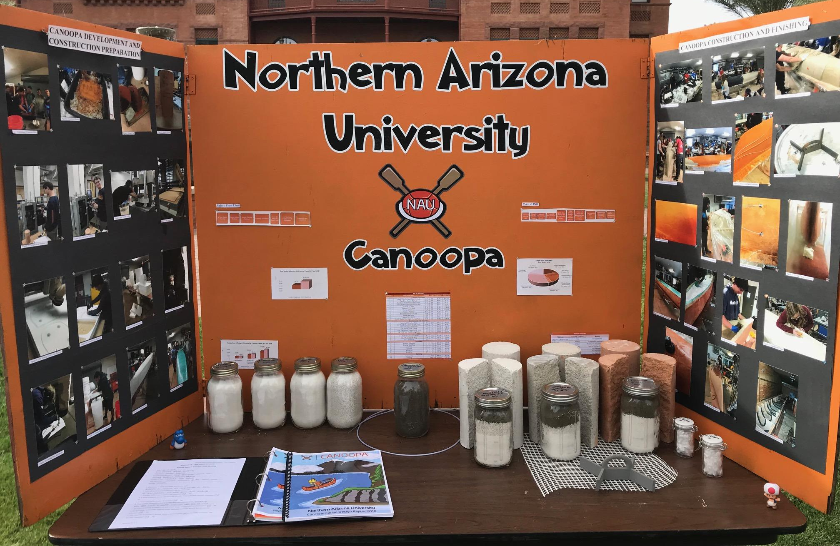
Project Background
Concrete Canoe
Concrete Canoe Competition
Pacific Southwest Conference (PSWC) 2018 at Arizona State University
April 12-14, 2018
Conference Deliverables
Final Product
Racing Placement
Design Paper
Oral Presentation
Figure 1: Conference Display Board
Figure 2: 4 Person Coed Sprint
Katlynn 2

Slide 3
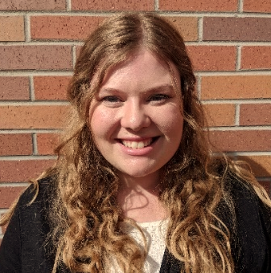
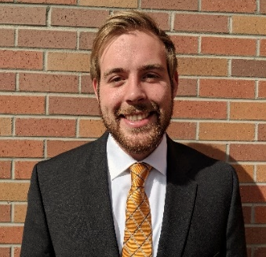
Canoopa Team
Constraints
$2000 Budget for Testing and Construction of the Canoe
National Concrete Canoe Competition (NCCC) Rules
Local Materials
Impacts
NAU and ASCE Reputation
Further Institutional Knowledge
Katlynn Adams
Project Manager
Joshua Leon Reinforcement Lead
Branden Petersen
Mix Design Lead
Zach Radovich
Structural Lead
Gina Boschetto
Quality Assurance/Control
Katlynn 3

Slide 4
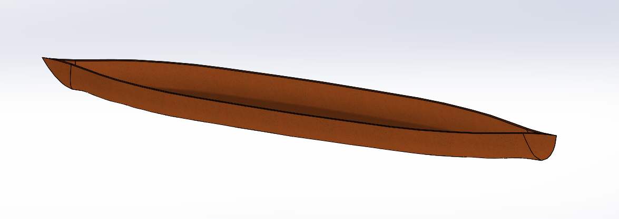
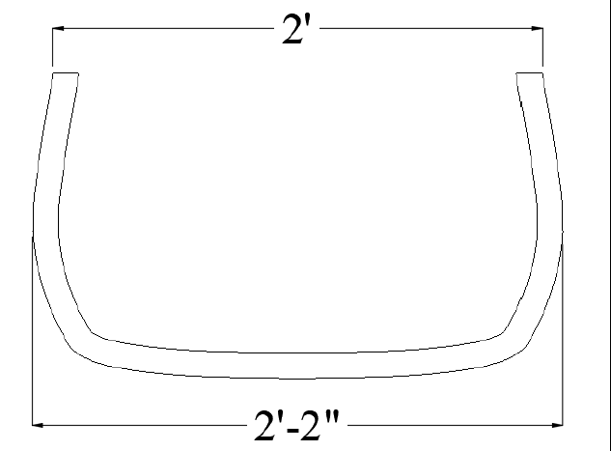
Hull Design
Tumblehome
Flat Bottom
Table 1: Hull Dimensions
Hull Dimensions
Maximum Length | 258 in
Maximum Width | 26 in
Maximum Depth | 15 in
Average Thickness | 1.25 in
Weight | 300 lb
Figure 3: SolidWorks Model
Figure 4: Cross-Section Canoe Mid-Span
Zachary 4

Slide 5
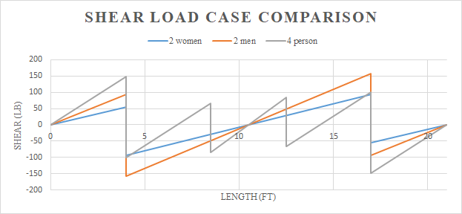
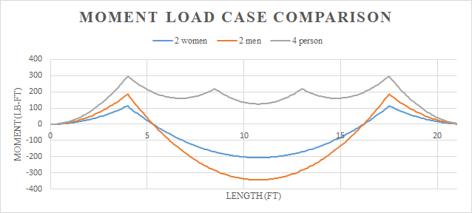
Structural Analysis
2 Women Races
2 Men Races
4 Person Races
Figure 6: Shear Diagram
Figure 5: Loading Scenarios
Figure 7: Moment Diagram
Zachary 5

Slide 6
Structural Analysis
Table 2: Structural Analysis Results for Each Load Scenario
Structural Analysis Results
Loading Scenarios | Shear (lb) | Moment (lb-ft) | Shear Stress τ (psi) | Compressive Stress σ_{c} (psi) | Tensile Stress σ_{T} (psi)
2-Women | 94.16 | 206.25 | 4.13 | 23.34 | 13.87
2-Men | 156.98 | 343.75 | 6.88 | 38.91 | 23.11
4-Person | 148.84 | 297.68 | 6.53 | 30.25 | 21.76
Table 2: Structural Analysis Results
Zachary 6

Slide 7
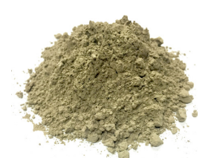
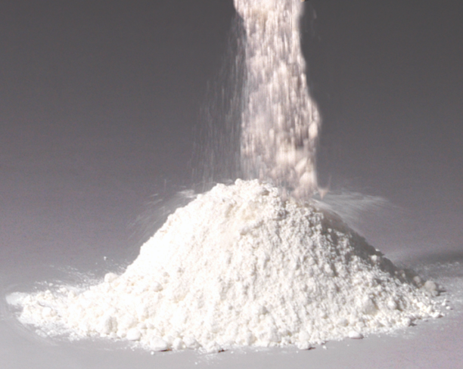
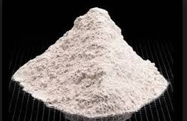
Concrete Mix Design (Material)
Implemented new cementitious material
^{White Portland Cement}
^{Class C Fly Ash}
^{Natural Blended Pozzolan}
Figure 9: Class C Fly Ash
Figure 8: Portland White Cement
Figure 10: Natural Blended Pozzolan
Branden 7

Slide 8
Concrete Mix Design (Material)
Main Goal: Create lighter mix
Paddlegonia: 63.7 lb/ft3, Canoopa: 59.5 lb/ft3
Implemented a higher ratio of aggregate
Paddlegonia: 55%
ASTM C330: 29% Sand, Poraver: 24% (1-2 mm), 19% (0.5-1 mm), 27% (0.1-0.5 mm)
Canoopa: 64%
ASTM C330: 25% Sand, Poraver: 16% (1-2 mm), 19% (0.5-1 mm), 21% (0.25-0.5 mm), 19% (0.1-0.3 mm)
Table 3: Concrete Mix Proportions
Mix | c/cm ratio | w/cm ratio | Cement (%) | Aggregate (%) | Slump (in)
Structural #1 | 0.5 | 0.56 | 13.4 | 63.0 | 1.0
Structural #2 | 0.43 | 0.54 | 14.3 | 65.9 | 1.0
Finishing | 0.5 | 0.46 | 12.9 | 65.0 | 1.0
Branden 8

Slide 9
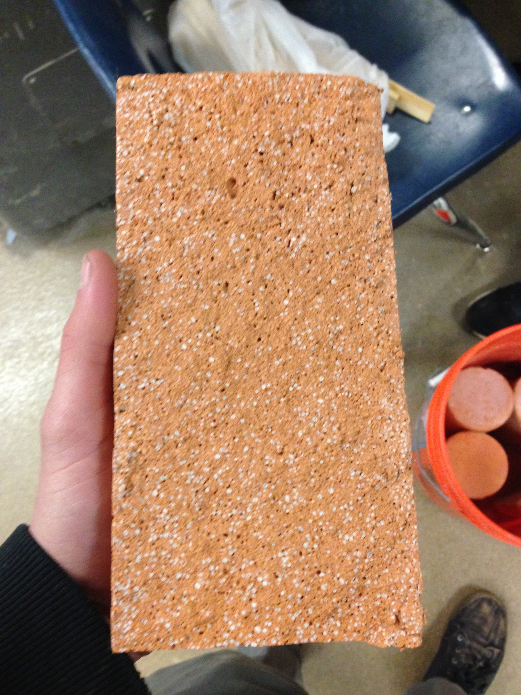
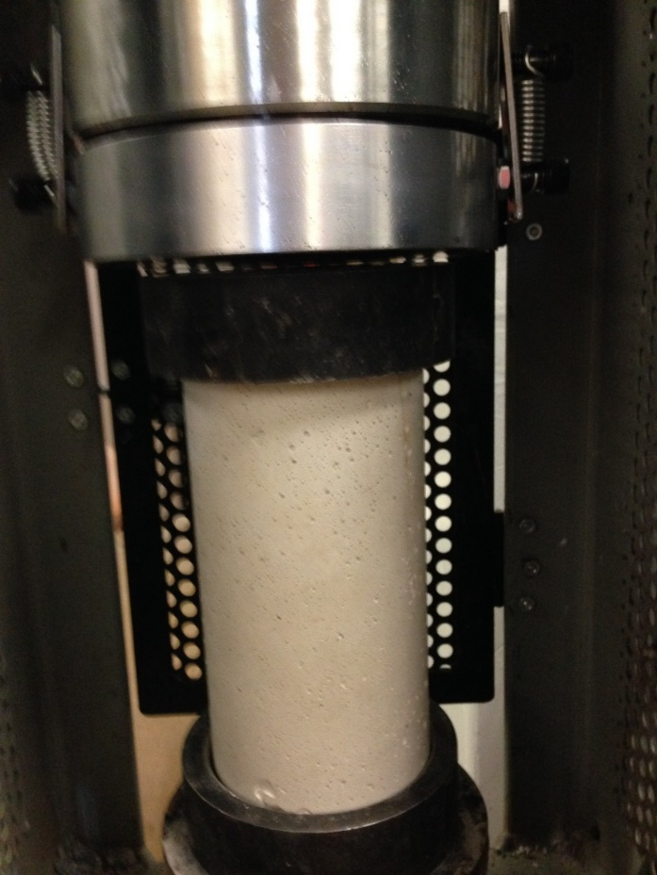
Concrete Mix Design (Testing)
Figure 11: Concrete Mixing
Figure 12: Concrete Compression Test
Figure 13: Split Tensile Cylinder
Branden 9

Slide 10
Concrete Mix Design (Testing)
Table 4: Finishing Mix Properties
Table 5: Structural Mix #1 Properties
Table 6: Structural Mix #2 Properties
Finishing Mix
Wet Unit Weight | 65.85 lb/ft3
Oven-Dry Unit Weight | 59.15 lb/ft3
Compressive Strength | 1900 psi
Tensile Strength | 350 psi
Flexural Strength | 915 psi
Air Content | 11.30%
Structural Mix #1
Wet Unit Weight | 68.37 lb/ft3
Oven-Dry Unit Weight | 61.34 lb/ft3
Compressive Strength | 1600 psi
Tensile Strength | 375 psi
Flexural Strength | 835 psi
Air Content | 9.92%
Structural Mix #2
Wet Unit Weight | 65.01 lb/ft3
Oven-Dry Unit Weight | 56.12 lb/ft3
Compressive Strength | 1100 psi
Tensile Strength | 315 psi
Flexural Strength | 780 psi
Air Content | 12.39%
Branden 10

Slide 11
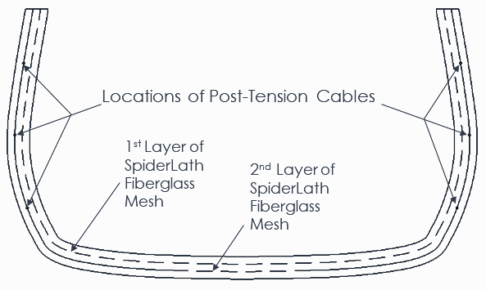
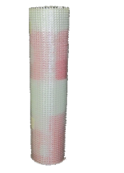
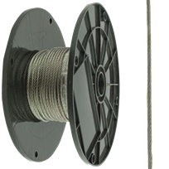
Reinforcement
Materials
SpiderLath Fiberglass Mesh (Primary)
1/16” Galvanized Steel Wires (Primary)
Fibers (Secondary)
Figure 14: Primary Reinforcement in Canoe, Mesh (Left), Wire (Right)
Figure 15: Reinforcement Layout
Josh 11

Slide 12
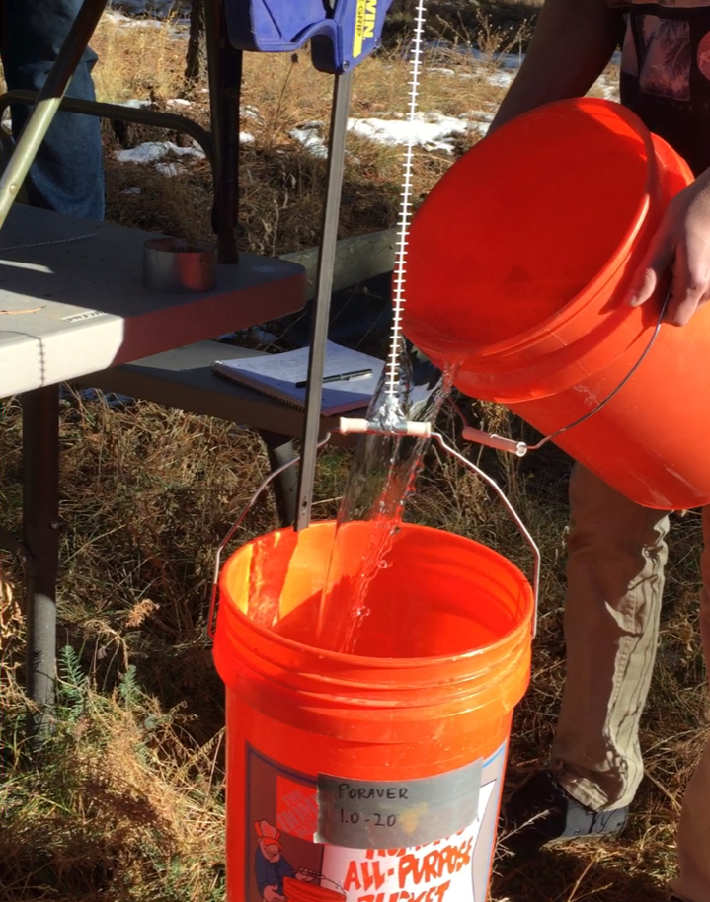
Reinforcement Testing
Table 7: Strand Tensile Testing
SpiderLath Mesh |  | Tested Strength (lbs.) |  | Average Strength (lbs.)
Reused Material |  | 24.88 |  | 27.24
 |  | 25.53
 |  | 31.32
Purchased Material |  | 26.34 |  | 27.79
 |  | 25.62
 |  | 31.41
Figure 16: Concrete Slabs with Mesh Overlap
Figure 17: Applying Load to Mesh Strand
Josh 12

Slide 13
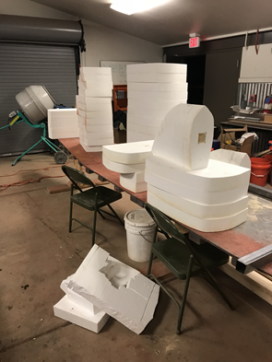
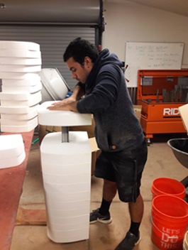
Mold Construction
Figure 18: CNC Router
Figure 19: Mold Cross-Sections
Figure 20: Mold Assembly
Gina 13

Slide 14
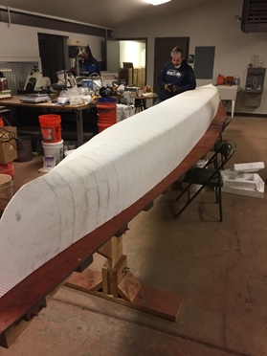
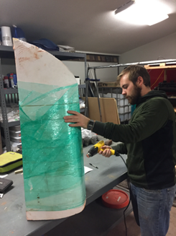
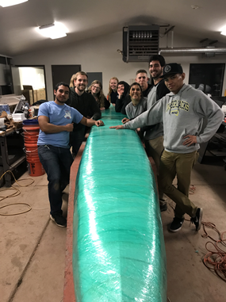
Mold Construction
Figure 21: Final Constructed Mold
Figure 22: Plastic Wrapping Cross Section
Figure 23: Prepared Mold for Pour Day
Gina 14

Slide 15
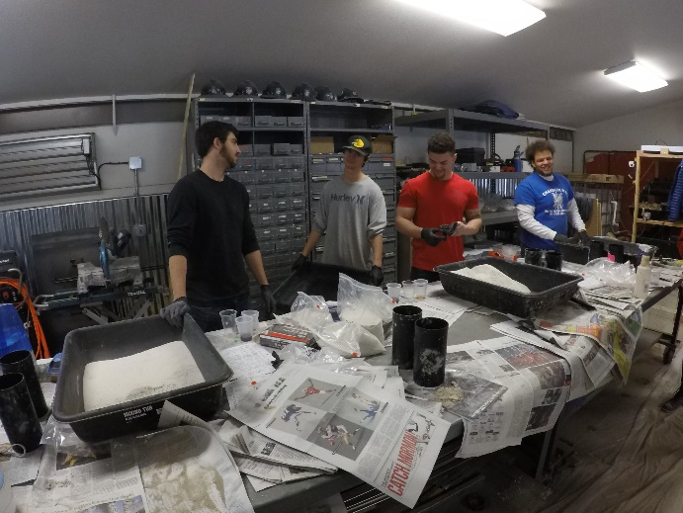
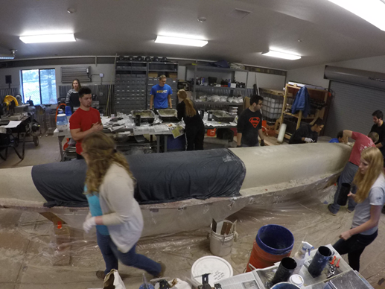
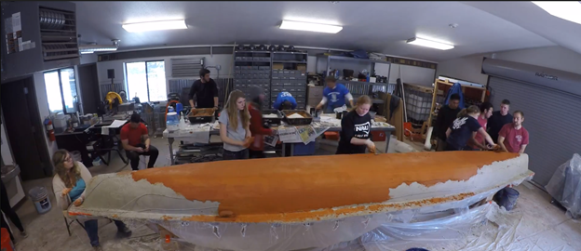
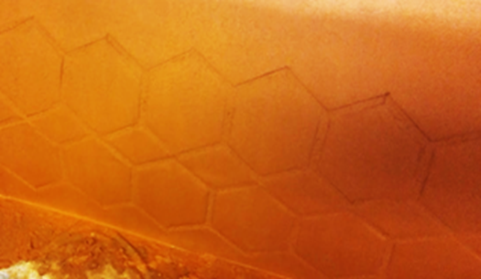
Pour Day
Figure 24: Concrete Preparation
Figure 25: First Layer of Structural Concrete
Figure 26: Applying Mesh
Figure 27: Applying Finishing Layer
Figure 28: Canoe Imprint
Gina 15

Slide 16
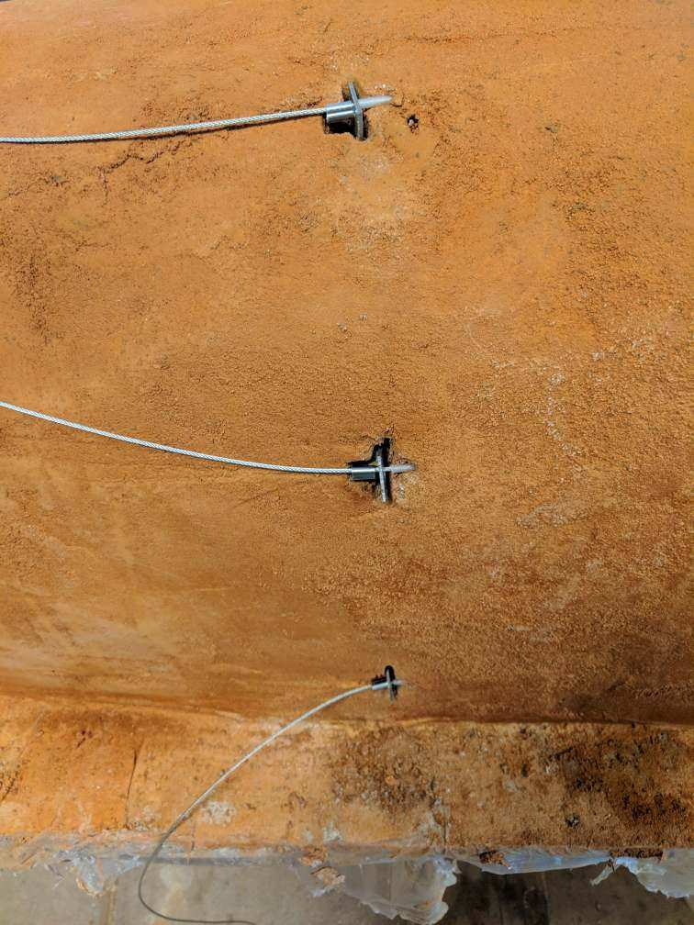
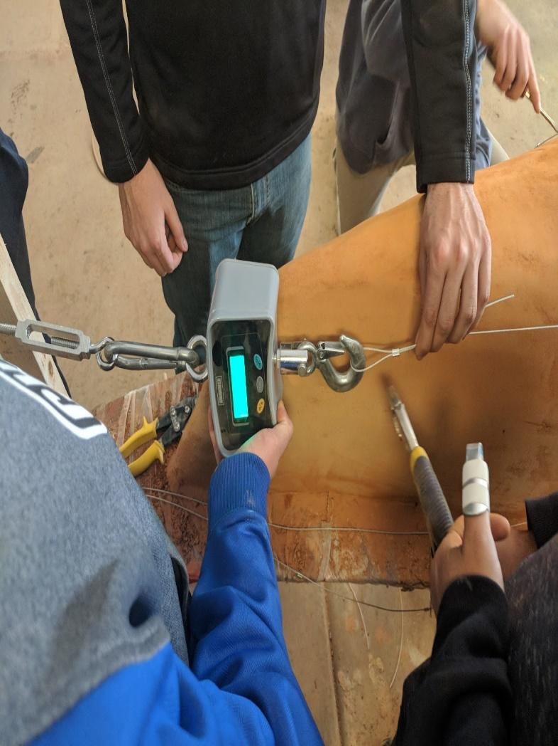
Post-Tensioning
Table 8: Post Tensioning
Wire Location | Applied Tension (lbs.) | Tension After Losses (lbs.)
1 | 80 | 50
2 | 80 | 50
3 | 80 | 50
1
2
3
Figure 29: Installing Anchors to Cables
Figure 30: Monitoring Tensile Force for Cables
Josh 16

Slide 17
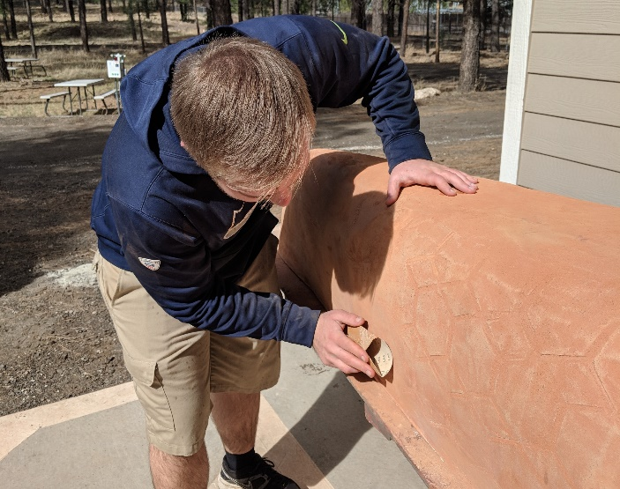
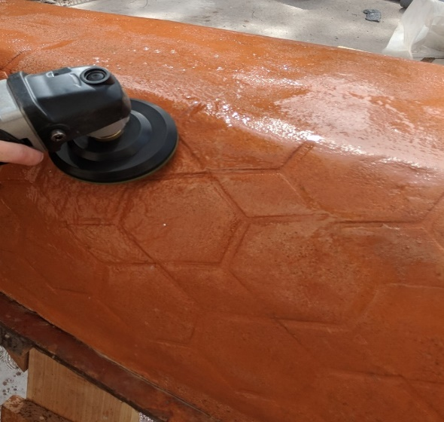
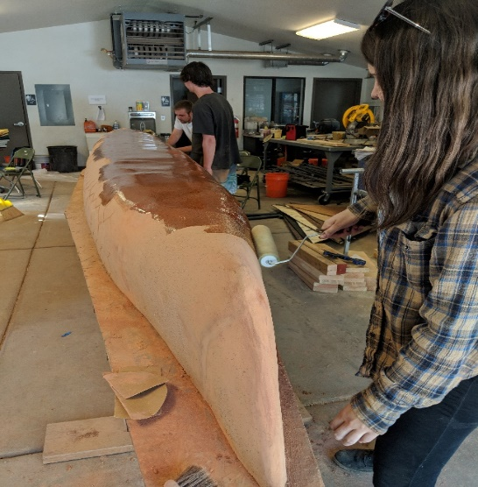
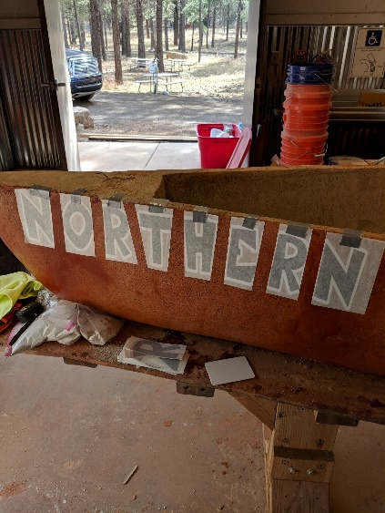
Finishing and Aesthetics
Figure 31: Sand Canoe
Figure 32: Encasing End-Caps
Figure 33: Polish Canoe
Figure 34: Seal Canoe
Figure 35: Apply Letters
Gina 17

Slide 18
Project Schedule
Table 9: Schedule
Task Name | Scheduled End Date | Actual End Date
Project Management & Fundraising | 4/14/2018 | 4/14/2018
Analysis and Design | 12/31/2017 | 2/17/2018
Testing | 12/31/2017 | 1/15/2018
Mold Construction | 1/20/2018 | 2/18/2018
Canoe Construction | 4/2/2018 | 4/8/2018
Canoe Curing | 3/18/2018 | 3/18/2018
Finishing | 4/2/2018 | 4/8/2018
Paddling Practice | 4/5/2018 | 4/5/2018
Katlynn 18

Slide 19
Project Management
Table 10: Person Hour Breakdown
Person Hour Breakdown
Term | Projected Hours | Projected Hours % of Overall | Actual Hours | Actual Hours % of Overall
Project Management | 250 | 13.24% | 300 | 18.18%
Hull Design | 81 | 4.29% | 40 | 2.42%
Structural Analysis | 110 | 5.83% | 100 | 6.06%
Mixture Design Development | 385 | 20.39% | 250 | 15.15%
Mold Construction | 46 | 2.44% | 60 | 3.64%
Canoe Construction, including research, testing and construction | 550 | 29.13% | 500 | 30.30%
Finishing | 70 | 3.71% | 100 | 6.06%
Academics, including the design paper, presentation, and display | 396 | 20.97% | 300 | 18.18%
Total Number | 1888 | 100.00% | 1650 | 100.00%
Katlynn 19

Slide 20
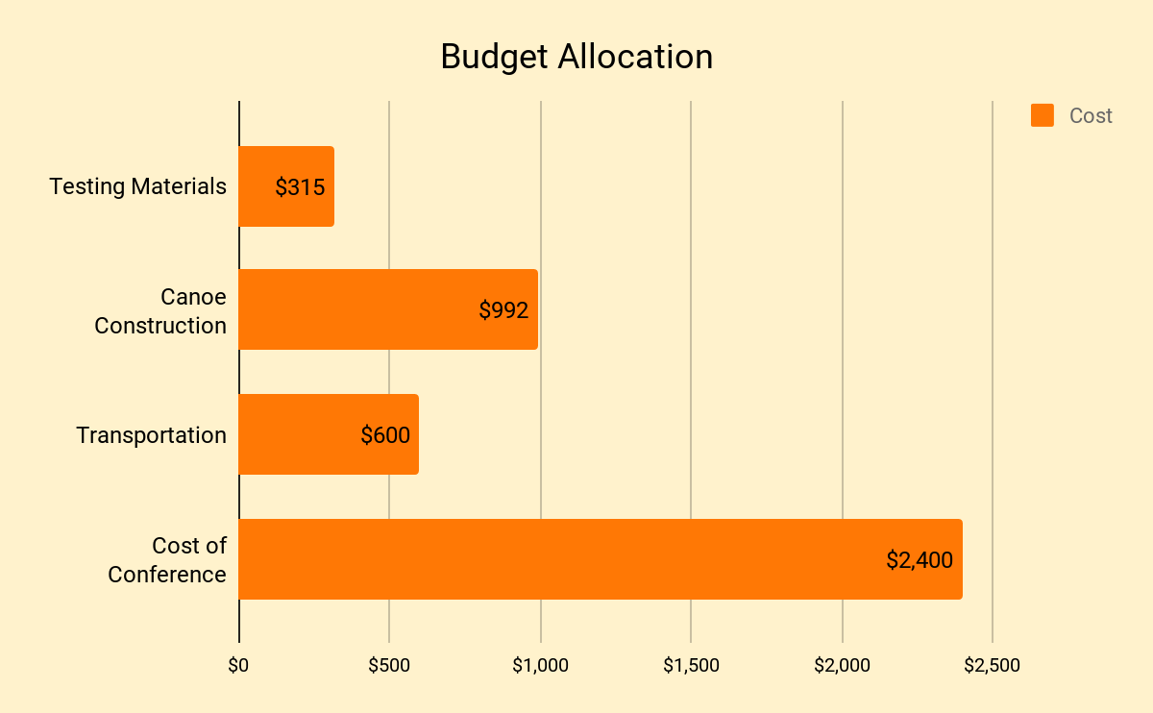
Project Cost
Budget for Testing and Canoe Construction: $2,000
Actual Cost of Testing and Canoe Construction: $1,307
All Other Costs: $3,000
Total Cost of Project: $4,307
Total Cost of Engineering Services: $127,455
Figure 36: Cost Comparison
Katlynn 20

Slide 21
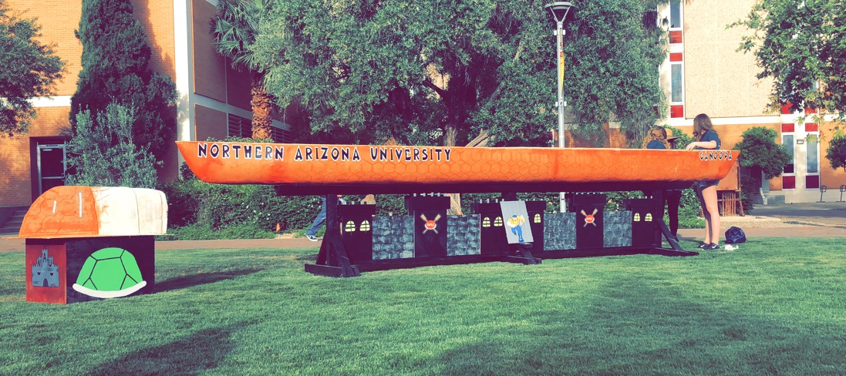
PSWC Results
Table 11: PSWC Conference Results
PSWC Results
Event | Placement
Product Display | 6th
Racing | 12th
Design Paper | 5th
Oral Presentation | 12th
Overall | 9th
Figure 37: Presenting Canoopa on Display Day at PSWC 2018
Gina 21

