Slide 1

Canoopa
Northern Arizona University
Presenters:
Gina Boschetto
Branden Petersen
Zach Radovich

Slide 2
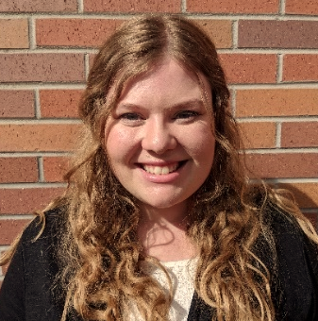





The Team
Goals:
Renovate Hull Design
Improve Mix Design
Set up future teams for success
Katlynn Adams
Project Manager
Joshua Leon Reinforcement Lead
Mix Design Lead
Branden Peterson
Zach Radovich
Structural Lead
Gina Boschetto
Quality Assurance/Control

Slide 3
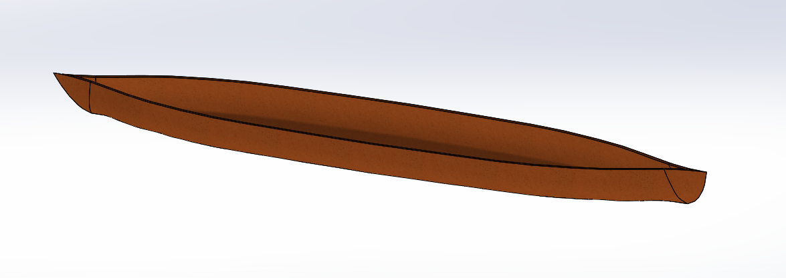
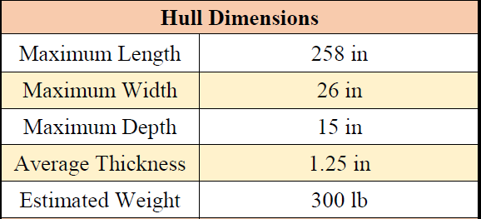
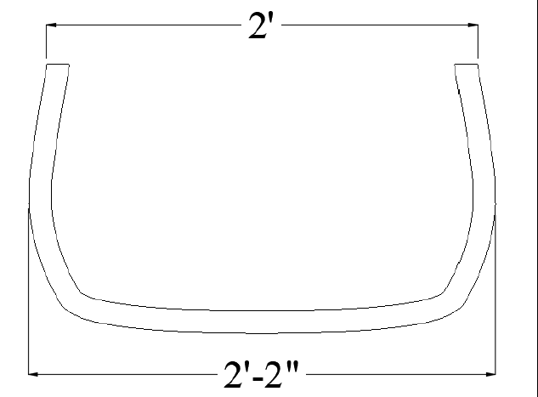
Hull Design
Tumblehome
Flat Bottom
Table 1: Hull Dimensions
Figure 1: SolidWorks Model
Figure 2: Cross-Section Canoe Mid-Span

Slide 4
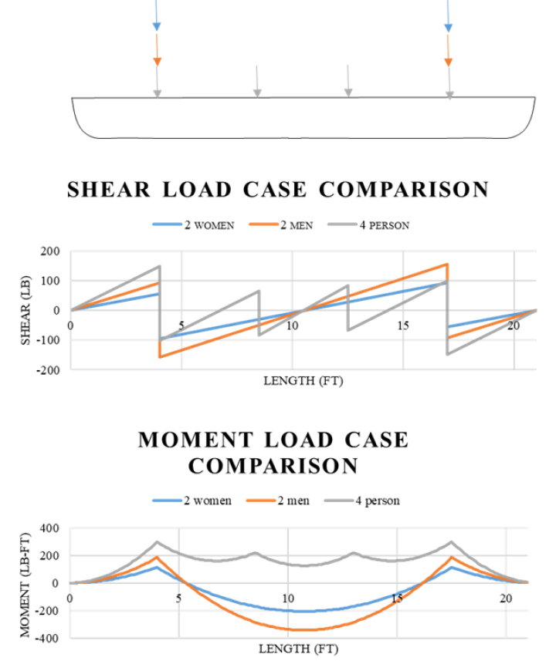
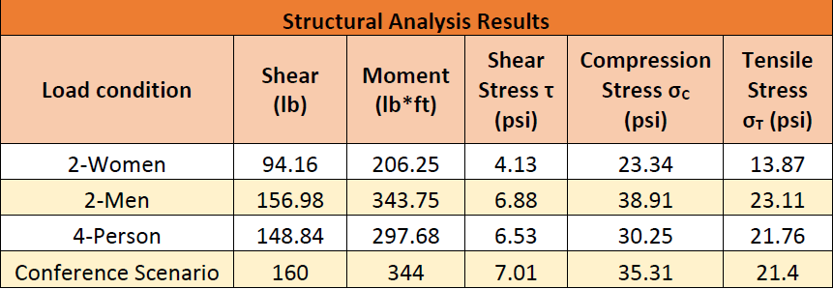
Structural Analysis
Table 2: Structural Analysis Results
Figure 3: Structural Analysis Diagram

Slide 5
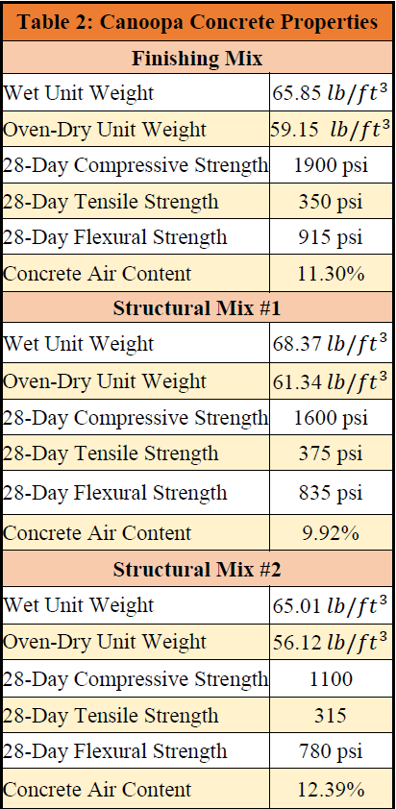
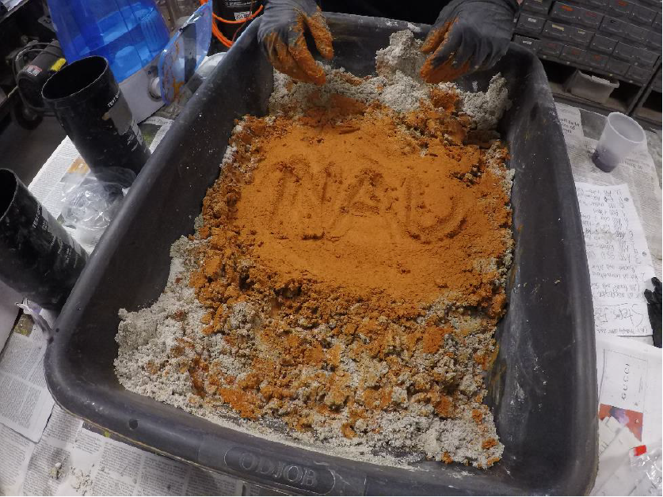
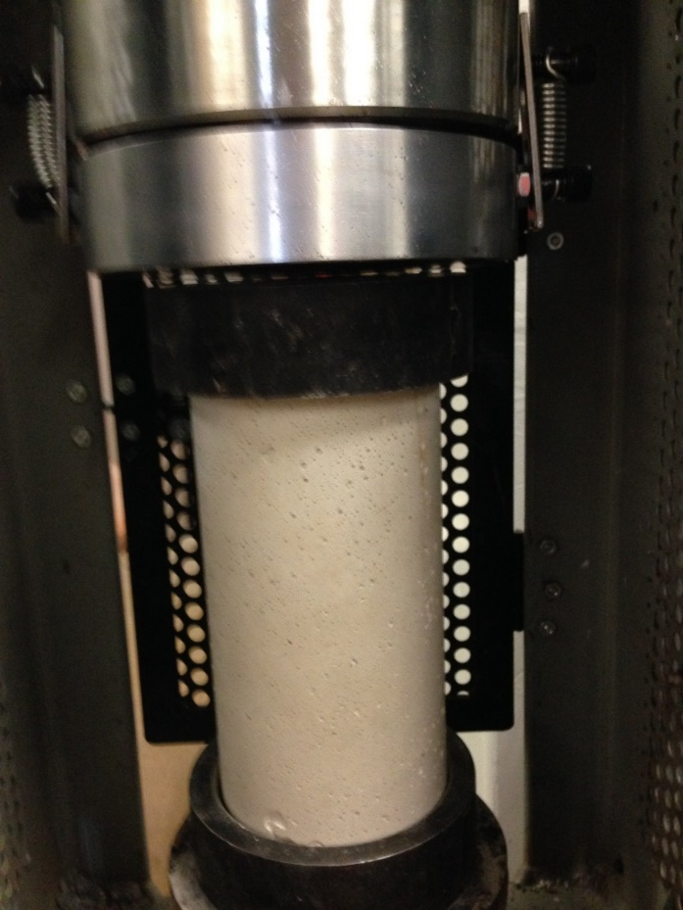
Concrete Mix Design
Table 3: Concrete Mix Properties
Figure 4: Concrete Mixing
Figure 5: Concrete Compression Test

Slide 6
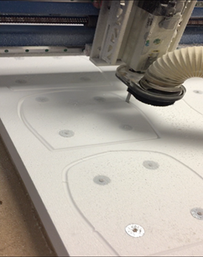
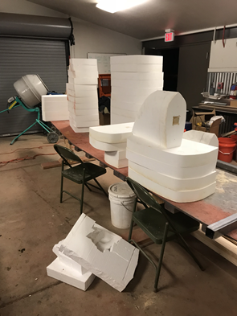
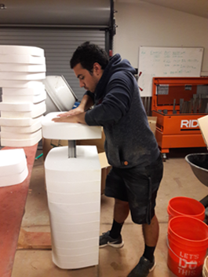
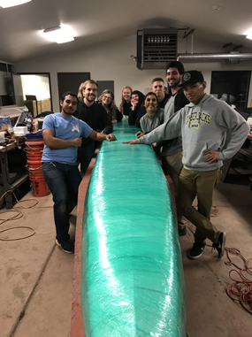
Mold Construction
Figure 6: CNC Router
Figure 7: Mold Cross-Sections
Figure 8: Mold Assembly
Figure 9: Shrink Wrapped Mold

Slide 7
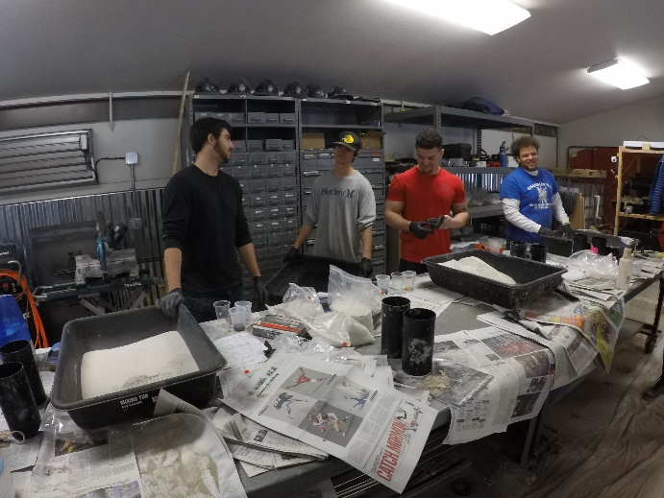
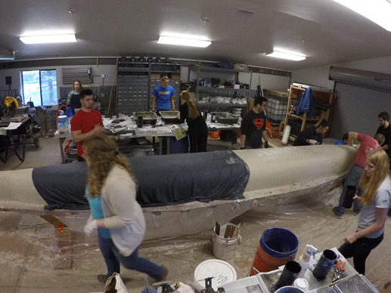
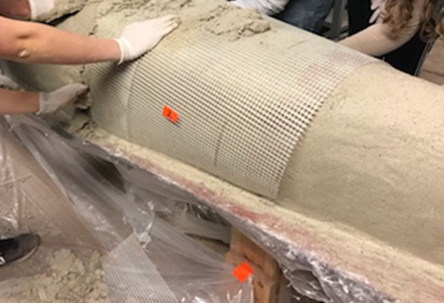
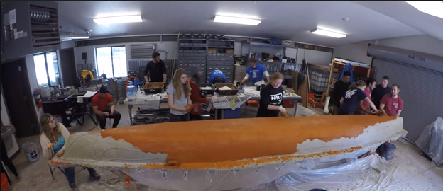
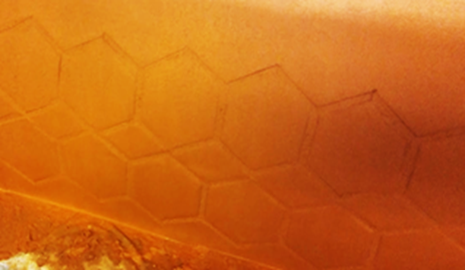
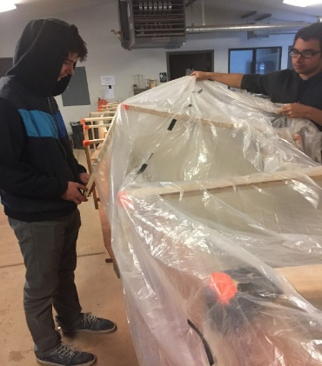
Pour Day and Curing
Figure 10: Concrete Preperation
Figure 11: First Layer of Structural Concrete
Figure 12: Applying Mesh
Figure 13: Applying Finishing Layer
Figure 14: Canoe Imprint
Figure 15: Cure Chamber Assembly

Slide 8
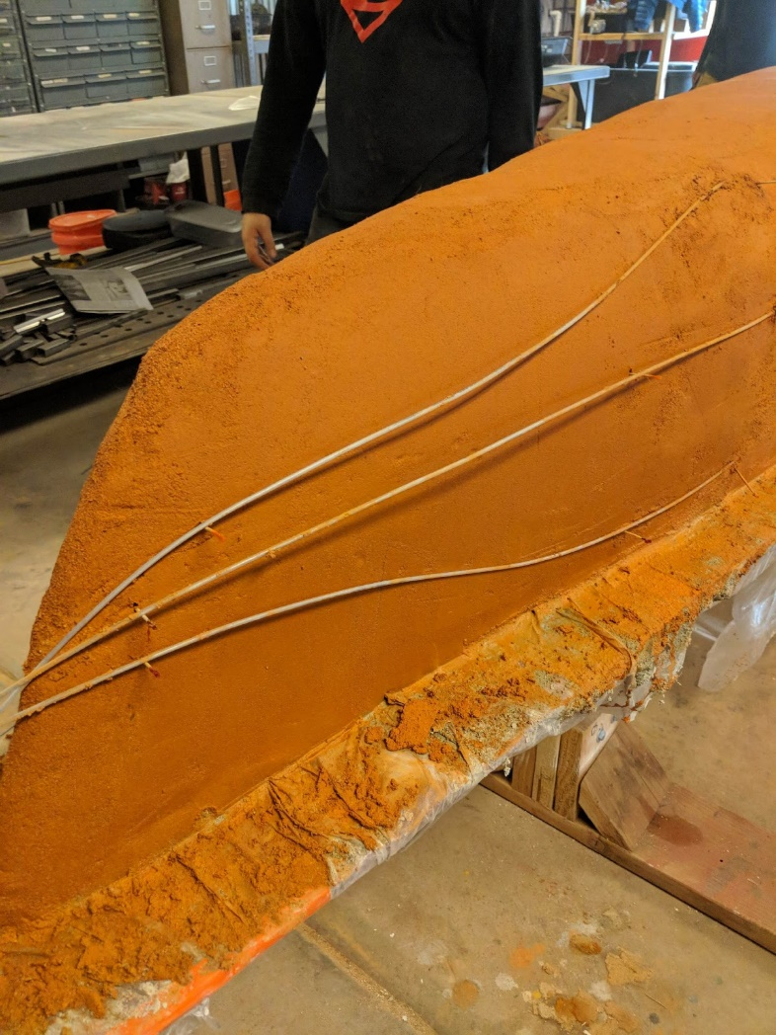
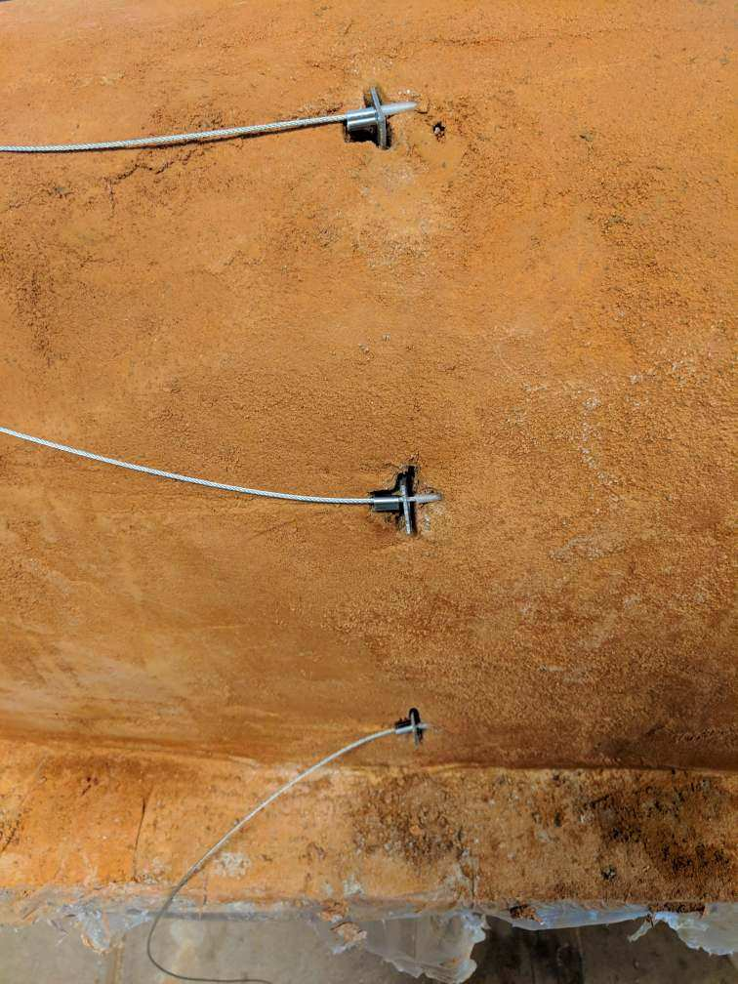
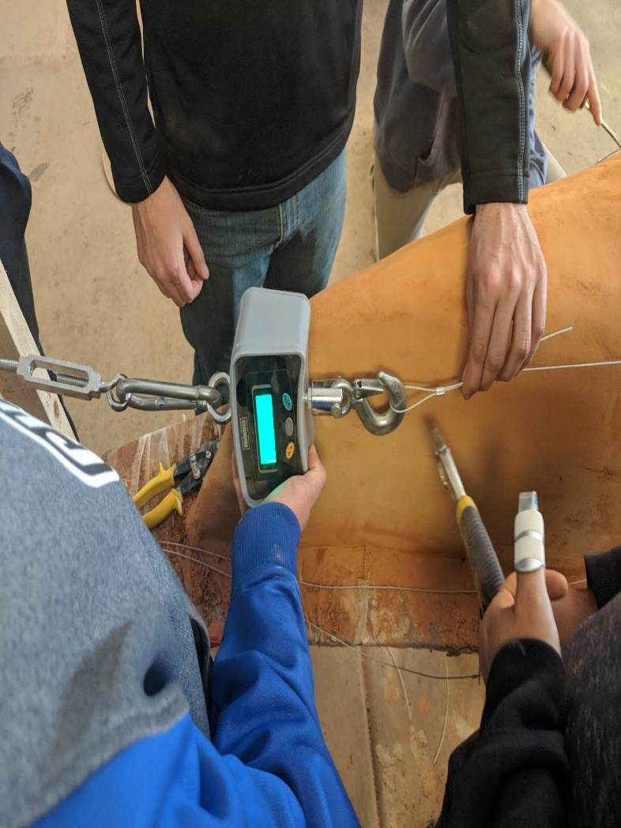
Post-Tensioning
Figure 16: Setting Tensioning Cables
Figure 17: Installing Anchors to Cables
Figure 18: Monitoring Tensile Force for Cables

Slide 9
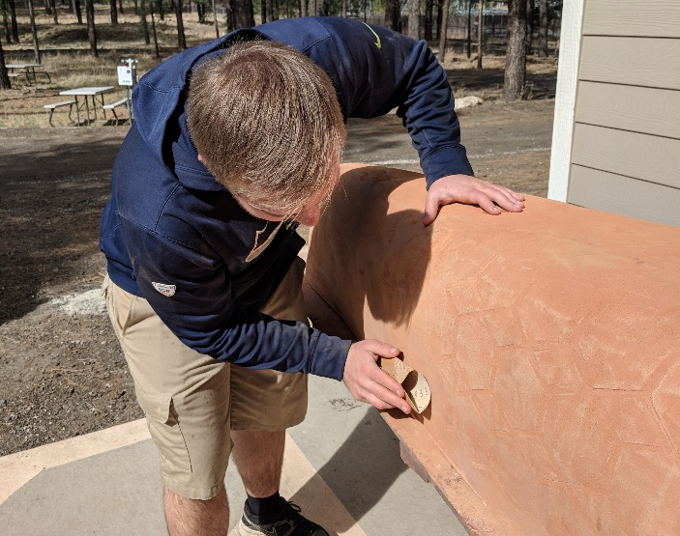
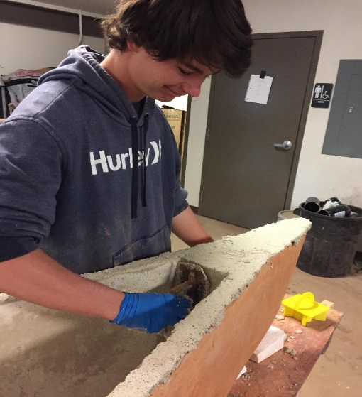
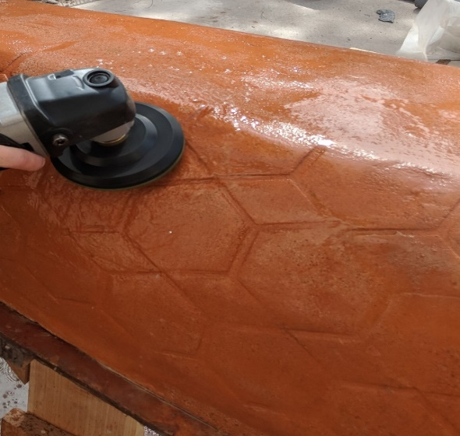
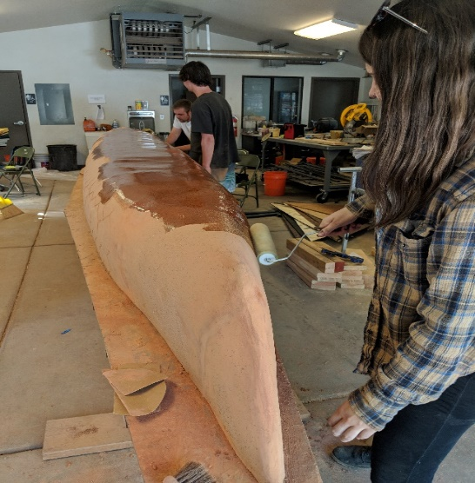
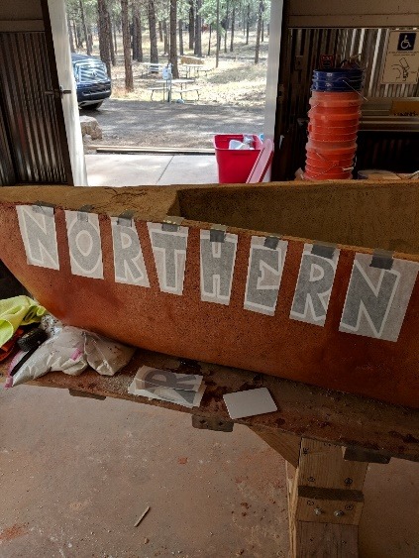
Finishing and Aesthetics
Figure 19: Sand Canoe
Figure 20: Encasing Endcaps
Figure 21: Polish Canoe
Figure 22: Seal Canoe
Figure 23: Apply Letters

Slide 10
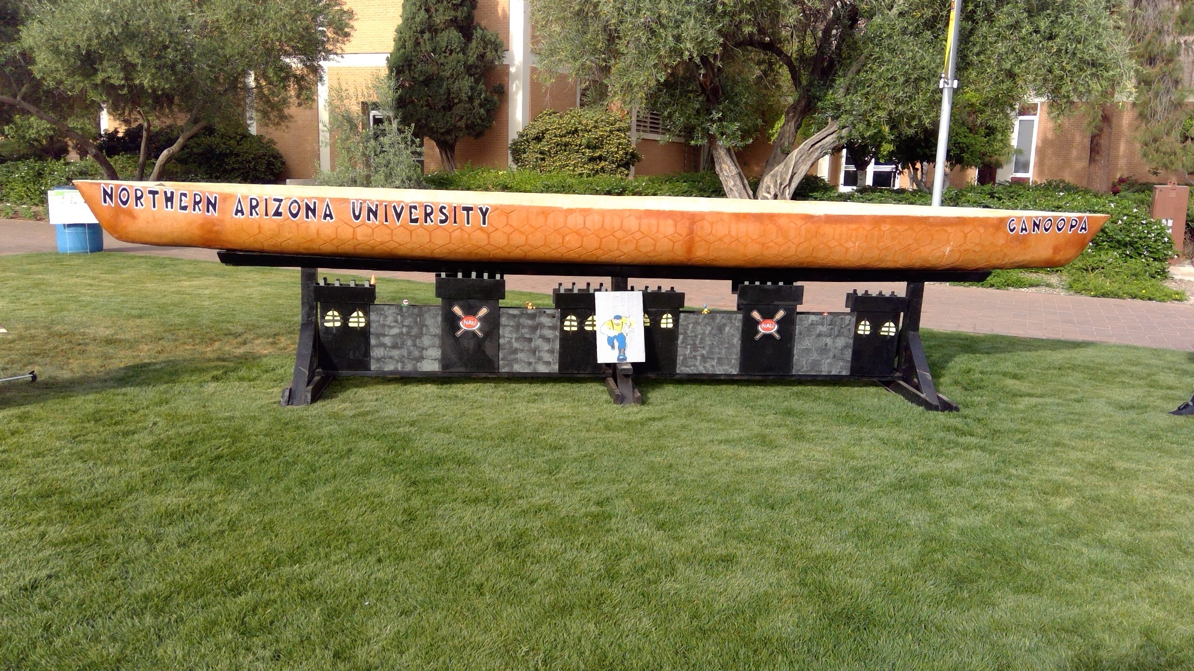
Canoopa
Figure 24: Canoe on Stand

