Slide 1

TASK 2-DEVELOPMENT OF AN IMPROVED SOLAR DISTILLATION STILL
Dr. Wilbert Odem (Advisor)
Banning Burt,
Yiguo Chen,
Chaz Enbody,
Benjamin Shields,
Yang Yang

Slide 2
Problem Statement
Design a still with the highest efficiency
Design a still that is cost effective
Ensure that the brackish groundwater contaminants are removed
No electricity
Notes:
Chen

Slide 3
Brackish Water Condition
Component | Value
Conductivity | 6100 µS/cm
Sulfate | 3300 mg/L
Chloride | 550 mg/L
Hardness (as CaCO₃) | 3000 mg/L
Sodium | 700 mg/L
Calcium | 600 mg/L
Magnesium | 375 mg/L
Silica | 25 mg/L
Strontium | 10 mg/L
Notes:
Banning

Slide 4
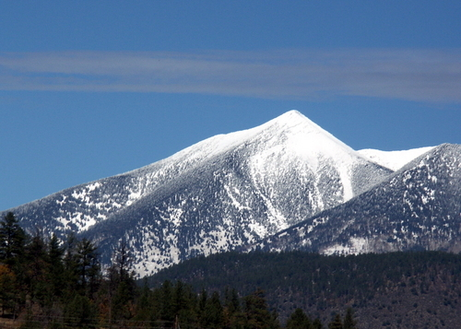
Flagstaff

Slide 5
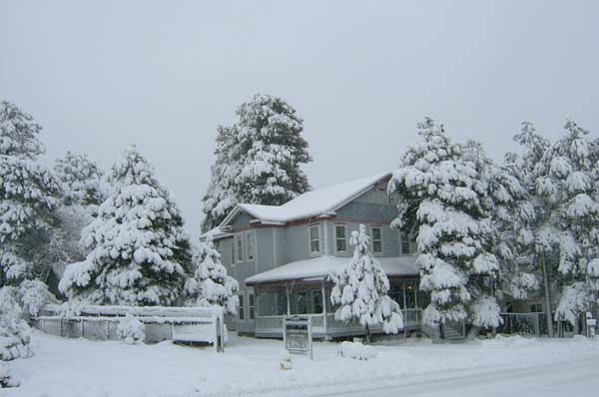
Flagstaff

Slide 6
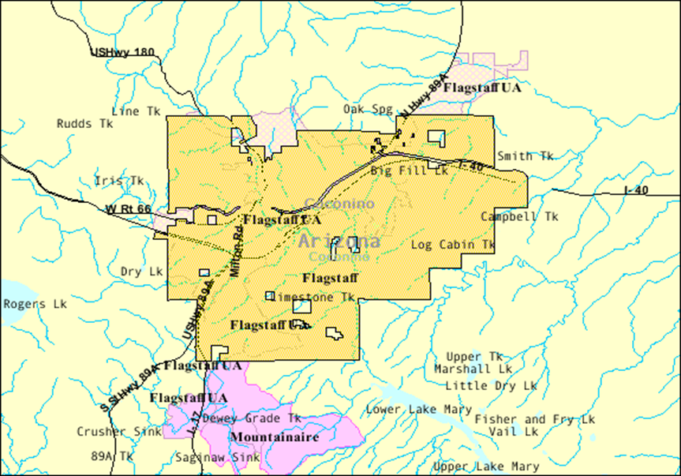
Flagstaff Details
Climate-November,2011-October,2012
Average Maximum Temperature(ºF) | 62.5
Average Wind Speed (MPH) | 6.6
Average Sky Cover | 0.2
Average Relative Humidity (%) | 51.7

Slide 7
Design Matrix
Notes:
Chaz

Slide 8
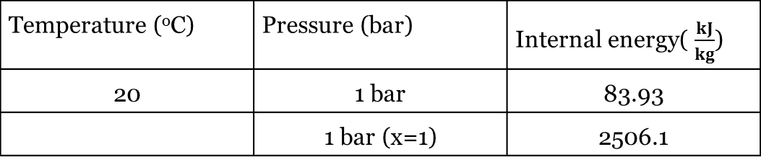
Energy Requirement
Equation E= m * (u₂ – u₁)
Thermodynamic properties for water
Water volume 5 gallon
Energy requirement : 45,780 kJ
Temperature (ºC) | Pressure (bar) | Internal energy( $\frac{kJ}{kg}$)
20 | 1 bar | 83.93
 | 1 bar (x=1) | 2506.1
Notes:
Yang (E= Energy, in kJ, M= Mass of water, in kg, and U= Internal energy, in kJ/kg)

Slide 9
Energy Input
Total Energy
Solar radiation: 1000W/m²
Area: 1,152 in²
E = R * A * N_{reflection} * N_{absorption}
Total Energy Input: 2,440kJ/hr
Energy Loss
q = h * A * (T_{S} – T∞)
Total Energy Loss: 345.4kJ/hr
Energy Input: 2,094.6kJ/hr
Notes:
(Where E is energy input in kJ/h, R is solar radiation W/m², A is area catch the sunlight in m², N_{reflection} is mylar reflection efficiency at 0.97 and N_{absorption} is pipe absorption efficiency at 0.94)
(q is the energy loss in kJ/h=, h is the conductivity coefficient in 7.5 W/m²K, A is the surface area of pipe in 0.15 m², T_{s} is the pipe surface temperature in 372.5 K and T∞ is the surrounding temperature in 287.15 K)

Slide 10
Efficiencies/ Benefits of Materials
Copper- High Thermal absorption coefficient (231 BTU/ft-hr-F)
Mylar- Reduces absorption of heat and hot spots (areas where there is an excessive accumulation of heat) Efficiency- .97
One inlet/ one outlet allows for greater efficiency and rate of production (streamlined process).
Due to simplification of distillation process, entire unit can easily be manipulated to optimize solar energy utilization.

Slide 11
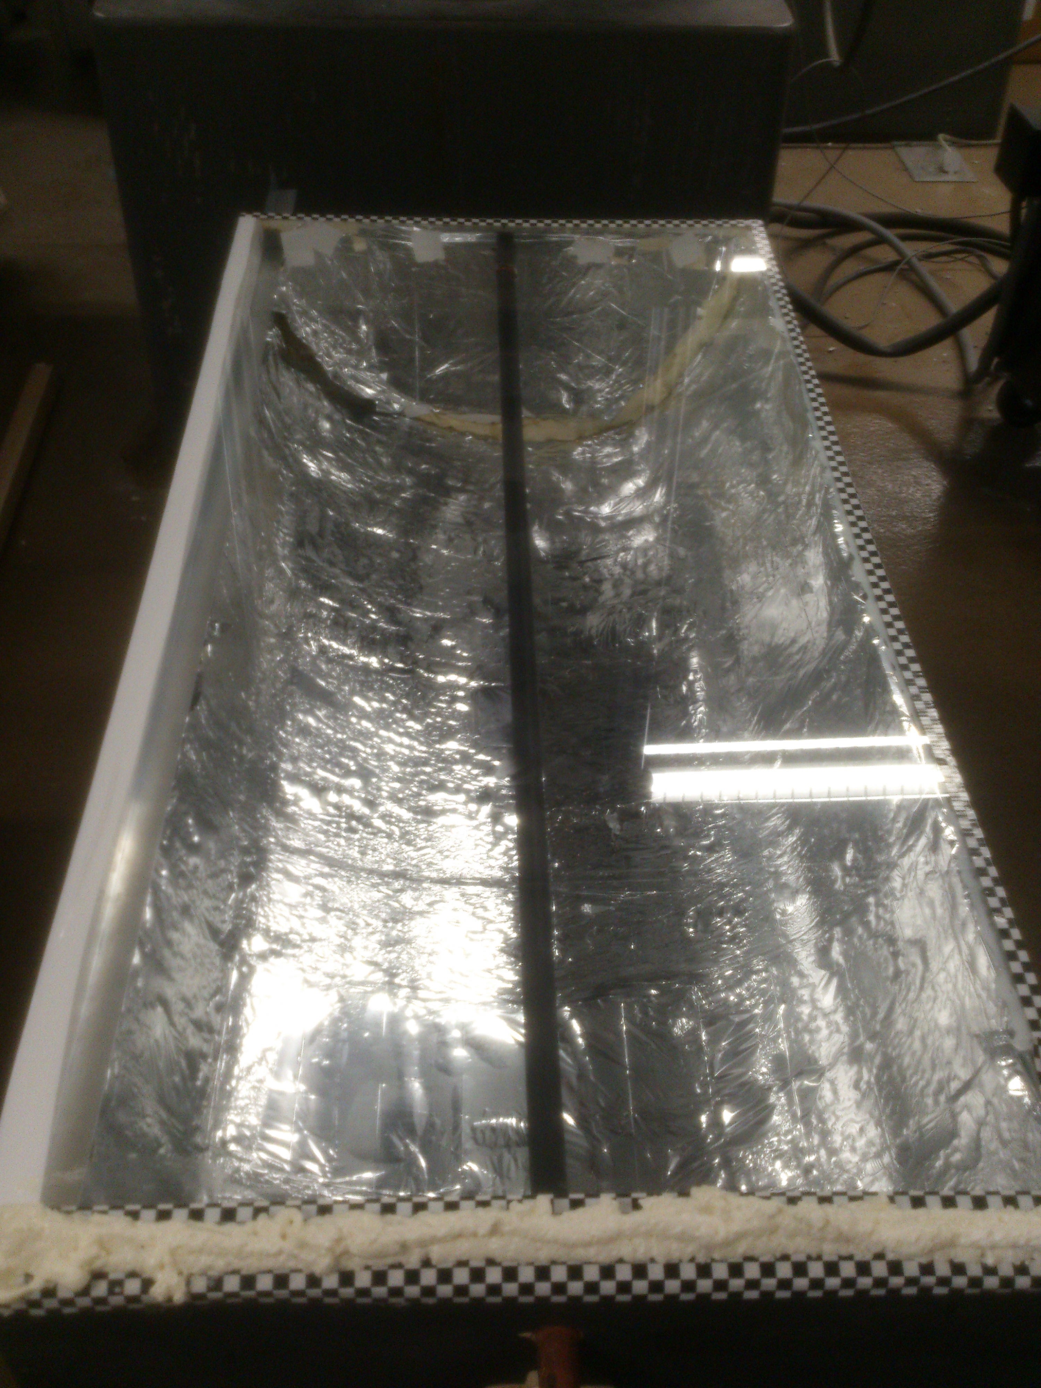
1st Design
Description
48” Х 24” Х 24”
Wood, Metal Sheet, Mylar, Copper Pipe with Small Holes, Glass Cover, Frame and V-shape Gutter
Issues
No water collected by gutter.
Focal point not optimized
Incorrect application of Mylar
Notes:
Banning

Slide 12
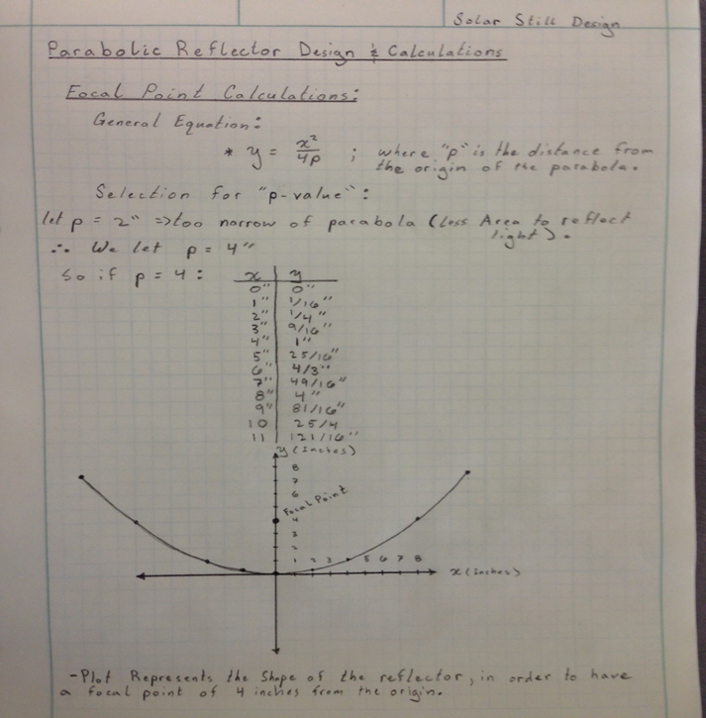
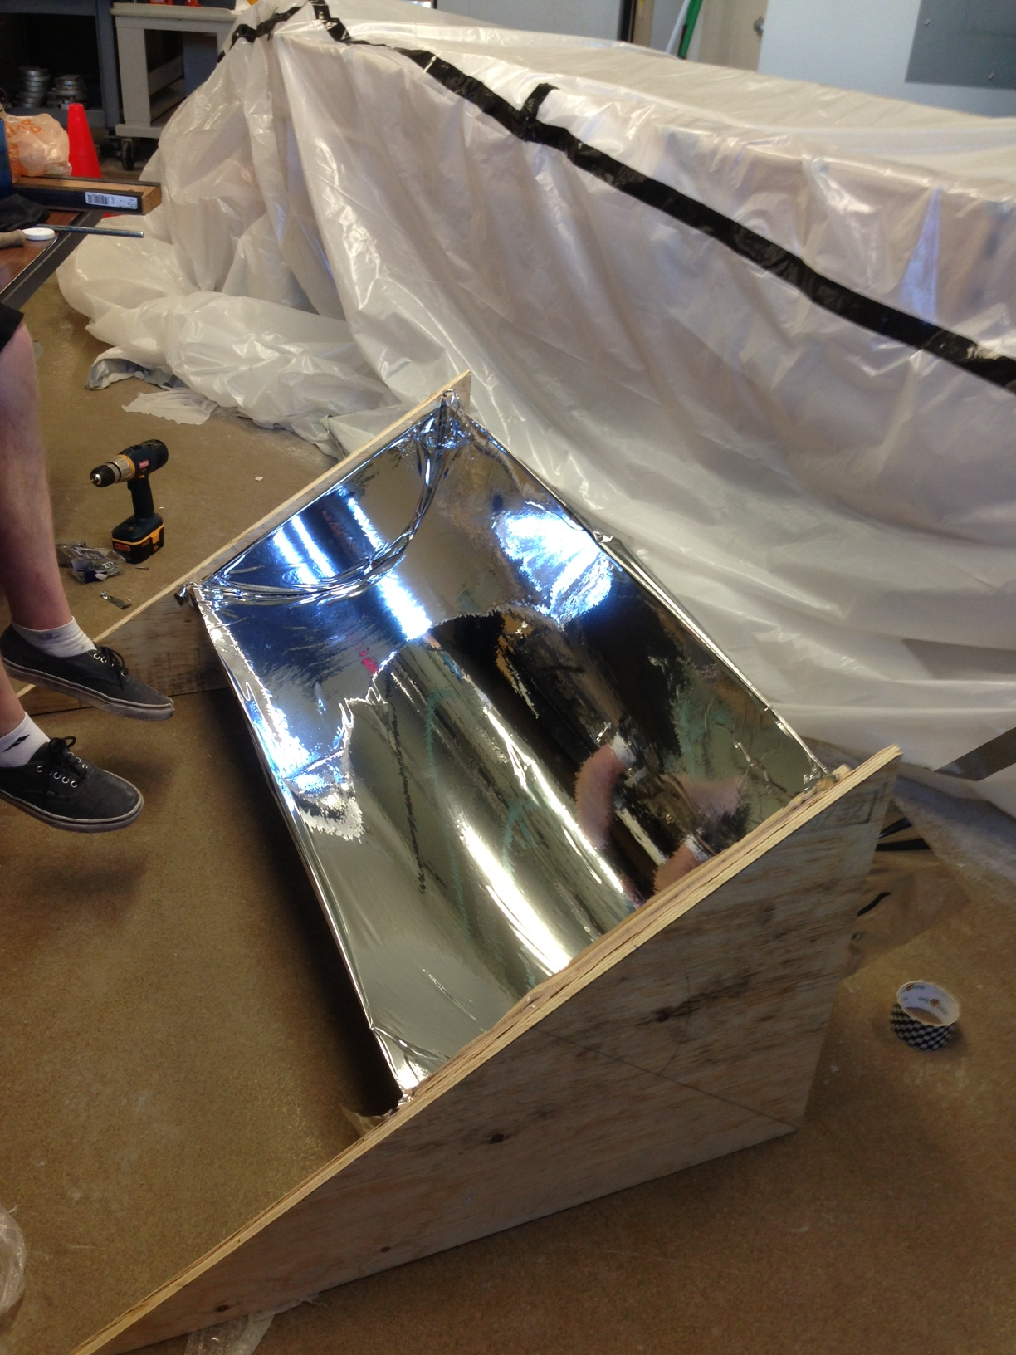
2nd Design
Description
48” Х 36” Х 24”
Holes at end of copper pipe
G-code utilized for higher accuracy and efficiency
Super-Max Drilling Mill (±0.01 inch accuracy)
Issues
Steady hydraulic flow was difficult to achieve
High losses due to forced thermal convection
Issues involved with condensation and collection
Notes:
Ben
Dimensions: 48” Х 36” Х 24”
Same materials except for the gutter
Holes were placed at end of copper pipe
G-code: determine the location of the pipe in a parabolic shapes
G-code is a type of programming language used by the Super-Max Drilling Mill to cut the parabola shape to a ±0.1 inch accuracy.
Hydraulic flow was very difficult.
Improper sealing caused wind to be a large factor when condensation was on the glass
Difficulty collecting the cleaned water

Slide 13
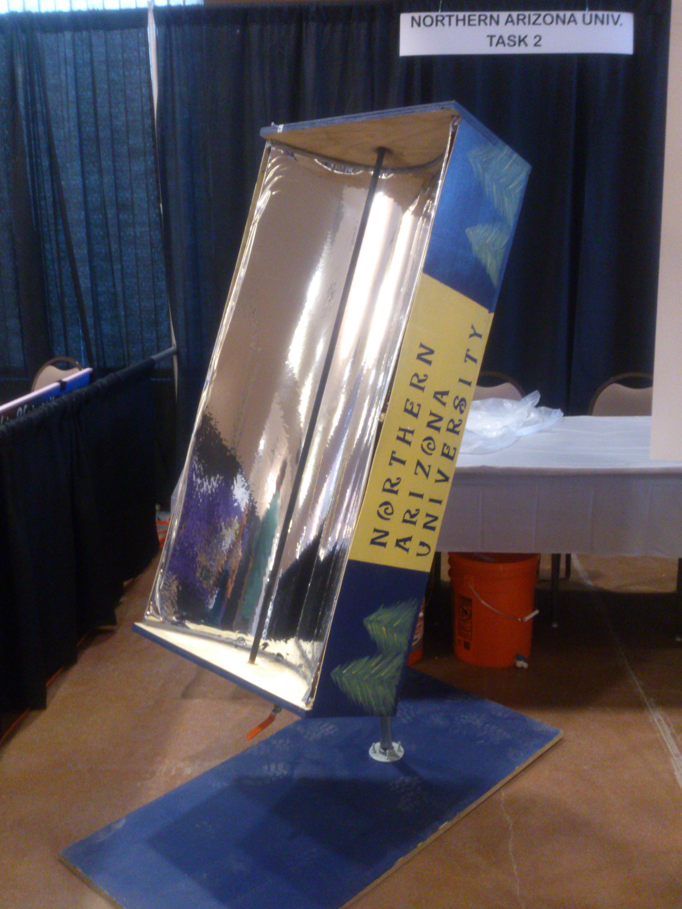
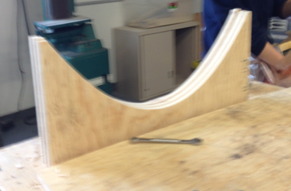
3rd Design
Description
48” Х 24” Х 24”
Wood, Metal sheet, Copper Pipe, Mylar, Dripper, and T-Valve, reflux condensing coil
No glass cover
No holes in copper pipe
One inlet, one outlet, steady hydraulic flow
G-code
Notes:
Chaz

Slide 14
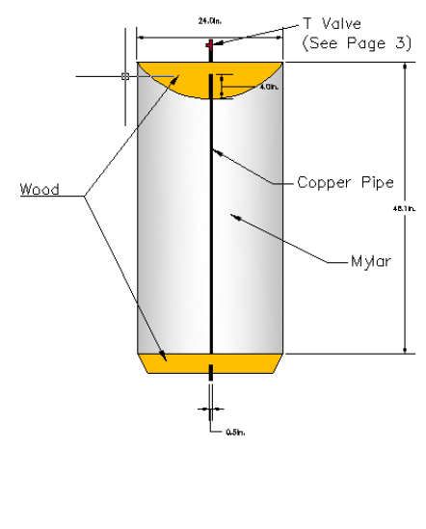
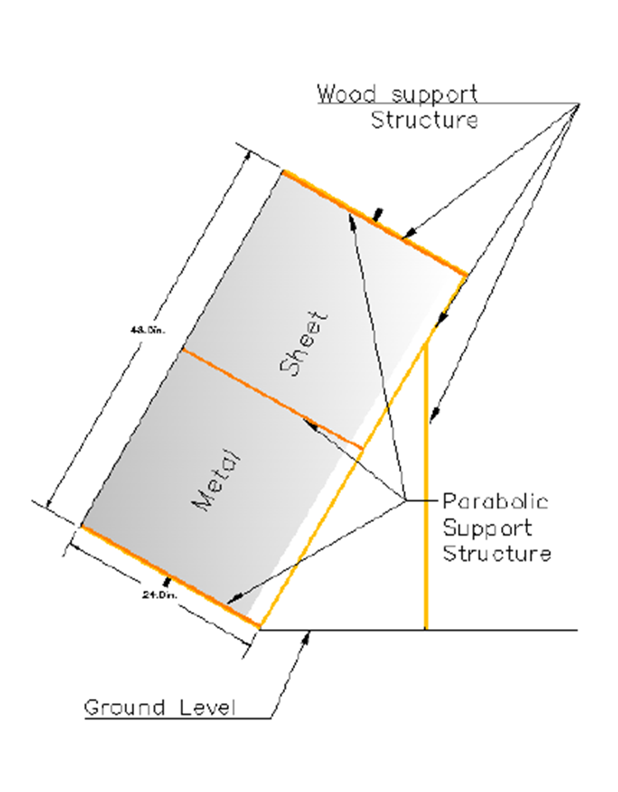
Final Design
Condenser

Slide 15
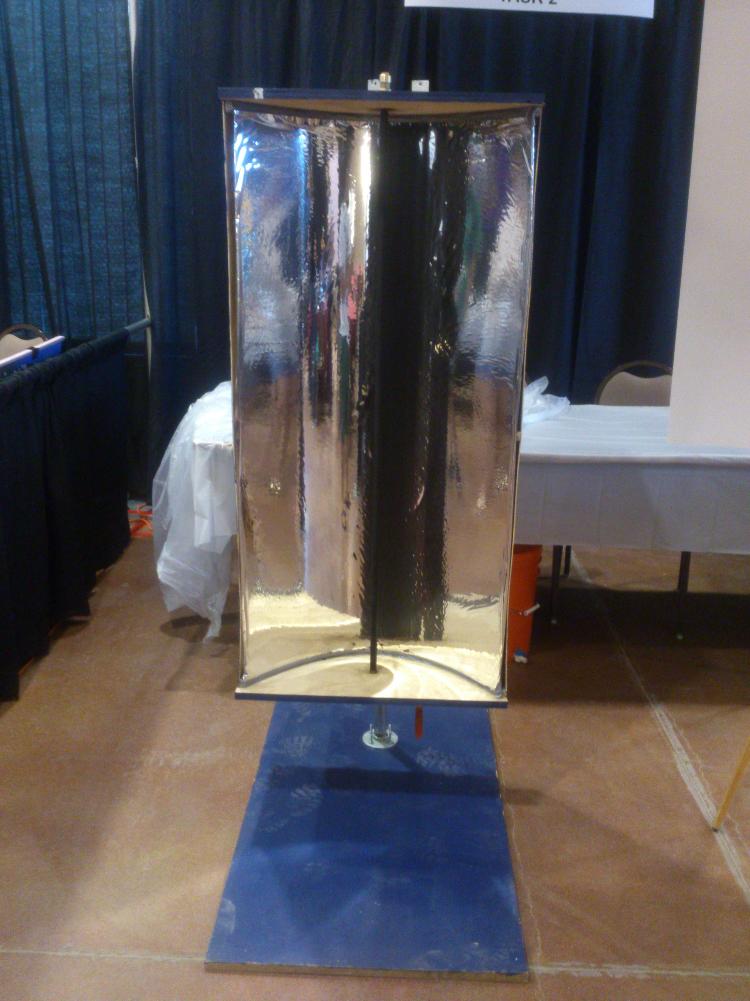
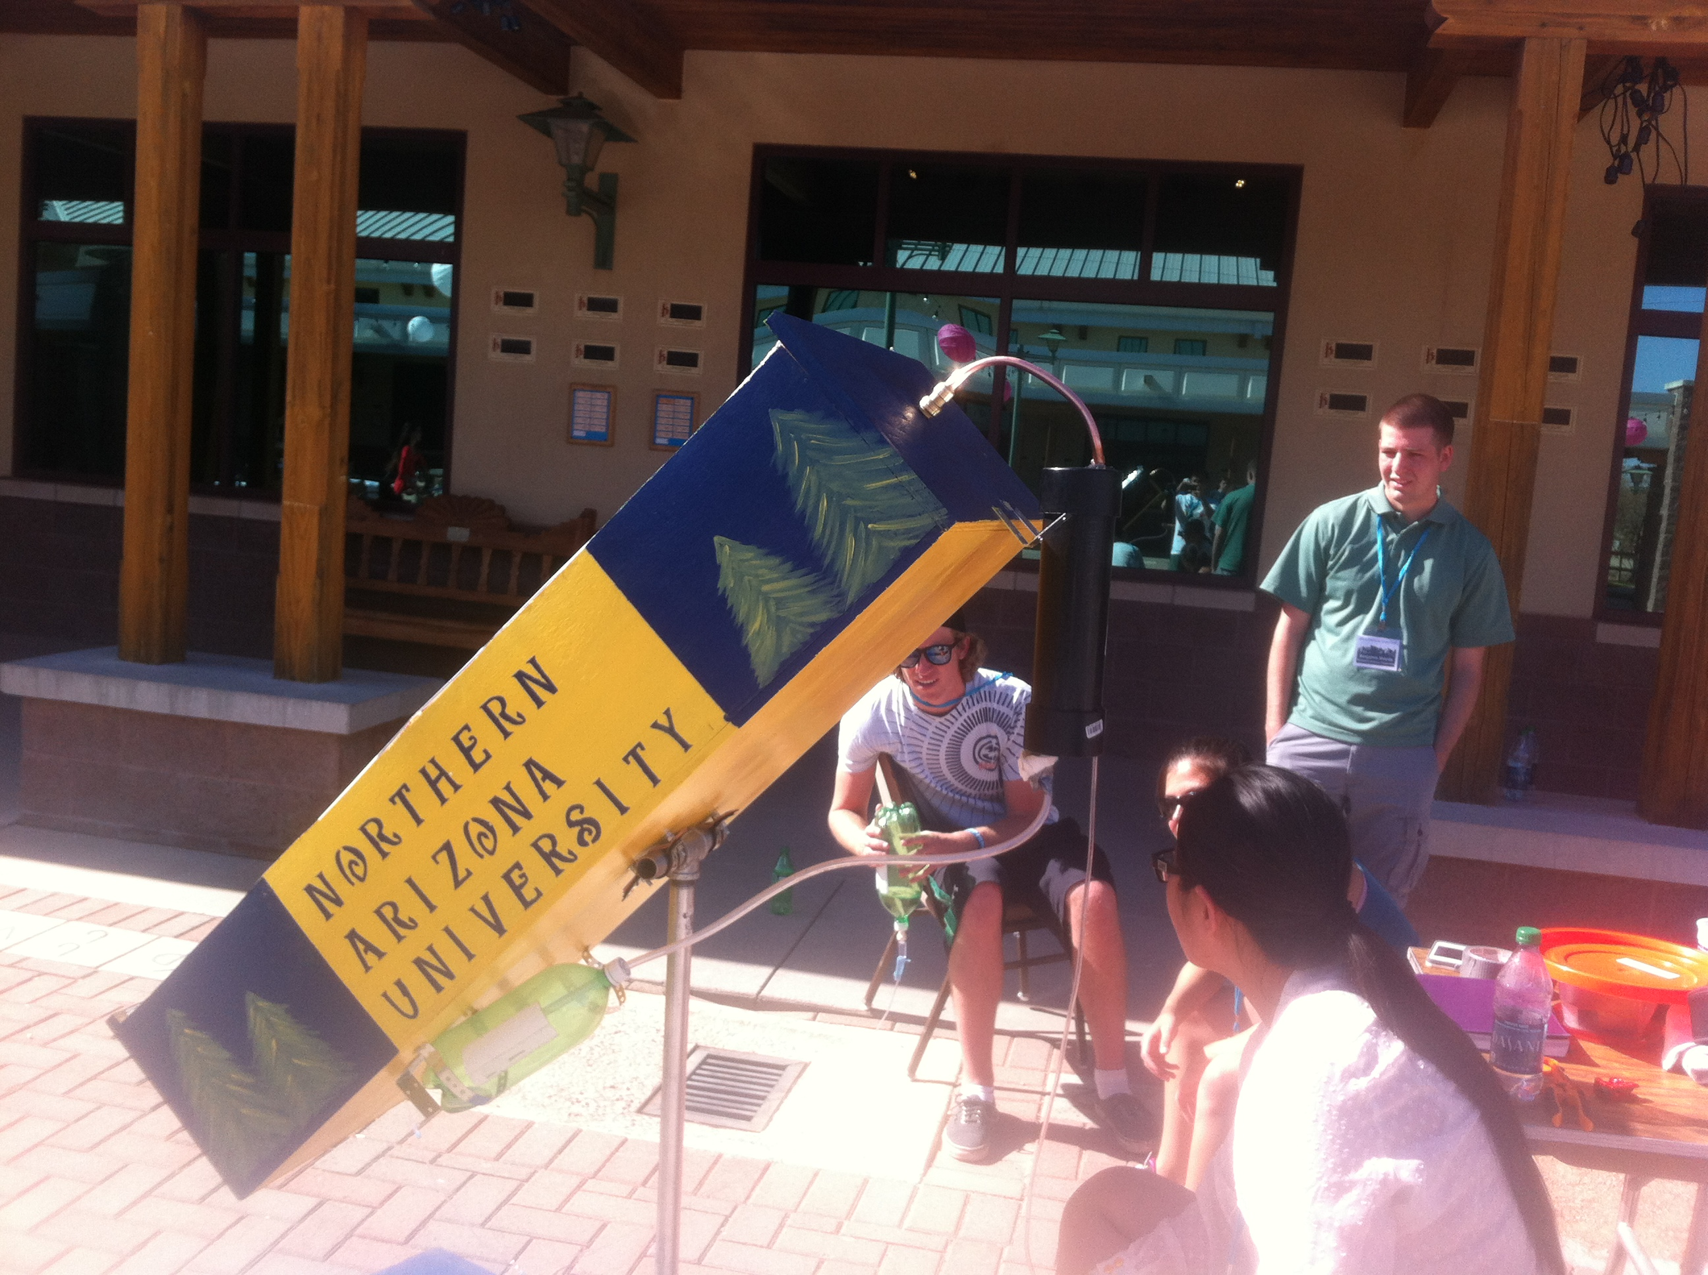
Final Design

Slide 16
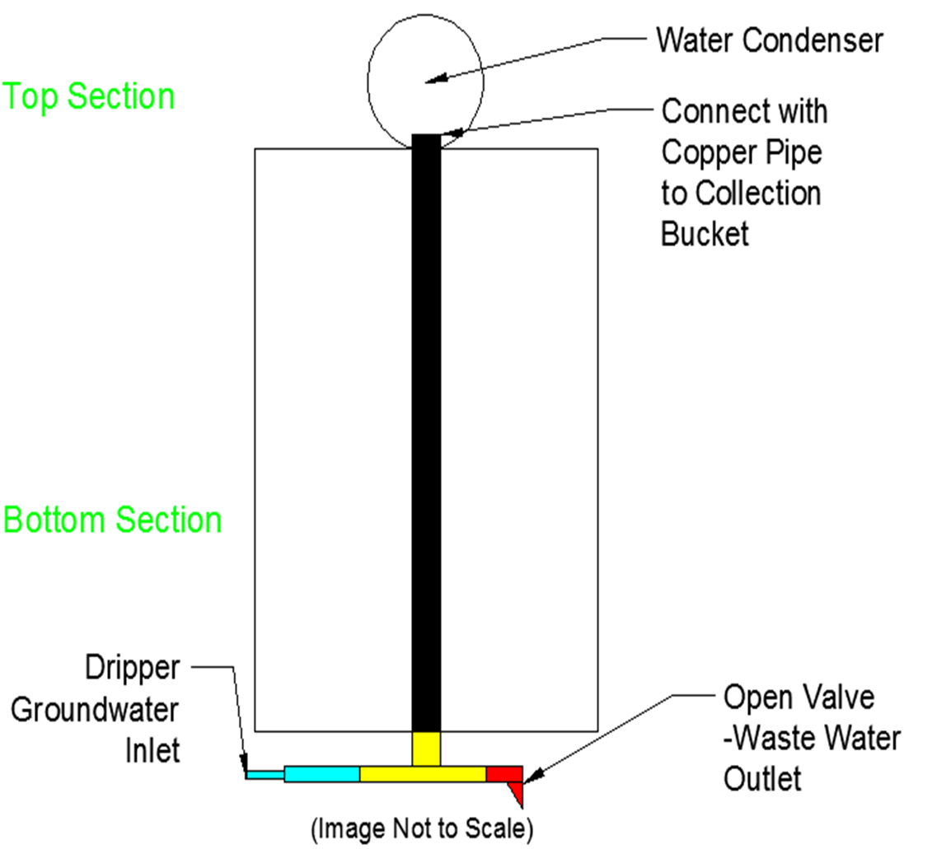
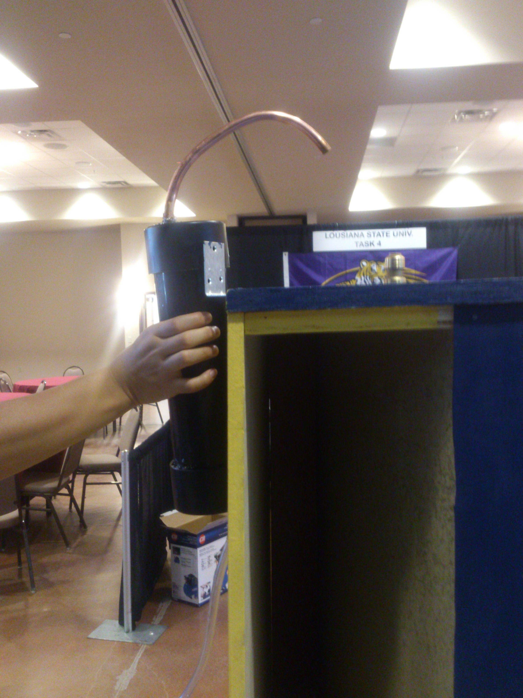
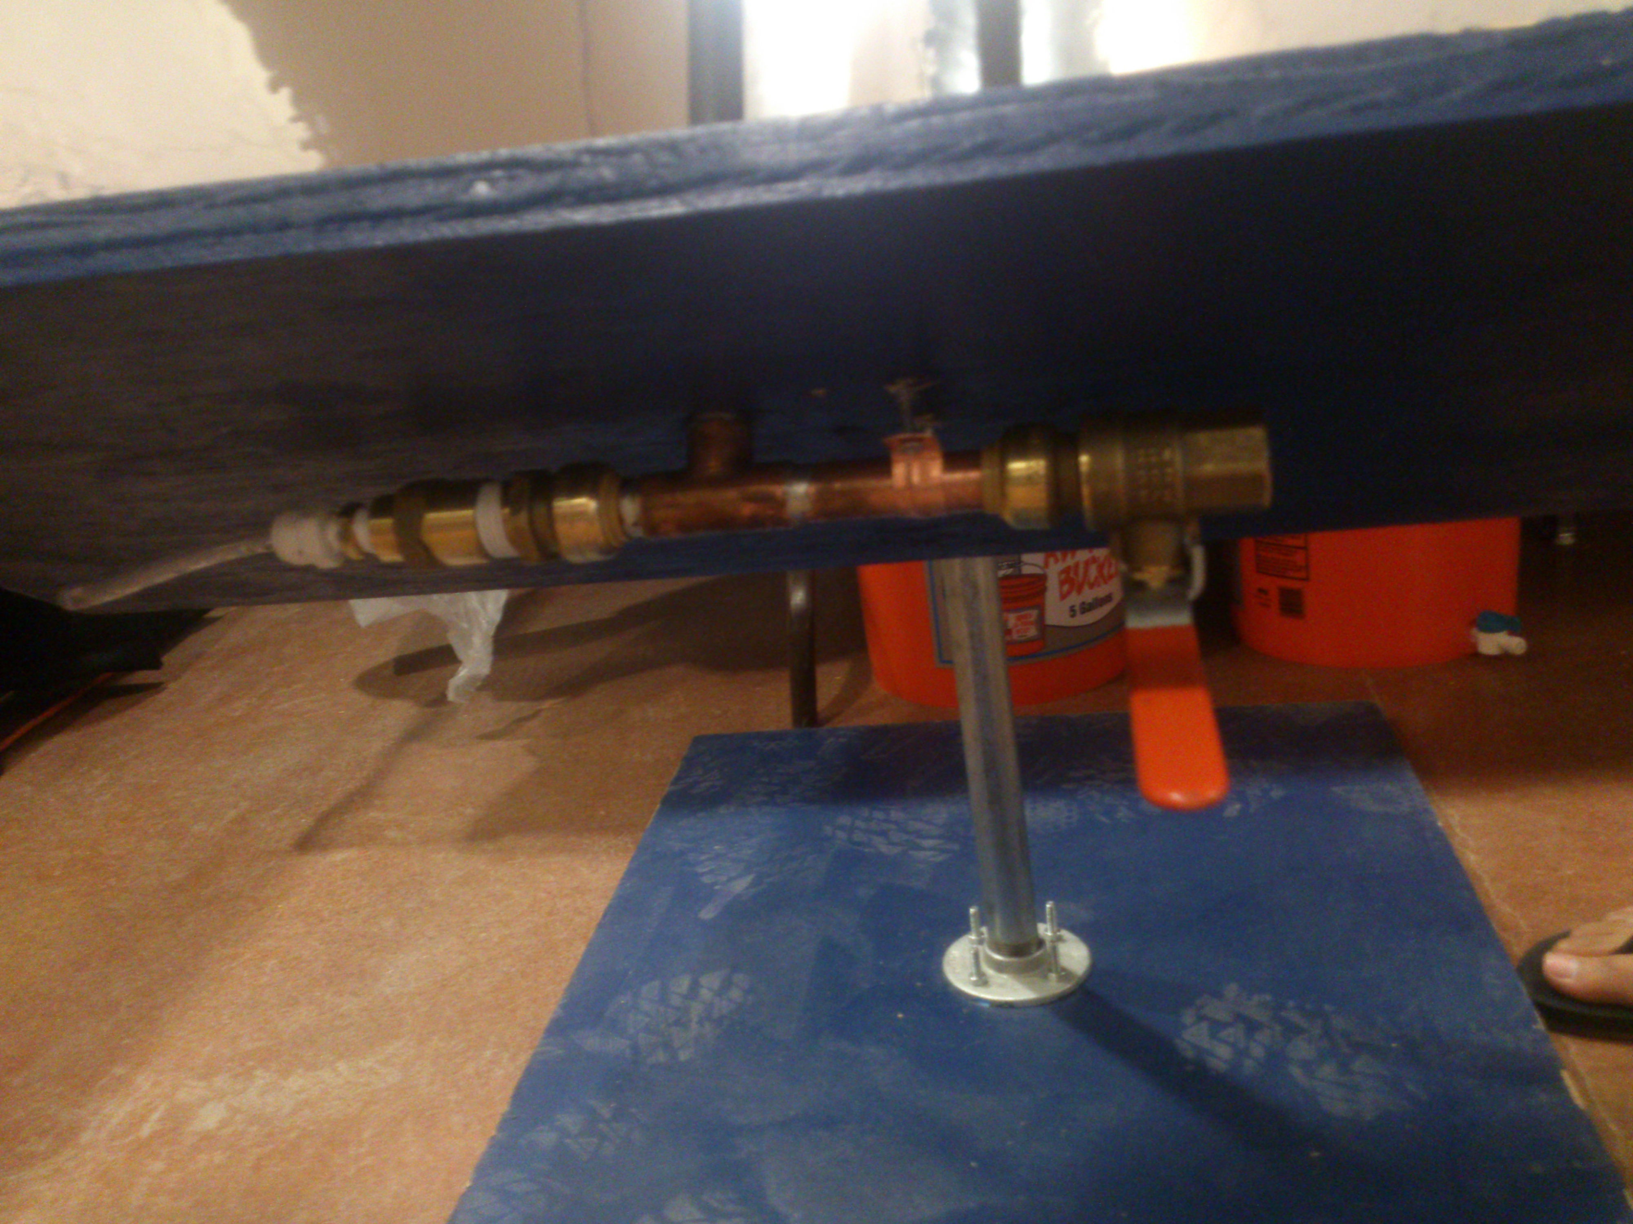
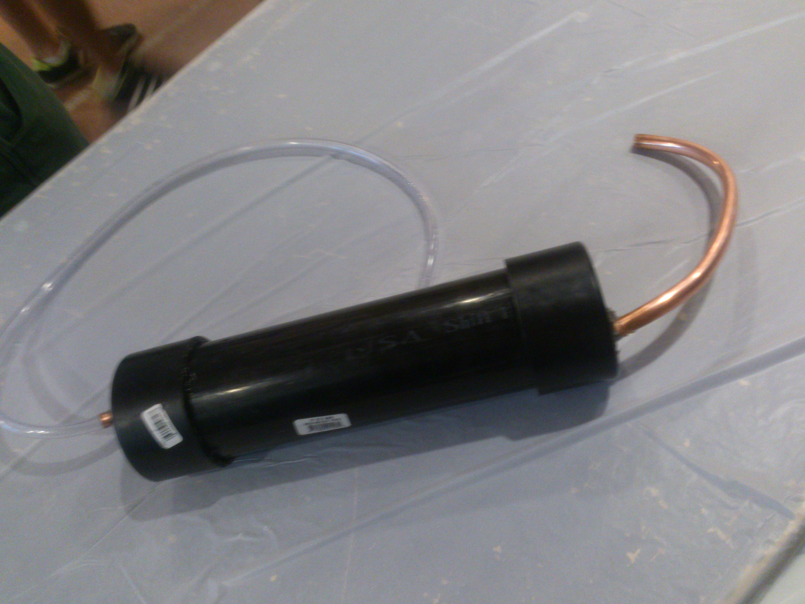
Final Design

Slide 17

Set-Up and Maintenance
Materials
Excel-G Code
Water proof paint
Replacement-easy and cheap
Notes:
ben

Slide 18
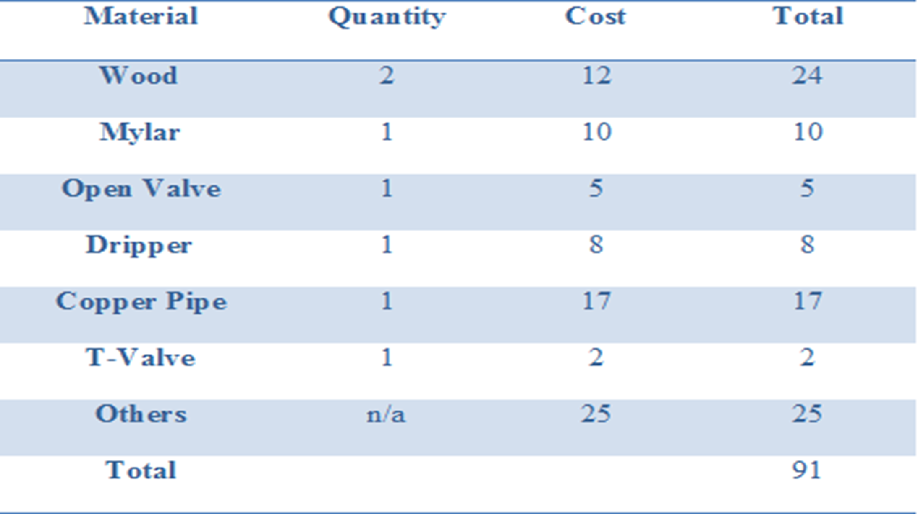
Materials and Cost
Notes:
Ben

Slide 19
Testing
9:30am on March 12, 2013
45◦F , 10 mph wind speed
Input: 50mL water
Operating time: 36 minutes
Operation result: 10mL of purified water
20mL of Drained Water
Mass Balance: Ceout = (CinQin− CCWoutQCWout) ∕ (Qeout)
Conclusion:
Water condensed is 33.33%,
Water vaporized is 60%.
C_{left} is 2.5 C_{in}
Notes:
yang

Slide 20
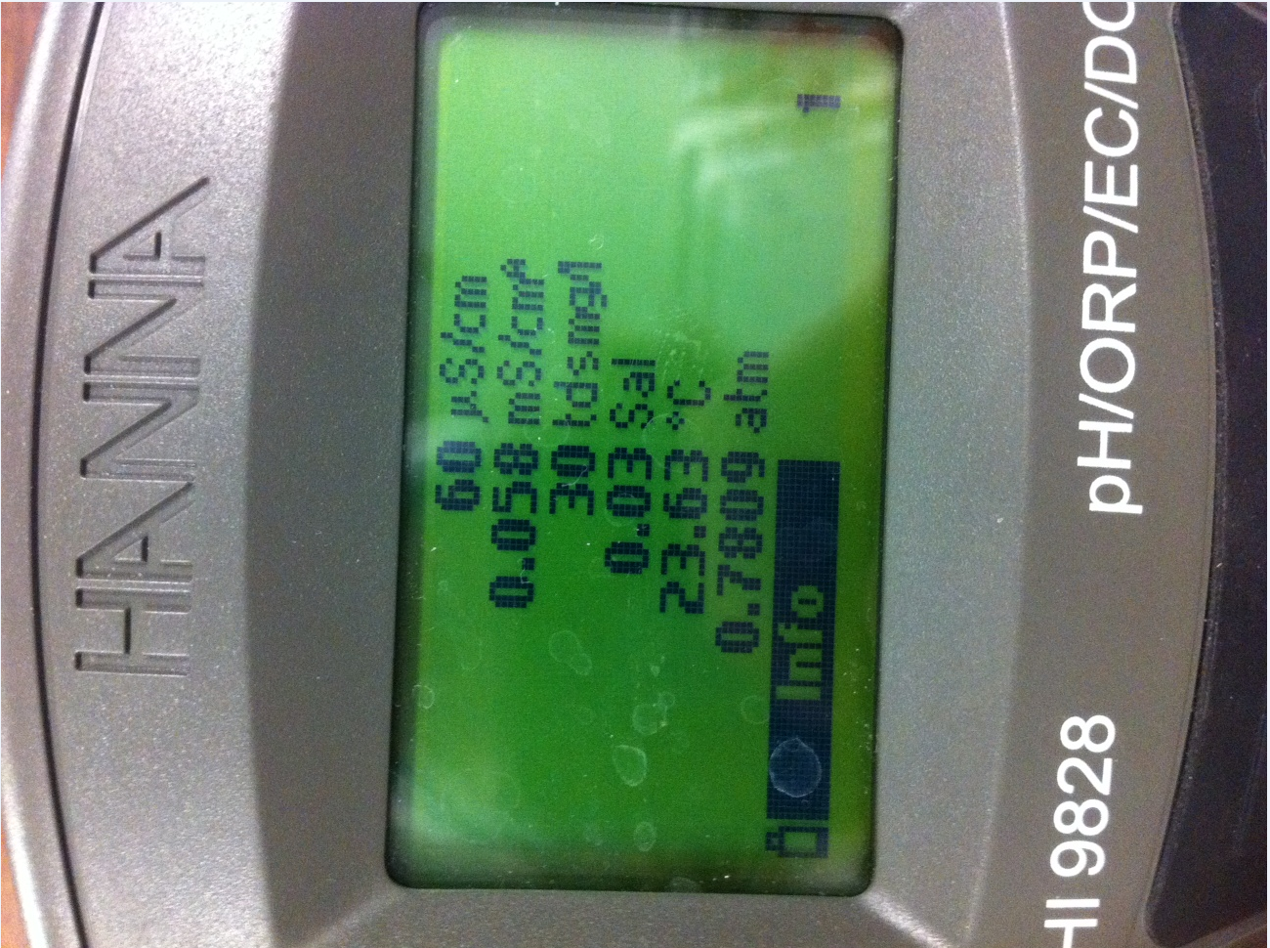
Conductivity Testing

Slide 21
Losses/Issues
Losses occurred due to:
Forced Thermal Convection
Pipe Fittings- h_{L}=K*(v^2/2(g))
Un-even layering of Mylar (reflectivity)
Thermal absorption of surrounding materials (steel)
Notes:
banning

Slide 22
Legal and Regulatory Consideration
Primary Drinking Water Standards
Secondary Drinking Water Standards
Manufacturing Phase
Operating Phase
Waste Stream Treatment
Notes:
ben

Slide 23
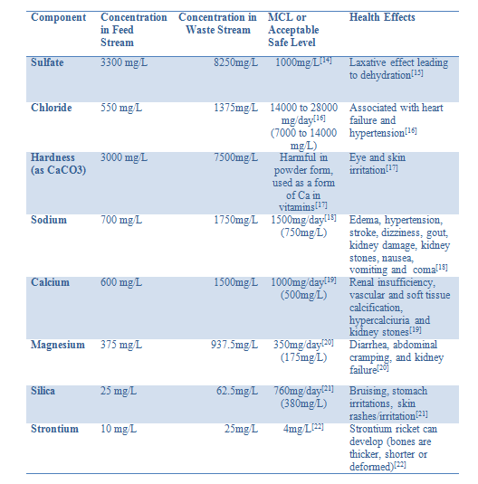
Health Issues
Notes:
chaz

Slide 24
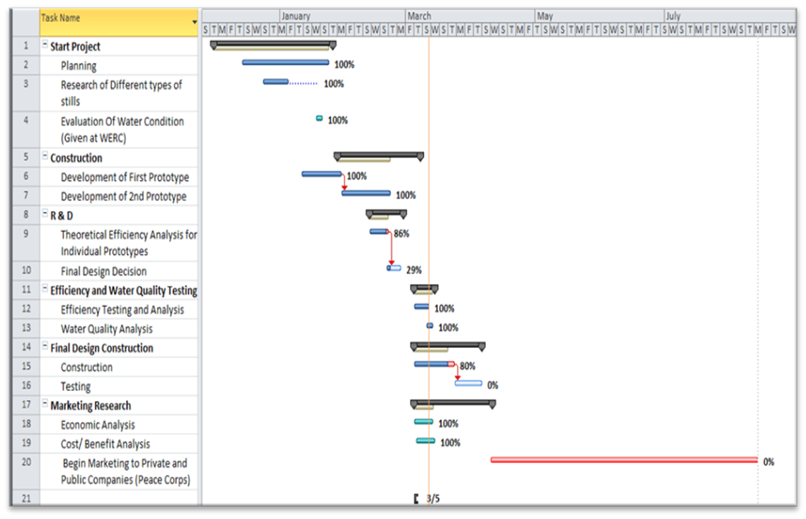
Business Plan
Notes:
banning

Slide 25
Practical Improvements
Optimize reflectivity of Mylar
Utilize evacuated solar tubes/ glass pane to reduce losses due to Forced Convection.
Helio-stat
Notes:
banning

Slide 26
References
WERC. 2013. Task 2- Development of an Improved Solar Distillation Unit. Retrieved from http://www.ieenmsu.com/werc-2/design-contest-2013/tasks-2/task-2-solar-distillation-unit/
Practical Action. 2002. Solar Distillation. Retrieved from http://practicalaction.org/s
olar-distillation-1.
National Oceanic and Atmospheric Administration. 2013. National Weather Servic Flagstaff, AZ, Retrieved from http://floodsafety.noaa.gov/view/validProds.php?prod=
CLI&node=KFGZ
Joel Gordes & Horace McCracken. 1985 .Understanding Solar Stills. Arlington, Virginia.
National Weather Service Forecast Office, 2012. Flagstaff, AZ. Retrieved from http://www.nws.noaa.gov/climate/index.php?wfo=fgz.
Michael J. Moran, Howard N. Shapiro, Daisie D. Boettner and Margaret B. Bailey. 2011. John Wiley & sons, Inc. Hoboken, NJ.
Interactive mathematics. 2013. The Parabola. Retrieved from http://www.intmath.com
/plane-analytic-geometry/4-parabola.php
GlobalMarket, n.d. Solar copper pipe (high efficiency). Retroeved from http://solarsupplier.gmc.globalmarket.com/products/details/solar-copper-pipe-high-efficiency-611915.html
Woods Hole Oceanographic Insitution. n.d. Solar Radiation Retrieved from http://www.whoi.edu/science/AOPE/mvco/description/SolRad.html
Cbsalary. n.d 30 Jobs that pay $30 an Hour. Retrieved from http://www.cbsalary.com/salary-information/article.aspx?articleid=72.
Glassdoor. 2013. Engineering Intern Salaries. Retrieved from
University of Florida. n.d. Zoysiagrass. Retrieved from http://gardeningsolutions.ifas.ufl.
Outsidpride.com. n.d. Seashore Paspalum-Sea Spray. Retrieved from http://www.outsidepride.com/seed/grass-seed/seashore-paspalum/seashore-paspalum- grass-seed.html
Chien L et al. (1968) Infantile gastroenteritis due to water with high sulfate content. Canadian Medical. Association Journal, 99:102–104.
US EPA (1999a) Health effects from exposure to high levels of sulfate in drinking water study. Washington, DC, US Environmental Protection Agency, Office of Water (EPA 815-R-99-001).
Copenhagen, WHO Regional Office for Europe, 1978 (EURO Reports and Studies 2).
Office of Environmental Public Health. 1998. Health Effects Information. Retrieved from http://public.health.oregon.gov/HealthyEnvironments/DrinkingWater/Monitoring/Documents/health/calcar.pdf
Acu-Cell Nutrition. n.d. Phosphorus & sodium. Retrieved from http://www.acu-cell.com/pna.html
Office of Dietray Supplements. 2013. Calcium. Retrieved from http://ods.od.nih.gov/factsheets/Calcium-HealthProfessional/
Office of Dietray Supplements. 2013. Magnesium. Retrieved from http://ods.od.nih.gov/factsheets/Magnesium-HealthProfessional/
Acu-Cell Nutrition. n.d. Germanium & Silicon/Silica. Retrieved from http://www.acu-cell.com/gesi.html
Wisconsin Department of Health Services. 2012. Strontium. Retrieved from http://www.dhs.wisconsin.gov/eh/HlthHaz/fs/strontium.htm
IRIS. 2013. Integrated Risk Information System (IRIS) Retrieved from http://www.epa.gov/IRIS/
Notes:
banning

Slide 27
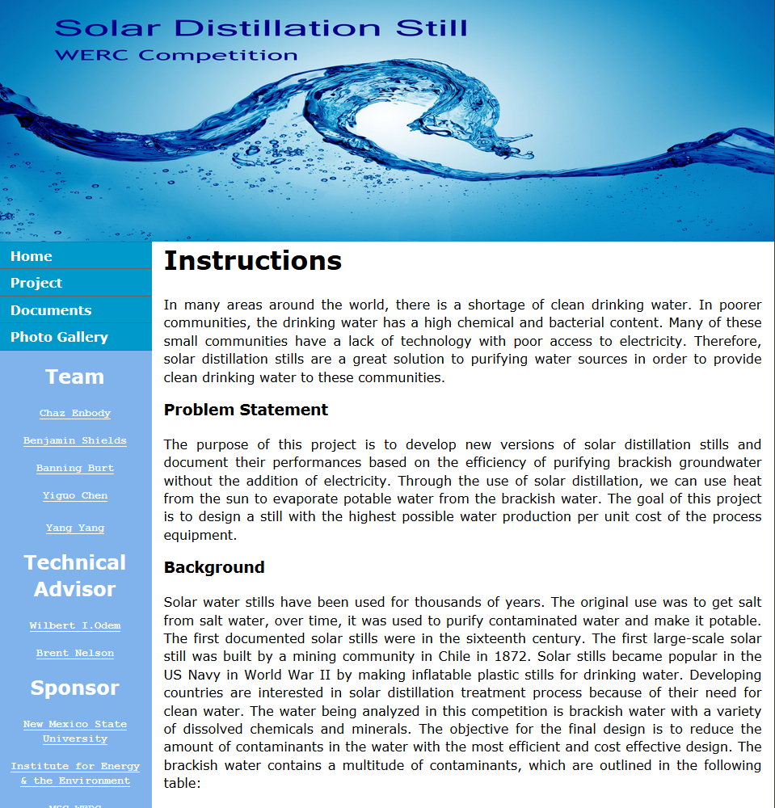
Website
http://www.cefns.nau.edu/interdisciplinary/d4p/EGR486/CENE/13-Projects/WERC%20Solar%20Distillation/
Notes:
Chen

Slide 28
Questions?
Thank You for Listening

